Slide 1
Animals in Winter
Which animals might visit our school field?
How do they survive in the winter?

Slide 2
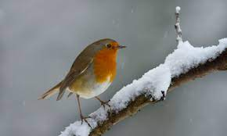
Birds

Slide 3
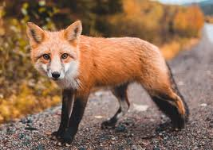
Foxes

Slide 4
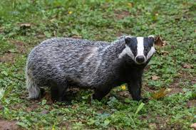
Badgers

Slide 5
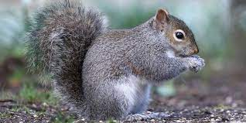
Squirrels

Slide 6
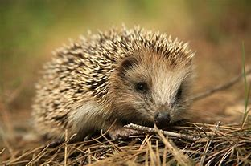
Hedgehogs

