Slide 1
Classwork 27/02/2024 Christian Beliefs - Incarnation
Quick 6 Questions:
Finish the SOWA: God breathed the… (6 words)
What does the Creation story teach Christians about stewardship?
Give one example of moral and natural evil
How does evil cause problems for Christians?
Give one Biblical solution to the problem of evil
Name the three parts of the Trinity and their roles
Step 1: Write the date and title into your books
Step 2: Stick the Quick 6 Questions into your books
Step 3: Answer the Quick 6 Questions in your books

Slide 2
Quick 6 Questions:
Finish the SOWA: God breathed the… (6 words)
What does the Creation story teach Christians about stewardship?
Give one example of moral and natural evil
How does evil cause problems for Christians?
Give one Biblical solution to the problem of evil
Name the three parts of the Trinity and their roles
Quick 6 Questions:
Finish the SOWA: God breathed the… (6 words)
What does the Creation story teach Christians about stewardship?
Give one example of moral and natural evil
How does evil cause problems for Christians?
Give one Biblical solution to the problem of evil
Name the three parts of the Trinity and their roles
Quick 6 Questions:
Finish the SOWA: God breathed the… (6 words)
What does the Creation story teach Christians about stewardship?
Give one example of moral and natural evil
How does evil cause problems for Christians?
Give one Biblical solution to the problem of evil
Name the three parts of the Trinity and their roles
Quick 6 Questions:
Finish the SOWA: God breathed the… (6 words)
What does the Creation story teach Christians about stewardship?
Give one example of moral and natural evil
How does evil cause problems for Christians?
Give one Biblical solution to the problem of evil
Name the three parts of the Trinity and their roles
Quick 6 Questions:
Finish the SOWA: God breathed the… (6 words)
What does the Creation story teach Christians about stewardship?
Give one example of moral and natural evil
How does evil cause problems for Christians?
Give one Biblical solution to the problem of evil
Name the three parts of the Trinity and their roles
Quick 6 Questions:
Finish the SOWA: God breathed the… (6 words)
What does the Creation story teach Christians about stewardship?
Give one example of moral and natural evil
How does evil cause problems for Christians?
Give one Biblical solution to the problem of evil
Name the three parts of the Trinity and their roles

Slide 3
Classwork 27/02/2024 Christian Beliefs - Incarnation
Quick 6 Questions:
Finish the SOWA: God breathed the breath of life into his nostrils
What does the Creation story teach Christians about stewardship? We should take care of God’s earth as it is gift from God
Give one example of moral and natural evil Murder and hurricanes
How does evil cause problems for Christians? Causes them to question God’s qualities, they can lose loved ones, houses, livelihood
Give one Biblical solution to the problem of evil Story of Job teaches that God is testing our faith, Psalms teaches that we can change and learn from evil and suffering
Name the three parts of the Trinity and their roles Father = Creator, Son = Saviour, Holy Spirit = Giver of life/messenger

Slide 4

The BIG Idea
Classwork 27/02/2024 Christian Beliefs - Incarnation
We are Learning to...
Consider the importance of the belief that Jesus is God in human form.
In today’s lesson...
You will be able to recall the meaning of Jesus Christ as the incarnate Son of God.
You will be able to analyse the Biblical basis of the meaning.
You will be able to evaluate the importance of the incarnation for Christians.

Slide 5
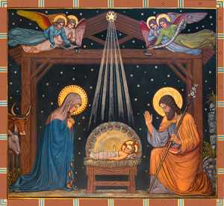
What is the incarnation?
This is the belief that God became flesh (or man) in the person of Jesus.
The Holy Spirit conceived Jesus in the womb of the virgin Mary.
Jesus was fully God and fully man and he did this to show mankind how much God loves them
(John 3:16 – For God so loved the world that he gave his only begotten son).
May want students to copy these down or print this slide off for LPA students.
Notes:
Picture is hyperlinked

Slide 6
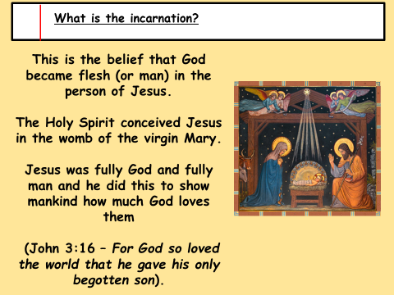

Slide 7
What is the incarnation?
Christians believe that when Adam and Eve disobeyed God, the perfect relationship between God and humankind was broken. Therefore BEFORE the incarnation, one could only have a partial relationship with God.
The incarnation meant that the power of sin was cancelled, and through the incarnation it became possible for humans to have a full relationship with God and go to heaven after death.
Notes:
Picture is hyperlinked

Slide 8
What is the incarnation?
https://www.youtube.com/watch?v=I8zs81Omhsc
As we watch the video we will be answering a series of questions on the incarnation.
What does the word incarnation mean? Put on flesh
Why did God the Son enter humanity? To teach humans how to live, bring salvation and offer eternal life
What two natures did Jesus have? Human and Divine
How did Jesus show he was fully human? Felt compassion, fear, died, he got hungry
How did Jesus show he was fully divine? Could forgive sins, heal the sick, resurrect the dead
Notes:
Picture is hyperlinked

Slide 9
What does the word incarnation mean?
Why did God the Son enter humanity?
What two natures did Jesus have?
How did Jesus show he was fully human?
How did Jesus show he was fully divine?
What does the word incarnation mean?
Why did God the Son enter humanity?
What two natures did Jesus have?
How did Jesus show he was fully human?
How did Jesus show he was fully divine?
What does the word incarnation mean?
Why did God the Son enter humanity?
What two natures did Jesus have?
How did Jesus show he was fully human?
How did Jesus show he was fully divine?
What does the word incarnation mean?
Why did God the Son enter humanity?
What two natures did Jesus have?
How did Jesus show he was fully human?
How did Jesus show he was fully divine?
What does the word incarnation mean?
Why did God the Son enter humanity?
What two natures did Jesus have?
How did Jesus show he was fully human?
How did Jesus show he was fully divine?
What does the word incarnation mean?
Why did God the Son enter humanity?
What two natures did Jesus have?
How did Jesus show he was fully human?
How did Jesus show he was fully divine?
What does the word incarnation mean?
Why did God the Son enter humanity?
What two natures did Jesus have?
How did Jesus show he was fully human?
How did Jesus show he was fully divine?
What does the word incarnation mean?
Why did God the Son enter humanity?
What two natures did Jesus have?
How did Jesus show he was fully human?
How did Jesus show he was fully divine?
What does the word incarnation mean?
Why did God the Son enter humanity?
What two natures did Jesus have?
How did Jesus show he was fully human?
How did Jesus show he was fully divine?
What does the word incarnation mean?
Why did God the Son enter humanity?
What two natures did Jesus have?
How did Jesus show he was fully human?
How did Jesus show he was fully divine?

Slide 10
Independent Tasks
Task 1: Draw an image that helps you understand what the word incarnation mean.
Task 2: Why is it important Jesus was fully human?
Task 3: Would he have been as successful if he was just fully divine?
Extension:
What helps Christians understand God’s nature more, the incarnation or the Trinity?

Slide 11

