Slide 1
Creative Writing
Starter
Year 7

Slide 2
Identify the literary techniques…
The forest stood tall and imposing. Deep within the cries of wolves could be heard echoing through the trees. I stood on the outskirts of the forest, trembling against the cold, the wind seemed to cut through my clothes and bite at my face. I waited. I tried to peer through the gloom, but my gaze could not penetrate the thick fog that seemed to be thickening as each second passed. The musty smell of trodden earth snuck sneakily up my nose. Still, I waited. The night laid out before me as blank as the pages of an unwritten book.
Starter

Slide 3
Identify the literary techniques…
Literary techniques to find…
Personification
Sensory language
Alliteration
Varied sentence length
Simile
The forest stood tall and imposing. Deep within the cries of wolves could be heard echoing through the trees. I stood on the outskirts of the forest, trembling against the cold, the wind seemed to cut through my clothes and bite at my face. I waited. I tried to peer through the gloom, but my gaze could not penetrate the thick fog that seemed to be thickening as each second passed. The musty smell of trodden earth snuck sneakily up my nose. Still, I waited. The night laid out before me as blank as the pages of an unwritten book.
Starter

Slide 4
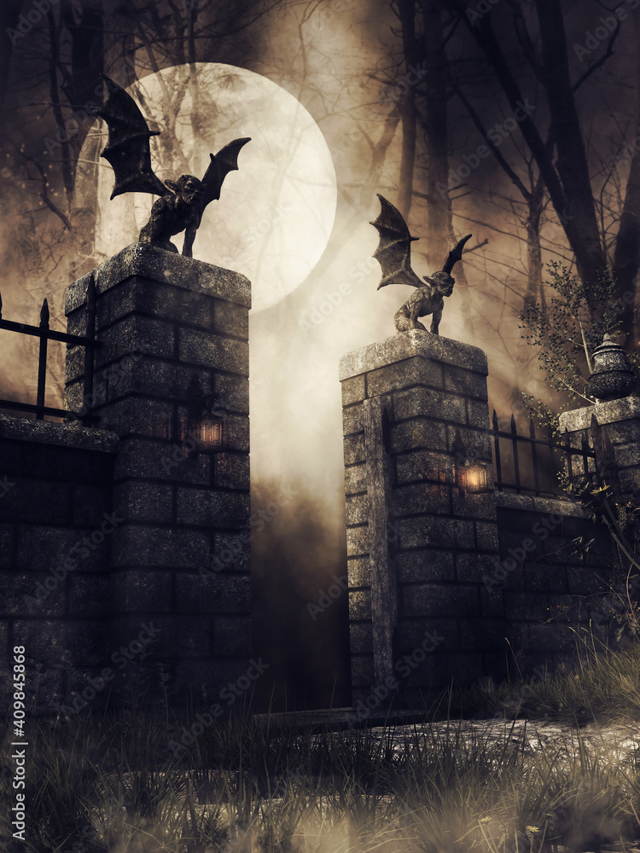
Brainstorm
Describe the picture of a spooky gothic gateway…
Where does the gateway lead?
Are the walls guarding something or are they keeping someone, or something trapped inside?
Think of a simile to describe the picture and an alliteration.
What are some key words you’ll use?
Explore

Slide 5
Descriptive Writing
Write a short paragraph describing a scene inspired by this picture.
Focus on the senses, what can you smell, see, hear, feel and taste?
Try to include:
Alliteration
Simile
Personification
Short sentences
Sentence starter : I stand at the foot of two towering pillars of stone…
Independent Task

