Slide 1
Teacher guide for ‘gallery activity’
Aim of activity:
To engage students to analyse the work of artists and designers in a low stakes, supportive manner which feels less rigid to students. The nature of the activity is also collaborative, similarly supporting lower-attaining students and very able students, producing a resource at the end that all students have access to. This is helpful for students to write meaningful analyses afterwards.
PREVIEW
You will need:
-Print-outs of mood word bank
-A3 size print-outs of each individual artist profile that you want to feature in the gallery activity
-Blue Tac to stick each artist profile up
-markers for students to note down opinions/ideas
-Prompts using CFPM analysis framework:
Maeveyknit 2026

Slide 2
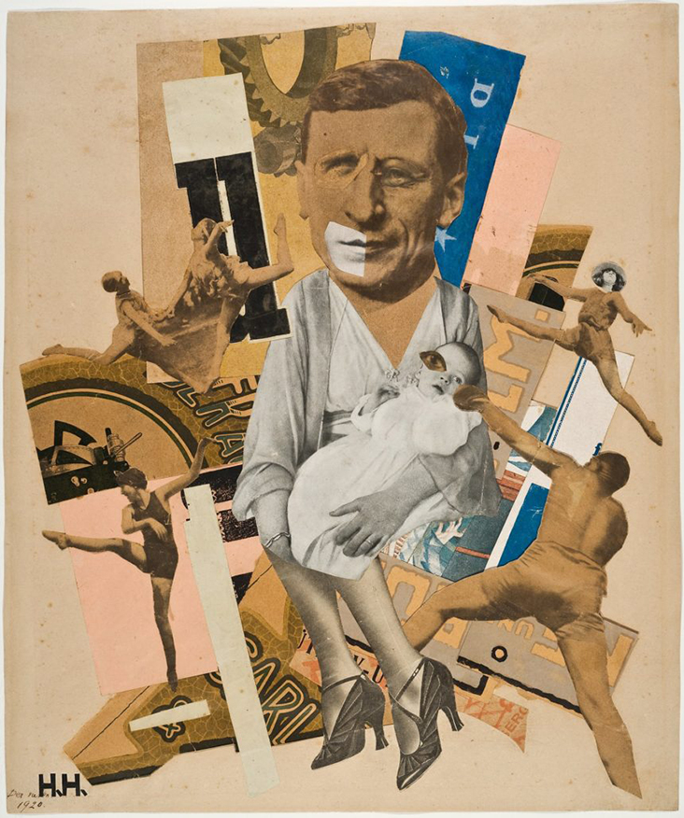
N.B. Remember to leave a lot of space around the image of the artwork so that students can jot down words/phrases they think of when they view the artwork!
Hannah
Hannah Hoch
Prompts using CFPM analysis framework:
-What can you see?
-What do you think the artwork might be about?
-What might the artist have used to make the artwork?
-Have you seen these materials used anywhere before?Which colours have they used- do they remind you of anything?
-Why might they have given the artwork that name? How might the artist feel about their father?
-How do you think the artist was feeling when they made this - why? Do you have any emotions looking at it?
-Do you know anything about what was happening in 1920? How might this have influenced what artists made?
PREVIEW
‘The Father’ - 1920
https://blog.fabrics-store.com/2024/02/13/hannah-hoch-rebel-with-a-cause/
Maeveyknit 2026

Slide 3
Teacher guide for ‘gallery activity’
Which artists to include?
-You can print the suggested artists/designers from the ESA paper or select class favourites—artists whose work students find engaging and easy to respond to.
-Ensure your choices are accessible both visually and conceptually, so students can confidently transcribe ideas, respond, and develop their thinking from the artworks.
Maeveyknit
favourite artists/
designers:
-Tracey Emin quilts
-Ben Giles
-Jessica Wohl
-Mary Katzantrou
-Mana Morimoto
-Shirley Nette Williams
-Lauren Di Cioccio
-Allison Diaz
-Carolle Benitah
-Joseph Cornell
Maeveyknit
favourite artists/
designers:
-Sandra Meech
-Anne Gret Soltau
-Josh Blackwell
-Ines Seidel
-Hen’s Teeth (Viv Sliwka)
-Jasper James
-Sebastian Magnani
-Lucas Simoes
-Hannah Hoch
PREVIEW
Maeveyknit

Slide 4
Step-by-step of gallery activity:
Preparation
-Print out the artist profiles and display them around the room using Blu-Tack.
-Print enough word banks so that each student has their own copy.
-Provide each student with an individual marker
Activity
-Ask students to circulate the room, stopping at each artist profile.
-Using the word bank as support, students should jot down any words or ideas that come to
mind when viewing the artwork directly onto the artist profile sheet.
-Be strategic about starting points: consider directing less confident students to begin with a more challenging artist and finish with a more accessible one.
-After 1–2 minutes, prompt students to move on to the next artist profile.
-Emphasise that students must contribute at least a few words to every profile.
After the Activity
-Remove the Blu-Tack and collect all artist profile sheets.
-Scan or photocopy each profile and compile them into a mini booklet (PDF or hard copy) to share with students. This is both to act as a visual reminder for students and to minimise the work that you have to do after!
-Gently remind students to view the mini booklets when completing each analysis.
PREVIEW
Maeveyknit

