Slide 1
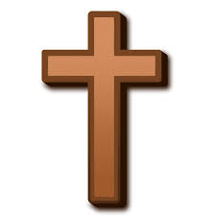
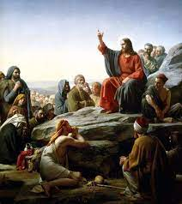

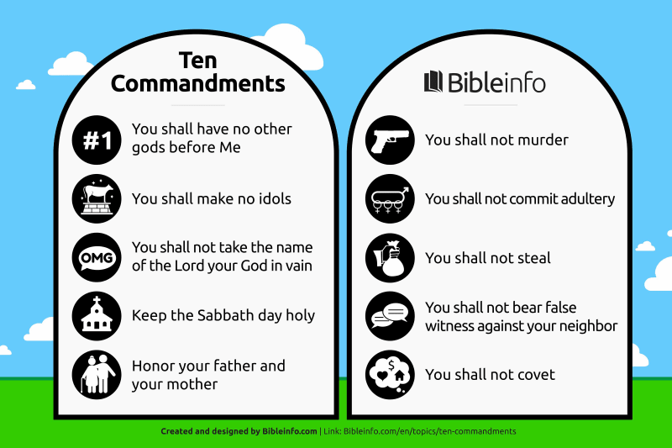
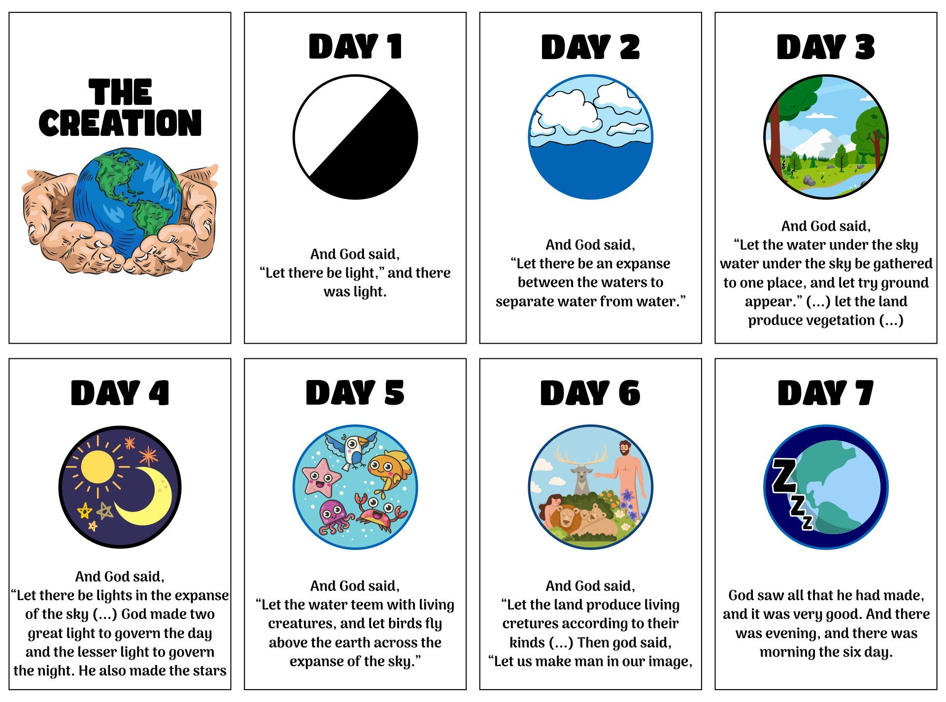
--------- Christianity KNOWLEDGE ORGANISER ---------
Overview
Christianity is one of the world’s major religions. It is the world’s largest religion, with about 2.4 billion followers. Christians (same as Judaism and Islam), believe in one G-d, who created the world and all that is in it. Christians believe in the teachings of Jesus Christ, who was a middle-eastern preacher and healer who lived around 2,000 years ago. Christians believe that Jesus Christ was sent down to earth to save people, by taking their punishment and dying on the cross. The holy book in Christianity is called the Bible. A church is a building designed for Christian worship. | An artist’s impression of Jesus Christ giving the ‘Sermon on the Mount’
The Life of Jesus
Christians believe that Jesus is the Son of G-d. He was born to ordinary parents, Mary and Joseph, in Bethlehem. Christian’s celebrate the birth of Jesus on 25 December – Christmas Day. | Jesus travelled around, teaching people about G-d and helping the sick. He chose 12 men to travel with him. They were his special companions, known as Disciples.
Jesus was sentenced to death for calling himself the son of G-d. He had a final meal with his Disciples (‘The Last Supper’) before being crucified. He is said to have died for the sins of man.
Important Questions and Answers
Where do Christians worship G-d? | Christians can pray anywhere, but the most common location is in a purpose built building called a church. Churches can be very different; new, old, plain, decorated. Often the floor plan is in the shape of a cross. Common features include; an altar, lectern, pulpit, font and stained glass windows. Services often include; hymns, prayers and readings from the Bible.
What is the Bible? | The Bible is the holy book for Christians. It contains the Old and New Testament. The Old Testament is similar to the Jewish Bible and was written before Jesus’ birth. The New Testament contains stories about Jesus, written by those who knew him.
How do Christians believe people should live their lives? | People should be kind to one another, and show respect to G-d, themselves and others. Praying to G-d helps them to say sorry for the things they have done wrong, and offer thanks for the blessings they have received. G-d wants them to carry on the good work that Jesus did.
There are lots of different groups of Christians.
Christian Beliefs
G-d’s Creation Christians believe that G-d created the Earth and everything in it in 6 days, resting on the 7th. The story of creation tells Christians that at first everything was dark, until G-d intervened and created matter. Details about this are found in the Bible in Genesis 1 and 2. | The Holy Trinity Christians believe that G-d can be seen in three ways, known as the Holy Trinity. The Father – Creator of the world The Son – Who came to Earth as Jesus The Holy Spirit – G-d’s power within Christians

