Slide 1
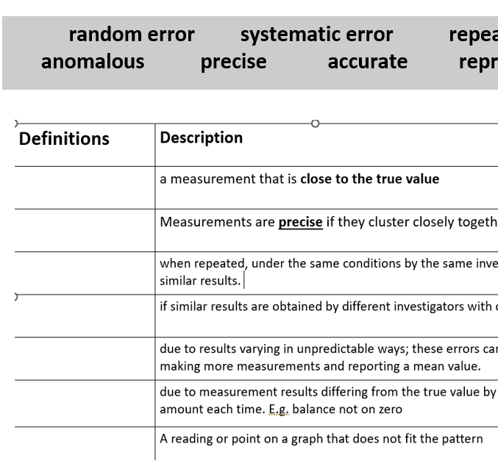
Title: KS3 and KS4 Working scientifically
There are 2 main types of errors
Random
Systematic

