Slide 1


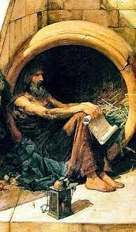
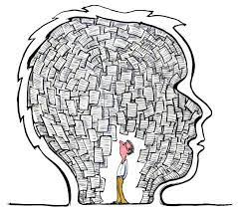
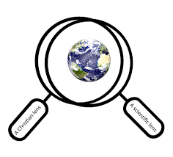
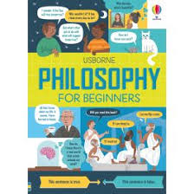
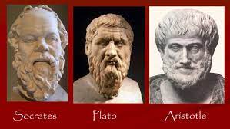
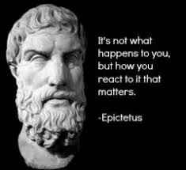
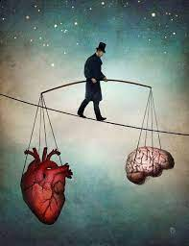
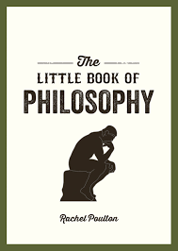
An Introduction to Philosophy
Diogenes adopted the philosophy of the Cynics, who taught that to attain wisdom and virtue one must give up all the pleasures of life, which were thought to stand in the way of self-mastery. Thus he discarded all his possessions except a cloak, a purse, and a wooden bowl. He later threw away the bowl as unnecessary when he saw a boy drinking from his hand.
Key Word | Definition
Philosophy | a story, poem, or picture that can be interpreted to reveal a hidden meaning, typically a moral or political one.
Allegory | a story, poem, or picture that can be interpreted to reveal a hidden meaning, typically a moral or political one.
Influence | the capacity to have an effect on the character, development, or behaviour of someone or something, or the effect itself.
Syllogism | an instance of a form of reasoning in which a conclusion is drawn from two given or assumed propositions
Stoic | a person who can endure pain or hardship without showing their feelings or complaining.
Cynic | reasoning conducted or assessed according to strict principles of validity. A person who believes that people are motivated purely by self-interest rather than acting for honourable or unselfish reasons.
Logic | reasoning conducted or assessed according to strict principles of validity.
Aristotle was the first to develop a formal system for reasoning. He observed that the deductive validity of any argument can be determined by its structure rather than its content, for example, in the syllogism: All men are mortal; Socrates is a man; therefore, Socrates is mortal.
Socrates believed that no one does wrong voluntarily. Evil is the result of ignorance. If people knew what was the right thing to do they would do it. We always choose what we think is the best or good for us.
Plato
How do we know what’s real?
Allegory of the cave: A man who has lived his whole life in a cave and never left it might be convinced that’s all there is to the world – but he would be wrong. Plato used this to show how humans should not trust what their senses or other people tell them, but instead use their own reason to understand the world.
Brain in a jar: a thought experiment that asks how any of us can know what is real.
Epictetus
Stoics acknowledge that people don't have control over all, or even much, of what happens in life. And they emphasize that worrying about things outside of their control is unproductive, or even irrational to a person who wants to attain tranquillity.

