Slide 1
Paper 2 Case Study Booklet

Slide 2
Urban Issues and Challenges
Major City in an LIC/NEE – Mumbai and Dharavi
Urban planning in an LIC/NEE- Dharavi
Major city in the UK – Bristol UK
Urban regeneration (example) – Temple Quarter, Bristol
Sustainable cities – Freiburg
Changing Economic World
Tourism to reduce the development gap (example) – Kenya
LIC/NEE experiencing rapid growth – Nigeria (including shell)
How modern industrial development can be more environmentally
Modern sustainable Industry(example) – Cambridge business park
Rural growth & decline (example) – S. Cambridgeshire and Outer Hebrides
Resource Management
Wakel River Basin (Example)– Local sustainable water Supply in an LIC
Lesthoto (Example)– Large scale water transfer

Slide 3
Urban Issues and Challenges

Slide 4
Mumbai (LIC/NEE City)
National Importance of Mumbai?
Mumbai is India’s commercial and financial capital, contributing around US $310 bn to its economy.
Responsible for 70 per cent of India’s maritime trade and is responsible for 25 per cent of its industrial output.
Nationally, Mumbai contributes 33% of all income tax and 60% of all customs duty from trade.
The Hindi film industry, known popularly as Bollywood, is India’s largest film industry and is located in Mumbai.
Mumbai has the highest percentage of internet access of any Indian city (12 million people in 2013)
Mumbai is a transport hub with links to all major industrial cities in India.
Location Mumbai is located on the western coast of Maharashtra state in western India, bordering the Arabian Sea. The city is on a narrow peninsula (a piece of land that is almost entirely surrounded by water but is connected to the mainland on one side).
With an estimated population of around 20 million people, Mumbai is India’s biggest city and the fourth largest in the world. Mumbai is an ‘alpha’ city due to its economic importance
Regional Importance
Three million people commute from surrounding areas to Mumbai for work. The population of Mumbai is constantly growing, taking the young workforce from neighbouring cities.
The city contributes 40% of the total income of the whole state of Maharashtra.
The Hi-tech industry is growing call centres, online banking and software development.
Why is Mumbai Growing?
Natural increase -Natural increase is a major cause of population growth in Mumbai. Mumbai has a fertility rate of around two children per woman. This has led to the population of Mumbai growing by approximately 5 per cent year on year – this equates to 1 million extra people being born every year.
Migration - Factors that attract people to Mumbai include:
educational opportunities with access to schools and universities;
improved health care providers with access to hospitals and dentists;
services such as water, electricity and sewage;
friends and family who have already moved to the city
improved job prospects with higher wages;
the opportunity to work in the public sector and for international agencies in public works
Global Importance
Largest amount of foreign investment of any other city in India.
Mumbai has the largest number of international companies in Asia.
The Bank of America, Volkswagen, Walt Disney and many more international companies have their headquarters located in the city.
Mumbai’s tourism industry is booming with thousands flocking to the area from all over the globe.

Slide 5
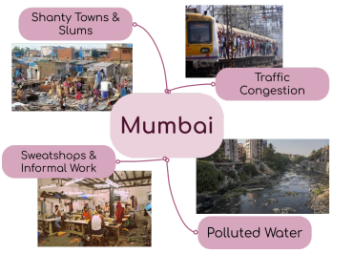
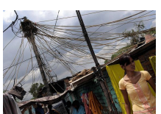
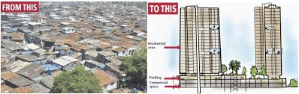
Mumbai (LIC/NEE City) – Opportunities and challenges
Mumbai Opportunities
1. Social ​ ​
​ Over 1000 primary and secondary schools in Mumbai. Compulsory, free education to every child from age 6 to 14. Mumbai literacy rates are high at 89.7% compared to the national average, which is 74.04 per cent.
More hospitals than any other urban area in India.
Over 300 community toilet blocks have been built, housing more than 5100 individual toilets,
upgraded electricity connections for 8,000 to 10,000 dwellers
2. Economic ​
Incomes are higher and more reliable than rural areas​
High community spirit and high workforce, 80% employment rate (75% UK)​
3. Environmental​
Recycling is successful 1600 factories ¼ million people employed​
80% of Mumbai’s waste is recycled
The Dharavi redevelopment project​
Positives ​
57,000 families rehoused with running water, electricity in a 21sq ft apartment ​
Newly built hospitals and schools to keep up with demand ​
Only companies that do not cause pollution will be allowed to operate in the area ​
It will be built near the financial centre next to a rail line and bus services ​
Negatives ​
Only some families will be rehoused, they have to be able to prove they’ve lived in the slum for 5 years or more​
They do not legally own the property ​
The redevelopment could ruin the existing livelihoods/ community ​
Mumbai Challenges
1. Social ​
Poor housing conditions often built on sewage/ water pipes ​
3500 people die on Mumbai’s railway each year.
2. Economic ​
Informal work, no taxes paid, governments don’t benefit ​
Negative multiplier effect ​
3. Environmental​
Polluted drinking water ​
Mumbai had the 6th highest level of air pollution in India.
Running water turned on at 7am for 1 hour ​
Lack of sanitation​ - spread of water-borne diseases.
500 share 1 toilet

Slide 6
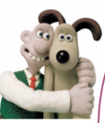
Bristol, UK – HIC City
Why are there social opportunities in Bristol?
Population is increasing
Increased ethnic diversity
Good transport links (for business and commuters)
Over 2 million live within 50km of the city
Sport opportunities
Ashton Gate Stadium - plans for a £100m development for a new sports and entertainment quarter for the city.​
The Ashton Gate Sports & Convention Centre - a 4000-capacity venue will provide a permanent home for Bristol Flyers basketball team and includes additional housing, offices and multi-storey car park along with two hotels.
Shopping opportunities
£500 million on Cabot Circus to tackle crime and improve the environment
The area was pedestrianized and they added CCTV
More attractive street furniture
Public transport improved
They developed an open street market
Harbourside
Regeneration at the centre of the city
Former workshops and warehouses were converted into bars, nightclubs and cultural venues
Art galleries , Media centre, Museum & Science exhibition
The free three-day annual Harbourside festival attracts around 300,000 spectators
Why are there economic opportunities?
Bristol’s traditional industries are based around the port
Well paid knowledge industries have taken over the cigarette and tobacco industries
Unemployment in Bristol is lower than the national average and wages are higher
Why is their employment structure changing?
The major change in Bristol's industry has been the growing numbers of people employed by high-tech companies. (highest employment sectors are public services, lowest employment sectors are agriculture, food, construction).
Factors attracting high-tech business in Bristol:
A Government grant of £100million to become a super connected city with broadband download speeds of at least 80Mbps
Close links between the city council and the University
An educated and skilled workforce with advanced research at the university
A clean non polluted environment
High-tech industries: There are 50 micro-electronic and silicon design businesses
Aardman animations (Wallace and Gromit)
Hewlett-Packard (HP)
Toshiba
There are smaller firms that work in robotics, and 3D printing
Huawei has also invested in the area Awarding Bristol the UK’s smartest city
Bristol is a UK city in the South West of England. Bristol can be found on the coast of the Bristol Channel with a population over 460,000.
Regional and national importance:
2 universities
The largest silicon chip manufacturing company outside of California
UK’s 8th most popular city for foreign visitors
2 cathedrals
Home to Aardman animations (Wallace and Grommet)
International importance
On the M4 corridor to London (in 2.5 hours)
Good rail links and an airport to major European cities and the USA
Change from the traditional tobacco and paper industries to finance, business, technology, culture and media
There has been lots of FDI (foreign direct investment) in manufacturing, finance and high tech
Bristol university attracts students from all over the world, providing graduates for the high skilled jobs
Migration
Since 1800s Bristol has been a multicultural city. Today 16% of Bristol's population are Black, Asian and Mixed race. Migration has contributed positively to the growth of Bristol:
Migrants have been employed in jobs where there has been a gap in skills
Migrates bring culture to the city e.g. Food, music
Bristol hosts St Paul's Carnival to integrate and celebrate migrants.

Slide 7
Bristol, UK – HIC City
how urban change has created challenges:
The impact of urban sprawl on the rural–urban fringe,
Large housing estates have been built on rural greenfield land. This provides a pleasant environment for people to live in but means that open spaces are lost and ecosystems damaged or destroyed. Out of town developments take advantage of cheaper land outside the city and easily accessible to lots of people. Large areas of rural land are lost and it can lead to air and noise pollution as well as traffic congestion).
Growth of commuter settlements (Commuter settlements are places
in the rural-urban fringe where the majority of the population leaves the
town each day to work elsewhere.
This can cause challenges:
New housing developments can affect the character of rural settlements and damage the environment.
Demand for housing increases house prices. Locals may not be able to afford to stay)
Challenges due to growth of Bristol Social and economic:
Urban deprivation - Filwood (south of Bristol) is in the top 10 % of the most
socially deprived areas in the country)
Inequalities in housing - Housing in Filwood is split equally between owner occupied and those rented from the city council. Compared to Stoke Bishop in the north of Bristol where 81% of the housing is owner occupied. Most of the council houses in Filwood were built in the 1930s and are poorly insulated).
Education - In Filwood in 2013 only 36% of students got top grades at GCSE, including English and Maths compared to 94% in Stoke Bishop (wealthier area)
Health – In Filwood death rates from cancer are higher than average and life expectancy is 78 years compared to 83 years in Stoke Bishop
Employment (Only 3% of people in Stoke Bishop are unemployed compared to 1/3 of people aged 16-24 in Filwood)
Environmental:
Dereliction - Stokes Croft in Bristol’s inner city became notorious for
its derelict housing and abandoned properties and many empty houses have been taken over by squatters and the area has suffered from anti-social behaviour)
Building on brownfield and greenfield sites, (brownfield sites need
bulldozing and decontaminated and greenfield sites leads to a
reduction in the urban-rural fringe)
Waste disposal - The city produces half a million tonnes of waste per
year. It is among the worst cities in the country in terms of the
amount of food waste it creates.
An example of an urban regeneration project – Temple Quartre
Reasons why the area needed regeneration:
During the late twentieth century, decline set in. Industries closed, and land became derelict, run-down and polluted. By the 1990s much of the area comprised unused railway lines, demolished slum housing and abandoned wasteland. It was very run-down.
The main features of the project:
The 70-hectare Temple Quarter project was officially opened in 2012 and is expected to last for 25 years.
The target is to create 4 000 new jobs by 2020 and 17 000 jobs by 2037. By 2015, 300 businesses had already been attracted to the area creating over 2 000 jobs.
Land has been cleared and decontaminated.
New offices, houses and retail areas will be constructed, and the area will be
landscaped, with green areas, footpaths and cycleways.

Slide 8
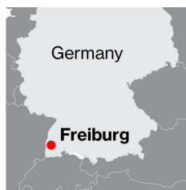
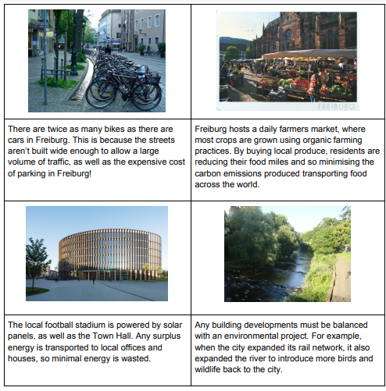
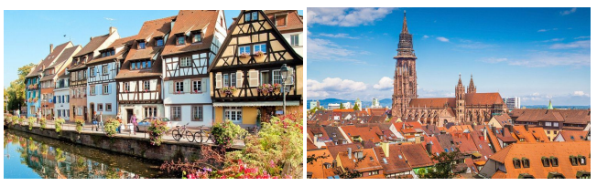
Sustainable Cities – Freiburg
Environmental Sustainability – all developments and day-to-day living doesn’t damage the environment.
Location Freiburg is a city in the south of Germany. In the 1970’s the government set the aim to become more sustainable It wanted to adapt because:
It has the youngest population in Germany
The old town is cobbled which reduces traffic A 9 month protest in 1975 showed how passionate people where about the environment.
Economic Sustainability
Providing jobs for families so they can afford to live
Businesses have a n obligation to be responsible for their impacts to the environment
Green technology and environmental industry.
10,00 residents are employed in green industry. E.g. – Solar Valley, a cluster of solar panel manufacturers. They employ a variety of people of different skills and education and the solar panels are then used on important public building or individual houses.
Social Sustainability – people have a voice in changes in the local area. Everyone has an equal input rather than decision just being made by the local government
Groups of children are involved in giving feedback on new development
Financial investors given free football tickets for investing into the city.

Slide 9
The Changing Economic World

Slide 10
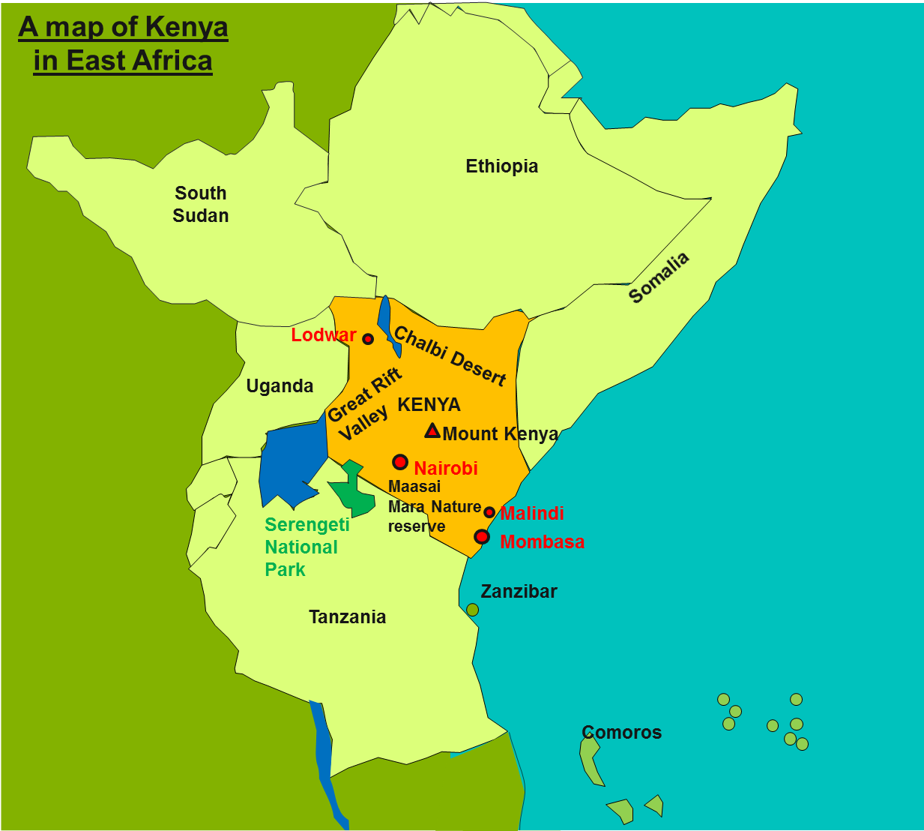

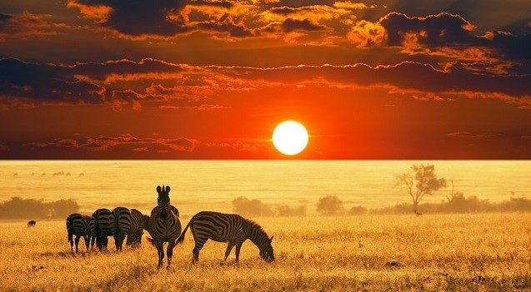
Tourism to reduce the Development Gap - Kenya
Location & Background:
Kenya is a country in East Africa that has successfully developed a tourism industry over the past 40 years.
Tourists visit Kenya for many reasons, including to go on safari and to visit its spectacular coastline around Mombasa. Wildlife viewing of animals such as lions, elephants and giraffes is the major tourist attraction in Kenya., Kenya attracted nearly 1.4 million visitors in 2017.
Positives of tourism
1. Tourists like to see cultural shows by Maasai warriors and will pay good money for it
2. Local infrastructure is improved as water and sanitation facilities, roads, buses, taxis and airports are provided for tourists.
3. Tourists see beautiful landscapes, wildlife such as elephants and plants. They can also be educated about the dangers to fragile ecosystems in the modern world.
4. The Kenyan government loves tourism - foreign currency spent by tourists can be invested in improving local education, health and other services
5. Tourism creates jobs for local people in Kenya and people can learn new skills in tourism services and construction
6. Visitors get an insight into local customs and traditions.
Facts & Figures
• Travel & Tourism generated 226,500 jobs directly in 2018, indirectly 11.6% of Kenyan’s jobs rely on tourism
• 7.6% of Kenya’s capital investment (money coming into the country to develop industry and projects) comes from tourism
• Tourism brings in US$5.3billion to Kenya’s economy
Negatives of tourism
1. Foreign companies may bring foreign workers to do the skilled jobs; so local people only do low skilled, poorly paid work.
2. Important projects for local communities might be side lined as infrastructure developments are focused on tourists.
3. Pollution and disruption to wildlife habitats could occur if tourism isn't sustainable.
4. Profits can often go to foreign companies, such as tour operators and hotel chains, rather than to the local community.
5. Coastal Environments such as those in Mombasa have been damaged by tourism e.g. destruction of coral reefs as tourists step on the coral and also take souvenirs

Slide 11
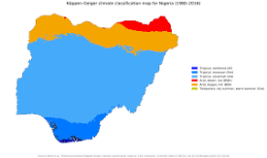
Nigeria (NEE)
Why is the economy developing?
Rapid advances in technology
Greater concern for the environment
Many people speak English, giving potential for growth in telecommunications
Investment in science and technology training – Nigeria’s huge population is seen as a potential asset for the country
Information technology is beginning to drive the economy rather than oil
Increased use of telecommunications – Nigeria is able to benefit from global finance and trade
Location Nigeria is a former colony of the UK and is located in West Africa. Nigeria is characterized by three distinct climate zones, a tropical monsoon climate in the south, a tropical savannah climate for most of the central regions, and the Sahel a hot and semi-arid climate in the north of the country.
Nigeria’s links with the wider world
Political links:
African Union – economic planning and peacekeeping group. Nigeria is in alliance with Niger, Chad, Benin and Cameroon to provide troops.
United Nations – in 2013, Nigeria contributed the 5th largest number of troops to the UN peacekeeping force. In 2014-15 it was a temporary member of the UN Security Council.
ECOWAS (Economic Community of West African States)– trading group made up of the countries in West Africa with headquarters in Abuja.
CEN–SAD (Community of Sahel-Saharan States) – has similar aims to ECOWAS, and also seeks to develop sporting links.
OPEC (Organisation of Petroleum Exporting Countries) – aims to stabilise the price of oil and to ensure a regular supply.
Trade links:
Nigeria’s main exports are crude and refined petroleum, natural gas, rubber, cocoa and cotton.
It’s main imports are refined petroleum from the EU and the USA, cars from Brazil and the USA, telephones from China, rice and wheat.
Nigeria’s growing population and the emerging middle class have seen a rise in the demand for telephones. Nigeria ranks 7th in the world for the number of mobile phones used (UK is rank 16th).
Factors affecting development:
The Nigerian government was previously corrupt as a result of Nigeria gaining independence. However, recent elections in 2011 and 2015 were seen as free and fair – a change from previous corruption.
Several countries are now starting to invest in Nigeria:
China is making major investments in construction in the capital, Abuja.
South Africa is investing in businesses and banking.
American companies such as General Electric are investing in new power plants.
American corporations such as Wal-Mart, and IT giants IBM, Microsoft and Oracle are operating in Nigeria.
Nigeria’s Changing Economy
Traditionally, primary products had been Nigeria’s main source of income eg. cocoa, timber, oil palm, groundnuts and cotton were it’s main exports. Today, oil accounts for about 14% of the country’s GDP and 98% of its export earnings. Nigeria has the world’s 10th highest level of oil reserves. At the present rate of production, it has around 50 years’ supply left.

Slide 12
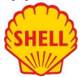
Nigeria (NEE)
The impacts of international aid in Nigeria
Nigeria receives 4% of aid given to African countries. In 2013 aid represented 0.5% of Nigeria’s GNI – nearly US$5000 million. Most came from individual countries such as the UK and USA, and some from international organisations like the World Bank.
Examples of aid include; The NGO Nets for Life provides education on Malaria prevention and distributes anti-mosquito nets to households and in 2014 the World Bank approved US$500 million to fund development projects and provide long term loans to businesses.
What prevents aid from being used effectively – Corruption by the government is a major factor in the loss of aid and donors may have political influence over what happens to the aid
The role of TNCS in Nigeria
There are about 40 TNC in Nigeria, majority have headquarters in the UK, USA or Europe. They include things like Unilever (food and homecare) ranging to KFC. Shell oil is one of the world’s largest oil companies. Since oil was discovered in the Niger Delta in 1958 Shell’s operations have been controversial.
Advantages of SHELL
Making major contributions in taxes and export revenue
Employment for 65,000 Nigerian workers
91% of Shell contracts to Nigerian companies
Supporting the growth of Nigeria’s energy sector
Disadvantages of SHELL
Oil spills have caused water pollution and soil degradation, reducing agricultural production and fishing yields.
Frequent oil flares send toxic fumes into the air
Militant groups disrupt oil supply in the delta
The environmental impacts of economic development in Nigeria
Nigeria’s rapid economic development has created negative environmental impacts:
In Lagos many harmful pollutants go directly into open drains and water channels – these are harmful to people and damage ecosystems downstream
70-80% of Nigeria’s forests have been destroyed through logging, urban expansion and industrial development. Many species have disappeared e.g. cheetahs and giraffes and 500 species of plant.
Many oil spills in the Niger Delta have had disastrous impacts on freshwater and marine ecosystems – Bodo oil spills (2008)
Commercial farming and inappropriate practices have led to land degradation. There is water pollution due to chemicals, soil erosion and silting of river channels.
How has economic development affected the quality of life for people in Nigeria?
Nigeria’s HDI has been increasing steadily from 2005. It has risen from 0.465 in 2005 to 0.505 in 2013.
Life expectancy has risen from 46 in 1990 to 52 to in 2013
Mortality rates have decreased from 213/1000 in 1990 to 117/1000 in 2013
Despite these clear improvements many people are still poor, Limited access to services such as safe water and sanitation is still a problem e.g. % of people with access to sanitation facilities dropped from 37% in 1990 to 28% in 2013.
Now the price of oil has fallen and technology is leading to the developments of shale oil elsewhere, Nigeria’s over dependence on oil could be a problem in the future.
How is manufacturing affecting economic development?
Regular paid work gives people a more secure income.
As industries grow more people are employed, and revenue from taxes increases.
A thriving industrial sector attracts foreign investment which stimulates further economic growth

Slide 13
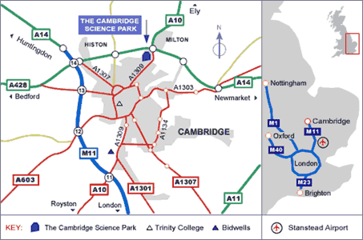
Modern Sustainable Industry
Cambridge Science Park
he Cambridge Science Park was founded by Trinity College in 1970 and is the oldest science park in the UK. It is a concentration of science and technology related businesses and has strong links with the nearby University of Cambridge. Many businesses are in Biotech or technology.
Location:
The science park is situated about 3 km to the north of Cambridge city centre, by junction 33 of the A14. It has many site factors and
Advantages;
The site has its own fitness club and gym
It has the benefit of fibre optic broadband systems in operation
There is an onsite nursery
Recycling - Plastic bottles, glass, Aluminium drinks cans, Clean office paper and newspaper , A skip for clean cardboard
The park has low density of buildings.
The landscaping design was to create a peaceful and serene environment in accord with a location whose ideal is the pursuit of scientific research and development.
Efforts made to conceal car parks behind trees and shrubs.
The 152 acre site benefits from 20 acres of park style landscaping which provides a central area of lakes, natural habitat, mature trees, shrubs and extensive grassed areas. No building is permitted in this protected area.
Transport
CYCLING - Already more than 22% of commuters cycle to work.
Electric pool bikes for FREE hire – allowing employees to use electric bicycles for journeys in and around the area or for quick visits into Cambridge city The Science Park is a committed member of Travel Plan+ (TP+) - promotes more sustainable travel to work.
An on-site Commuter Centre based at the Innovation Centre on the Park where people can speak to local travel planning experts
Rail - Cambridge North Station is about 1km from the eastern end of the Science Park so a 12-minute walk approximately. From other parts of the park it is about 2km.
Car sharing - 11% of Cambridge Science Park commuters currently car share.
Companies on Cambridge Science Park have been registered to use CamShare, the Cambridgeshire on-line car sharing matching database

Slide 14
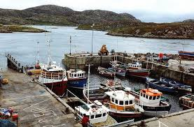
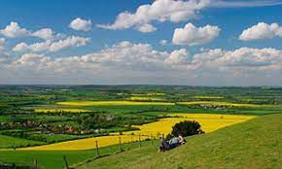
Rural Growth and Decline – S. Cambridgeshire & Outer Hebrides
The Outer Hebrides - Population Decline
The Outer Hebrides are a group of islands off the northwest coast of Scotland. Since 1901 it has experienced a 50 per cent decline in its population, mainly due to young people moving away. They have migrated to the mainland in search of jobs. The current community is around 27,000, and most inhabitants live on the islands of Lewis.
Social impacts:
School closures could result from fewer children
An ageing population, caused by the migration of young people, will require higher amounts of social care, which will have social and economic impacts
A further decline in the fishing and farming industry due to the ageing population
Economic impacts:
Maintaining transport services such as ferries and other services is very costly
There has been a significant decline in traditional fishing for lobsters and prawns
Tourism has become an essential source of income. However, the infrastructure is struggling to cope with this
Shellfish catches have increased, due to more foreign boats.
South Cambridgeshire
S. Cambridgeshire is the mostly rural area surrounding the city of Cambridge. The population of 150,000 is increasing due to migration into the area. Migrants have mostly moved from the city area of Cambridge and other parts of the UK but some are starting to arrive from Eastern Europe.
Benefits of population growth in rural areas:
An increased population leads to a higher demand for goods and services. This helps ensure the future of rural shops, schools and businesses.
It provides balance to rural-urban migration, particularly as young people move away in search for better opportunities.
New people are more likely to invest in new, local businesses.
New developments in rural areas provide jobs.
Problems of population growth in urban areas:
Rural areas can lose shops as commuters buy products in supermarkets in urban areas on their way home from work.
The increase in ‘outsiders’ can change the social fabric and rural culture.
Older people tend to move to rural areas, which raises the average age.
House prices often increase rapidly due to wealthy newcomers, pushing out local people.
Car owning commuters do not require public transport, so services may be reduced, affecting local people.
Resentment may is felt towards new members of the rural community
Modern developments in rural areas cause tensions with the local community.
The sale of agricultural land in rural areas can lead to unemployment in the local community.

Slide 15
Resource Management

Slide 16
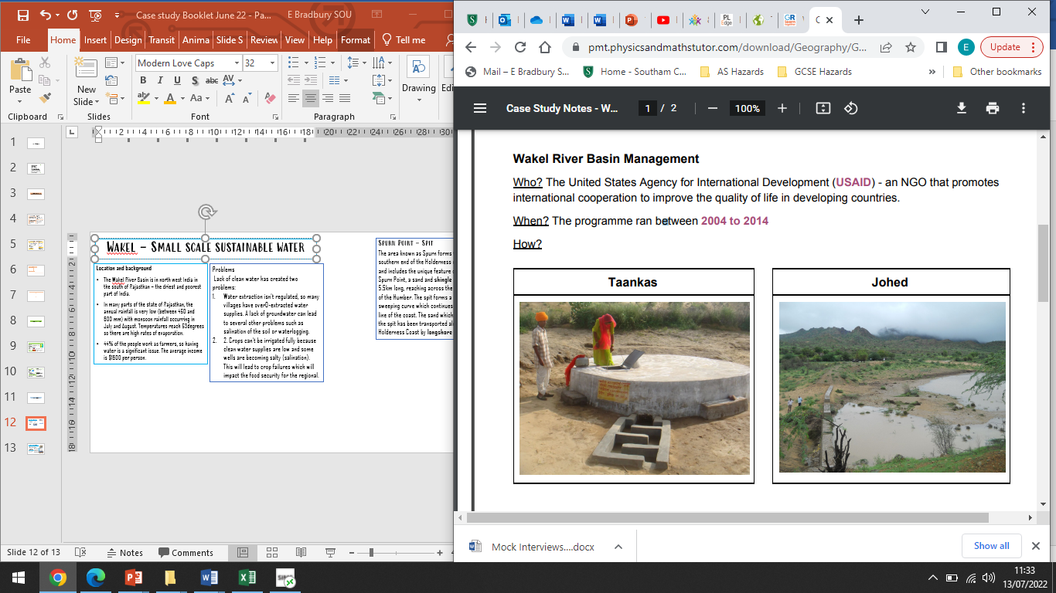
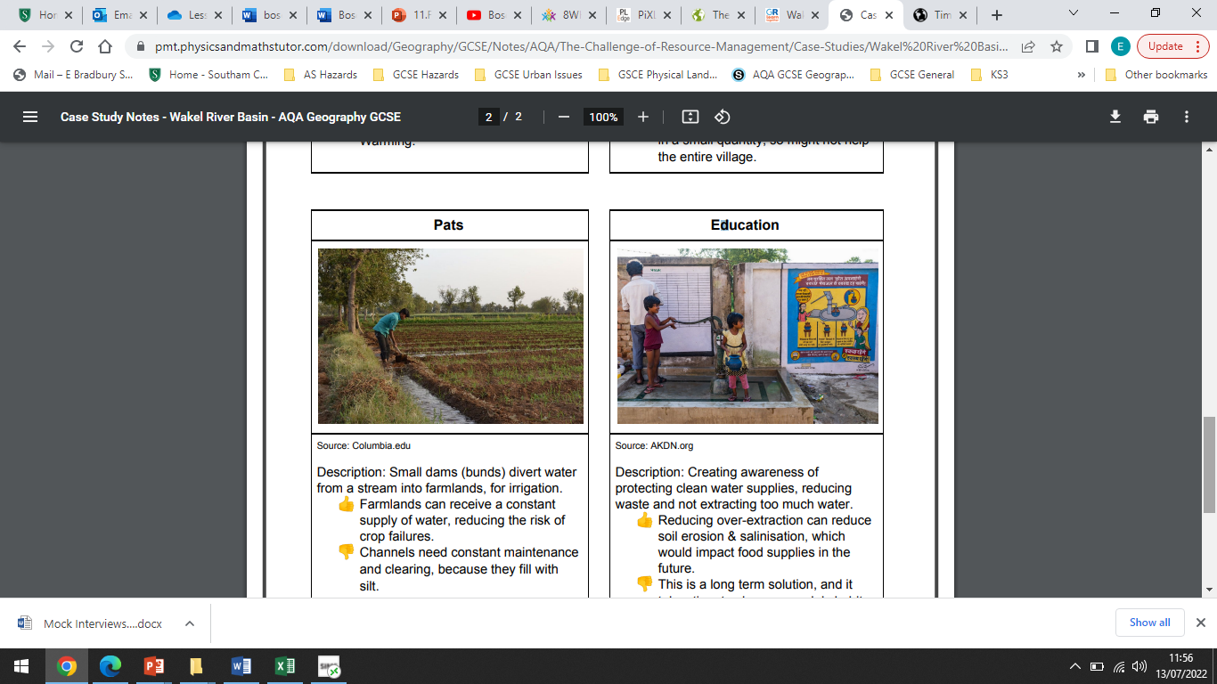
Wakel – Small scale sustainable water
Location and background
The Wakel River Basin is in north west India in the south of Rajasthan – the driest and poorest part of India.
In many parts of the state of Rajasthan, the annual rainfall is very low (between 450 and 600 mm) with monsoon rainfall occurring in July and August. Temperatures reach 53degrees so there are high rates of evaporation.
44% of the people work as farmers, so having water is a significant issue. The average income is $1600 per person.
Problems - Lack of clean water has created two problems:
Water extraction isn’t regulated, so many villages have over-extracted water supplies. A lack of groundwater can lead to several other problems such as salination of the soil or waterlogging.
2. Crops can’t be irrigated fully because clean water supplies are low and some wells are becoming salty (salination). This will lead to crop failures which will impact the food security for the regional.
Taankas – concreted containers underground for water collected from roofs.
+ Concrete creates a cool storage so water isn’t lost through evaporation
- Producing concrete releases carbon dioxide which contributes to global warming.
Johed – Earth and sand can be used to build small dams, to increase the water flow in rivers.
+Dams keep water flowing through the rivers all year round
- Dams affect the water supplies in a small quantity, so might not help the entire village.
Pats – Small dams (bunds) divert water from a stream into farmlands for irrigation
+ Farmlands can receive a constant supply of water, reducing the risk of crop failures.
- Channels need constant maintenance and clearing, because they fill with silt.
Education – Cresting awareness of protecting clean water supplies, reducing waste and not extracting too much water
+ Reducing over-extraction can reduce soil erosion & salination
- This is a long erm solution and it takes time to change peoples habits.

Slide 17
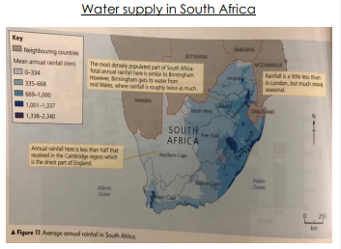
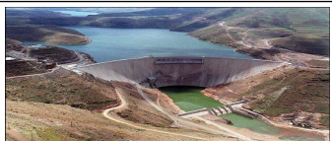
Lesotho – Large Scale water transfer
Background
Lesotho is a small land locked country surrounded by South Africa.
Rainfall varies across southern Africa. The east Atlantic coast of South Africa receives less than 300mm of rainfall a year. The west coast of Africa, including Lesotho, receives a lot more rain, in excess of 1200mm each year. This is due to relief rainfall caused by air travelling over the Indian Ocean towards Africa being forced to rise over the Lesotho Highlands, a large mountain range.
Lesotho is only a small country but has a large amount of water and is therefore able to sell water to South Africa who have a water deficit, particularly Johannesburg which is located in the rain shadow of the Highlands.
Impacts on Lesotho
Advantages
Lesotho is one of the world’s poorest countries, with no natural resources, except water, and a high percentage of unemployment (50%).
The scheme will help the country to develop and will provide 75% of Lesotho’s income. The dams will provide HEP, providing cheaper electricity to Lesotho.
There will be improved roads in the country, as a result of construction work. Local workers have been given jobs on the construction of the project and have received training which has improved their skills.
Disadvantages
The scheme is estimated to cost $8 billion, given on loan from the World Bank. This money will need to be paid back.
In the short term, Lesotho will struggle with water shortages and poor sanitation.
Local people have no access to the water supplied by the dams, and they will be made homeless as valley are flooded once it is built. Farming land has been lost which has resulted in food shortages.
Impacts on South Africa
Advantages
The percentage of people with access to safe drinking water in South Africa will increase to 87%.
Disadvantages
There have been many complaints from residents as leaking pipes has led to much water being lost and as a result prices of water have increased.
The project
The Lesotho Highlands Water Project (LHWP) I a large scale water management scheme. It consists of 4 phases where 6 dams will be built in Lesotho and 200km of tunnel systems to transfer the water to South Africa.
It is the largest water management scheme in Africa, transferring 40% of Lesotho’s water to South Africa.

