Slide 1
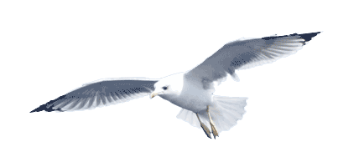
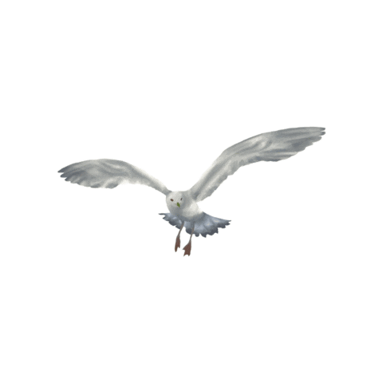
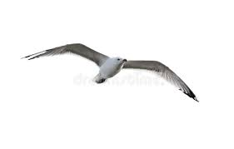

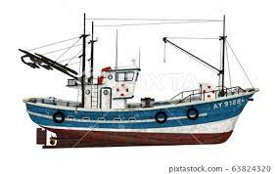

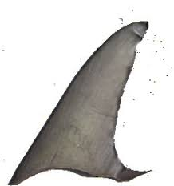
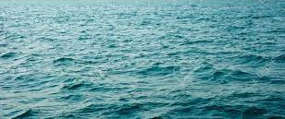
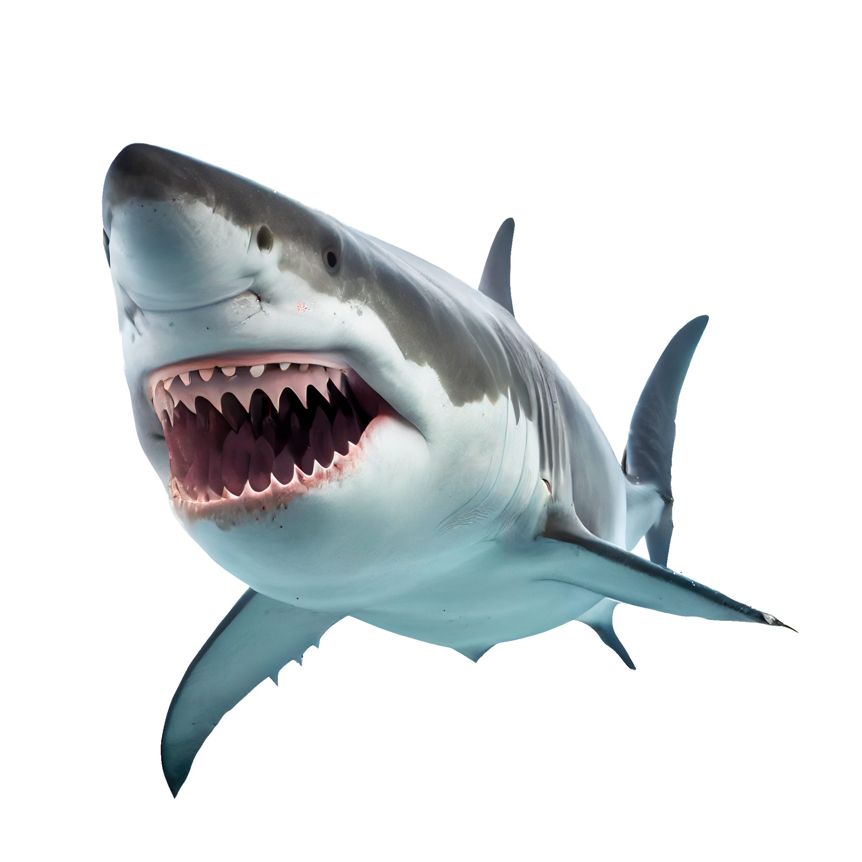
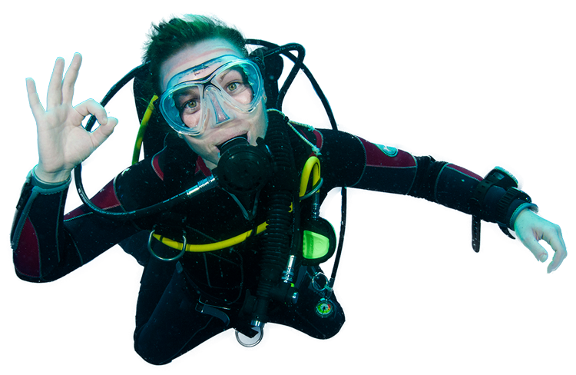
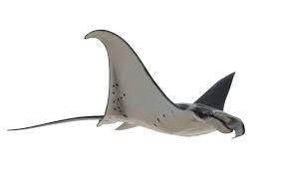
Aquatic Food Resources
Fishing
AQA A Level Environmental Science
Paul Madelin PIEMA

Slide 2
Is fishing important?
Well, Britain and Iceland certainly think so…..

Slide 3
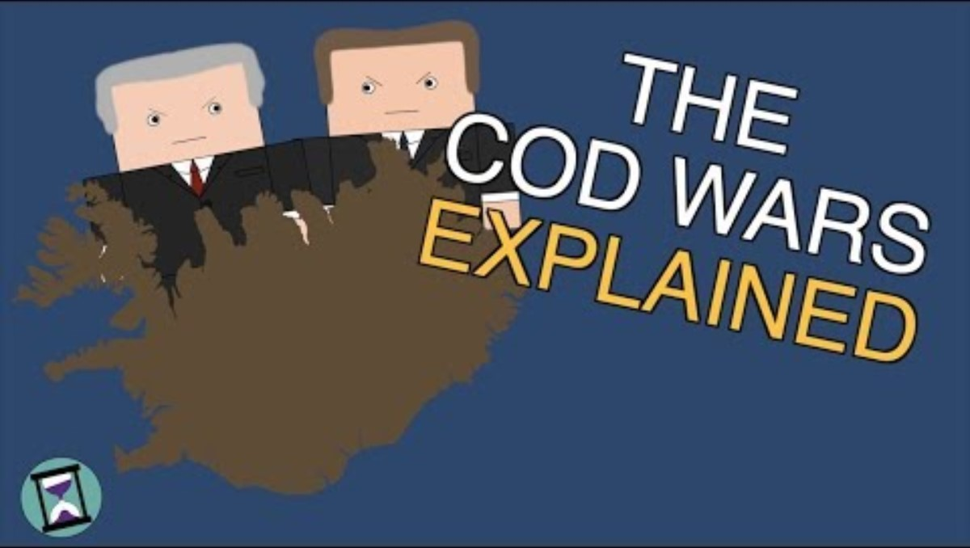

Slide 4
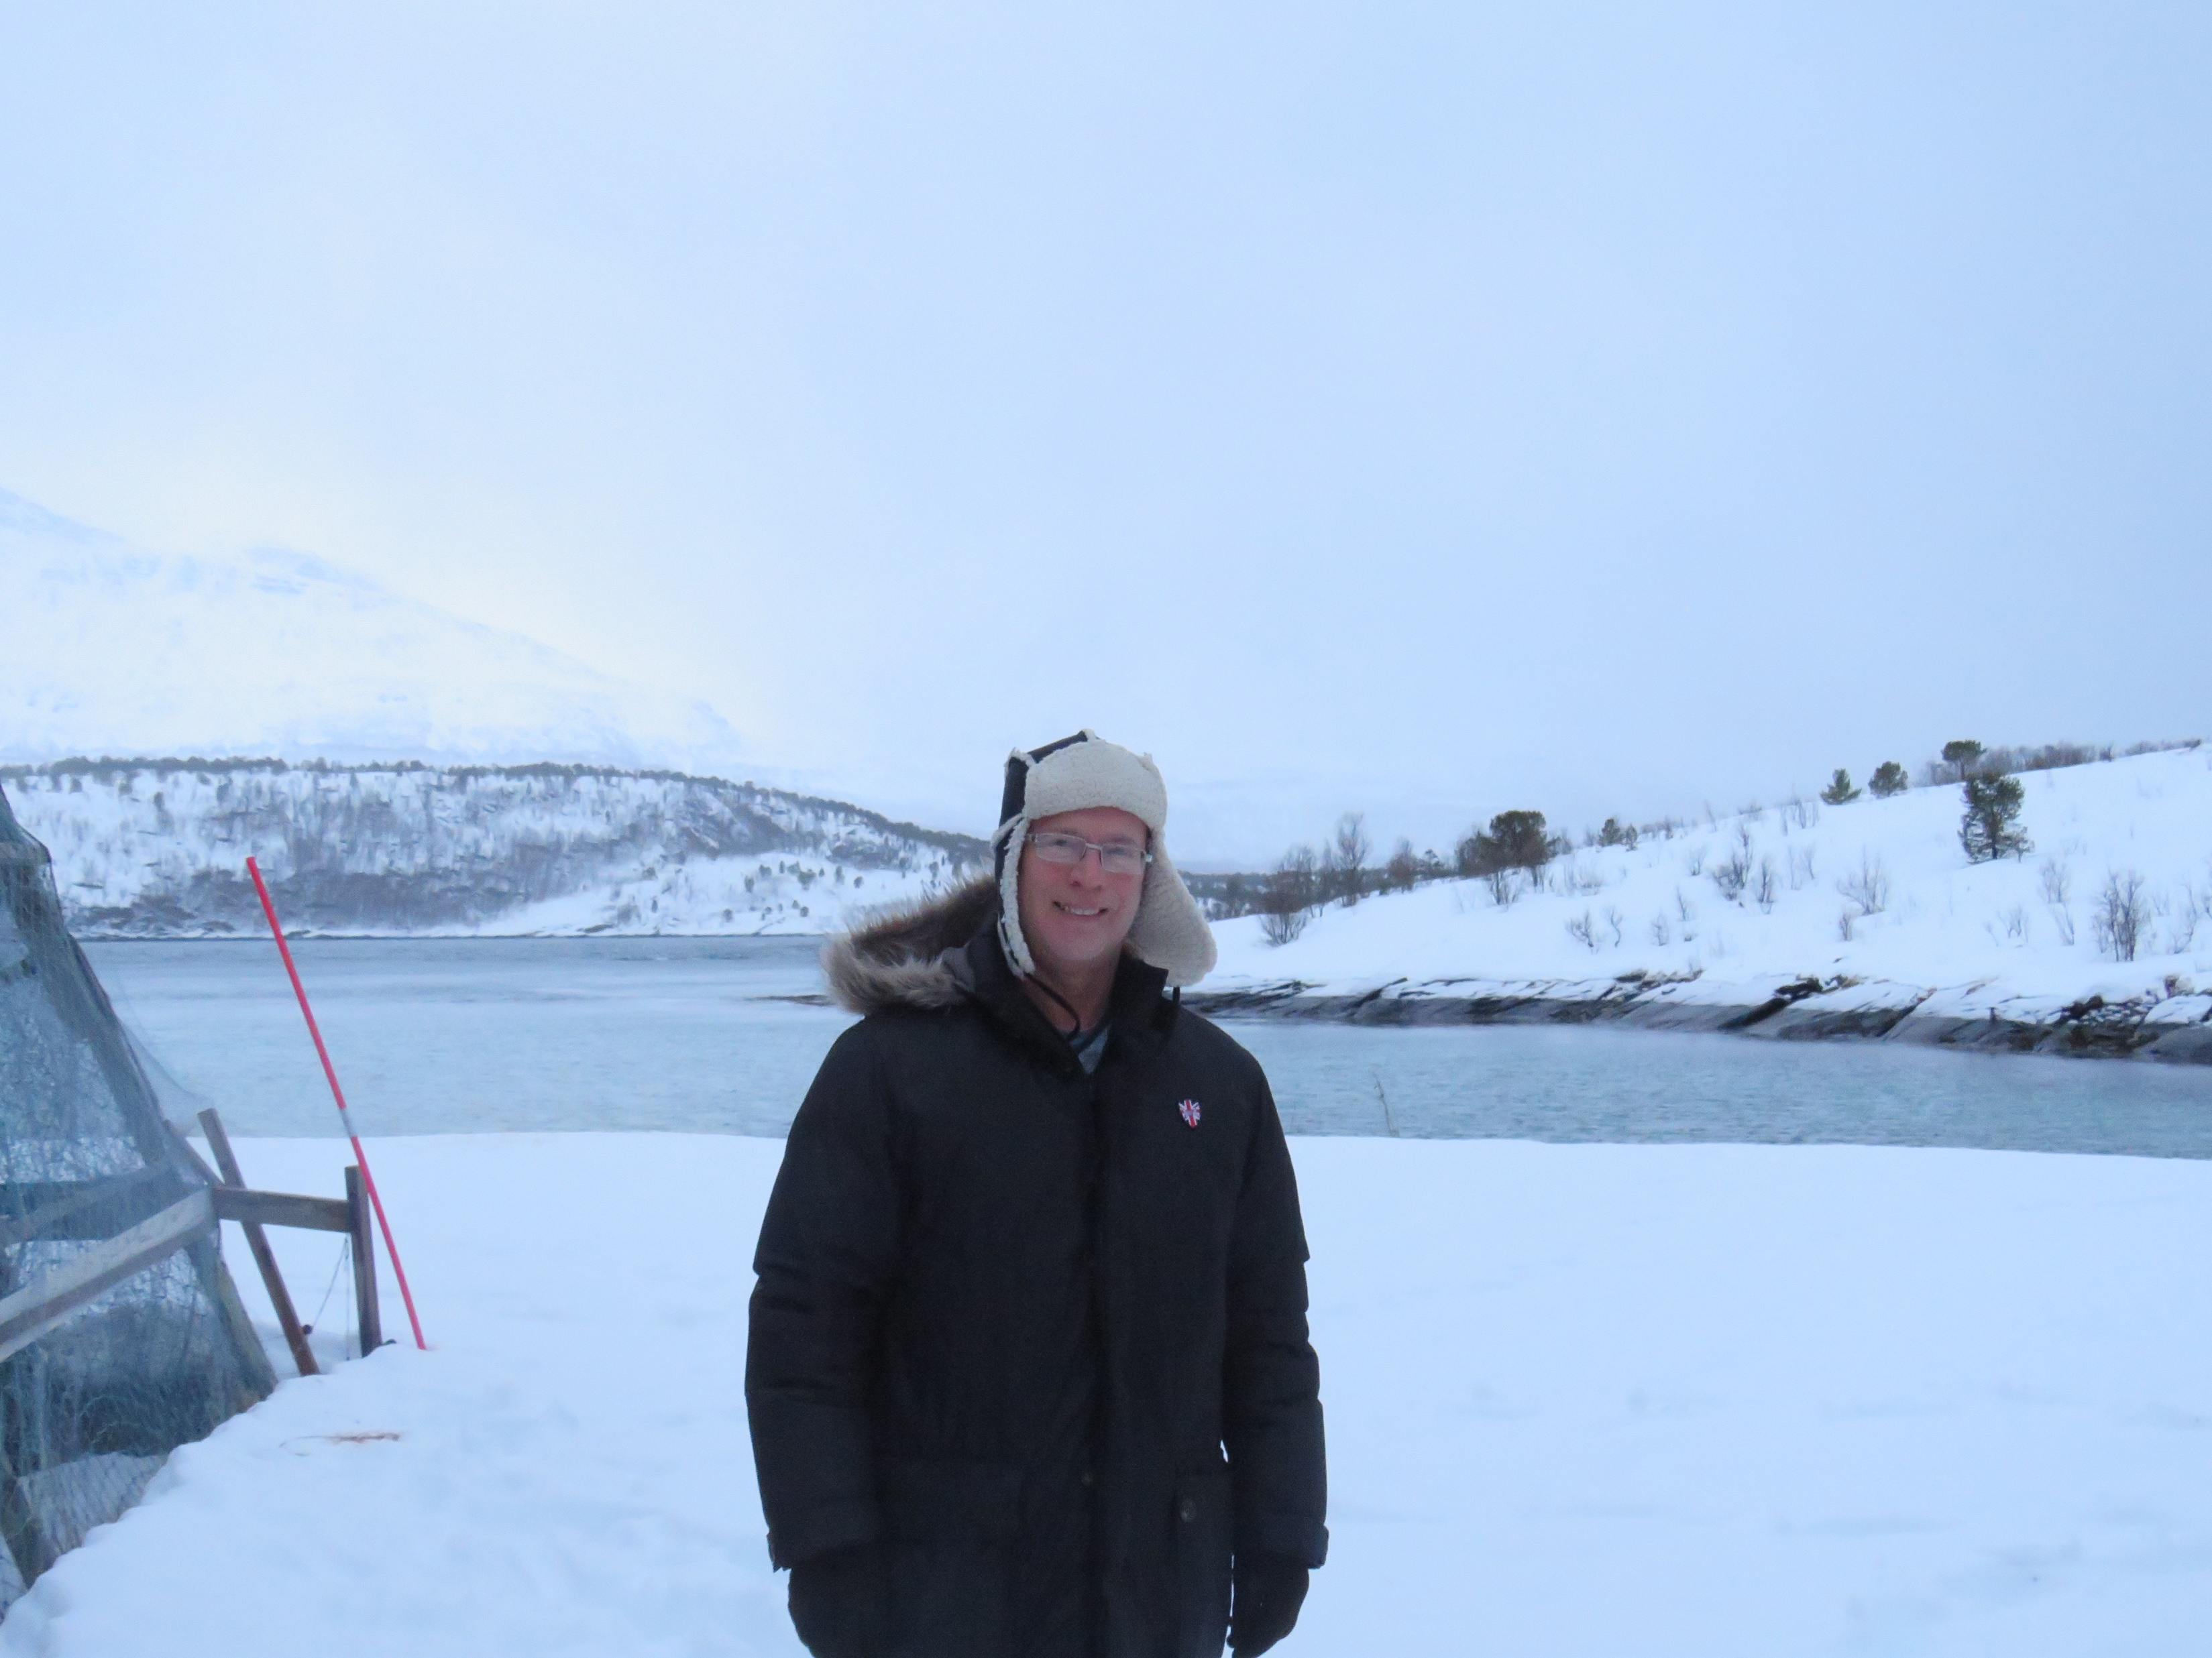
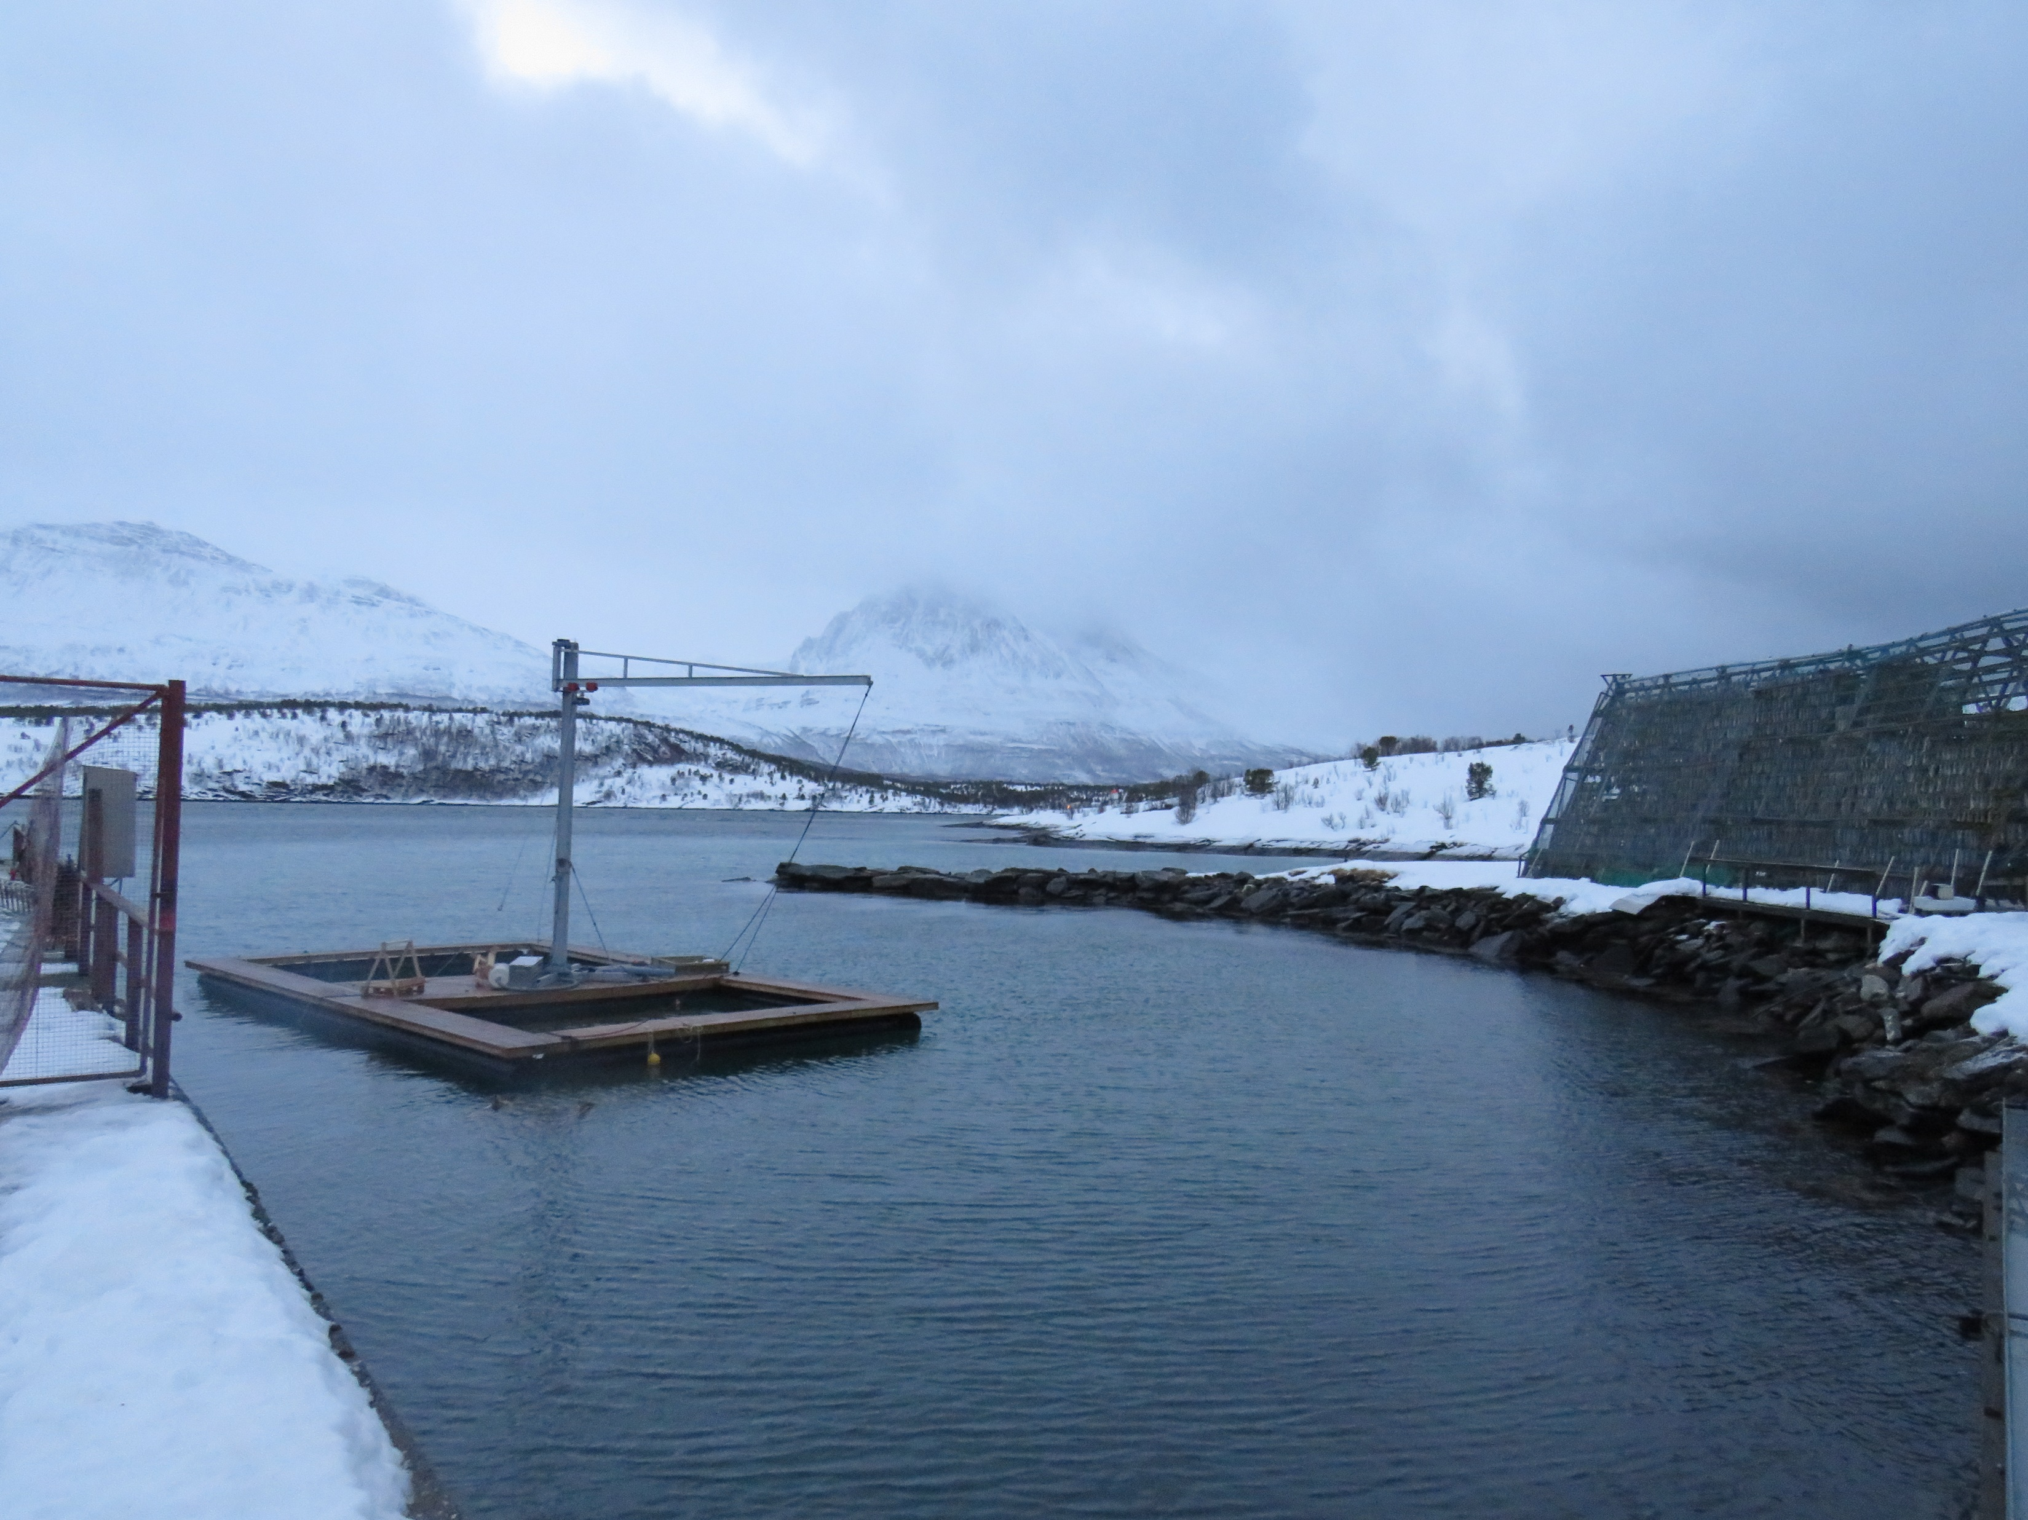
…Norway, too
So I went there, just to research it for you. You are welcome.

Slide 5
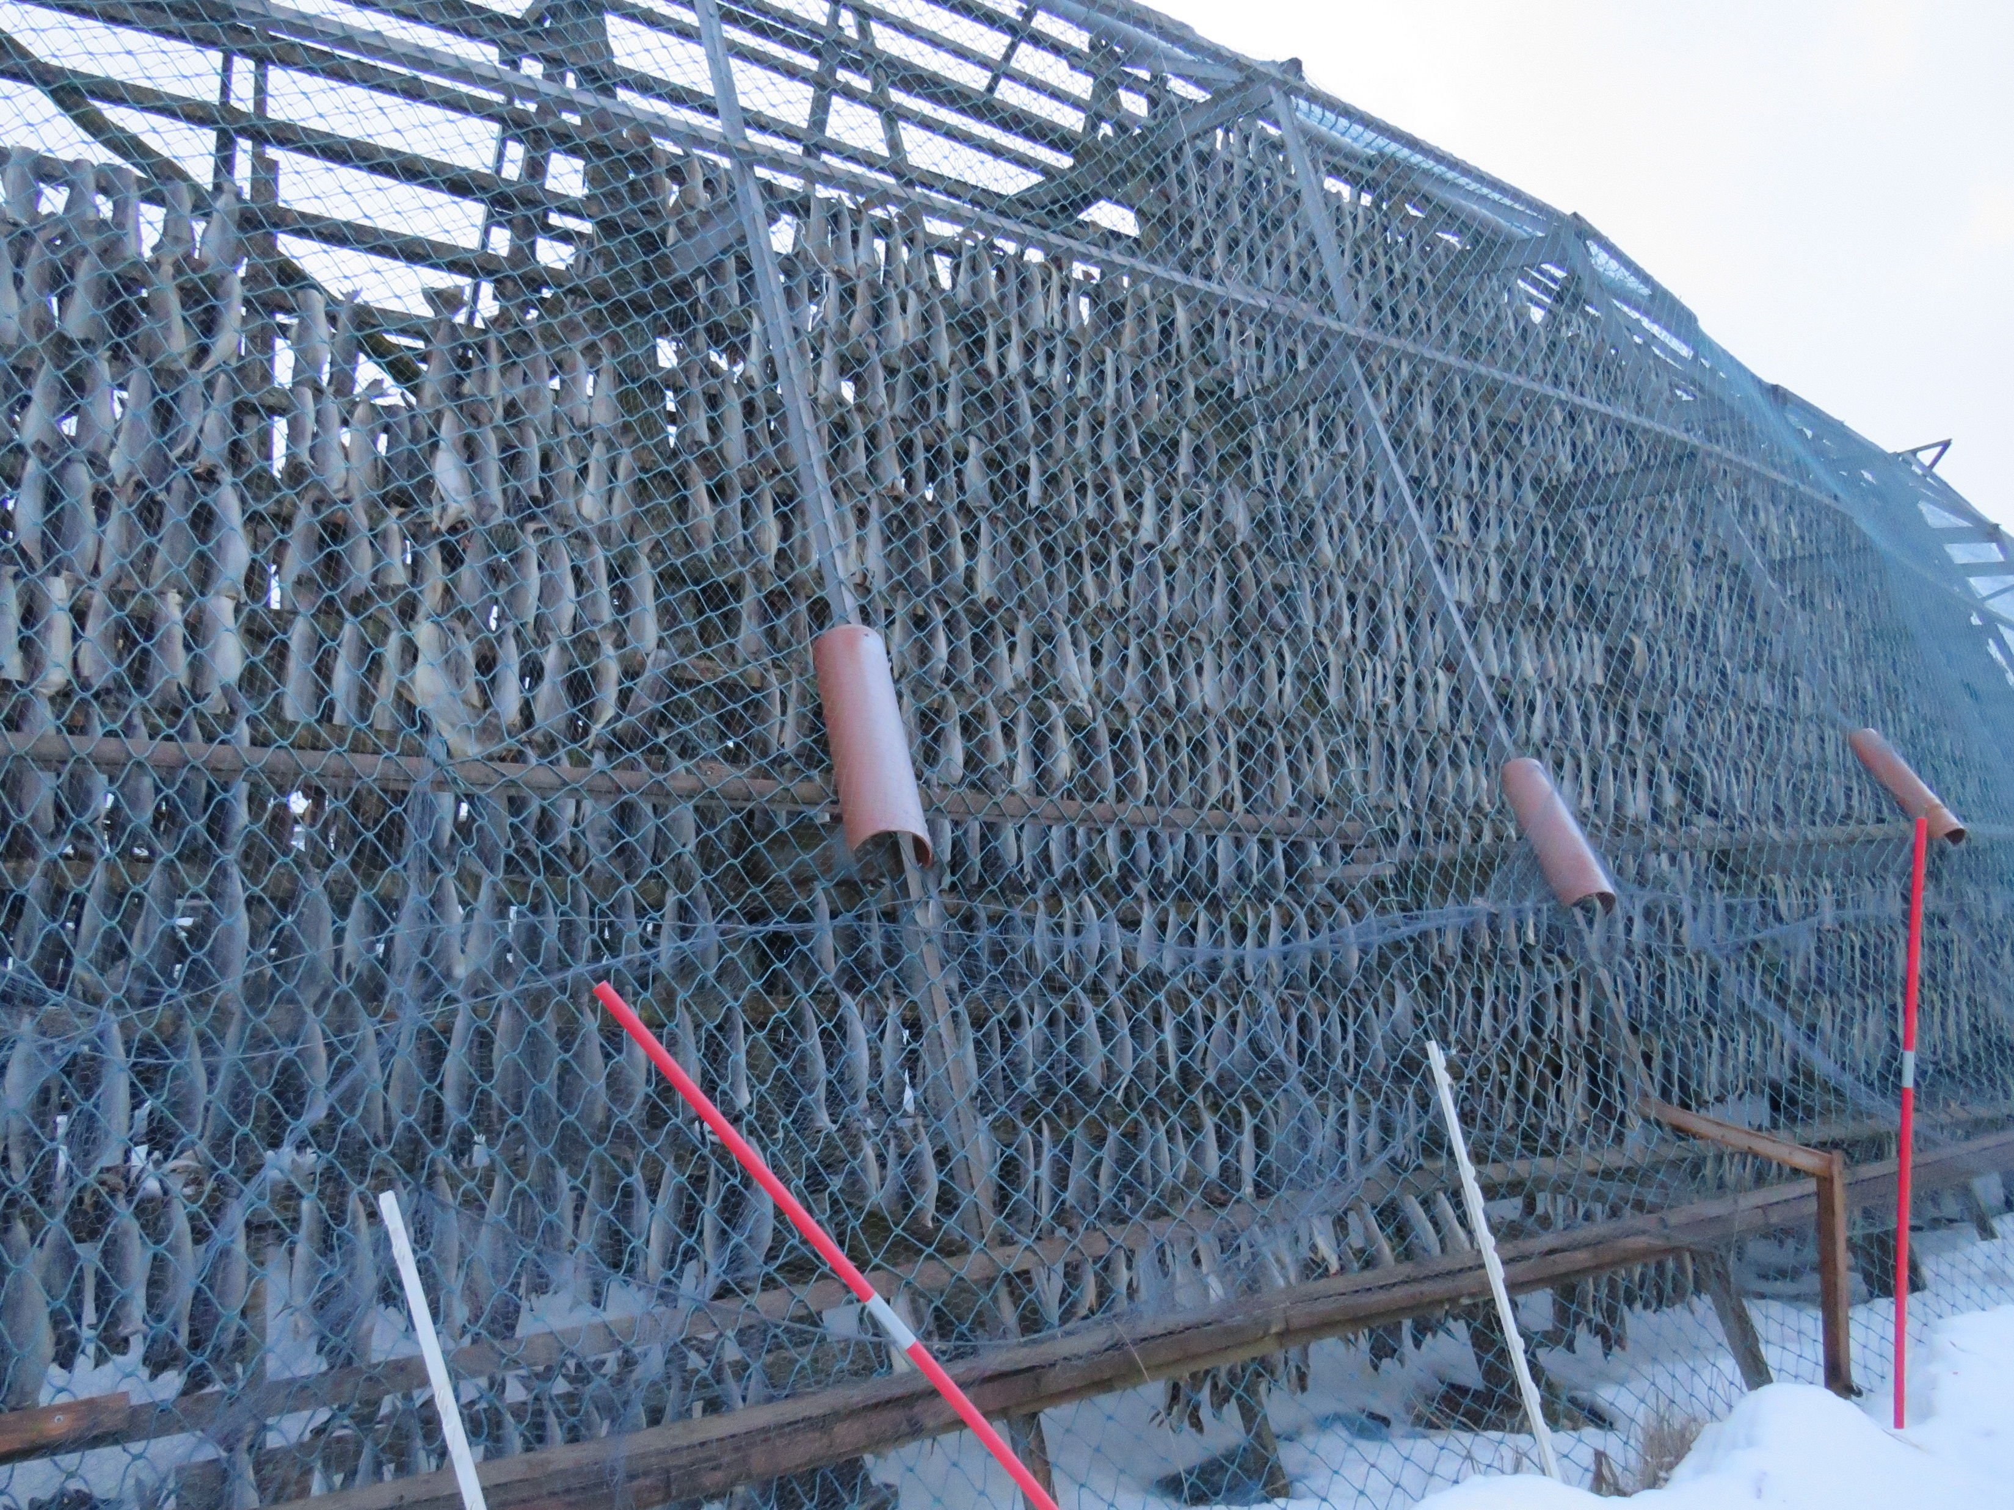
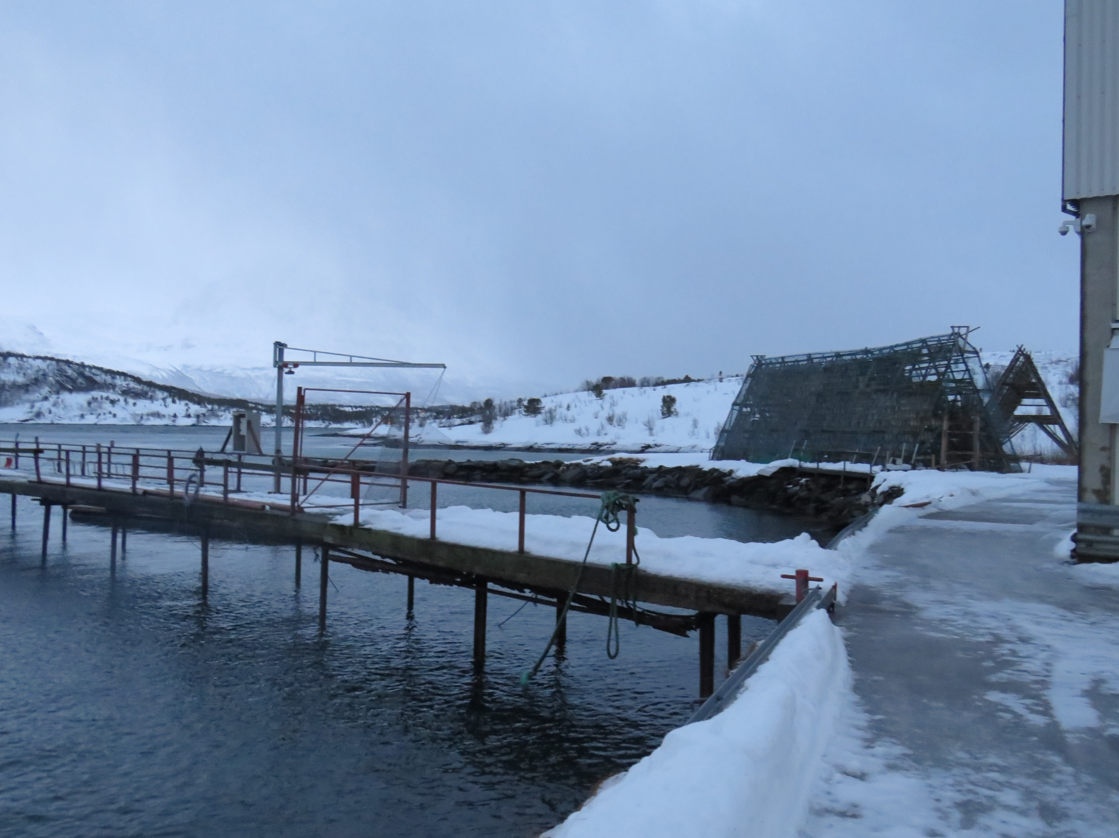
Norway is the world's leading producer of Atlantic salmon and one of the largest seafood exporters in the world. The Norwegian aquaculture industry has developed to become an industry of major importance in the country.
In fact, the industry is so vast that it is the second largest contributor to Norway's economy, after oil and gas

Slide 6
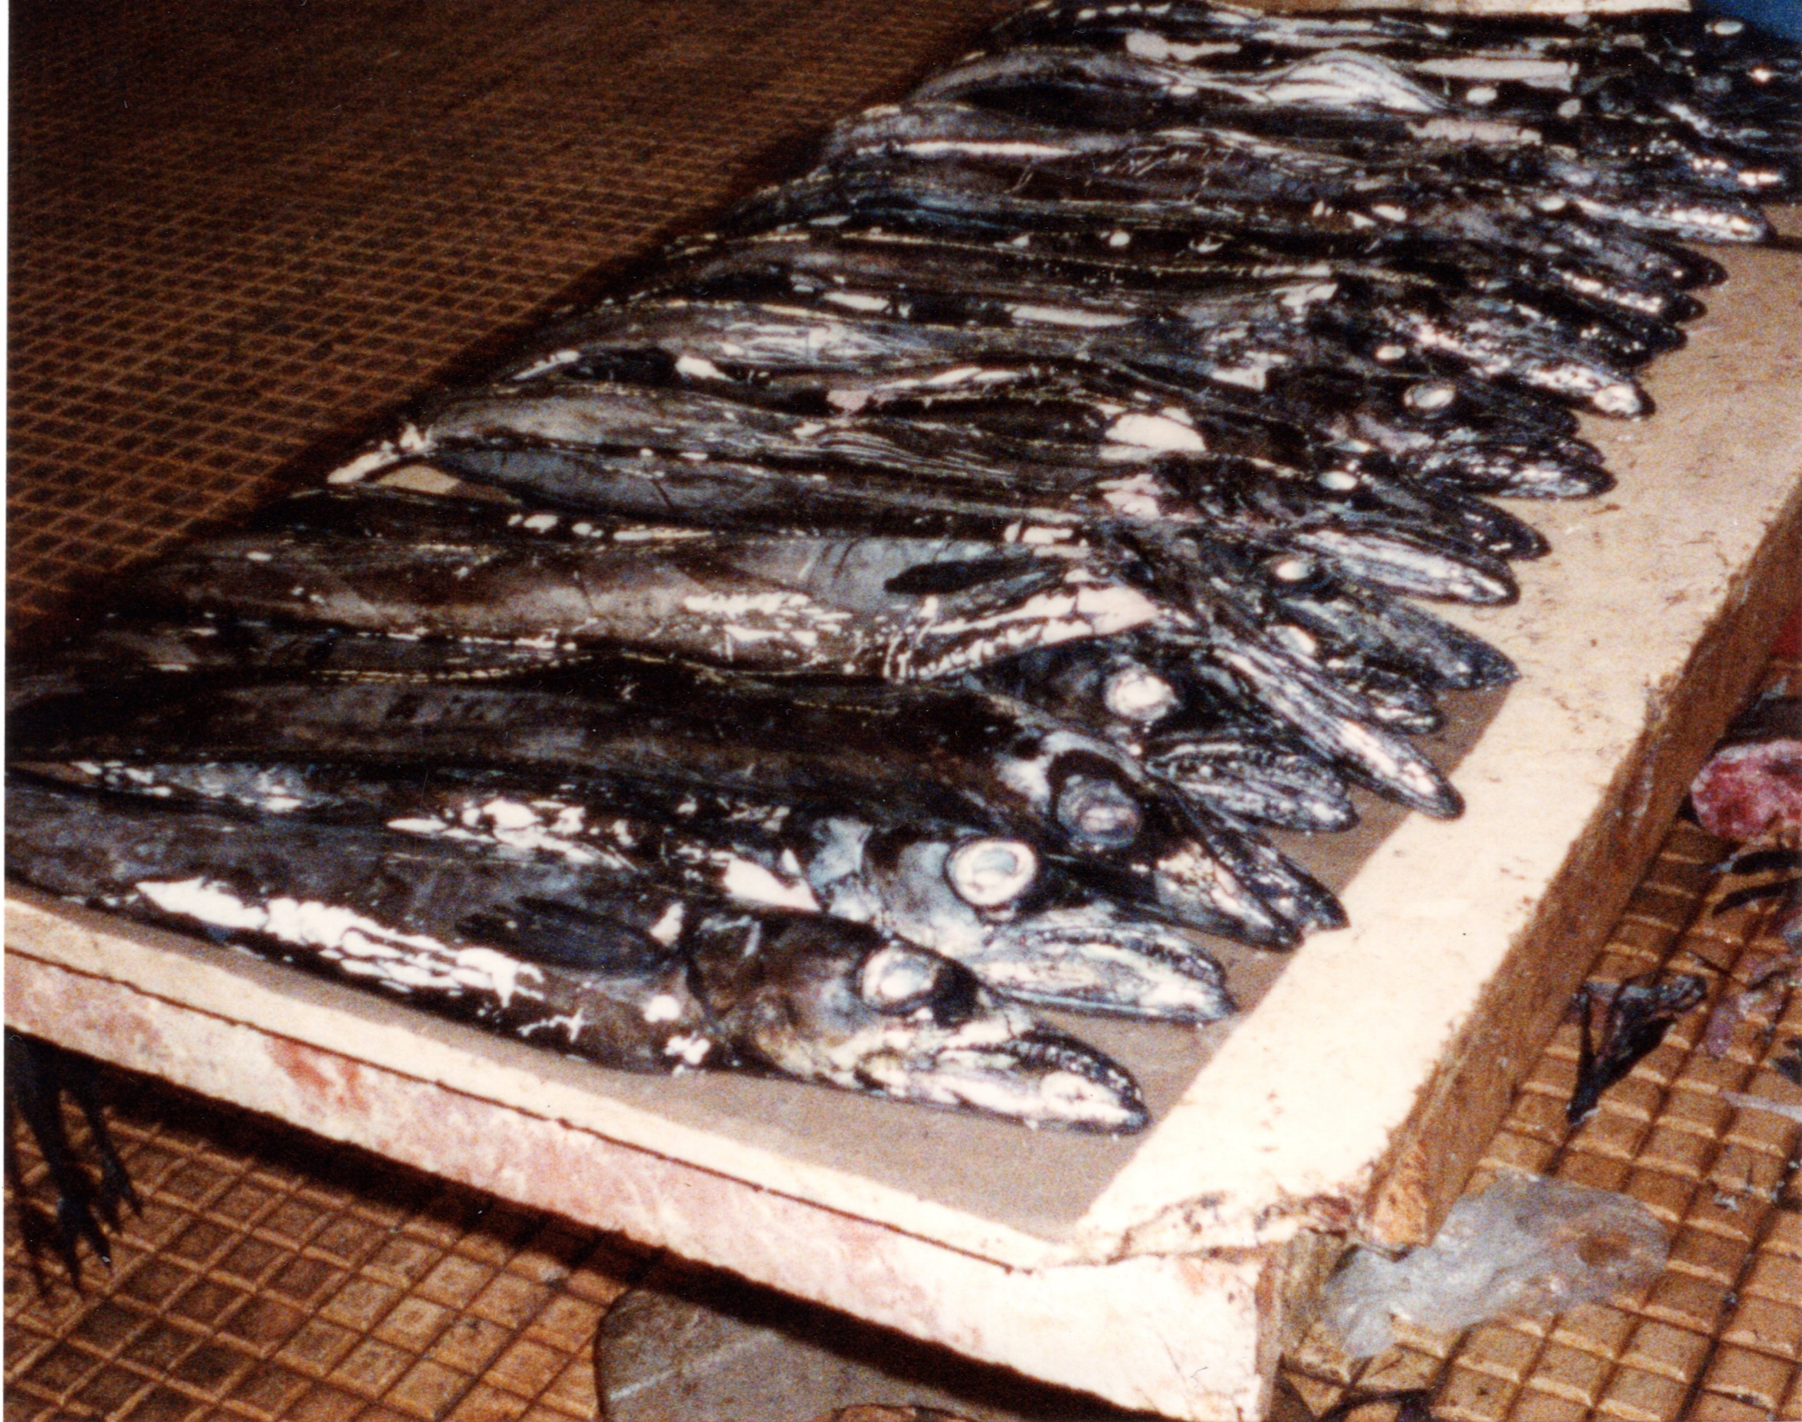
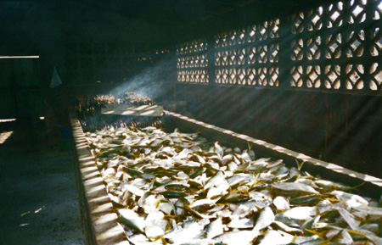
Fish processing plant
The Gambia 1996
Espada
(Black Scabbardfish)
Funchal Fish Market, Madeira
1989

Slide 7
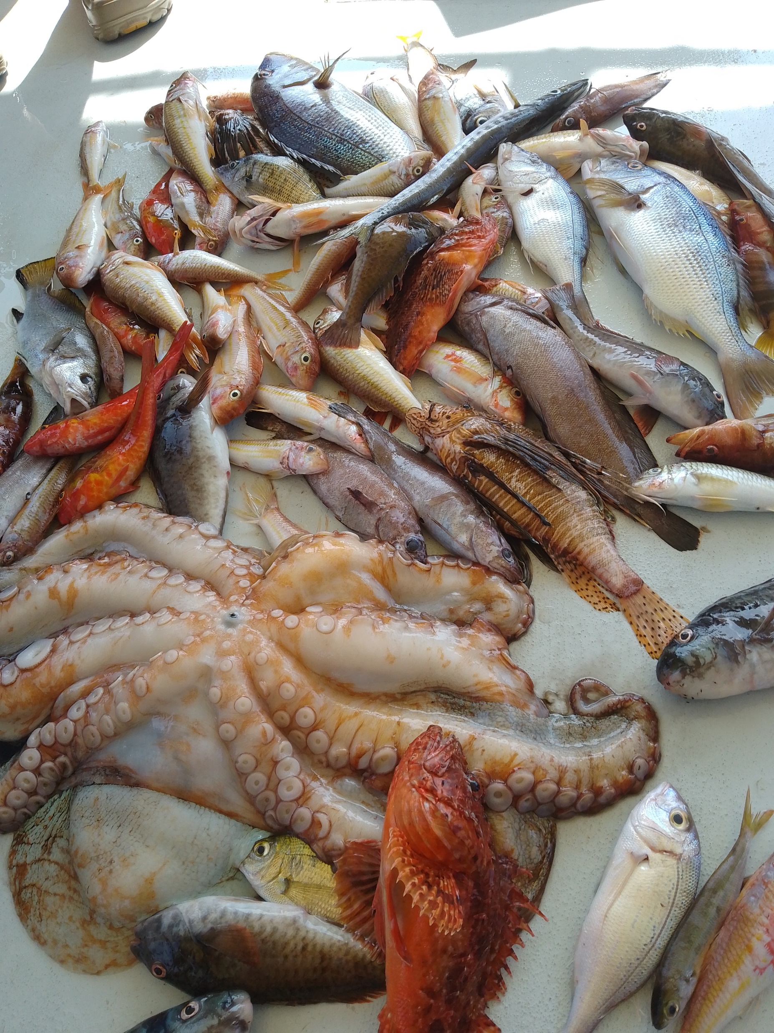
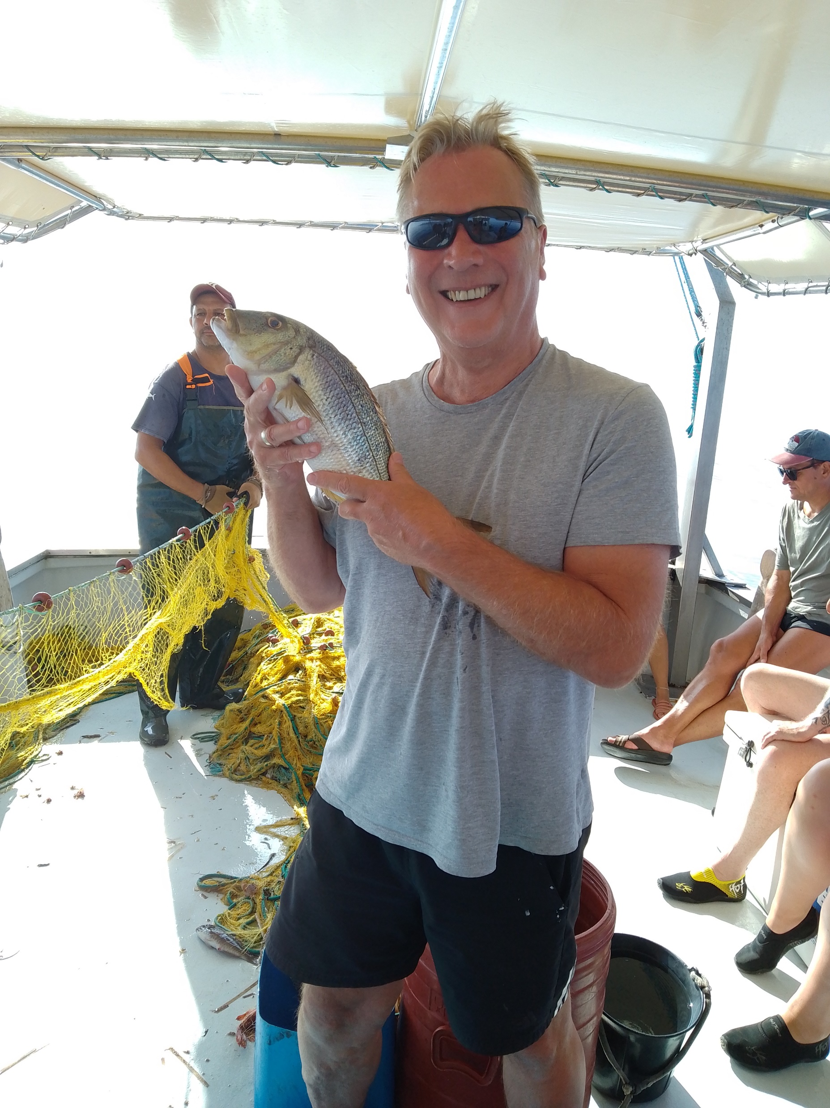
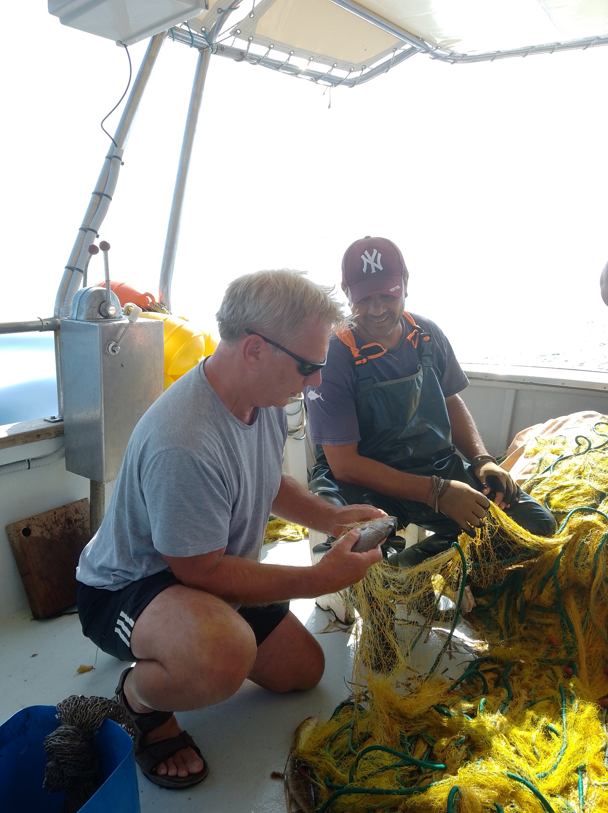
Kefalonia 2023

Slide 8
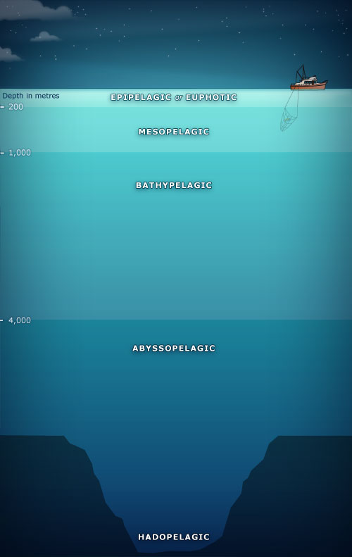
Photic layer
Pelagic
Pelagic species live in open water above the seabed, often near the water surface. Examples include Tuna and Herring. Caught by pelagic trawling, drift nets, purse seining or pelagic long lines
Midwater
Bass. Caught by
Midwater pair
trawl
Aphotic
Layer
Demersal
Demersal species live on, or just above, the sea bed. Examples include Cod, Plaice and Haddock. Caught by demersal trawl, or demersal longline.
Benthic
Layer
Shellfish traps catch crustaceans
Such as lobsters, crabs and crayfish

Slide 9
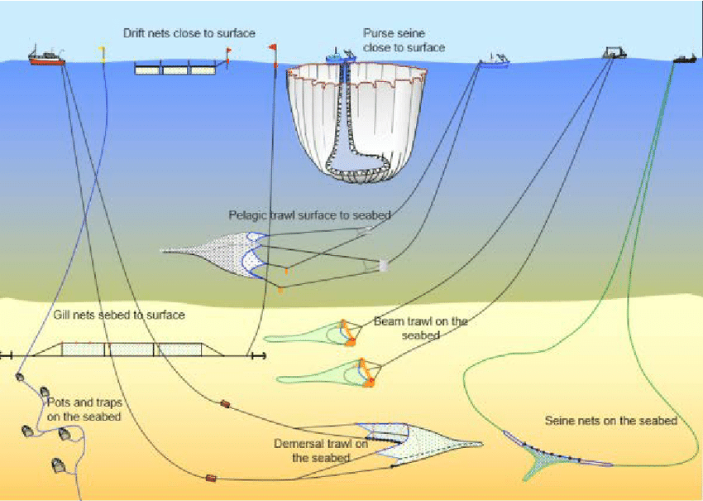

Slide 10
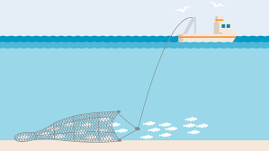
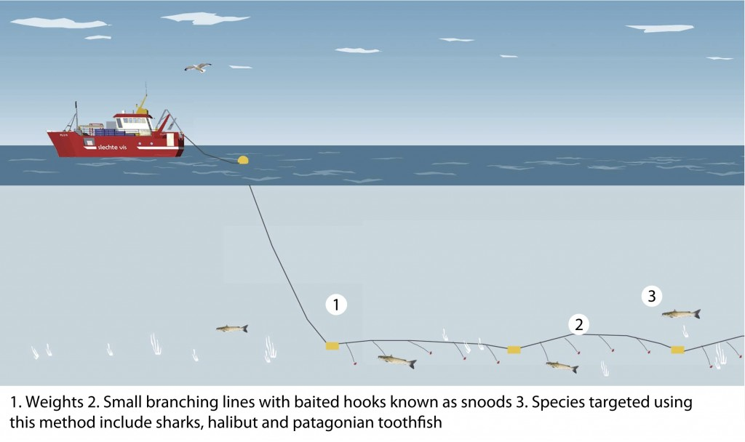
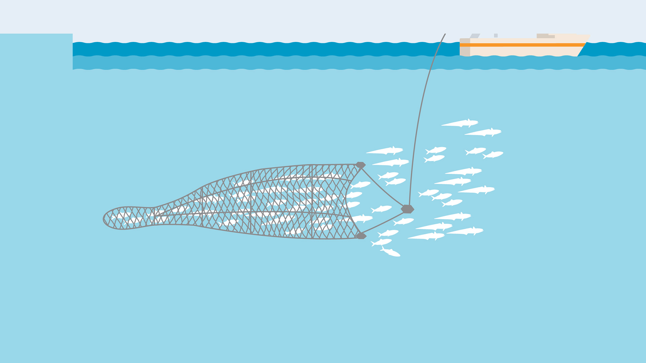
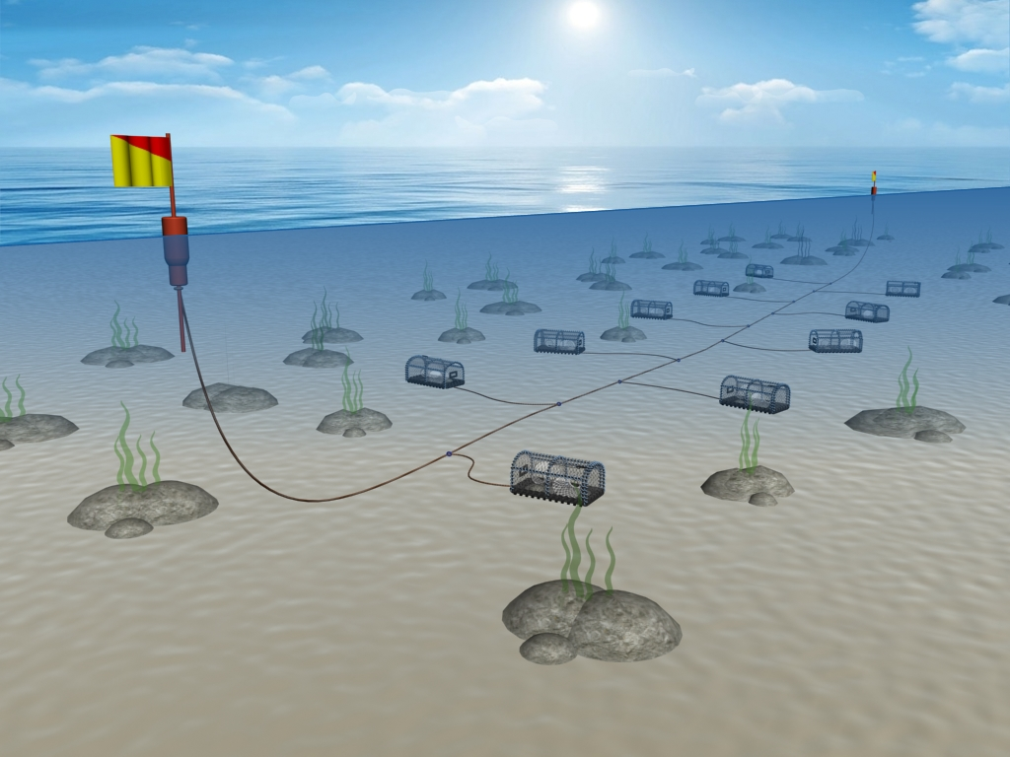
Demersal Trawling
Demersal long line
Pelagic Trawling
Baited shellfish traps

Slide 11
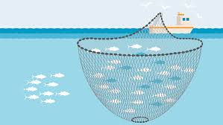
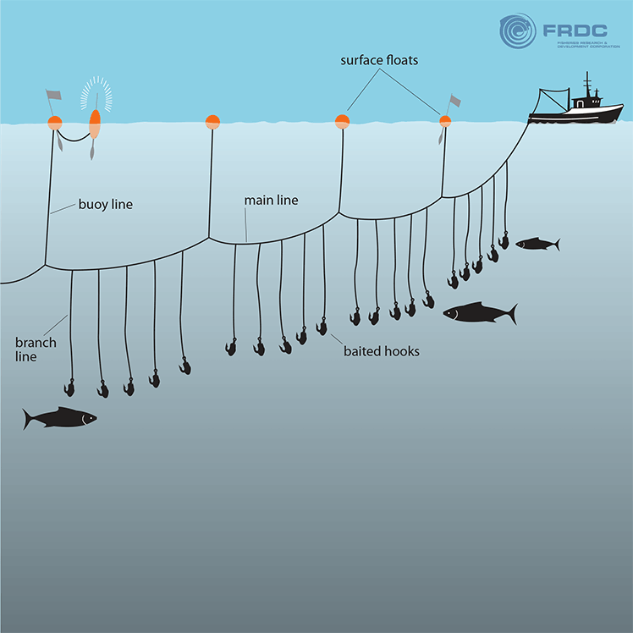
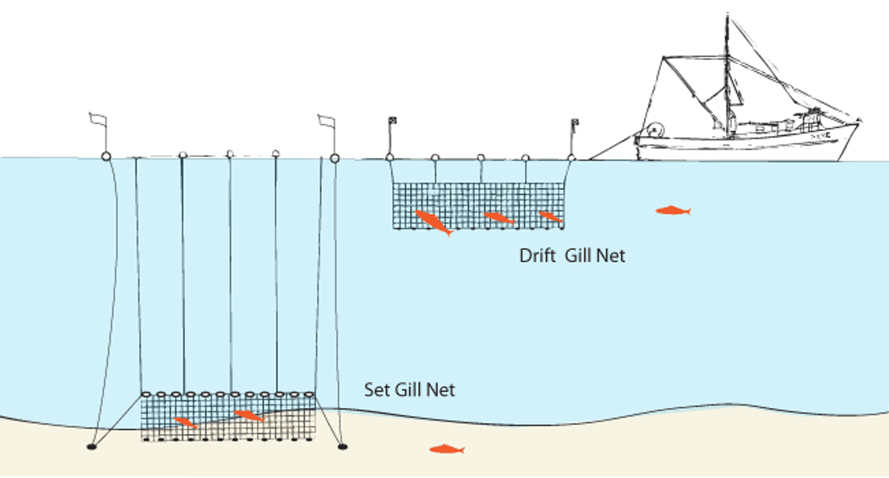
Purse seine
Pelagic long lines
Drift nets

Slide 12
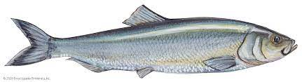
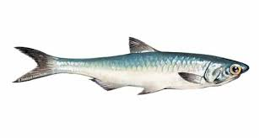
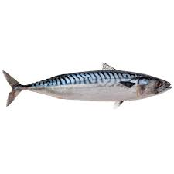
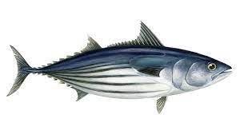
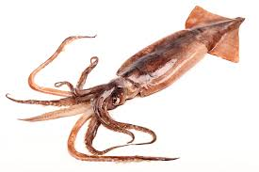
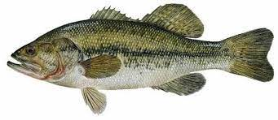
Pelagic
Herring, Tuna, Anchovy, Squid, Mackerel
(single shoals)
Pelagic Drift net – catch dolphins, whales, turtles, sharks
Attaching reflective disks can alert whales and dolphins
Pelagic long-line – Catches Albatrosses
Fish at night, weigh down line beyond Albatross’ reach
Mid-water
Bass
Mid-water pair trawl – can kill porpoises

Slide 13
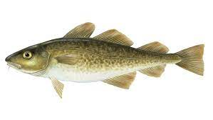
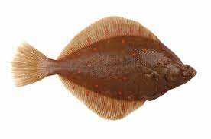
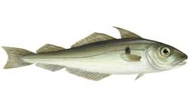
Why are these 3 particularly
important to British people?
Demersal
Cod, Plaice, Haddock (mixed shoals, increased by-catch)
Demersal trawl
Demersal long-line – can catch sharks and turtles
Bottom
Bottom trawl – Kills all organisms, destroys seabed habitat
By-catch = The capture of non-target
species during fishing

Slide 14
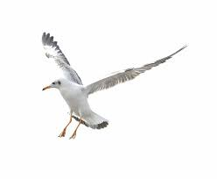
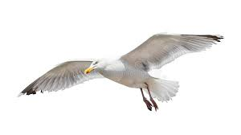
By-Catch, explained by a footballer…
“When the seagulls follow the trawler
it’s because they think sardines
will be thrown into the sea”
Eric Cantona

Slide 15

By-Catch, illustrated…

Slide 16
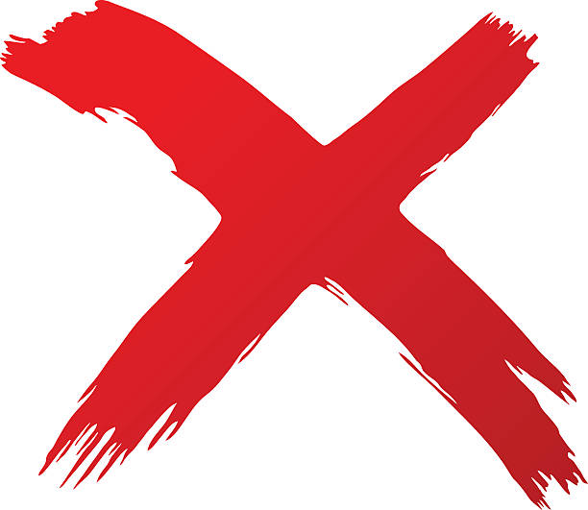
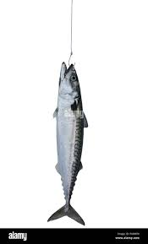
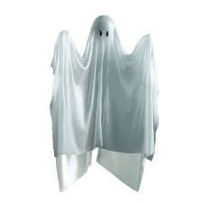
Ghost Fishing

Slide 17
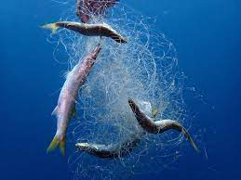
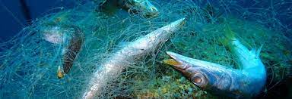
Ghost Fishing
Discarded or lost fishing gear (nets etc) can continue to trap and kill marine organisms for a long time. The organisms that die in the gear then act as bait, attracting more individuals who then also become entangled and die.

Slide 18
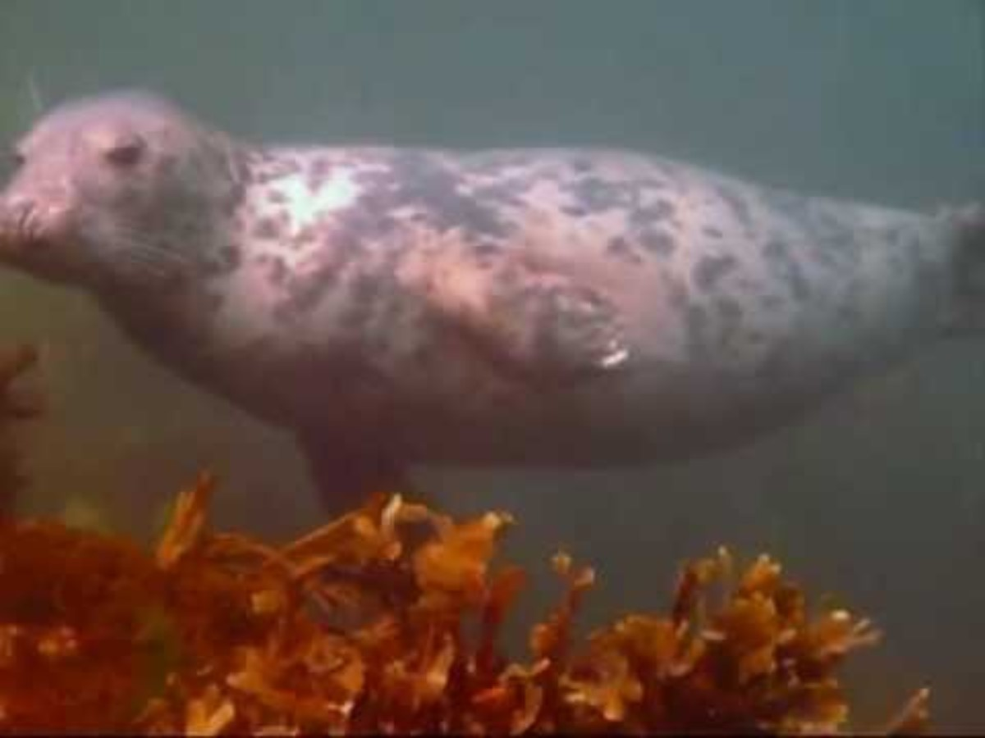
A Grey Seal I met in 2012……

Slide 19
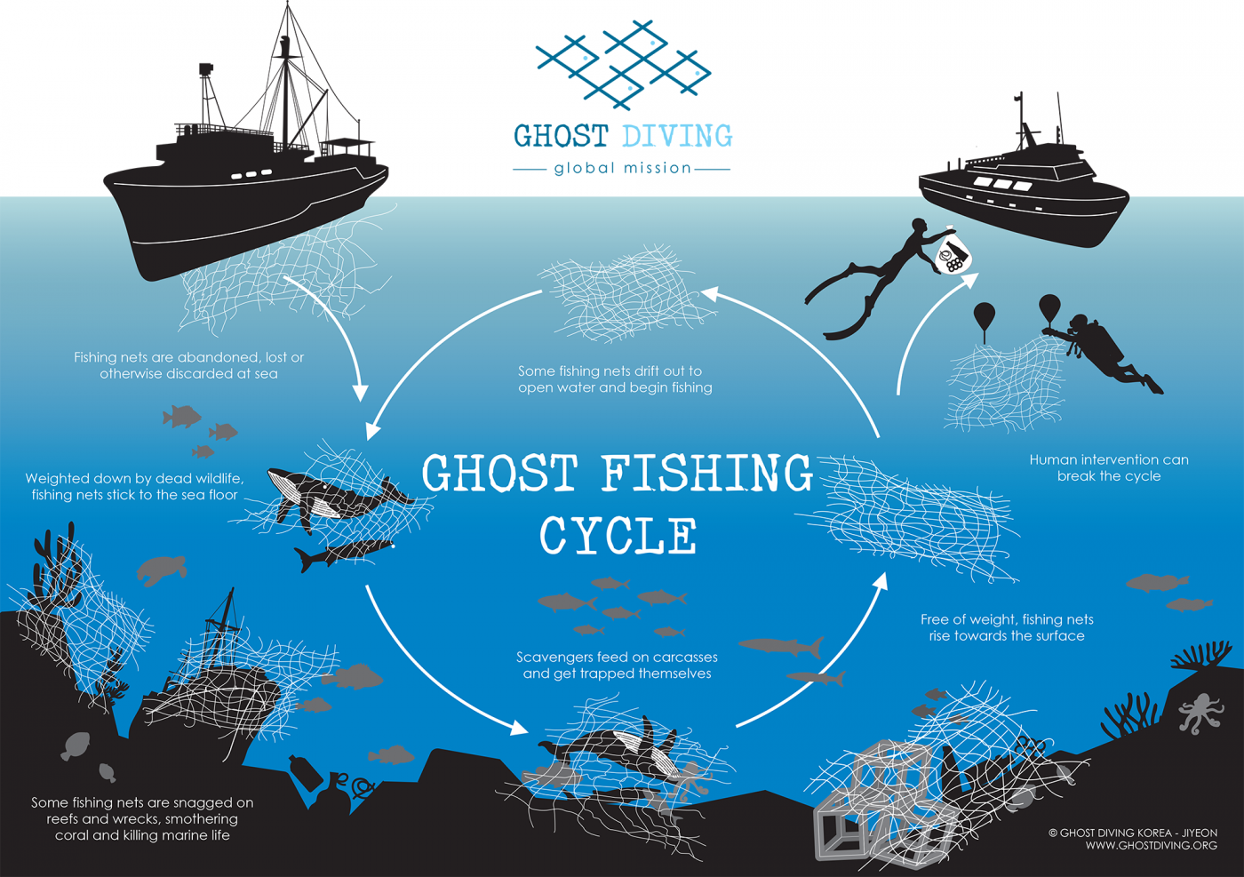
Seal pups trapped in fishing nets cut free by beachgoers - BBC News

Slide 20
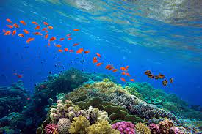
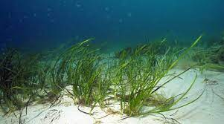
Damage to habitats
Seabed damage
Trawl nets often have chains or metal balls to disturb the seabed. This destroys habitats severely affecting slow-growing organisms such as sea fans and deep water coral
Coral Reef damage
Coral can be damaged by touch, so discarded nets, traps and ropes can all cause physical damage
Dynamite Fishing
Illegal in most countries, but still carries on. Particularly used on coral reefs, which are destroyed along with many organisms
Seagrass beds
Vastly important as a carbon store and oxygen provider, as well as acting as nurseries for young fish. Grow in shallow sandy areas which are disturbed by trawling

Slide 21
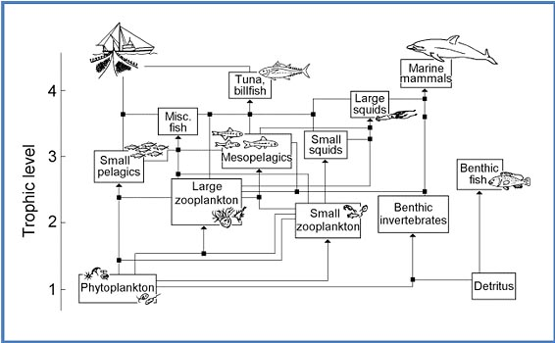
Food Web Impacts
Reducing the number of any species logically has a knock-on effect on other species in the same food web.
Competitors may become more common
Their prey may become more common
Their predators may become rarer

Slide 22
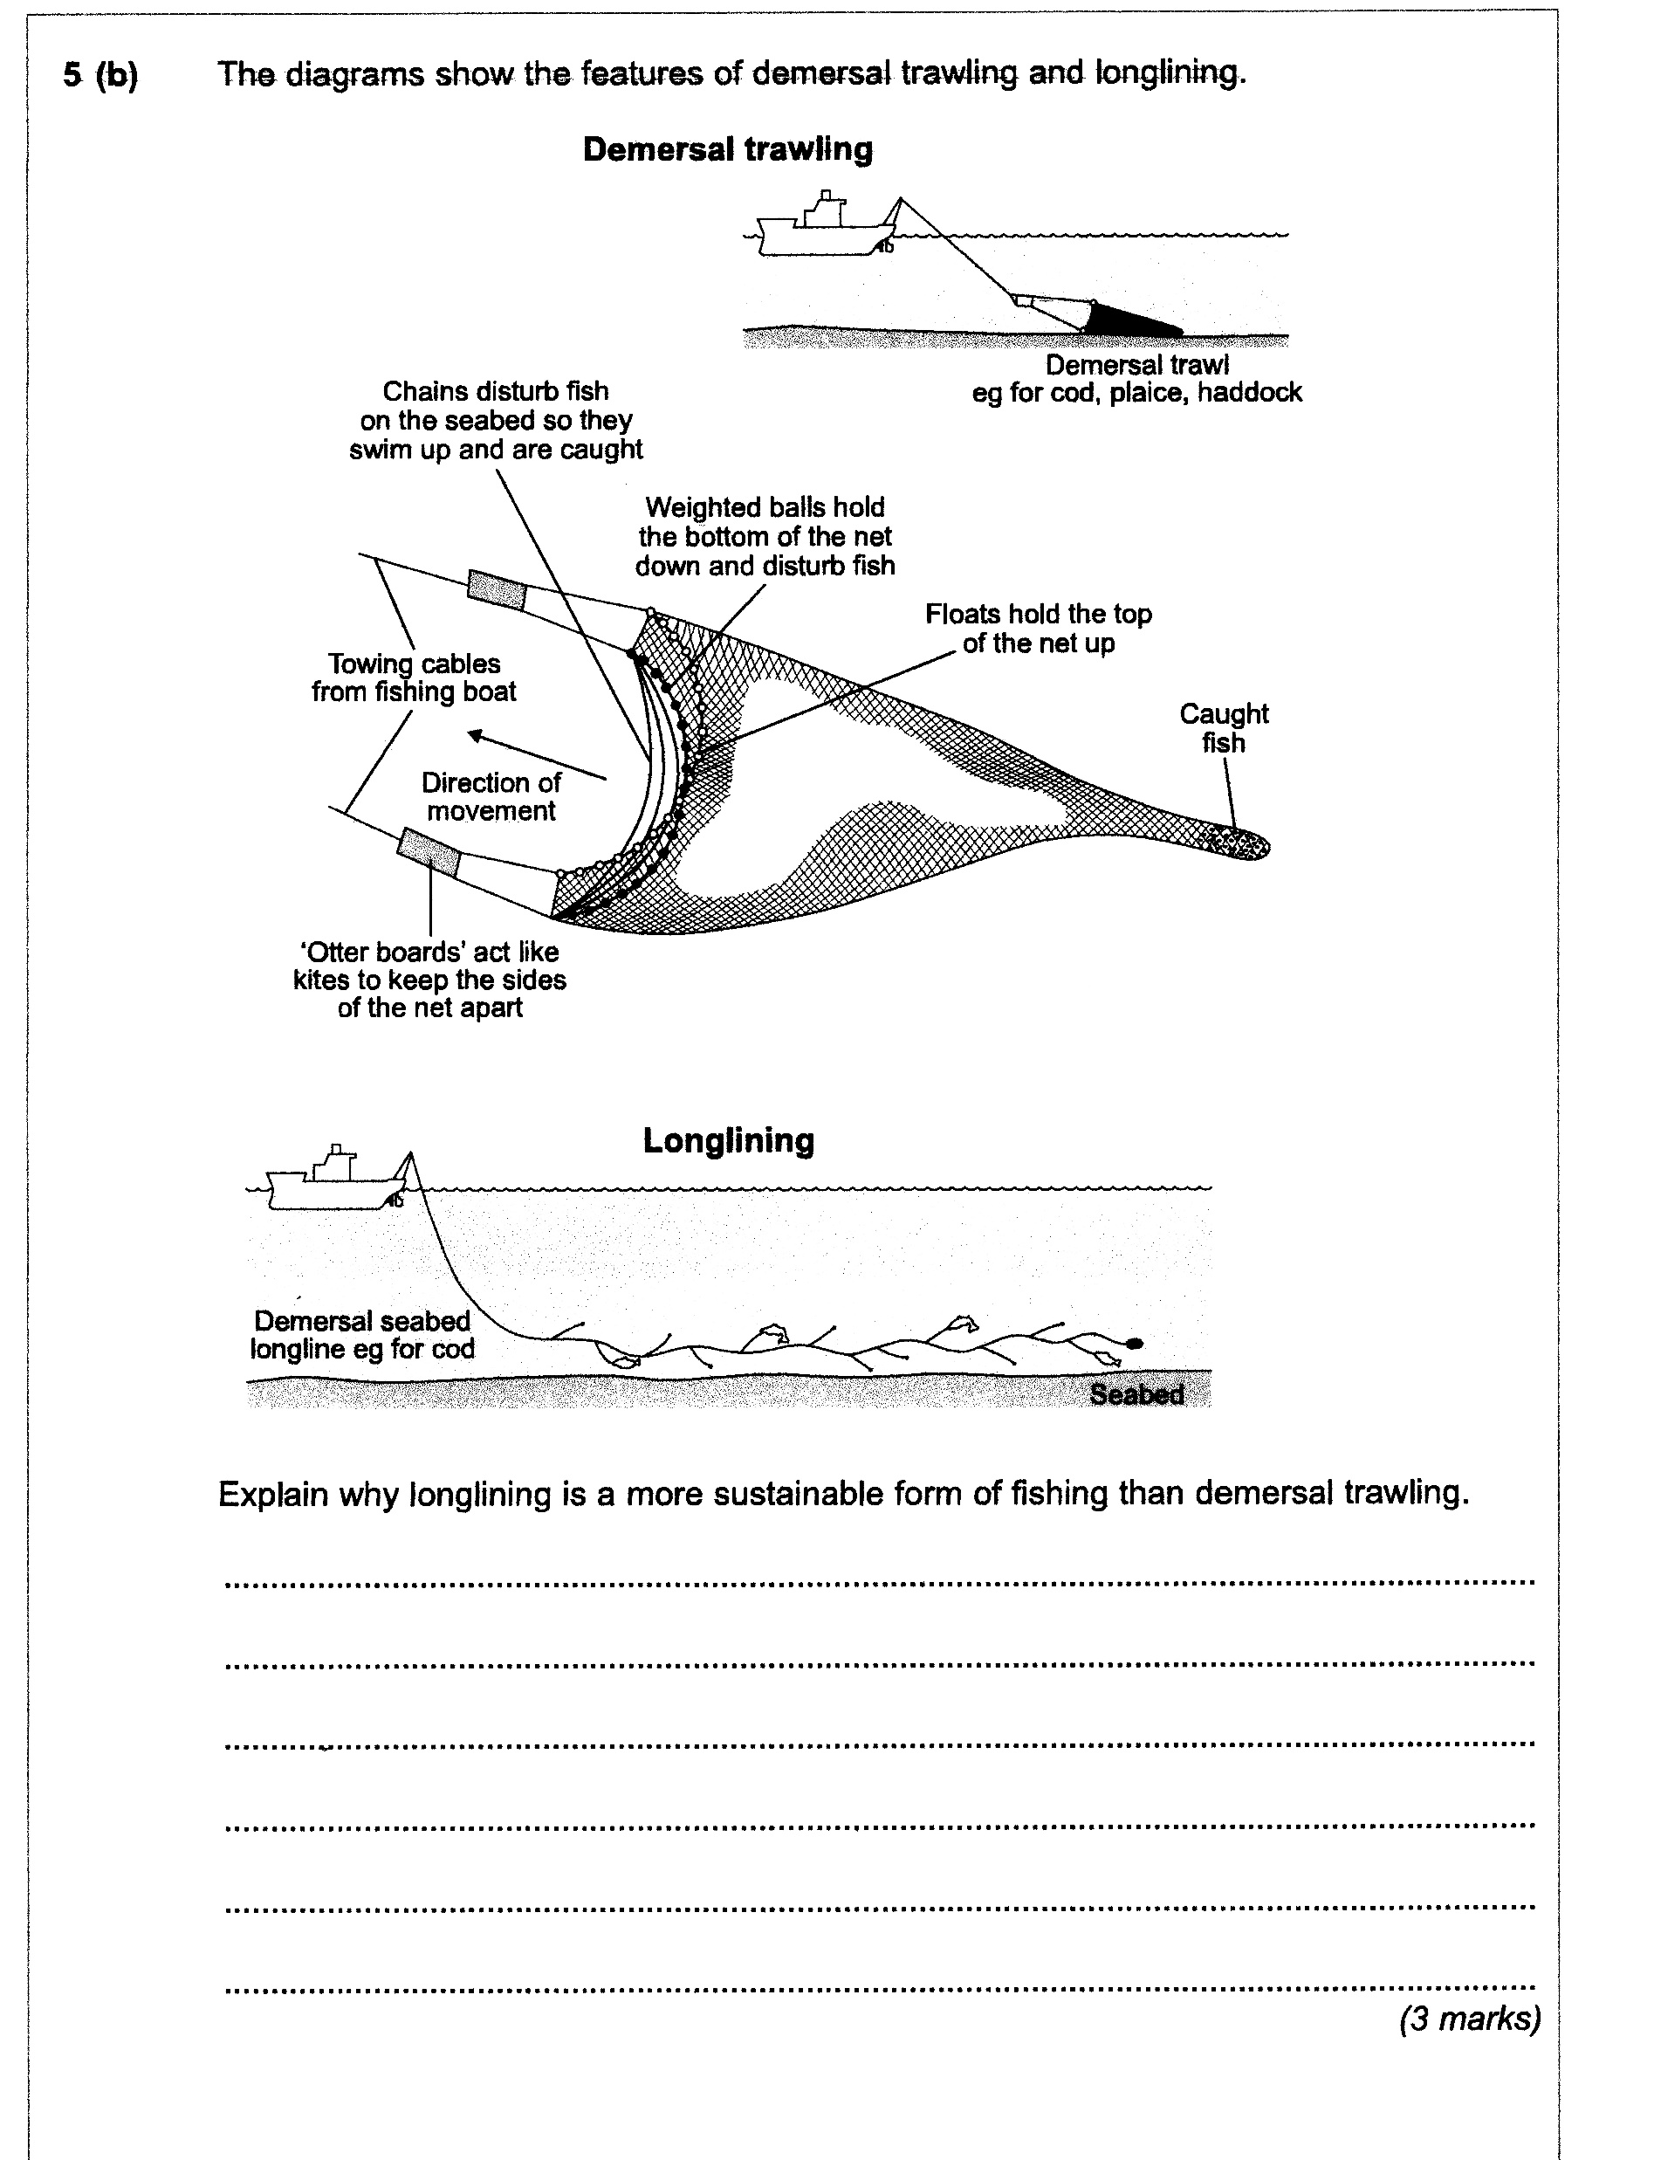
5(b) Sea bed/benthos not damaged
less by-catch/more species specific
less food web effects
less ghost fishing
MAX 3

Slide 23




How fishing has become more efficient
Larger, more powerful boats with engines, rather than small sailing vessels
Sonar and echo-sounding equipment – ‘underwater radar’ (but using sound rather than radio waves) which allows fishing boats to locate shoals of fish much more easily
Nylon nets and lines which are lighter and stronger (and can therefore be much larger) than earlier ones which were made from natural fibres
Use of factory ships which allow fish to be processed at sea, allowing fishing boats to spend much longer periods of time on the fishing grounds.

Slide 24


Overfishing
In 2006, Boris Worm of Dalhousie University in Halifax, Canada, published a study in the journal Science.
The study claimed that If current trends of overfishing and pollution continue, by 2050 the populations of just about all seafood species face collapse.
“This research shows we’ll have few viable fisheries by 2050,” Andrew Sugden, international managing editor of Science, told reporters at a telephone news briefing.
The report made headline news around the world

Slide 25

Overfishing
Key Term:
Maximum Sustainable Yield (MSY)
The maximum harvest which will not reduce the ability of the population to replace losses
Scientists can estimate the MSY using the Russell formula;
S2 = S1 + (A+G) – (C+M)
S1 = biomass of stock at beginning of year
S2 = biomass of stock at the end of the year
A = biomass of young fish added to stock
G = biomass added by growth of all fish in the stock
C = biomass caught by fishing
M = biomass lost through natural mortality
This is known as Recruitment

Slide 26


Overfishing
Cod catch – Newfoundland, Canada Cod Population – North Sea
“Counting fish is just like counting trees — except that they are invisible, and they keep moving around”
John Shepherd, Professor at the University of Southampton National Oceanography Centre, UK

Slide 27
Newfoundland The North Sea
In 1988 fisheries scientists recommended that the total catch allowed should be cut by half, but nothing was done and so by 1990 the scientists were warning that the Newfoundland cod fishery was in danger of being wiped out by overfishing.
In 1990 the total biomass of spawning cod off Newfoundland was estimated at 400,000 tonnes. By 1994 this had fallen to 1,700 tonnes.
Too late, in 1992, the Canadian government banned fishing for cod off most of the Newfoundland coast.
Over 40,000 people lost their jobs as a result of the Newfoundland cod collapse and although the economy of the area has begun to grow again there are very few signs that the cod population is recovering. Some ecologists believe that once overfishing removes the cod other species move in and prevent the cod from returning.
In the 1970s it was calculated that North Sea cod stocks were at 270,000 tonnes, by 2006 this was reduced to just 44,000 tons. This meant that cod numbers were below the safe biological level recommended by scientists and urgent action was needed in order to allow the species to recover.
The European Union and Norway implemented the Cod Recovery Plan from the mid-2000s onwards. This saw a number of measures introduced such as the closure of fishing areas which contained high concentrations of juvenile cod (NTZs), rewards for decommissioning older and larger fishing vessels and a clampdown on the illegal capture, landing and selling of cod.
In 2017 North Sea cod stocks were at the highest level they had been at since the early 1980s, being assessed as being at 152,000 tons.
Reflecting on the cod moratorium, 30 years later - YouTube

Slide 28


Slide 29

Capture of non-target species
(during fishing)
Ghost Fishing
The addition of new/young
fish to the (adult) population
Upwelling (zone)
A limit on the mass/number/
amount of fish which can be
landed; [A caught]

Slide 30


According to Stephen Jay Gould
- one of the world’s leading biologists –
there is no such thing as fish

Slide 31


