Slide 1
STARTER TASK…
Without looking through your notes, match the following keywords with their definition…
A model to explain children’s cognitive development, which considers that children develop their own ideas based on experiences and interactions
Constructivist Approach
B) What a child is currently able to do
2) Social Constructivist Approach
C) A model that explains children’s cognitive development by suggesting that their logic and reasoning is developed through experiences, but also by interactions with, and questions from, adults and older children.
3) Zone of Proximal Development
4) Zone of Actual Development
D) What a child is able to do with an adults support
Notes:
1 & A
2 & C
3 & D
4 & B

Slide 2
Cognition, language and communication and development

Slide 3
Learning Objectives
To be able to identify some more key theorists in children’s learning, play and development
To understand what each theorists believes

Slide 4
How theories of learning explain thought, language and communication
There are many different theories that consider the way that children learn, think and develop language and communication.
Many of these theories were developed before the advent of neuroscience but are still considered to be influential.
LO/S: To be able to identify some more key theorists in children’s learning, play and development
To understand what each theorists believes

Slide 5
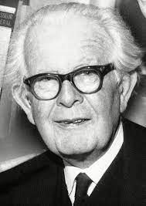
Jean Piaget (1896-1980)
A zoologist who became interested in children’s cognitive development as a result of working on intelligence tests.
He noticed that children consistently gave similar ‘wrong’ answers to some questions and began to consider why this was.
Piaget used his own children to make detailed observations and gradually developed a theory that has been influential in education in many countries. It has also acted as a starting point for other theories and research.
Although Piaget’s theory is based on children’s cognitive development, he also used it to explain the way that children play and their moral development
LO/S: To be able to identify some more key theorists
in children’s learning, play and development
To understand what each theorists believes

Slide 6
Jean Piaget
What was Vygotskys theory?
What is a contructivist approach?
As with Vygotsky, his theory of learning is sometimes referred to as a constructivists approach, as he suggested that children construct or build up their thoughts according to their experiences of the world around them.
Piaget used the term schema to mean a child’s conclusions or thoughts.
Piaget felt that the development of thoughts was an ongoing process, with children needing to adapt their original ideas if a new pieces of information seemed to contradict their conclusions – to describe this, he coined the term ‘adaptation’.
For example, a toddler may come to believe that milk is served in blue beakers, because their experience of having milk is linked with it being in a blue beaker. If one day the toddler is given juice in a blue beaker instead of milk, they will need to consider their theory, so coming to the conclusion that milk and other drinks come in blue beakers. Piaget used specific vocabulary to describe the process of children learning in this way.
What area of development does this fall into?
Can you come up with your own example of this?
LO/S: To be able to identify some more key theorists
in children’s learning, play and development
To understand what each theorists believes

Slide 7
Piaget’s theory of learning
Assimilation
The child constructs theory or schema
Equilibrium
The child’s experiences to date seem to fit the schema (everything balances)
Disequilibrium
An experience occurs that casts doubt on effectiveness of the schema (thins don’t add up anymore!)
Accommodation
This child changes the original schema to fit the new experience of piece of information
LO/S: To be able to identify some more key theorists
in children’s learning, play and development
To understand what each theorists believes

Slide 8

Why children think differently from adults
Piaget’s belief that children develop schemas based on their direct experiences so this can help us to understand why young children’s thinking is sometimes so different from ours.
A child who has a father with a beard may come to the logical conclusion that all fathers must have beards.
Piaget also suggests that, as children develop, so does their thinking.
LO/S: To be able to identify some more key theorists
in children’s learning, play and development
To understand what each theorists believes

Slide 9

Piaget’s universal stages of cognitive development
Piaget grouped children’s cognitive development into four broad stages.
Sensorimotor stage (birth to 2 years)
Pre-operational stage (2-7 years)
Concrete Operations stage (7-11 years)
Formal Operations stage (11-15 years)
Fill in the additional information box of any more notes we will make on each section.
LO/S: To be able to identify some more key theorists
in children’s learning, play and development
To understand what each theorists believes

Slide 10
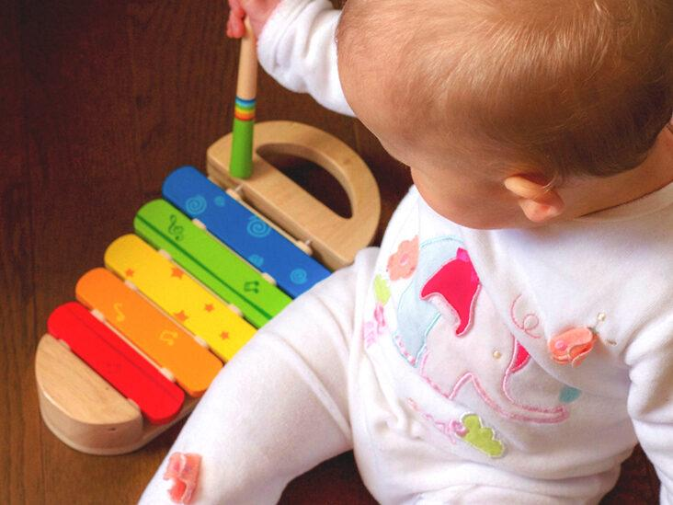
Sensorimotor stage
(birth to 2 years)
LO/S: To be able to identify some more key theorists
in children’s learning, play and development
To understand what each theorists believes
This is the first stage of children’s lives.
It begins at birth with babies using their reflexes to survive.
Babies are also very reliant on using their senses in the first 2 years, especially taste and touch.
Babies’ first schemas are physical ones, as they learn to repeat and then control their movements.

Slide 11
Development of Object Permanence
Object permanence involves understanding that items and people still exist even when you can't see or hear them.
One of the tests that Piaget used to show the development of thought in babies was object permanence.
In the first few months, a baby will appear to accept the disappearance of an object. Piaget suggested that this is because babies have not learned the idea that an object is still in existence somewhere, even if it is not visible.
At around 8 to 9 months, babies seem to understand this concept and we can test it by taking an object from a baby and hiding it under and cushion near them. The baby should lift up the cushion to find it.
LO/S: To be able to identify some more key theorists
in children’s learning, play and development
To understand what each theorists believes

Slide 12
Development of general symbolic function
Towards the end of the sensorimotor stage, the child begins to use symbols. Language is symbolic as we use words to represent objects.
The child also uses objects to stand for things in their play, such as a piece of dough to represent a cake.
Piaget felt that being able to use language is a breakthrough as schemas can be internal rather than physical.
Piaget believed that language developed from thought.
Others, such as Vygotsky, believed that thought developed from language
LO/S: To be able to identify some more key theorists
in children’s learning, play and development
To understand what each theorists believes

Slide 13
Pre-operational stage (2-7years)
During this stage, children develop their skills using symbols, i.e language.
Many early years professionals will find that children in this stage are using a lot of imaginative play, for example, using objects in a representational way: sticks may become guns or cardboard boxes may become cars.
Piaget did divide this stage into two further sub-stages ‘Preconceptual and Intuitive’.
But there are four main features that run through both of these sub-stages;
Egocentrism
Difficulty with conservation
Centration
Animism
LO/S: To be able to identify some more key theorists
in children’s learning, play and development
To understand what each theorists believes

Slide 14
Egocentrism
According to Piaget, children in the pre-operational stage tend to see things from their own perspective and thus their logic is different from that of adults.
Piaget called this Egocentrism and this is a strong feature of the whole of the intuitive stage.
Piaget designed several tests that showed the way in which children were seeing problems – one of the most famous being the Swiss mountain scene test.
In this test, children were shown a series of photos and asked which of the views the doll would be able to see.
Children under 7 consistently chose a photo that corresponded to the view they were seeing themselves. Piaget argued that this was because they could not ‘decentre’, i.e. take themselves out of their bodies and see something from another perspective.
Egocentrism explains why children may not always take an overview when solving problems and instead focus on the detail.
For example, they might be interested in finding their favourite parts in construction set rather than thinking about that might be needed to build a tower.

Slide 15
Task
Jason is 4 years old. At lunchtime, his friend pushes away the carrots on his plate explaining that he doesn’t like them. He says to his friend that he likes carrots. He goes on to say that ‘you must like carrots – everybody loves carrots’.
Explain how Jason has reached this conclusion.
How does Jason’s reaction link to Piaget’s cognitive theory?
At what age might Jason start to understand that not all children will like that same things as him?
LO/S: To be able to identify some more key theorists
in children’s learning, play and development
To understand what each theorists believes

Slide 16
Difficulty with conservation
In the pre-operational stage, children find it difficult to understand that things can remain the same, even though their appearance may change
Piaget suggested that the inability to ‘conserve’ was an important feature of the pre-operational stage.
He designed many tests to show whether children could conserve in different ways.
The table shows some tests that are commonly used with children. You might like to try these with children on your placement.
Difficulty with conservation explains why children may say things such as ‘you’ve become a girl’ when a boy puts on a dress in the role play area. This may seem logical to adults, but it is logical to a young child.
LO/S: To be able to identify some more key theorists
in children’s learning, play and development
To understand what each theorists believes

Slide 17
Centration
In this stage, children are beginning to classify objects and make associations. However they are often doing this by looking at only one attribute at a time, such as sorting objects according to size, but not size and colour.
Piaget called this centration.
This is why children are unable to conserve, i.e. in the mass conservation test described (table handout) they concentrate on the shape of the clay rather than its quantity.
LO/S: To be able to identify some more key theorists
in children’s learning, play and development
To understand what each theorists believes

Slide 18
Animism
Many children show signs of animism: believing that because they have feelings, other objects must also have feelings.
Many early years professionals see this when children say things such as ‘that dog’s mummy will be cross with her’ or ‘that wall is bad, it hurt me’.
LO/S: To be able to identify some more key theorists
in children’s learning, play and development
To understand what each theorists believes

Slide 19
Concrete operations stage 7-11 years
This stage marks a great leap in children’s logical abilities. They begin to use rules and strategies to help their thinking. Piaget called this the concrete operations stage because children’s understanding is aided by the use of practical tools, for example, using counters to find the answer 15 minus 9.
Children in the concrete operations stage are also able to conserve and decentre things from the point of view of others – for example, they understand that the view the doll sees in the Swiss mountain scene test will be different from their own view.
Piaget also suggested that these children would understand the concept of reversibility. An example of reversibility is when clay is rolled into a ball, then into a sausage back into a ball, it will still have the same mass.
LO/S: To be able to identify some more key theorists
in children’s learning, play and development
To understand what each theorists believes

Slide 20
Formal Operations stage (11-15 years)
The main difference between the formal operations stage and the concrete operational stage is that children are now able to manipulate thoughts and ideas to solve problems without needing practical props.
This means that in theory, tasks such as map reading can be done without having to turn the map around to work out whether a turning is to the right or left.
Piaget suggested that thinking at the formal operations level would not be an automatic step and that in some areas of learning we would not all achieve this level all of the time; and in some areas this would depend on the training and experiences that we were given.
In this case of the map reading, we might be able to manage to read a map without turning it around given enough experience and training.
LO/S: To be able to identify some more key theorists
in children’s learning, play and development
To understand what each theorists believes

Slide 21
Another feature of the formal operations stage is that children are able to hypothesise about situations in a realistic way, for example, what would you do if someone broke into your house? The ability to hypothesise means that children can speculate outcomes.
Piaget described this feature as thinking as hypothetico-deductive reasoning.
LO/S: To be able to identify some more key theorists
in children’s learning, play and development
To understand what each theorists believes

Slide 22
https://www.youtube.com/watch?v=IhcgYgx7aAA

Slide 23
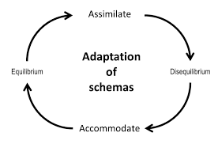
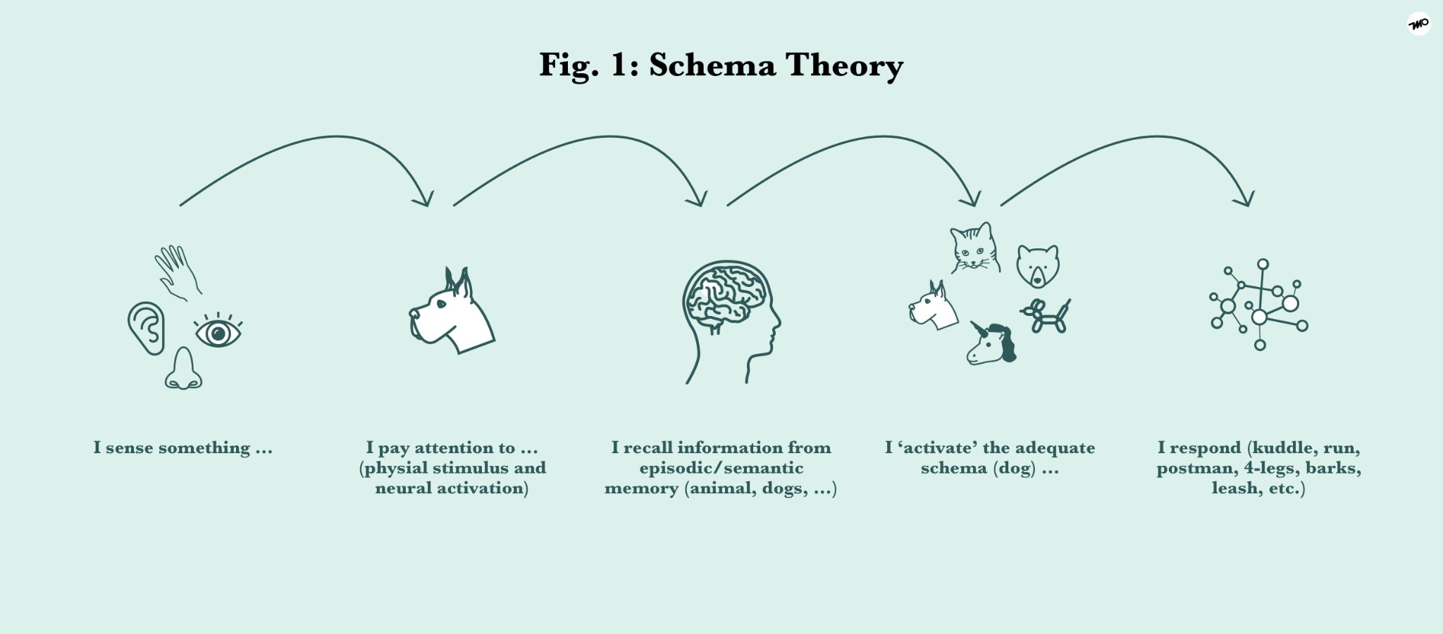
Summary of Piaget’s theory
Piaget’s work on the theory of cognitive development was so influential that is it perhaps useful to summarise some of its main features.
Children develop their thoughts according to their experiences
Children's learning passes through distinct stages, although attaining formal operations seems to depend on training and experiences
Children’s language is used to support their cognitive development
LO/S: To be able to identify some more key theorists
in children’s learning, play and development
To understand what each theorists believes

Slide 24
Criticism and further development of Piaget’s theory
Though Piaget developed a comprehensive theory about how children might learn, his work also acted as a springboard for other theorists, many of whom have found flaws in his theory.
Piaget’s research methods may have been biased
Does cognitive development really happen in stages?
Piaget and early years practice
Readiness
Make a mindmap with ‘Piagets Criticisms in the middle’
We will go through and make notes about this.
LO/S: To be able to identify some more key theorists
in children’s learning, play and development
To understand what each theorists believes

Slide 25
Piaget’s research methods may have been biased
Piaget used clinical interviews as major research method with children.
This method is open bias.
Piaget carried out hundreds of interviews and the type of data that was collected is qualitative.
Despite this, the data is very informative. Piaget also used experiments, but the tests he constructed have also been criticised.
LO/S: To be able to identify some more key theorists
in children’s learning, play and development
To understand what each theorists believes

Slide 26
Does cognitive development really happen in stages?
This is one of the criticisms of Piaget’s early work. However, from the 1970’s Piaget suggested that cognitive development was a spiraling process and considered that at times children will show features of more than one stage at once.
This he referred to as Decalage
Despite this, he maintained that children would not be able to skip whole elements of the stages and progress to another stage
LO/S: To be able to identify some more key theorists
in children’s learning, play and development
To understand what each theorists believes

Slide 27
Piaget and early years practice
Although Piaget had no particular recommendations about how this theory should be used to teach children, his work did have an effect on educational practice.
There are two main strands: readiness and learning by discovery.
Both of these strands were used to suggests that an individual approach to children’s learning should be taken.
LO/S: To be able to identify some more key theorists
in children’s learning, play and development
To understand what each theorists believes

Slide 28

Readiness
Children’s thought processes cannot be fast tracked, so we can only work at the children’s pace. For example, if a child does not have the concept of conservation of number, there is no point in teaching that child addition or multiplication
LO/S: To be able to identify some more key theorists
in children’s learning, play and development
To understand what each theorists believes

Slide 29

Learning by discovery
Children develop their thinking be reviewing their schemas and adapting their ideas (accommodation) to new information.
In order to do this, children will need a wide range of experiences.
LO/S: To be able to identify some more key theorists
in children’s learning, play and development
To understand what each theorists believes

Slide 30
Piaget underestimated children
One of the most widely accepted criticisms of Paget's work is that the ages he gave for children’s thinking are inaccurate.
He underestimated children’s level of thinking. One of the reasons given for his inaccuracies is the type of task that he used with children.
Margaret Donaldson, who worked with Piaget at one point, was a particular critic. With a colleague, she showed that results could be very different if the task was made sense to children and linked with their experiences.
Their use of a ‘naughty teddy’ to manipulate counters showed that children as young as 4-years-old could ‘conserve’
In a famous book called Children’s Minds, Donaldson outlines that children would be logical thinkers when they were able to make ‘human sense’ of the situation
LO/S: To be able to identify some more key theorists
in children’s learning, play and development
To understand what each theorists believes

Slide 31
Babies’ Abilities
More recent research studies are now showing that Piaget underestimated babies’ abilities, particularly in reference to object permanence.
Several researchers, including Elizabeth Spelke at Harvard University, have carried out tests showing that babies express surprise if a number of items are shown, disappear and then a different (either decreased or increased) number of objects reappear.
LO/S: To be able to identify some more key theorists
in children’s learning, play and development
To understand what each theorists believes

Slide 32
Piaget underestimated how training and practice can help children
Piaget suggested that the cognitive development of children was heavily linked to maturation and, therefore, children could not be fast tracked through the stages.
There has, however, been some research suggesting that children achieve tasks if they are given experiences to help them
LO/S: To be able to identify some more key theorists
in children’s learning, play and development
To understand what each theorists believes

Slide 33
Task
Think about your work placement setting
Is there an assumption that children need to work at their own pace?
Are children grouped according to their stages of development or according or to their ages?
What type of activities are chosen that encourage learning through discovery? For example, children using containers and water to find out about the properties of water.
LO/S: To be able to identify some more key theorists
in children’s learning, play and development
To understand what each theorists believes

