Slide 1
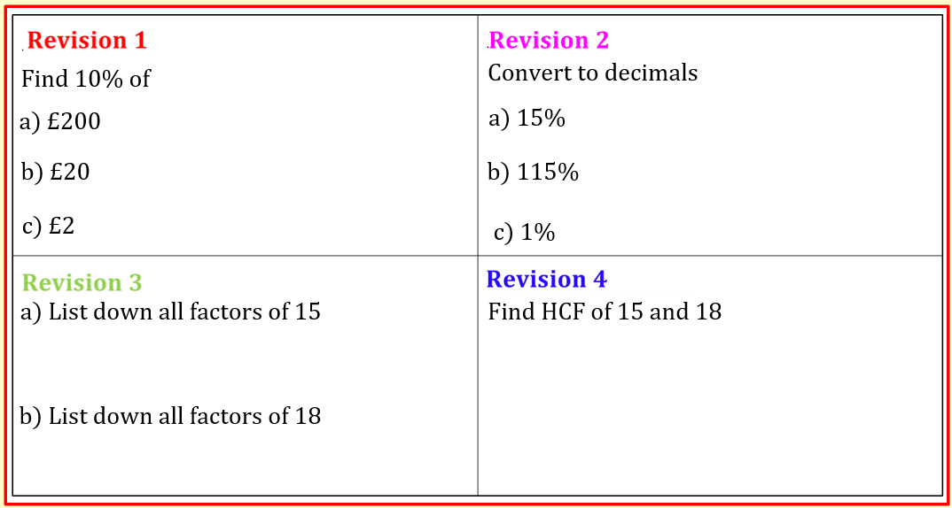

$$Percentages increase/decrease$$
11/03/2024
$$LO:To be able to use multipliers to find the result of a percentage increase or decrease$$
$$Nothing New Just Review$$
Keywords
Increase
Decrease
Percentage
Multiplier
Reduce
Depreciate
Save

Slide 2
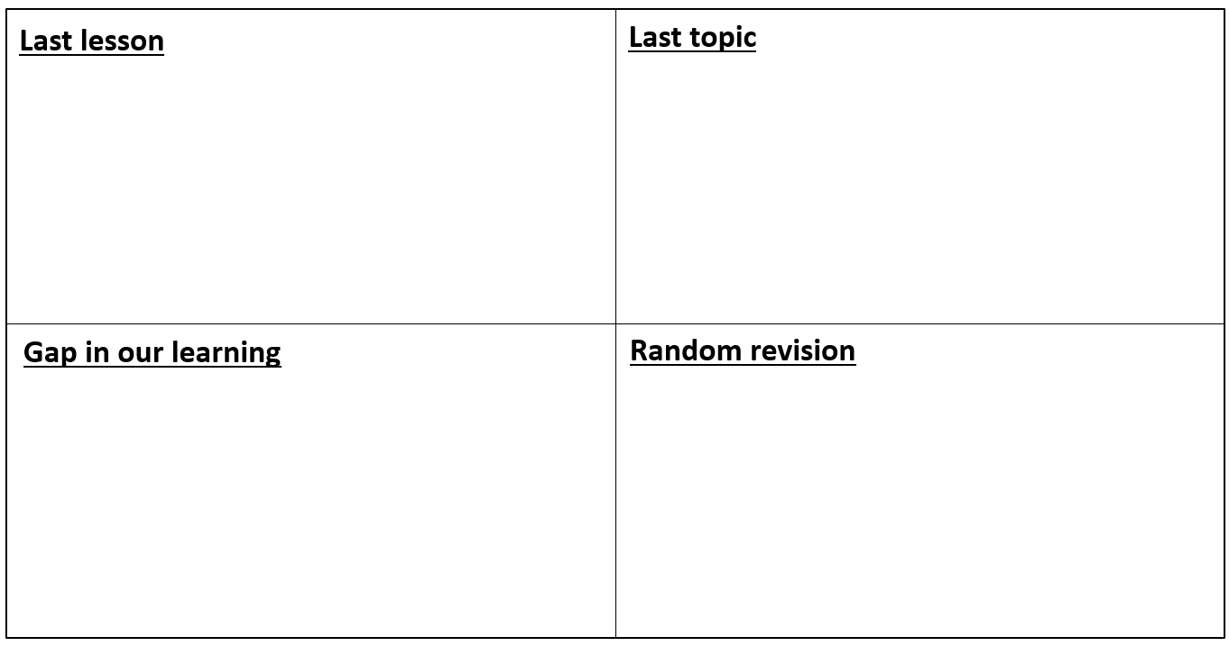



























$$Find 10\% of$$
$$Convert to decimals$$
$$\frac{15}{100}=0.15$$
$$a) £200$$
$$£20$$
$$a) 15\%$$
$$£2$$
$$\frac{115}{100}=1.15$$
$$b) £20$$
$$b) 115\%$$
$$c) £2$$
$$£0.2$$
$$\frac{1}{100}=0.01$$
$$c) 1\%$$
$$a) List down all factors of 15$$
$$Find HCF of 15 and 18$$
$$1×15=15$$
$$3×5 =15$$
$$Factors of 15 : 1, 3, 5, 15$$
$$Factors of 15 : 1, 3, 5, 15$$
$$Factors of 18 : 1, 2, 3, 6, 9, 18$$
$$b) List down all factors of 18$$
$$1×18=18$$
$$Highest Common Factor \left(HCF\right) of 15 and 18 is 3$$
$$2×9=18$$
$$Factors of 18: 1, 2, 3, 6, 9, 18$$
$$3×6=18$$

Slide 3

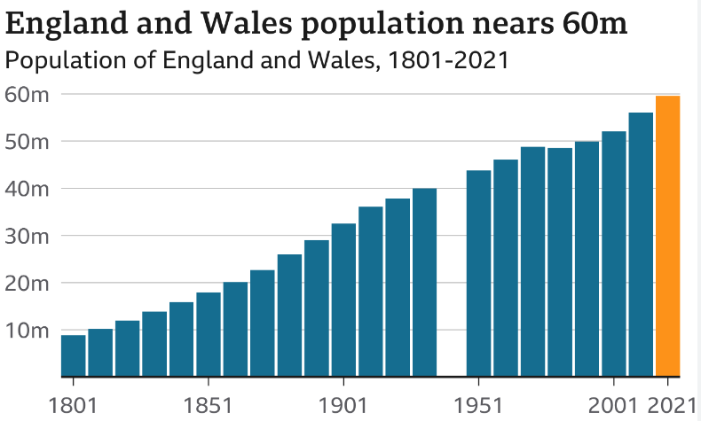
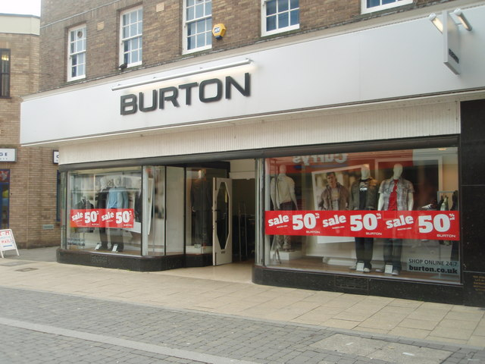
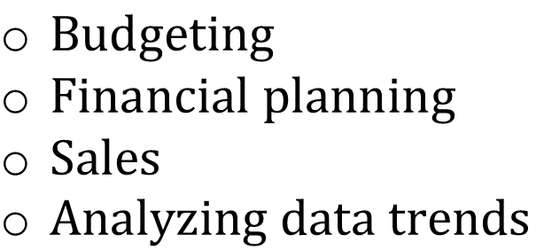
$$Think Pair Share$$
$$Why do we learn percentage increase/decrease$$
$Budgeting$
$Financial planning$
$Sales$
$Analyzing data trends$

Slide 4
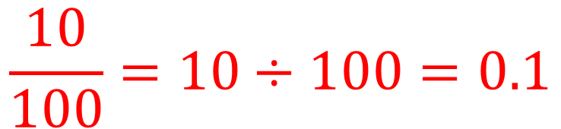
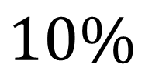
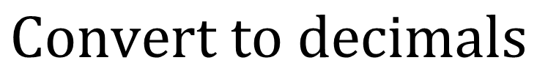
$$MWB$$
$$Convert to decimals$$
$$10\%$$
$$\frac{10}{100}=10÷100=0.1$$

Slide 5
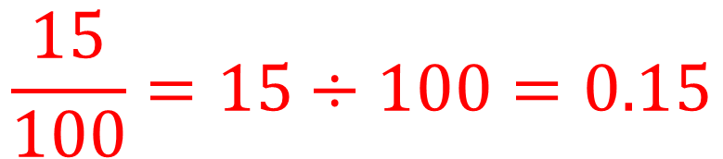
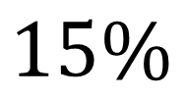
$$MWB$$
$$Convert to decimals$$
$$15\%$$
$$\frac{15}{100}=15÷100=0.15$$

Slide 6
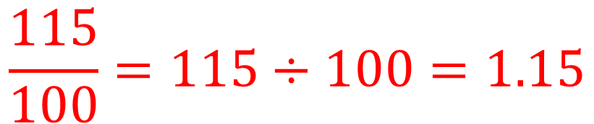
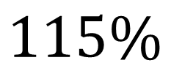
$$MWB$$
$$Convert to decimals$$
$$115\%$$
$$\frac{115}{100}=115÷100=1.15$$

Slide 7
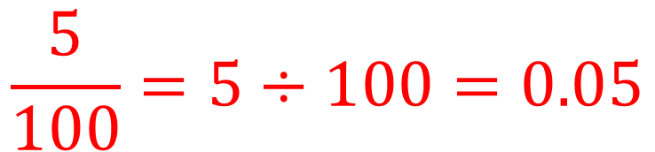
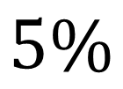
$$MWB$$
$$Convert to decimals$$
$$5\%$$
$$\frac{5}{100}=5÷100=0.05$$

Slide 8
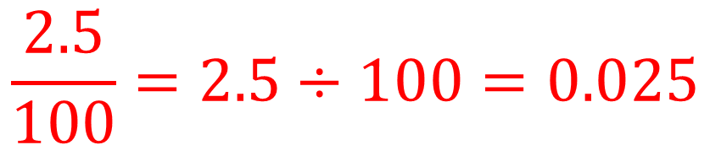
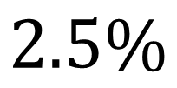
$$MWB$$
$$Convert to decimals$$
$$2.5\%$$
$$\frac{2.5}{100}=2.5÷100=0.025$$

Slide 9











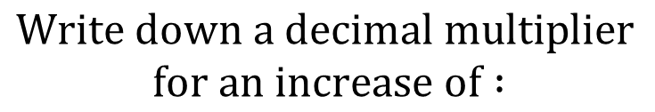


Percentage Increase (Multiplier)
$$Worked example$$
$$Your turn$$
$$Write down a decimal multiplier$$
$$for an increase of :$$
$$Write down a decimal multiplier$$
$$for an increase of :$$
$$1) 30\%$$
$$1) 10\%$$
$$100\%+10\%=110\%=1.1$$
$$2) 25\%$$
$$2) 20\%$$
$$100\%+20\%=120\%=1.2$$
$$3) 17\%$$
$$3) 15\%$$
$$100\%+15\%=115\%=1.15$$
$$4) 5\%$$
$$100\%+5\%=105\%=1.05$$
$$4) 6\%$$

Slide 10



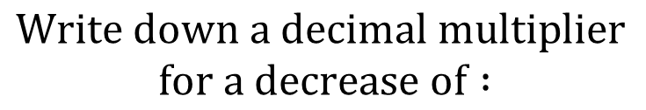

Percentage decrease (Multiplier)
$$Worked example$$
$$Your turn$$
$$Write down a decimal multiplier$$
$$for a decrease of :$$
$$Write down a decimal multiplier$$
$$for a decrease of :$$
$$1) 30\%$$
$$1) 10\%$$
$$100\%−10\%=90\%=0.9$$
$$2) 25\%$$
$$2) 20\%$$
$$100\%−20\%=80\%=0.8$$
$$3) 17\%$$
$$3) 15\%$$
$$100\%−15\%=85\%=0.85$$
$$4) 6\%$$
$$4) 5\%$$
$$100\%−5\%=95\%=0.95$$

Slide 11




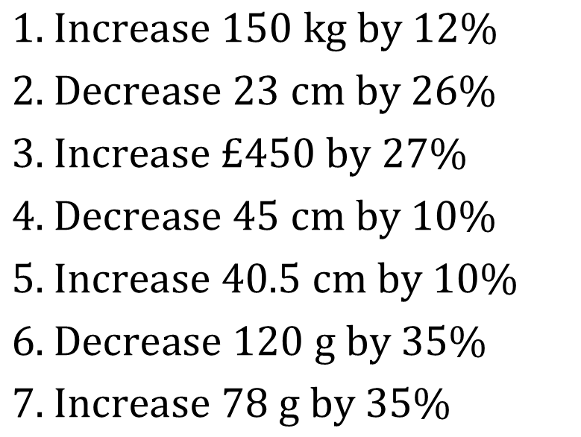





Percentage increase/decrease (Multiplier)
$$Worked example$$
$$Your turn$$
$Increase 150 kg by 12\%$
$Decrease 23 cm by 26\%$
$Increase £450 by 27\%$
$Decrease 45 cm by 10\%$
$Increase 40.5 cm by 10\%$
$Decrease 120 g by 35\%$
$Increase 78 g by 35\%$
$$168 kg$$
$$1) Increase £350 by 17\%$$
$$17.02 cm$$
$$£571.50$$
$$40.50 cm$$
$$2) Decrease £350 by 17\%$$
$$44.55 cm$$
$$78 g$$
$$105.3 g$$

Slide 12
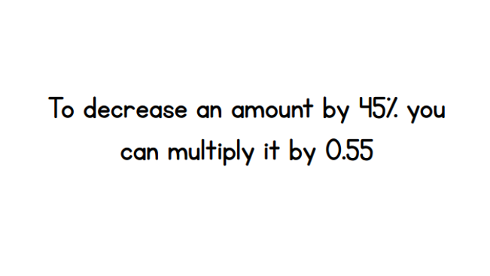
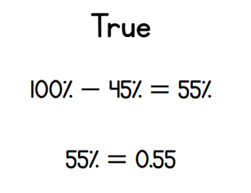

$$Think Pair Share$$
$$True or False$$

Slide 13





$$Checking your understanding$$
$$Increase £500 by 7.5\%$$
A
B
C
D
$$£875$$
$$£501.075$$
$$£537.50$$
$$£3750$$
A
B
C
D

Slide 14





$$Checking your understanding$$
$$Decrease £500 by 7.5\%$$
A
B
C
D
$$£462.50$$
$$£37.50$$
$$£492.50$$
$$£125$$
A
B
C
D

Slide 15












Independent Practice
Work out each of the following :
600ml increased by 70% (b) 600kg increased by 8% ( c) 143g increased by 19%
(d) 405 increased by 7.5% (e) 1150 increased by 115% (f ) 9kg increased by 0.15%
Work out each of the following:
800ml decreased by 5% (b) £460 decreased by 15% (c) 143g decreased by 20%
(d) 308 decreased by 40% (e) 4250 decreased by 0.5% (f) 9kg decreased by 5.05%
$$1020ml$$
$$648kg$$
$$170.17g$$
$$435.375$$
$$2472.5$$
$$9.0135kg$$
$$760ml$$
$$£391$$
$$114.4g$$
$$184.8$$
$$4228.75$$
$$8.5095$$

Slide 16



Independent Practice - Problem solving
1) Over the past 10 years, the population of a town has decreased by 4%.
The population of a town 10 years ago was 350000
What is the population of the town now?
2) Aaliyah spends £80 a month on electricity.
By changing company, Aaliyah can save 21%
How much would Aaliyah pay each months?
3) John’s salary used to be £24,000 before he received a 9% pay rise.
Work out how much John is now paid?
$$336000$$
$$£63.20$$
$$£26,160$$

Slide 17
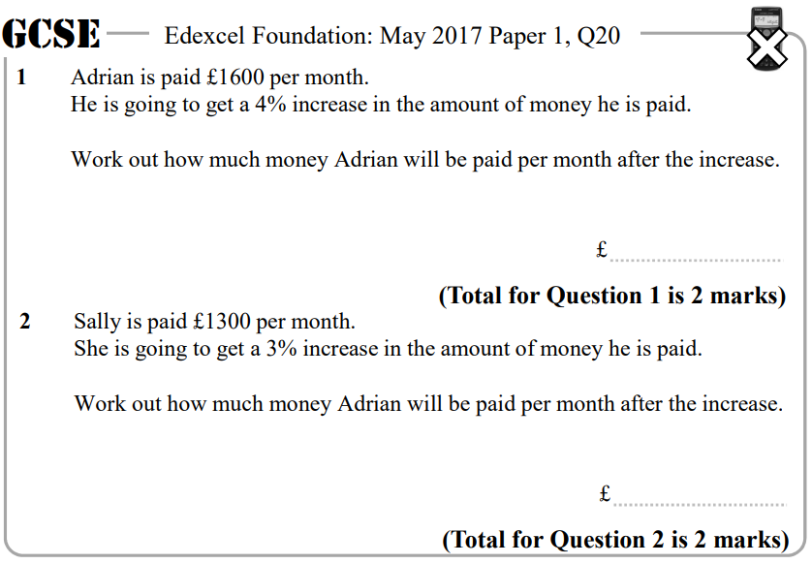
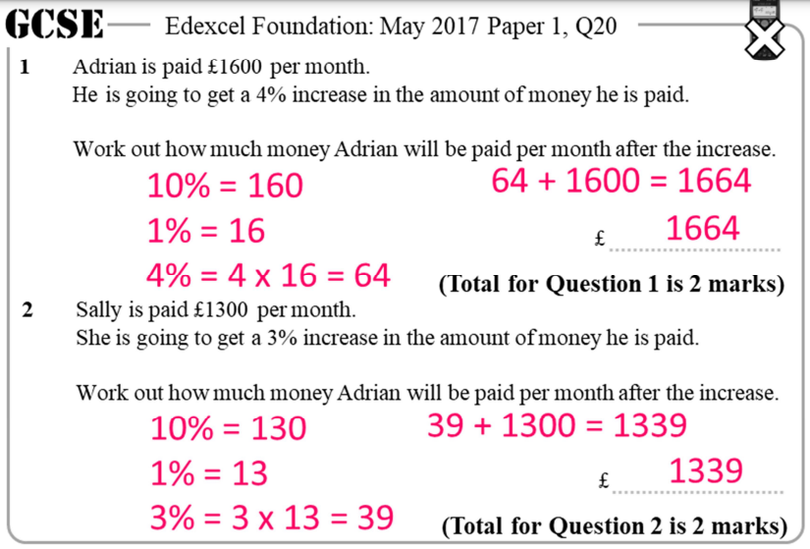

$$Exam questions$$

Slide 18
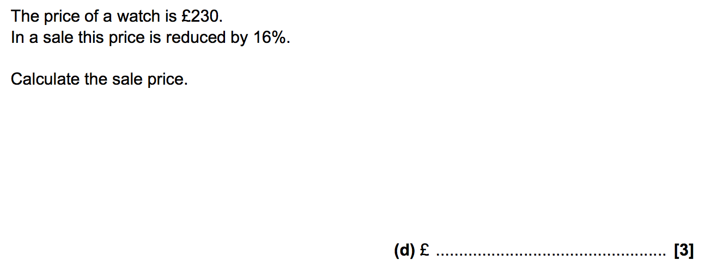
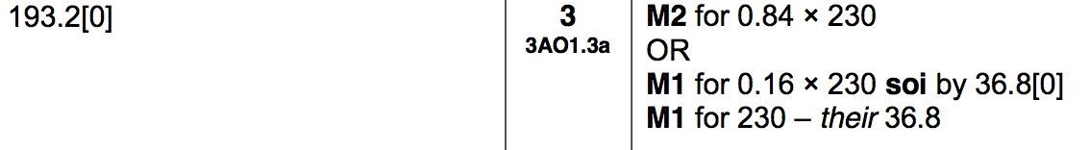

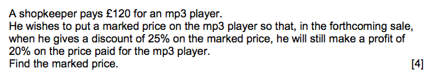
$$Exam questions$$

Slide 19


Extension
$$1) Increase £500 by 10\% then by 15\%$$
$$500×1.1×1.15=£632.50$$
$$2) Decrease £500 by 10\% then by 15\%$$
$$500×0.9×0.85=382.50$$
$$3) Which is bigger Increasing £500 by 10\% or Decreasing £600 by 5\%?$$
$$500×1.1=£550$$
$$600×0.95=£570$$

