Slide 1
PSHCE
Lesson title: CCE
Child Criminal Exploitation

Slide 2

Ground rules reminder

Slide 3
Lesson objective:
To recap Criminal Exploitation – to know the signs of being groomed and exploited criminally.
Common misconceptions in this lesson:

Slide 4
In previous lessons you have discussed Child Sexual Exploitation and Unsafe relationships
In today's lesson you will look at a different type of Exploitation.

Slide 5
Alfie’s story
The film you will watched is based on true events.
Alfie’s story shows how he was groomed and exploited by a Criminals.
RECAP:
What does groomed mean?
What does exploited mean?
Q) So what do you think Criminal Exploitation means?

Slide 6

Watch Part 1
https://www.youtube.com/watch?v=Sfr4f8FmwrM&t=42s
Q) What concerns do we have for Alfie so far?

Slide 7
Watch Part 2
https://www.youtube.com/watch?v=UFQtA0Xi7NQ
Q) What further concerns do we have for Alfie now?

Slide 8
Our class ideas
How would the criminals have won Alfie’s trust?
The gang might have given him expensive gifts, like phones or gaming systems. This would have made him feel special and happy.

Slide 9
Watch Part 3
https://www.youtube.com/watch?v=BmGUXX1O8ik
Q) What/whose help does Alfie need?

Slide 10
Watch Part 4
https://www.youtube.com/watch?v=t48vfjoDF7o
Q) What might have prevented all these things happening to Alife in the first place?

Slide 11
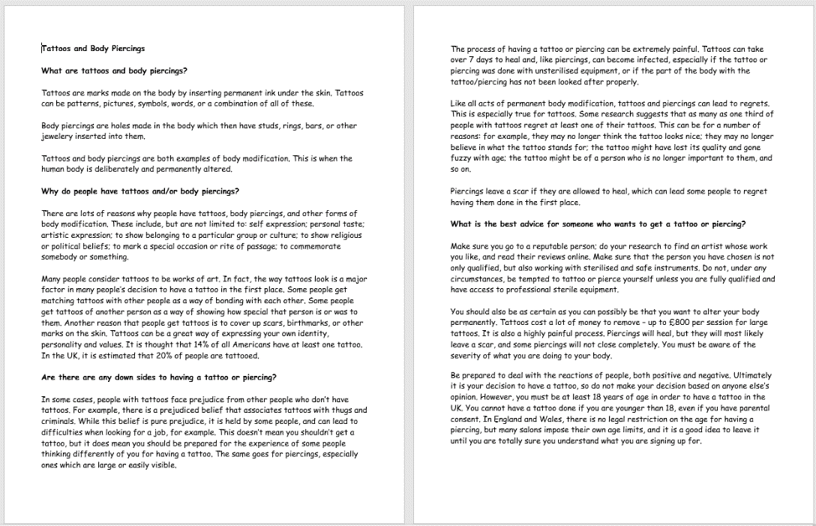
County lines is a specific type of Criminal Exploitation.
You might remember having an assembly about this with Mrs Nowell.
INFO SHEET: Read the sheet as a reminder of what is meant by County lines .
Task: Make a summary of what county lines is, how gangs recruit young people & what are the consequences of being involved?
Notes:
Teacher choice on how to go about reading this

Slide 12
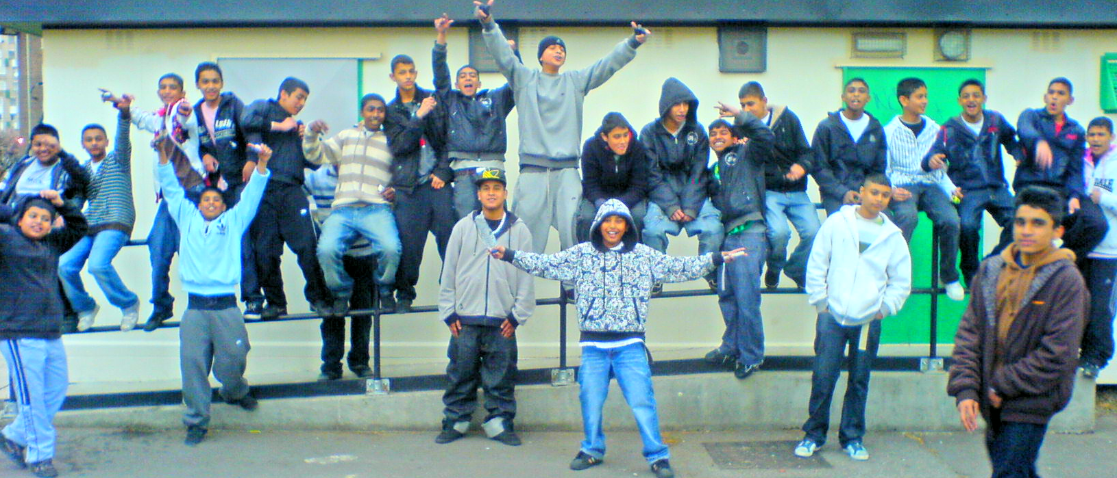
Why do criminal gangs exist anyway and why do teens join them?
https://www.youtube.com/watch?v=8n3uo-pZquU JUST LISTEN TO THE FIRST MAN SPEAKING FOR THE FIRST 1 MINUTE ONLY ( no more)
Reason | Why does this attract people? | What could be done to change this?
Class discussion –
Which do you think is the most significant reason for gangs, disenchantment or identity?
Be prepared to justify your reasoning to the class.

