Slide 1

Autism in boys and in general– ASD and its behaviour pattern in males
What is Autism or Autism spectrum disorder(ASD)?
The presentation of ASD in Males
Main/common behaviours and actions seen and portrayed in Males with Autism
How as an educator can I help students with ASD?
How can I as an educator help Male students with ASD and allow for equal support needs and opportunities compared to students with normal support needs.
How can I help students struggling with ASD?
By E.G 21/9/24

Slide 2
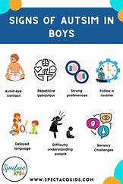
What is Autism or Autism Spectrum Disorder (ASD)?
Autism is a spectrum condition and developmental disorder it is characterized by
- difficulties in forming and maintain social relationships. - Impairment of the ability to communicate verbally and non-verbally
- Repetitive behaviour patterns and restricted interests and activities
It is a disability that is lifelong that has no treatment and no cure.

Slide 3
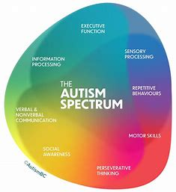
Sensory Processing
Repetitive behaviours
Motor Skills
Preservative thinking
Social Awareness
Verbal & Nonverbal communication
Information processing
Executive function

Slide 4
The presentation of ASD in males
Males with Autism tend to have more noticeable behavioural differences and patterns and are more likely to display abnormal behaviour for the social situation
Also autistic males are more likely to have difficult presentation they often struggle with:
- Sensory and cognitive differences
- Differences in non-speaking communication
- Difficulty understanding relationships
- Reliance on repeated patterns and daily routines
- More likely to stim and self soothe and not mask

Slide 5
How as an educator can I help students with ASD?
ASD is a developmental spectrum disorder that causes systematic struggles with behaviour, communication and preservative thinking.
This often means that school is a very overwhelming and harsh environment for Autistic people of all genders. Problems in information processing, communication with peers and teachers and staff.
As an educator always prioritise wellbeing with autistic students due to anxiety, overwhelm and sensory overload.
Speaking softly, kindly and with no forced contact like eye contact and touch initiated if the student doesn't want to – this is very common with ASD.

Slide 6
How can I as an educator help Male students with ASD and allow for equal support needs and opportunities compared to students with normal support needs.
Allow for a buddy system or have a male staff member to establish a confidential relationship with the student
If your school/educational premises have a SEND base allow regular visits for regulation and support
Be very clear in instructions so they are interpreted right – lots of autistic people struggle with metaphorical and non-literal language.
Autism means that students are different then neurotypical students; this means that their treatment and behaviour will be different and your behaviour to these students should be different to.
Never demand or request eye contact as this is a difficult thing to do for a lot of autistic people; just because an autistic student isn't looking at you doesn't mean that they are not listening.
A busy, loud classroom and corridor is a really hard environment it can lead to sensory overload, meltdowns and shut down behaviours – this is not the same as resisting instruction it is a product of the disability.

Slide 7
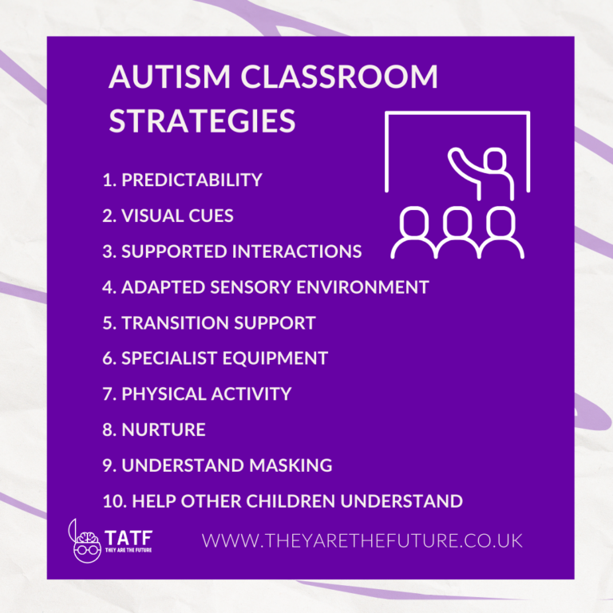
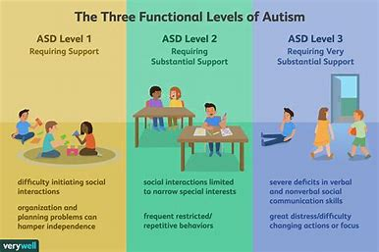

Slide 8
How can I help students struggling with ASD?
Have a designated plan in place that has been formed with input from the student themself and SEND department.
Allow the student to be aware of the classroom structure and familiar with all teachers and staff.
Ensure that if needed the student can sit next to someone in the class that they are comfortable or friends with.
Let the students be near an exit to the classroom if they need to leave if they become distressed, overwhelmed and can utilise a pass.
Create passes with students and the SEND department and their guardians for permission to exit a upsetting or overwhelming environment discreetly no questions asked, allowing them to go to a safe room or environment.
Don't demand eye contact or hard assignments such as speaking infront of the class
Allow for room in homework or assignments due dates
Assign a buddy or friend for the student and follow bully protocols if there are bad situations with other pupils.

Slide 9
Additional resources
Autism - NHS (www.nhs.uk)
National Autistic Society (autism.org.uk)
Signs that a child or adult may be autistic (autism.org.uk)
How Men and Women Experience Autism Differently | Psychology Today
Teaching secondary school autistic students (autism.org.uk)

