Slide 1
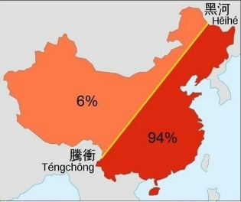
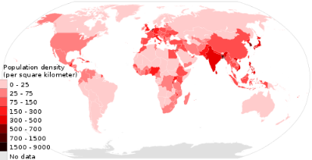
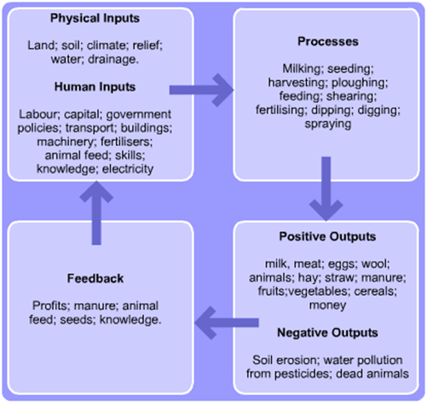
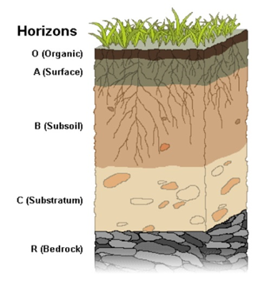
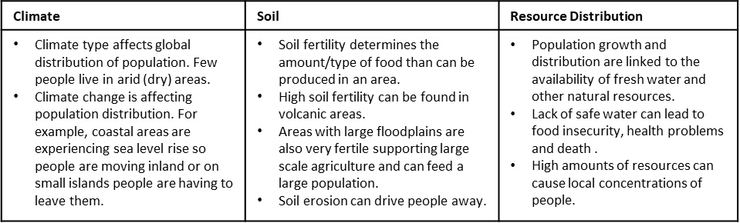
Year 12 Geography- People and the Environment.
Food production and consumption
Global food production and consumption is unevenly distributed.
Food production has increased globally over the last 50 years – the area of land used for producing food has increased and technological advances (e.g. rotary combines, pesticides and modern irrigation techniques) have made it possible to produce more food from less land.
Agricultural productivity = a measure of the amount of food that is produced in an area.
Farms are open systems – energy and matter can be lost or gained from the environment.
People are unevenly distributed around the world
Distribution: the pattern of where people live, they will live in places that are favourable. Over 90% of the population of China live in the east, only 6% live in the west as it’s mountains and deserts.
Density: the population of an area divided by the size of the area e.g. number of people per square kilometer. The areas of highest population density are located in South and East Asia.
Types of agricultural productivity:
Commercial farming = Farming to make a profit.
Subsistence farming = Only grow enough to feed the family, common in Africa or Asia.
Intensive farming = As much as possible is produced from the land.
Extensive farming = The opposite of intensive farming. It is low capital and labour input so produces less food but has less impact on the environment and provides better animal welfare.
Nomadic farming = Farmers move from place to place e.g. Sub-Saharan Africa.
Agricultural productivity is affected by the physical environment:
Climate: It can affect how successfully plants can grow and the number of animals that can survive.
Soil: Some areas don’t have enough soil or it is of poor quality.
Population is affected by the physical environment.
Soil Erosion
People and soils
Zonal soils are fully developed soils
Leaching = when water moves minerals and nutrients down through the soil profile
**You need to know about 2 different soil types and how they affect humans**
Podzols – acidic and have distinct horizons (layers)
Occur in cool temperate climates in the northern hemisphere where there is more precipitation than evapotranspiration.
Usually found under coniferous woodland or heather moorland.
The O horizon is a layer of needles from the coniferous trees and below there is a narrow, acidic A horizon. Nutrients are leached from the A horizon by water. The B horizon is a reddish-brown layer from deposited iron – hard pans
Podzols are not good for agriculture – livestock can be grazes but arable (crop) farming is difficult. The acidity and lack of nutrients means that few crops can grow. The land is vulnerable to water logging which can damage crops.
Latosols – deep and red
Found under tropical rainforests, the high temperature and humidity in the tropics encourage fast chemical weathering of the bedrock forming soils up to 30-40 metres deep.
Year round plant growth means the O horizon is quite thick however as soon as leaf litter decomposes to humus (dark organic material) its nutrients are absorbed by vegetation so the fertile A horizon is very thin.
Rainfall is higher than evapotranspiration so there is a lot of leaching, the high iron content gives the B horizon its red colour.
Latosols are poor for agriculture due to their low nutrient content. Humans living in the rainforest have adapted to this soil type with traditional agriculture using ‘slash and burn’ to clear small areas for growing crops. By burning vegetation it adds nutrients to the soil.
Soil erosion and its impacts on agriculture
Soil erosion is the wearing away of soil by wind or water, the following can make soil more vulnerable to erosion:
Clearing vegetation = rain falls directly on to soil washing it away
Topography = soil is more likely to be washed down a steep slope
Climate = high rainfall increases water erosion, low rainfall and high temperatures mean soil is dry = wind erosion
Land use = ploughing loosens soils and makes it more vulnerable to erosion
There are several management strategies to reduce soil erosion:
Crop rotation = instead of leaving fields bare after the main crop has been harvested, farmers plant cover crops to protect the land
Wind breaks = hedges or trees can be planted around fields as barriers against wind erosion
Terracing = steps cut into a steep hillside to slow down the movement of water down the slope
Contour ploughing = ploughing across the slope instead of downslope – stopping rainwater flowing downhill as quickly
Mulching = covering the soil with a layer of plant material protects the soil from the wind and rain and slows down runoff
People and climate
Cold Environment | Tropical Monsoon
There is permeant covering of the land by glacial ice with a surface layer of snow. Can be -40 with strong winds and snow. It freezes the land from the surface downwards to produce permanently frozen ground (permafrost). In the summer, the top layer thaws for a short time but the ground underneath remains frozen. In winter there is a covering of snow. This is called Tundra | The monsoon climate occurs in much of India and Bangladesh. It involves the seasonal reversal of winds. In winter, they are from the north and north-east and are very dry and bring drought. In the summer, the winds reverse and bring hot, wet air from the equatorial regions.
The polar climate makes human occupation difficult
Populations are low – the population in the Artic is 4 million and no-one lives permanently in Antarctica.
Agricultural productivity is low so traditional lifestyles depend on subsistence – only enough for themselves
Arctic diets are meat based as plants struggle to grow
The conditions make it difficult for development, people struggle to work and build on frozen ground
Increasing food security
People have food security when they have enough nutritious food. This depends on:
Food availability = a country must produce and/or import a sufficient amount of food
Food access = people must be able to regularly obtain food e.g. by buying or producing it
Food quality and use = the food that people consume must be nutritious enough for them to maintain a healthy life
People and climate
Human activities and numbers are influenced by the climate.
The world can be broadly classified into 5 climatic zones – arid, continental, polar, temperate and tropical.
Climate affects things like agricultural productivity and water availability – this means that population sizes and lifestyles in different climatic zones are often different.
**You need to know the characteristics and distributions of 2 climatic types and how their characteristics affect people.
The reverse of this knowledge organiser will cover polar and arid climates**

Slide 2
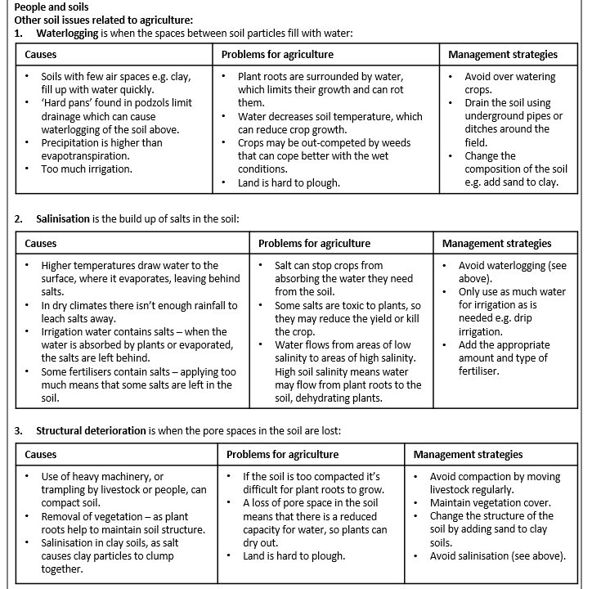
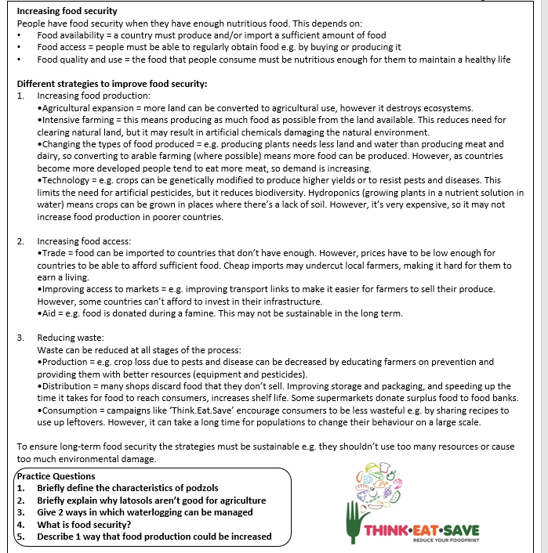
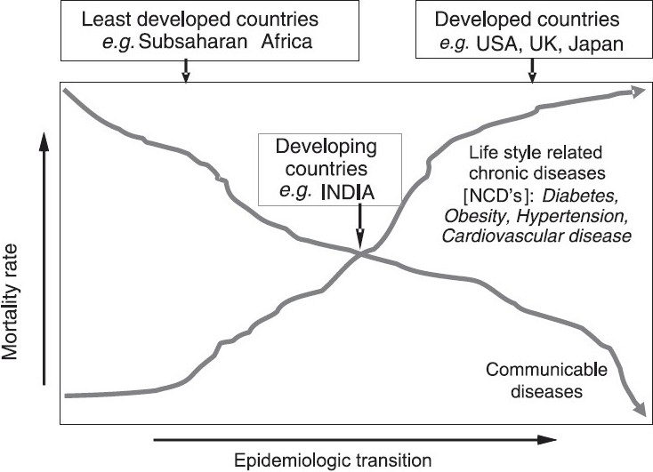
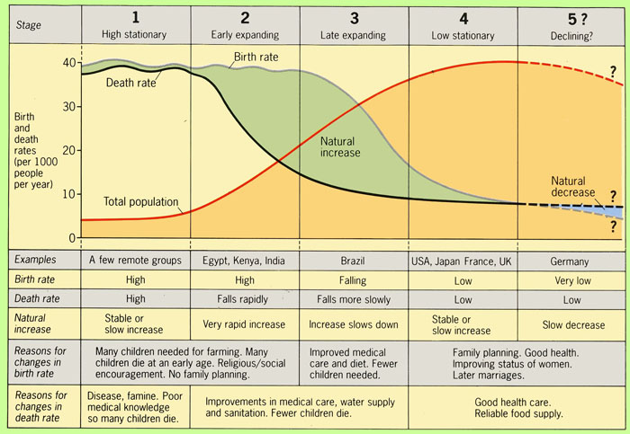
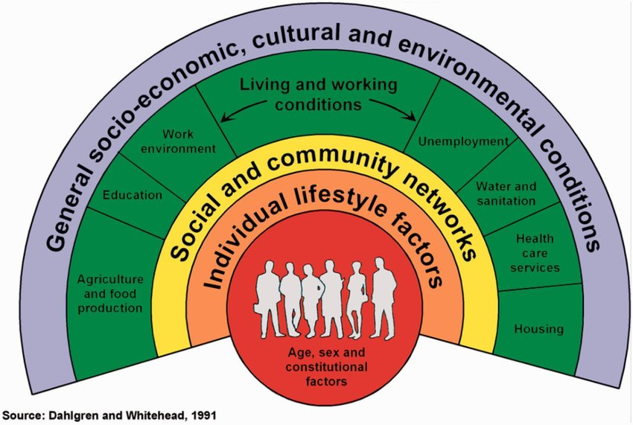

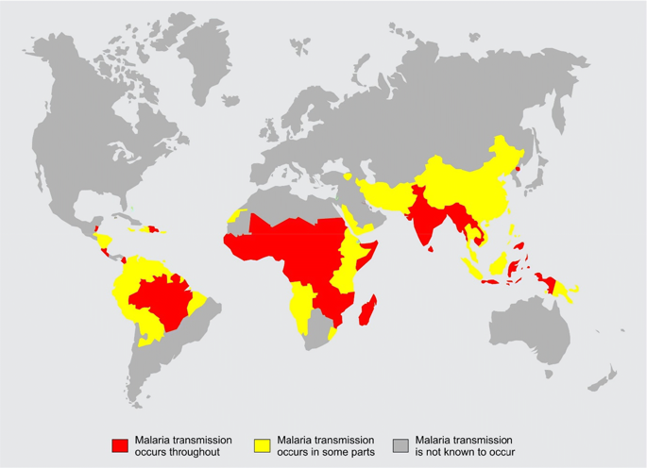
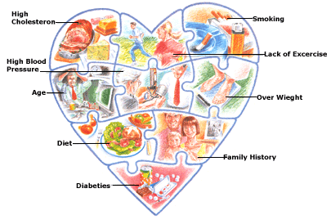
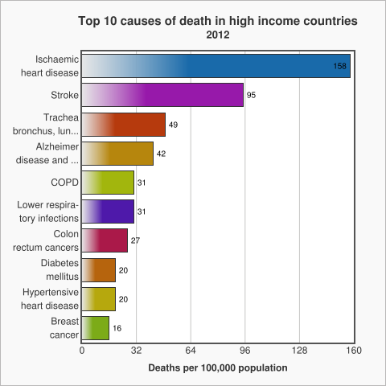
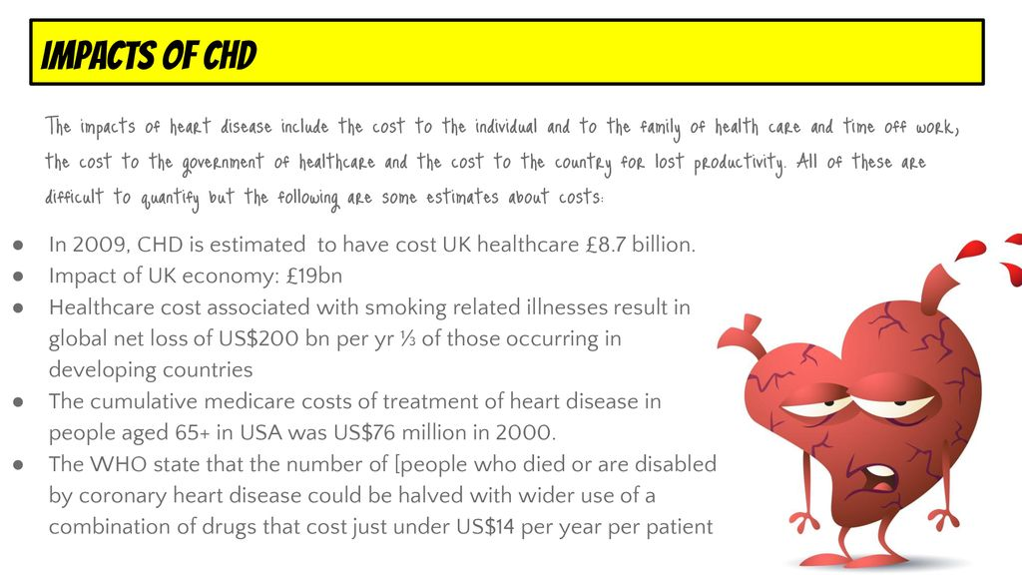
Year 12 Geography- People and the Environment.
Well being- the state of being comfortable, healthy or happy.
Environmental variables and their links to incidence of disease.
Climate/ SAD
Topography, drainage and health.
Air Quality and Health
Water Quality and health
Epidemiological Transition Model
The process of socio-economic development accounts for a transition over time, from infectious disease to chronic and degenerative diseases as the most important causes of death.
The Epidemiological Transition theory suggests that over time, infectious diseases like small pox and influenza will be replaced by chronic diseases like heart disease, cancer and dementia.
Determinants of Health
Malaria- is a tropical vector-borne disease, biologically transmitted by insects, which has a devastating impact on people’s heath and livelihoods around the world.
Disability Adjusted Life years-
DALYs- 58% of the total global
Burden due to Malaria is
Concentration amongst the
Worlds poorest 20%
CHD- Coronary Heart Disease – leading cause of death worldwide, accounting for about 7.5million death annually.
Management and mitigation
Educating the public
Making treatments affordable
Advising on healthy living practices.
In the UK dieticians promote benefits of healthy living and eating 5 fruit and veg a day
Health Education- supports public understanding, support and demand.
Policies and Legislation- only governments can legislate for prevention and / or control a disease.
Role of International agencies and NGOs in promoting health.
WHO-World health Organisation
UNAIDs- HIV prevention
UNICEF- reverse spread of HIV/ Malaria in children
World Bank-financial and technical assistance.
NGO’s- Non-Governmental Organisations. Medecins Sans Frontieres.

Slide 3
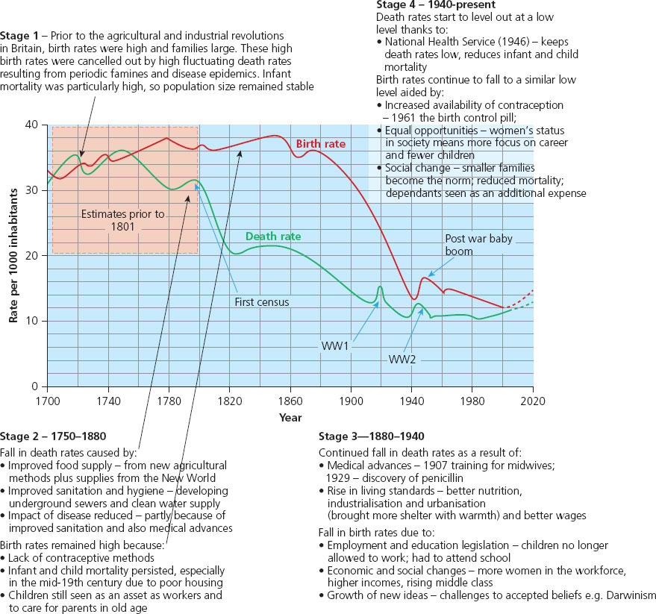
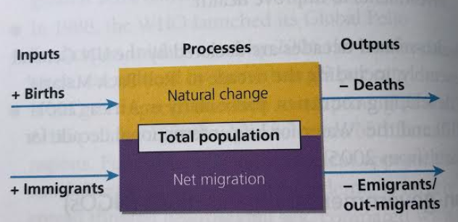
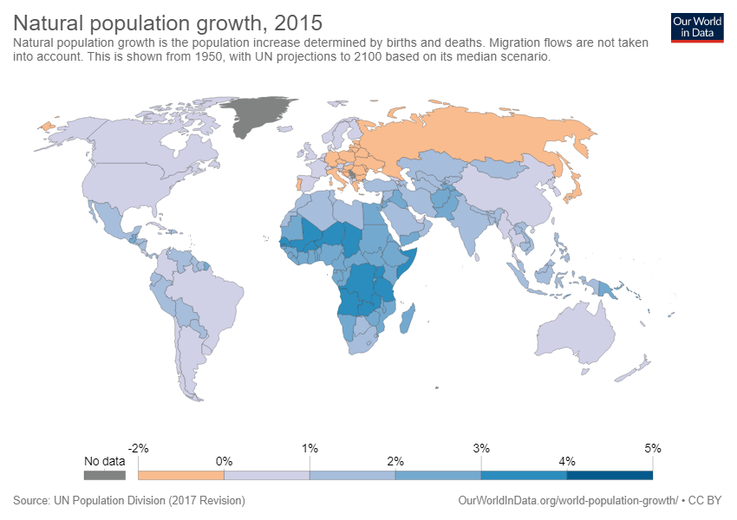
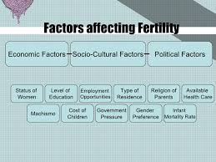
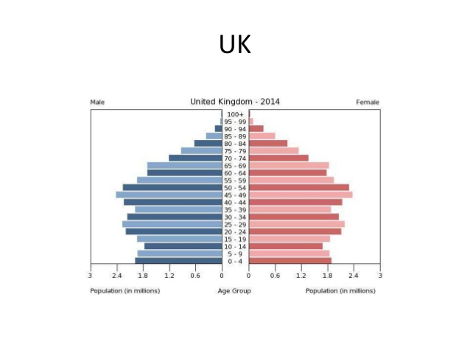
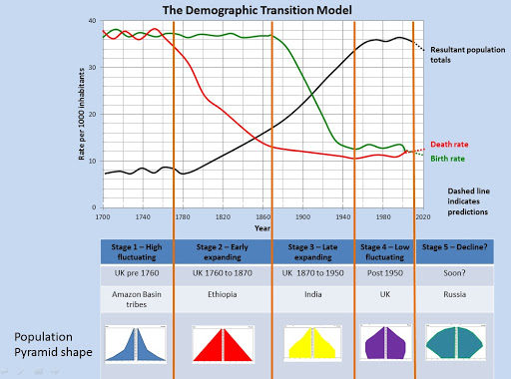
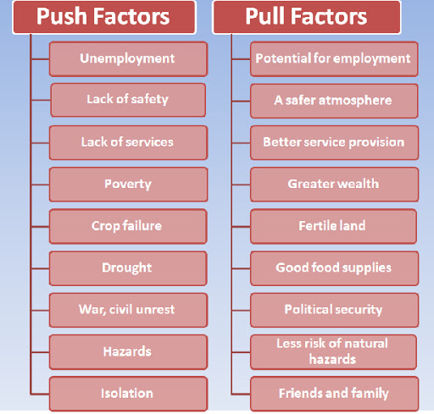
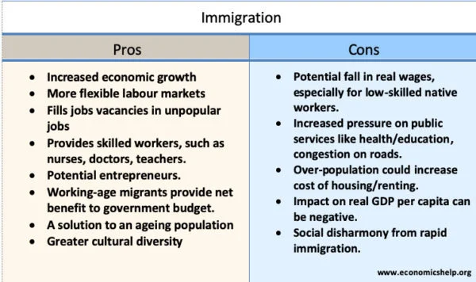
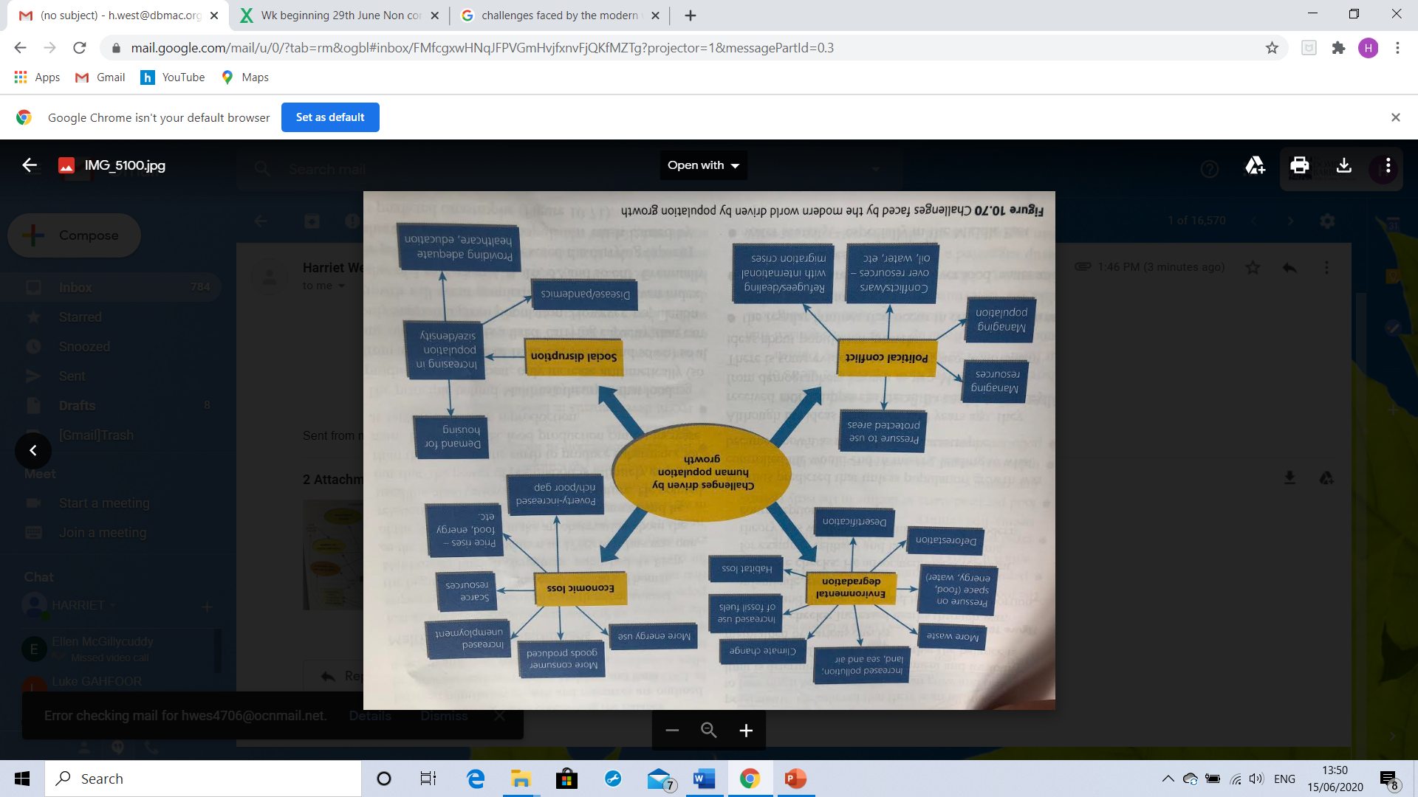
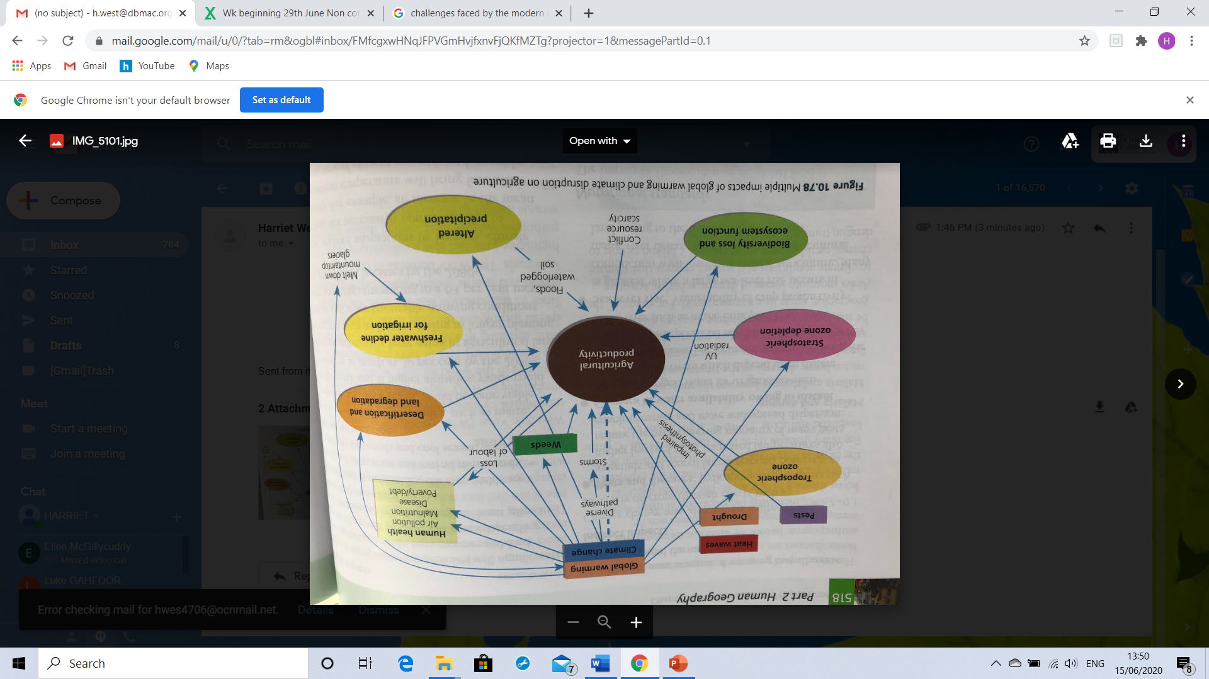
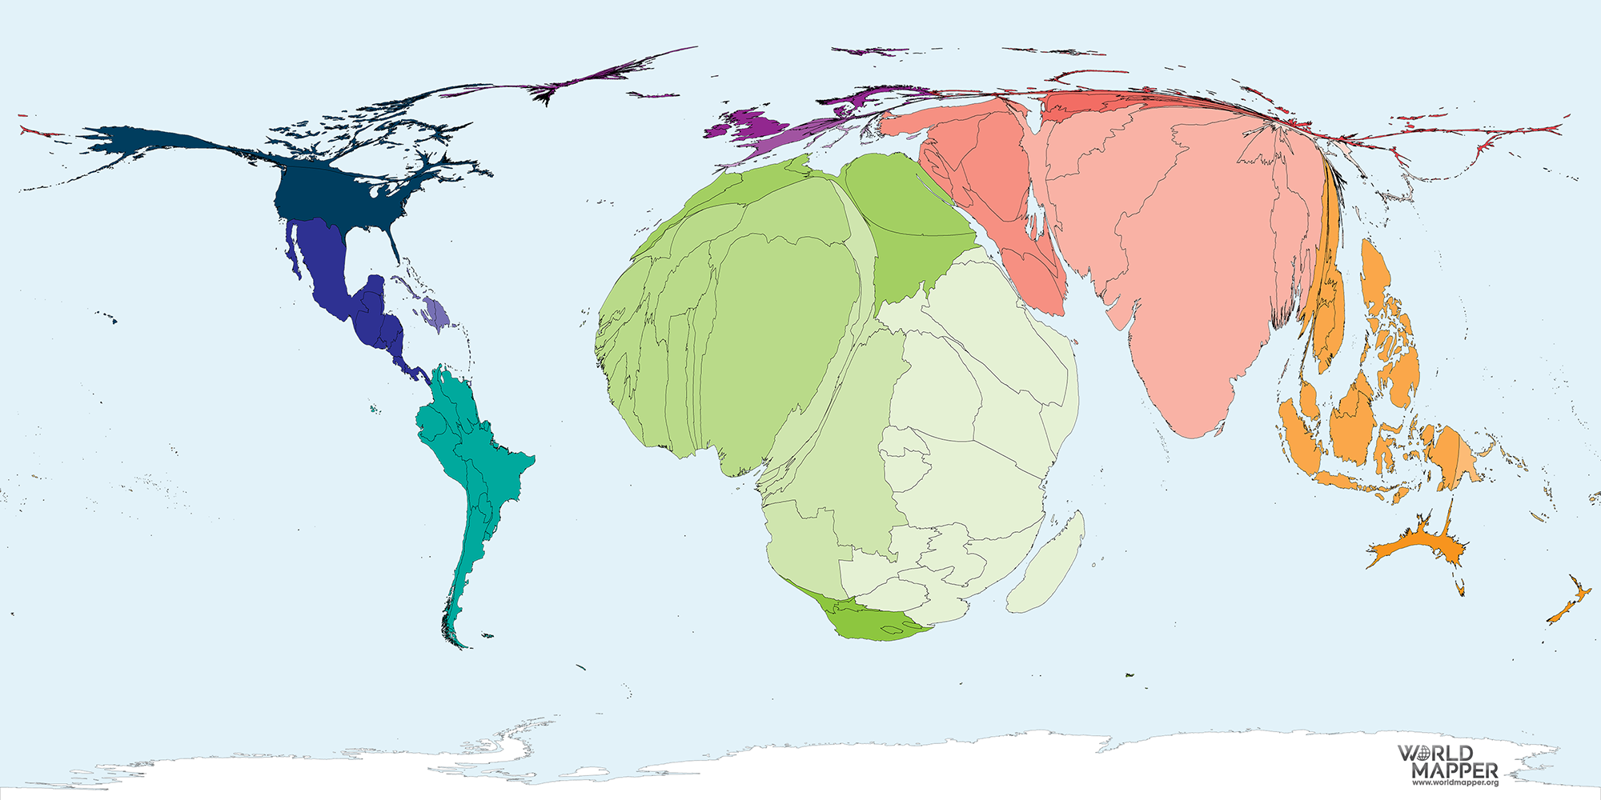
Year 12 Geography- People and the Environment.
Britain's population change
Population Change
There are two main components of population change- Natural Change and Migration
Natural population change will either give
Natural increase or natural decrease.
Other indicators that also link to this
Is total fertility rate and infant mortality rate.
There is a correlation between birth rates and
Fertility rates as the both measure reproductive
potential in a population.
Population pyramids
Niger | Canada
Human setting- sparsely populated, especially in the north. Higher concentrations of people on the Niger basin in the south in towns and cities. Most people live in rural areas and are subsistence farmers. | Human setting- large country with a relatively small population of 35 million. Has highly urbanized areas. The economy is based very much in the tertiary sector, particularly financial and manufacturing.
DTM- high birth rates and relatively low and falling death rates, stage 2 of the model. Young population and governmental policy to reduce infant mortality. | DTM- low birth rate and death rate with a low natural increase. Stage 4 of the model. Encourages some controlled migration so the natural increase is getting bigger. Wants a balanced population structure and not elderly like some other developed countries.
International Migration- the other major component for population change and can have a dramatic impact on the origin and destination. Types of migrants- refugees, asylum seekers and economic migrants
Global population futures- varying possible scenarios of future population growth. With more people on the planet the demand for resources will undoubtedly increase, especially if more people become more affluent and desire a higher standard of living.
At the same time, the earth’s physical environment is undergoing change, particularly with regards to its atmosphere and climate, which will impact on human health. Diagrams are challenges faced by the modern World and multiple impacts of global warming and climate change disruption on agriculture.
More optimistic predictions
International Institute for Applied Systems Analysis
They disagree that China’s fertility will start to rise again, from 1.6
They project that Nigeria’s population will only triple by 2100 not quintuple.
Education of girls has been proven to be the most successful method of reducing the population.
Population change from 2010-2050- debate on
which is going to be more significant as
a threat to planet earth- population or consumption

