Slide 1
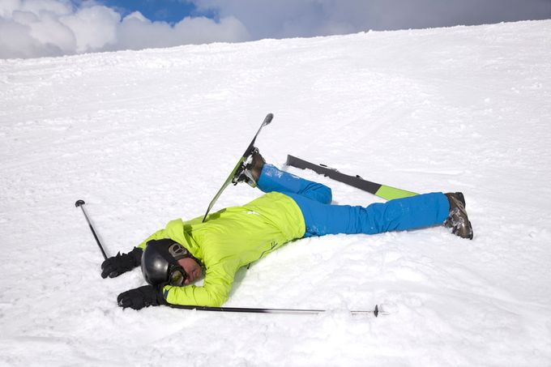
Fluid movement
Learning outcome
Explain laminar and turbulent flow and investigate viscosity.
Why does a skier crouch down when skiing?

