Slide 1
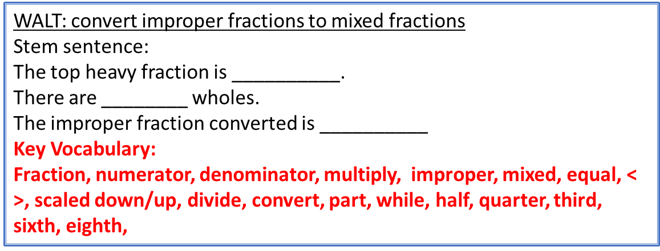
WALT: convert improper fractions to mixed fractions
Stem sentence:
The top heavy fraction is __________.
There are ________ wholes.
The improper fraction converted is __________
Key Vocabulary:
Fraction, numerator, denominator, multiply, improper, mixed, equal, < >, scaled down/up, divide, convert, part, while, half, quarter, third, sixth, eighth,

