Slide 1
Health and Social Care

Slide 2
Welcome to HASC at SSFC.
You will have one external exam (date to be confirmed) and the rest of your work will be internally marked.
If you miss a lesson, then you need to contact your teacher to catch up as deadlines are very strict.
You will study 9 units as part of this course, most of the work will be coursework based.

Slide 3
PWCS 21 Principles of communication in adult social care settings
The unit introduces the importance of communication in adult social care settings, and ways to overcome barriers to meet individual needs and preferences in communication. This unit is aimed at those who are interested in, or new to, working in social care settings with adults.

Slide 4

Why do people communicate?
Notes:
Teacher to write answers on the board as a spider diagram.

Slide 5
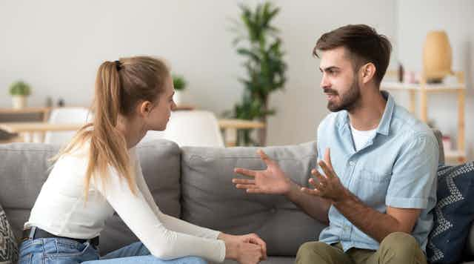
Why is effective communication, especially different word meanings important?
Notes:
Spider diagram.

Slide 6
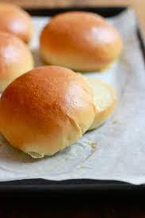
What is this?
Notes:
Bun, bap, bread roll, roll, cob, barm cake

Slide 7
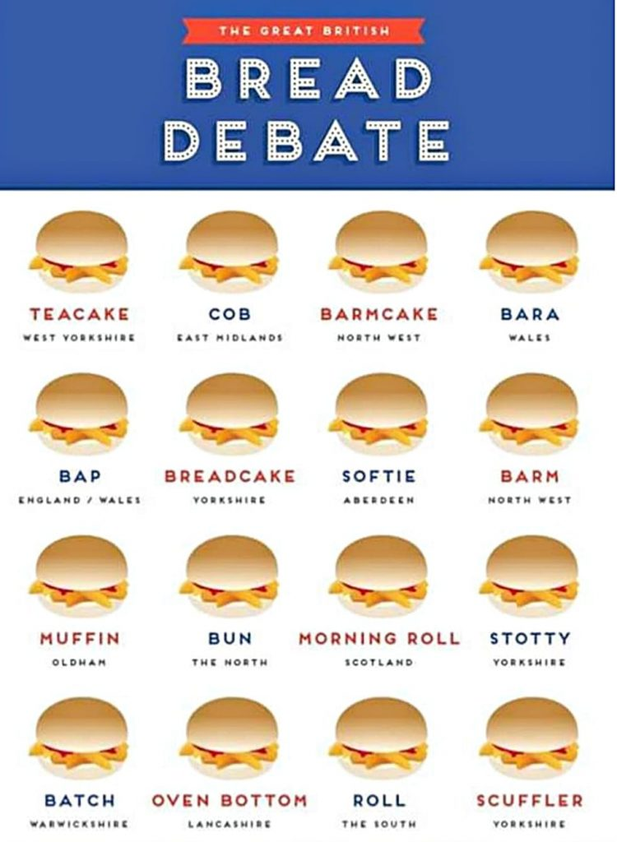

Slide 8
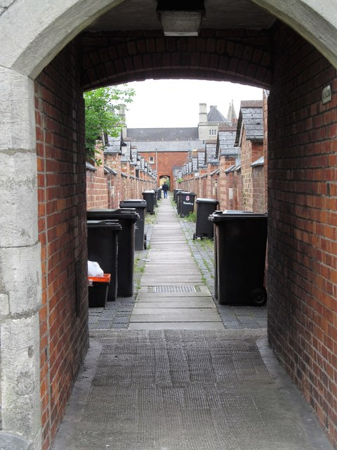
What is this?
Notes:
cut, ginnel, snick, snicket, alley

Slide 9

What is this?
Notes:
Pop, soda, fizzy drink, coke,

Slide 10

What is this?
Notes:
Change, pennies, loose change, slag

Slide 11

Teesside quiz
Notes:
Crust,

Slide 12
Aka - Crazy “He was going Aka” Ayaz / Aya – Ouch ”Aya that hurt!” Afta- Have to “I afta sort it out later” Akki – Filthy Bray - To hit or bang “I was braying on the door for ages before you answered” Boltic / Baltic- Freezing Cold Chew- bother “I dont want no chew tonight like” Clamming - Hungry
Fumin - Very angry “I’m fumin ma cars broke again”
Gadgie- Man, Male ”I helped an old gadgie cross the road” Howl / Howling – Laugh “I was howling at that last night!” Jafta- Do you have to “Jafta do that?” Janoaworramean? – ‘Do you understand what I am saying / talking about?’ Knack / Knacking – Hurt / Hurting “My feet were knacking off those shoes” Keggie– A bump or swelling (often on the head) “Leigh hit her head on the door and got a massive keggie” Parmo – Parmo or Parmesan, a breaded cutlet dish originating in Middlesbrough Radged- Mental, Crazy “Your raged you like” Woppa- Insult “You're a proper whoppa you, arn ya?” Winda- Window Worra - What a “Worra Load of Rubbish, "I’m sorry, I never quite heard you there"

Slide 13
What do the following words mean to you?
Smack
Spank
Tan (tanned someone's bottom).
Bray
Hit
Slapped

Slide 14

Nonverbal communication
List all methods of nonverbal communication you can think of

Slide 15
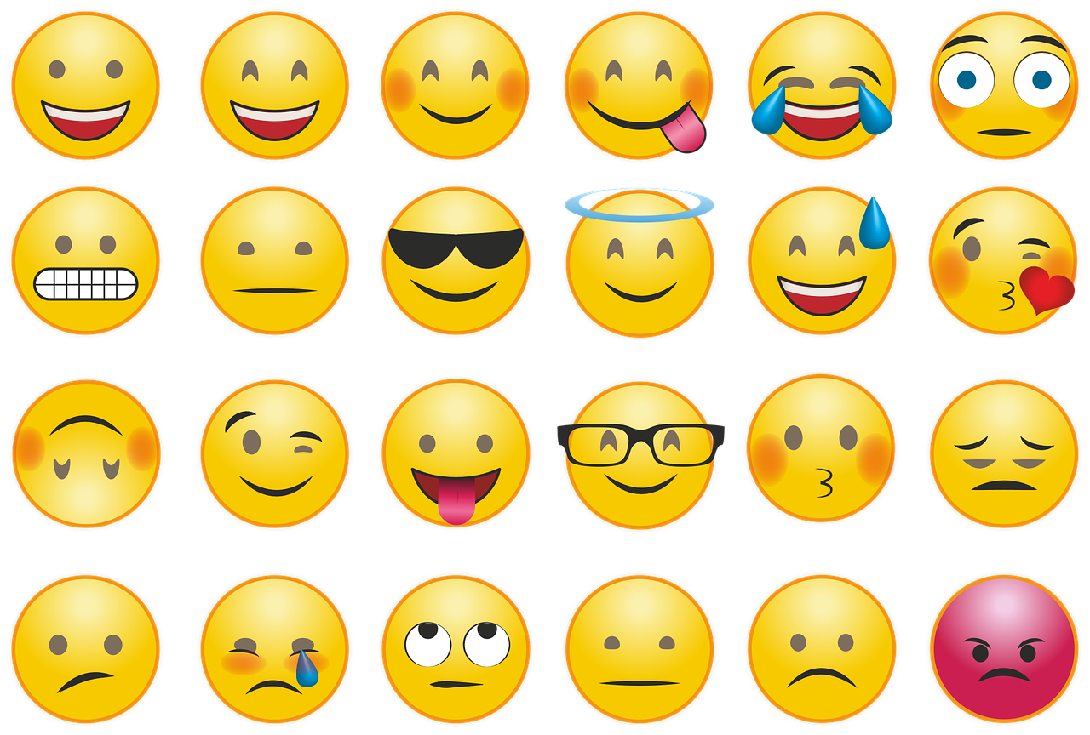
Nonverbal communication
Sign language
Pointing
Facial expressions
Body language
Emojis
Text
Typing / writing
Noises

Slide 16

Nonverbal communication
Non-verbal communication includes demonstrating opinions, thoughts or feelings without speaking.
This can do done by use of body language, facial expressions, hand gestures and eye contact – you can often tell what mood someone is in without them using words.

Slide 17
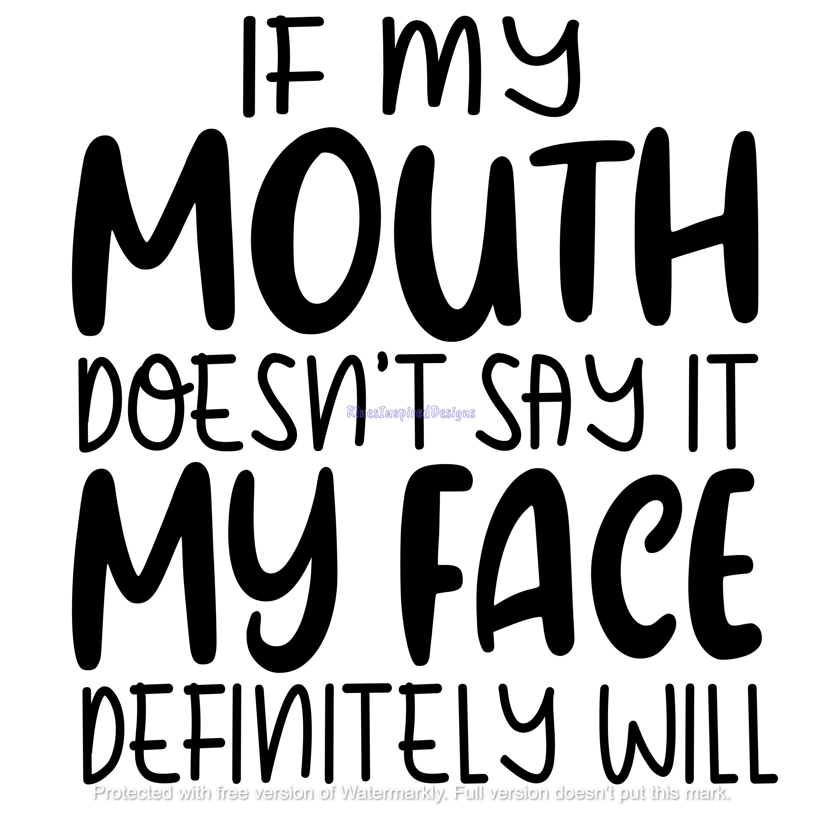
Facial expressions
A facial expression is an important form of non-verbal communication. We use facial expressions to communicate without words. You can tell if someone is happy, sad, angry, scared, all from their face.

Slide 18

Facial expressions – eyes, mouth and eyebrows
We can communicate using our eyes. Have you ever seen someone smiling but their eyes were sad? Excess blinking could indicate nervousness.
Using our mouths is a massive way of communicating. We smile when we’re happy, fake smile when we’re uncomfortable, open mouthed if we’re shocked.
We raise out eyebrows in shock, lower them when we’re mad.

Slide 19

Voluntary and Involuntary expressions
Voluntary expressions are expressions we purposely make. Involuntary are expressions we make without thinking, for example, seeing someone you fancy might make you smile or blush.

Slide 20

Question:
What other types of communication can you think of?
Write as many as you can think of in your books.

Slide 21

Task:
Imagine you are in a foreign country; you can’t speak the language. How would you feel?
Now imagine you’re in this foreign country and you need health care, how would you feel? How would you access it?

Slide 22

Question:
How do you think people overcome language barriers?

Slide 23
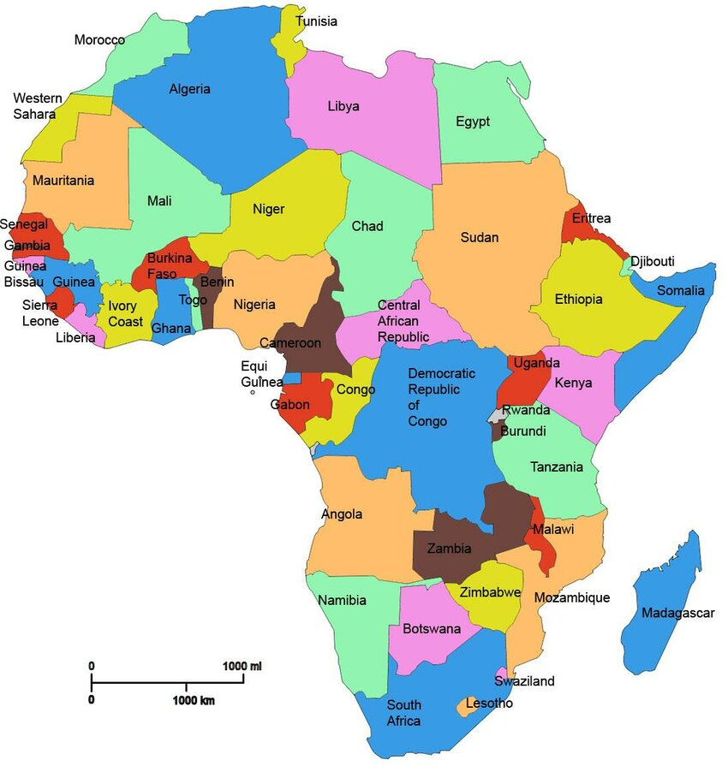
Overcoming barriers
Precious has recently come over from Africa. Precious cannot speak English. Precious has type 1 diabetes is does not know where to get insulin from. Precious has not yet registered with the GP surgery.
How would you overcome this barrier?

Slide 24

Overcoming barriers
Stephanie is aged 35, she lost her hearing when she was 29. As a result of this, Stephanie cannot fluently speak BSL although does know some phrases and words and can communicate on a low level.
Stephanie has recently found out she is pregnant and needs to access maternity services.
How would you overcome this barrier?

Slide 25

Overcoming barriers
Hearing impairment
Speech impairment
EAL
None English speakers
Learning disability
Mutism
Using the above list, explain how you would work with a service user to overcome language barriers.

Slide 26

Confidentiality
What does confidentiality mean to you?
Where do you think confidentiality applies?
When can confidentiality be broken?

Slide 27

Confidentiality
Confidentiality means protecting personal information
This information might include details of a service user’s lifestyle, family, health or care needs which they want to be kept private.
Service users expect the health and care professionals who are involved in their care or treatment, or have access to information about them, to protect their confidentiality at all times.
Notes:
https://www.hcpc-uk.org/standards/meeting-our-standards/confidentiality/guidance-on-confidentiality/introduction-to-confidentiality/

Slide 28

Confidentiality
Is not about keeping ‘secrets’. Confidentiality means keeping person information within the organisation in which you work.
For example, after a long day you see your manager for a debrief, as your manager is part of the organisation you work, you can discuss service users with them on site or in an appropriate place.
If a service user needs to be referred to another service, always discuss this where possible with them.

Slide 29

Confidentiality
In your books, list how the following places would uphold confidentiality.
Doctors' surgery
Hairdressers
School
Domestic abuse refuge
Bank

Slide 30
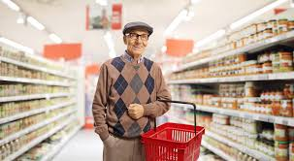
What would you do?
You’re a carer working with the elderly and whilst shopping with your friends, you see a service user. The service user approaches you and begins a conversation. He is asking you about his medication use and if you think he should seek medical advice about a change in his medication.
When he has left, your friend asks how you know the service user, can you say who it is?

Slide 31

What would you do?
You work for a victim support charity, whilst at work you find out that a convicted rapist lives on the same street as your friend. You only know this information because of your job but your friend could potentially be at risk.
Do you tell them?

Slide 32

What would you do?
You work for a domestic abuse charity. Your best friend has just started dating someone new. You know this person as a perpetrator.
Do you tell them?

Slide 33
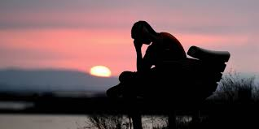
What would you do?
You are working in a mental health facility; a service user confides in you that they want to end their lives but says they won’t act upon these feelings. They beg you not to tell anyone as they are due to be discharged from the service.
What would you do?

Slide 34

Confidentiality and safeguarding
Confidentiality must be upheld at all times UNLESS there is a safeguarding issue.
A breach of confidentiality is only appropriate if a person is thinking of harming themselves, another person or is in danger.
Sharing confidential information would only be to appropriate people.

Slide 35
Confidentiality and safeguarding
This could be recording information in your safeguarding folder at work.
This could also mean reporting to another agency (mental health services, social services, GP etc).
If someone is in immediate danger, then inform the police.

