Slide 1

Friday Worship Song

Slide 2
Friday Worship
Welcome to our

Slide 3





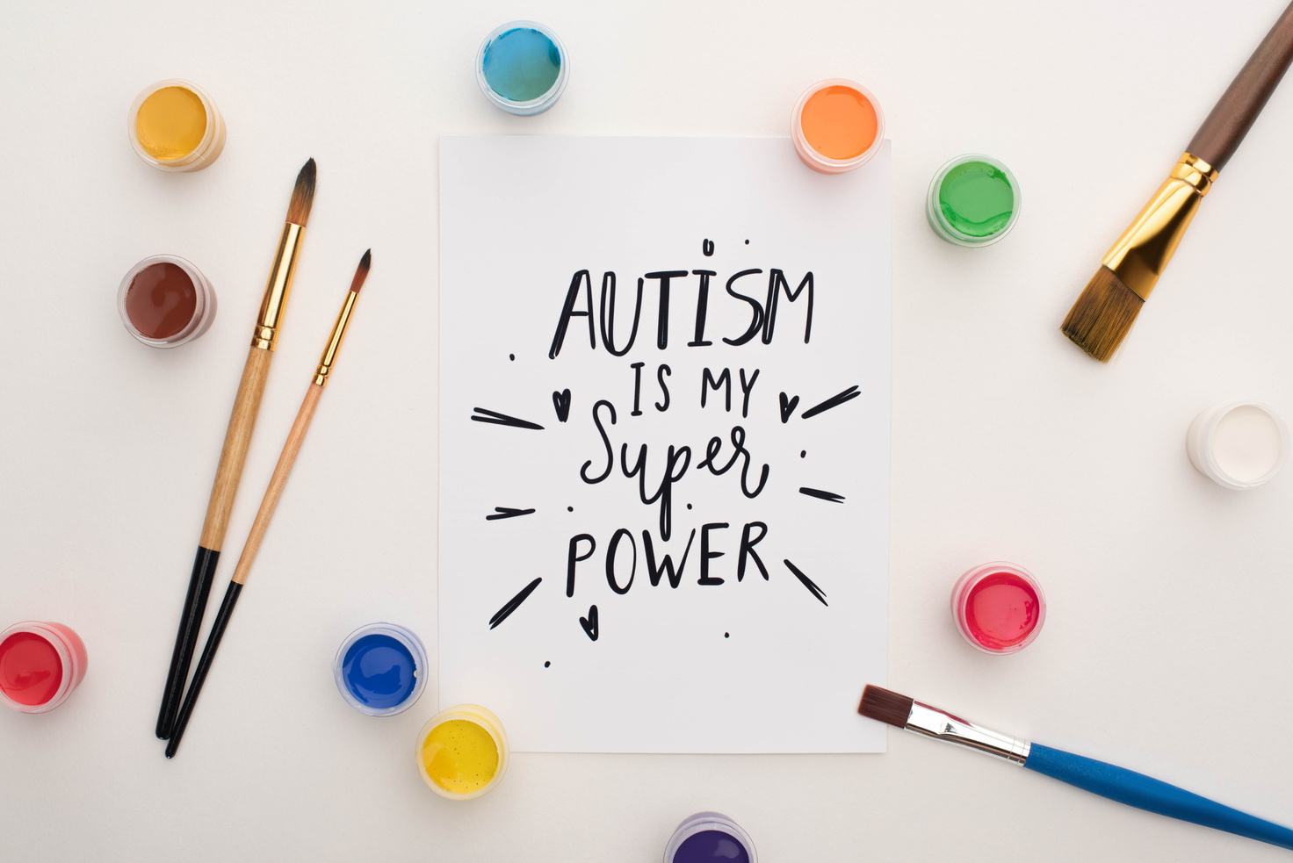


Autism Awareness
2nd April 2025

Slide 4





What is Autism Awareness?
A month has been dedicated to educate everyone about autism and to make the world friendlier to those that are affected by autism.
It was the UN who agreed in December 2007 that World Autism Awareness would begin in 2008 to help raise awareness of autism.
Notes:
https://www.un.org/en/observances/autism-day/background

Slide 5
What is Autism?
Autism affects how children and adults communicate and interact with the world.
All autistic people are all different and have
different strengths and difficulties.
It is a lifelong neurological condition.
Notes:
The definition of autism has changed over the years.
The main point is that autistic people have difficulty with communication and the way they interact with the world.
Remember that autism is also refered to as ASD - Autistic Spectrum Disorder. Each and every individual that has autism is different from one and other.
A useful video for teachers: https://www.autism.org.uk/advice-and-guidance/what-is-autism

Slide 6
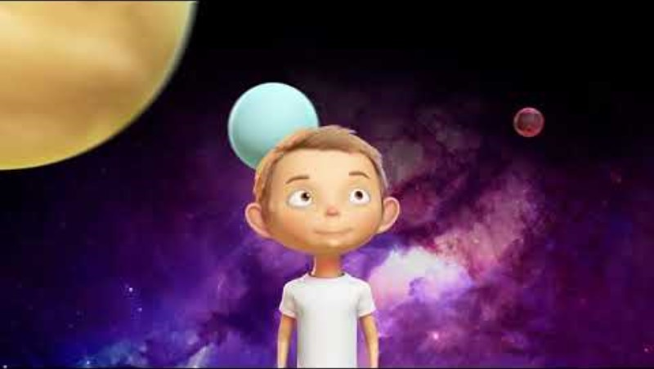

Slide 7
What is Autism?
Some of the ways that an autistic person may be affected are:
find it hard to communicate and interact with other people
find it hard to understand how other people think or feel
find things like bright lights or loud noises overwhelming, stressful or uncomfortable
Notes:
Taken from the NHS:
https://www.nhs.uk/conditions/autism/what-is-autism/
There is a video on this NHS webpage that you may find helpful for your own knowledge before talking about autism with your school or class.

Slide 8
What is Autism?
Some of the ways that an autistic person may be affected are continued:
get anxious or upset about unfamiliar situations and social events
take longer to understand information
do or think the same things over and over
Notes:
Taken from the NHS:
https://www.nhs.uk/conditions/autism/what-is-autism/
There is a video on this NHS webpage that you may find helpful for your own knowledge before talking about autism with your school or class.

Slide 9
How can we help?
It is not always obvious who has autism.
Children and adults with autism may not have all the symptoms or the symptoms they have will vary from person to person.
Notes:
Taken from the NHS:
https://www.nhs.uk/conditions/autism/what-is-autism/
There is a video on this NHS webpage that you may find helpful for your own knowledge before talking about autism with your school or class.

Slide 10
How can we help?
It is important that we are:
KIND AT ALL TIMES
BE PATIENT - TAKE YOUR TIME TO LISTEN
SAY EXACTLY WHAT YOU MEAN
ACCEPT EVERYONE FOR WHO THEY ARE

Slide 11
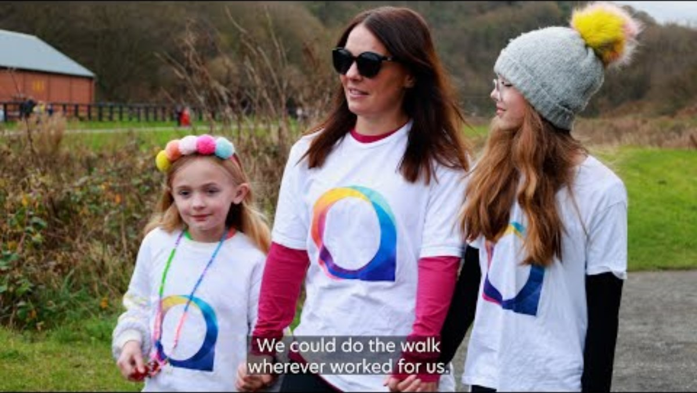
Sponsored Colour walk.

Slide 12
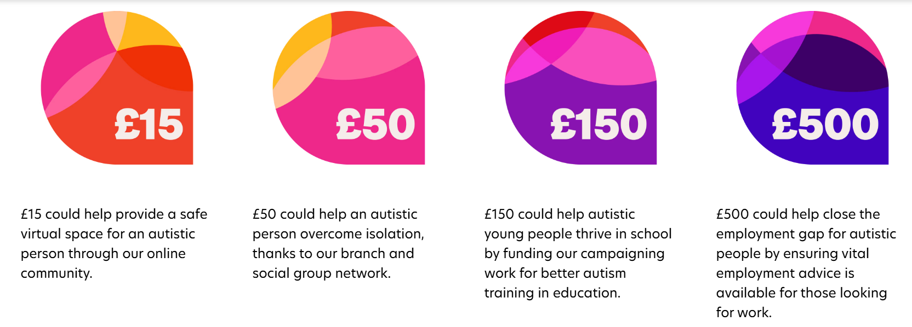
School sponsored Colour walk.
Today we will all be participating in a daily sponsored colour walk to raise money:

