Slide 1
Muscle Contraction
Muscle structure
Proteins in muscle
Sliding filament theory of contraction

Slide 2
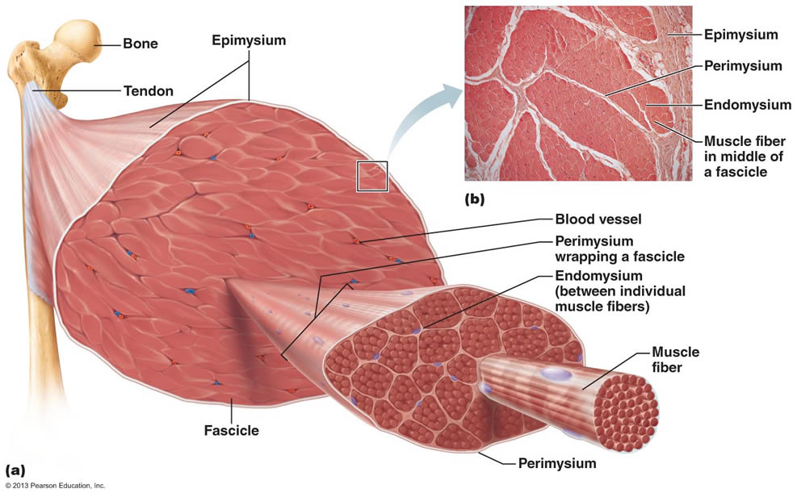
Muscle Structure

Slide 3
Muscle Structure
Muscle
Muscle bundle
Muscle fibre
Each level of organisation consists of vast quantities of the level immediately below it.
Separating each component is a thin substance called fascia to ensure smooth contraction of each component in the correct direction.

Slide 4
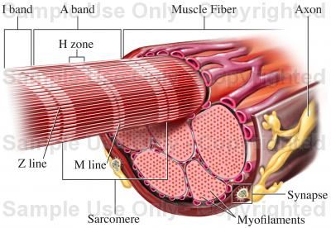
Going deeper

Slide 5
Simplest level of contraction
Muscle fibres – multinuclear cells with large quantities of mitochondria.
Muscle fibres consist of bundles of myofibrils, which are arranged into smaller myofilaments, which give muscle its stripy appearance.
Sarcomere – repeating patterns of myofibrils
Light filaments (Actin)
Dark Filaments (Myosin)

Slide 6
Muscle Checkpoint
Arrange the following terms in order from the simplest to most complex muscle structure
Myofibril
Muscle bundle
Muscle
Muscle fibre
Sarcomere

Slide 7
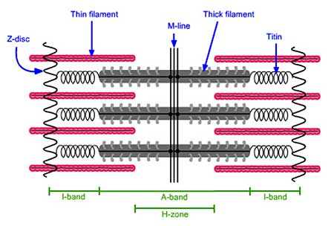
Sarcomere Structure

Slide 8
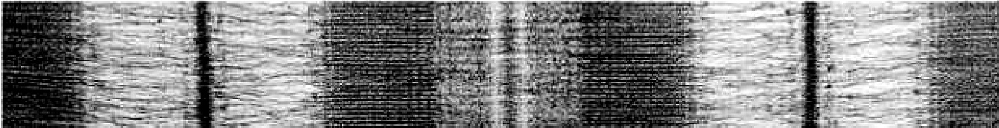
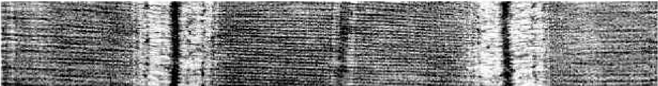
Say What You See!
Relaxed Sarcomere
Contracted Sarcomere

Slide 9
Sliding Filament Theory
Proposed by Hugh Huxley and Jean Hanson in 1954.
Protein filaments slide past one another rather than previous theory that filaments decreased in length.
Subsequent experiments revealed the mechanism of contraction.

Slide 10
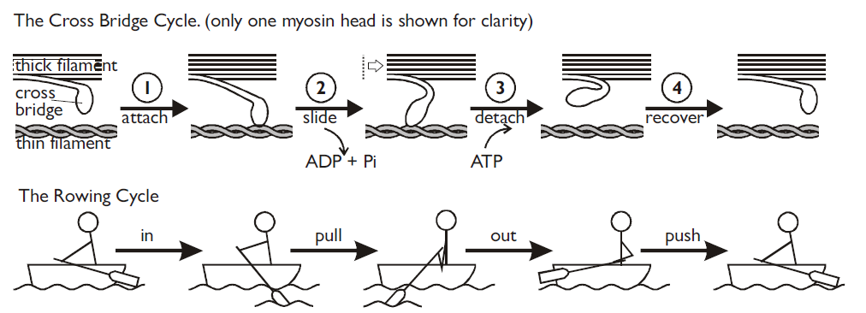
The Cross Bridge Cycle

Slide 11
Muscle Contraction
http://www.youtube.com/watch?v=83yNoEJyP6g&feature=related

Slide 12
Maintaining ATP supply
2. Anaerobic respiration.
Produces lactate and can lead to fatigue/cramp.
Aerobic respiration in muscle cells.
Needs a supply of respiratory substrate and oxygen
3. Creatine phosphate – another chemical present in muscle cells can donate its phosphate to recharge ADP back to ATP

Slide 13
Regulation of contraction
In small groups, research and illustrate how the cross-bridge cycle is switched on and off.
What is troponin and tropomyosin, where are they located in the sarcomere and what is their purpose?
What is the role of calcium (Ca²⁺) in muscle contraction and what releases it into the sarcomere?
Describe the sequence of events from calcium release to muscle contraction and its reversal.

