Slide 1
Classwork 27/02/2024 Christian Beliefs – Solutions to POE
Iterative Questions
Where do Christians find the creation story?
What does the term stewardship mean?
What are the two ways Christians can interpret the creation story?
What is situation ethics
Where can Christians find a SOWA?
Name 3 of God’s qualities
Step 1:Write the date and title into your books
Step 2: Stick the Iterative Questions into your books.
Step 3: Answer the following 6 questions in BLACK pen.

Slide 2
Iterative Questions
Where do Christians find the creation story?
What does the term stewardship mean?
What are the two ways Christians can interpret the creation story?
What is situation ethics
Where can Christians find a SOWA?
Name 3 of God’s qualities
Iterative Questions
Where do Christians find the creation story?
What does the term stewardship mean?
What are the two ways Christians can interpret the creation story?
What is situation ethics
Where can Christians find a SOWA?
Name 3 of God’s qualities
Iterative Questions
Where do Christians find the creation story?
What does the term stewardship mean?
What are the two ways Christians can interpret the creation story?
What is situation ethics
Where can Christians find a SOWA?
Name 3 of God’s qualities
Iterative Questions
Where do Christians find the creation story?
What does the term stewardship mean?
What are the two ways Christians can interpret the creation story?
What is situation ethics
Where can Christians find a SOWA?
Name 3 of God’s qualities
Iterative Questions
Where do Christians find the creation story?
What does the term stewardship mean?
What are the two ways Christians can interpret the creation story?
What is situation ethics
Where can Christians find a SOWA?
Name 3 of God’s qualities
Iterative Questions
Where do Christians find the creation story?
What does the term stewardship mean?
What are the two ways Christians can interpret the creation story?
What is situation ethics
Where can Christians find a SOWA?
Name 3 of God’s qualities
Iterative Questions
Where do Christians find the creation story?
What does the term stewardship mean?
What are the two ways Christians can interpret the creation story?
What is situation ethics
Where can Christians find a SOWA?
Name 3 of God’s qualities
Iterative Questions
Where do Christians find the creation story?
What does the term stewardship mean?
What are the two ways Christians can interpret the creation story?
What is situation ethics
Where can Christians find a SOWA?
Name 3 of God’s qualities

Slide 3
Classwork 27/02/2024 Christian Beliefs – Solutions to POE
Quick 6 Questions
Where do Christians find the creation story?
Genesis 1 and 2
What does the term stewardship mean?
Taking care and protecting the world
What are the two ways Christians can interpret the creation story?
Literally and metaphorically
What is situation ethics
Taking each situation as a unique one and doing the most loving thing
Where can Christians find a SOWA?
The Bible, in Church from a priest
Name 3 of God’s qualities
Omnipotent, omniscient, omnibenevolent, omnipresent.

Slide 4

The BIG Idea
Classwork 27/02/2024 Christian Beliefs – Solutions to POE
We are Learning to...
Investigate how Christians respond to the problem of evil and suffering.
In today’s lesson...
You will be able to describe, compare and contrast evil and suffering in the world.
You will be able to explain the problem of evil and consider responses to this.
You will be able to evaluate my belief in God and if there is logical reason for God.

Slide 5
Independent Tasks
Iterative knowledge Quiz
Can you answer a 3 mark question in bullet points?
What is the difference between a 4 and 5 mark question?
In a 12 mark answer do you put your own personal opinion in your answer?
What is the most famous Christianity quote?
What is the role of the Father in the Trinity?
What is the incarnation?
What is the inconsistent triad?
Name an example of moral evil
Name an example of natural evil
What does sanctity mean?
How was man made in Genesis 2?
How was woman made in Genesis 2?
What two ways can you interpret the creation story?
What is the Fall?
What is Original Sin?
If you finish:
Outline three events in Jesus last days (3 marks)
One event was…
A Second event was…
A final event was….
Outline three of God’s qualities (3 marks)
One quality is…
A second quality is…
A third quality is…
(A) Outline three reasons the incarnation is important (3 marks)
One reason is…
A second reason is…
A third reason is…

Slide 6
Iterative knowledge Quiz
Can you answer a 3 mark question in bullet points? No. Must be in 3 full sentences
What is the difference between a 4 and 5 mark question? A SOWA
In a 12 mark answer do you put your own personal opinion in your answer? No, they want you to focus on Christian teachings
What is the most famous Christianity quote? Love thy neighbour
What is the role of the Father in the Trinity? The Creator/Sustainer
What is the incarnation? God in human form
What is The Inconsistent Triad? Evil exists, God is Omnipotent and God is omnibenevolent. You cannot have a God that has all three parts.
Name an example of moral evil Murder, theft, ANYTHING THAT HUMANS DO TO OTHER HUMANS
Name an example of natural evil Volcanoes, earthquakes, floods ANYTHING THAT IS CAUSED BY NATURE
What does sanctity mean? Belief that life is sacred to God
How was man made in Genesis 2? From the dust of the ground and the breath of God (Holy Spirit)
How was woman made in Genesis 2? Man’s rib
What two ways can you interpret the creation story? Literal = word for word or metaphorical = a story
What is the Fall? Adam and Eve committing the first sin and betraying God
What is Original Sin? Sin all humans are born with due to the actions in the Fall

Slide 7
Iterative knowledge Quiz
Can you answer a 3 mark question in bullet points?
What is the difference between a 4 and 5 mark question?
In a 12 mark answer do you put your own personal opinion in your answer?
What is the most famous Christianity quote?
What is the role of the Father in the Trinity?
What is the incarnation?
What is The Inconsistent Triad?
Name an example of moral evil
Name an example of natural evil
What does sanctity mean?
How was man made in Genesis 2?
How was woman made in Genesis 2?
What two ways can you interpret the creation story?
What is the Fall?
What is Original Sin?
Iterative knowledge Quiz
Can you answer a 3 mark question in bullet points?
What is the difference between a 4 and 5 mark question?
In a 12 mark answer do you put your own personal opinion in your answer?
What is the most famous Christianity quote?
What is the role of the Father in the Trinity?
What is the incarnation?
What is The Inconsistent Triad?
Name an example of moral evil
Name an example of natural evil
What does sanctity mean?
How was man made in Genesis 2?
How was woman made in Genesis 2?
What two ways can you interpret the creation story?
What is the Fall?
What is Original Sin?
Iterative knowledge Quiz
Can you answer a 3 mark question in bullet points?
What is the difference between a 4 and 5 mark question?
In a 12 mark answer do you put your own personal opinion in your answer?
What is the most famous Christianity quote?
What is the role of the Father in the Trinity?
What is the incarnation?
What is The Inconsistent Triad?
Name an example of moral evil
Name an example of natural evil
What does sanctity mean?
How was man made in Genesis 2?
How was woman made in Genesis 2?
What two ways can you interpret the creation story?
What is the Fall?
What is Original Sin?
Iterative knowledge Quiz
Can you answer a 3 mark question in bullet points?
What is the difference between a 4 and 5 mark question?
In a 12 mark answer do you put your own personal opinion in your answer?
What is the most famous Christianity quote?
What is the role of the Father in the Trinity?
What is the incarnation?
What is The Inconsistent Triad?
Name an example of moral evil
Name an example of natural evil
What does sanctity mean?
How was man made in Genesis 2?
How was woman made in Genesis 2?
What two ways can you interpret the creation story?
What is the Fall?
What is Original Sin?
Iterative knowledge Quiz
Can you answer a 3 mark question in bullet points?
What is the difference between a 4 and 5 mark question?
In a 12 mark answer do you put your own personal opinion in your answer?
What is the most famous Christianity quote?
What is the role of the Father in the Trinity?
What is the incarnation?
What is The Inconsistent Triad?
Name an example of moral evil
Name an example of natural evil
What does sanctity mean?
How was man made in Genesis 2?
How was woman made in Genesis 2?
What two ways can you interpret the creation story?
What is the Fall?
What is Original Sin?
Iterative knowledge Quiz
Can you answer a 3 mark question in bullet points?
What is the difference between a 4 and 5 mark question?
In a 12 mark answer do you put your own personal opinion in your answer?
What is the most famous Christianity quote?
What is the role of the Father in the Trinity?
What is the incarnation?
What is The Inconsistent Triad?
Name an example of moral evil
Name an example of natural evil
What does sanctity mean?
How was man made in Genesis 2?
How was woman made in Genesis 2?
What two ways can you interpret the creation story?
What is the Fall?
What is Original Sin?

Slide 8
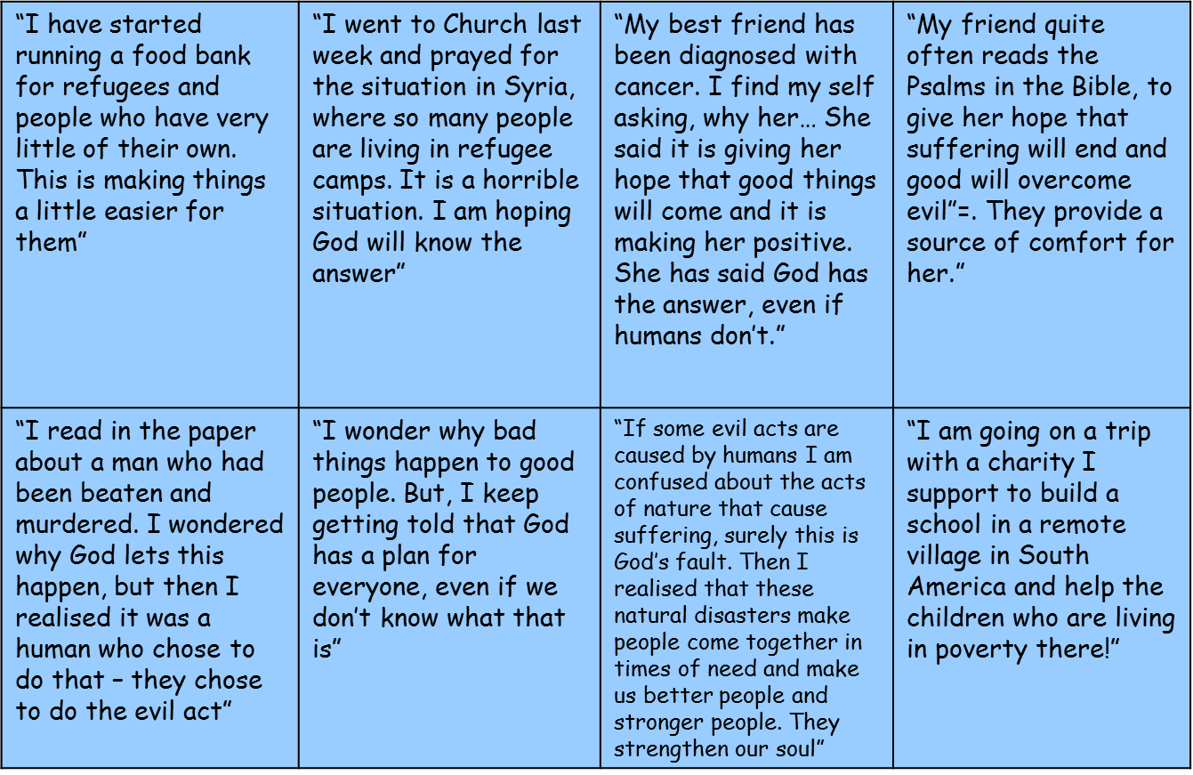
Christian Responses
Over the next 3 lessons we will be looking at a series of different responses to evil and suffering.
For non-religious people they claim evil and God cannot BOTH exist.
But for Christians they think this is possible and we will be exploring HOW and WHY they think this.
To do this we will look at Biblical, theoretical and practical explanations.
So let’s have some practice and see what we can guess.
Read the cards and categorise them under the appropriate headings:
Theoretical responses
Practical responses
Biblical responses

Slide 9
“I have started running a food bank for refugees and people who have very little of their own. This is making things a little easier for them” | “I went to Church last week and prayed for the situation in Syria, where so many people are living in refugee camps. It is a horrible situation. I am hoping God will know the answer” | “My best friend has been diagnosed with cancer. I find my self asking, why her… She said it is giving her hope that good things will come and it is making her positive. She has said God has the answer, even if humans don’t.” | “My friend quite often reads the Psalms in the Bible, to give her hope that suffering will end and good will overcome evil”=. They provide a source of comfort for her.”
“I read in the paper about a man who had been beaten and murdered. I wondered why God lets this happen, but then I realised it was a human who chose to do that – they chose to do the evil act” | “I wonder why bad things happen to good people. But, I keep getting told that God has a plan for everyone, even if we don’t know what that is” | “If some evil acts are caused by humans I am confused about the acts of nature that cause suffering, surely this is God’s fault. Then I realised that these natural disasters make people come together in times of need and make us better people and stronger people. They strengthen our soul” | “I am going on a trip with a charity I support to build a school in a remote village in South America and help the children who are living in poverty there!”

Slide 10
“I have started running a food bank for refugees and people who have very little of their own. This is making things a little easier for them” | “I went to Church last week and prayed for the situation in Syria, where so many people are living in refugee camps. It is a horrible situation. I am hoping God will know the answer” | “My best friend has been diagnosed with cancer. I find my self asking, why her… She said it is giving her hope that good things will come and it is making her positive. She has said God has the answer, even if humans don’t.” | “My friend quite often reads the Psalms in the Bible, to give her hope that suffering will end and good will overcome evil”=. They provide a source of comfort for her.”
“I read in the paper about a man who had been beaten and murdered. I wondered why God lets this happen, but then I realised it was a human who chose to do that – they chose to do the evil act” | “I wonder why bad things happen to good people. But, I keep getting told that God has a plan for everyone, even if we don’t know what that is” | “If some evil acts are caused by humans I am confused about the acts of nature that cause suffering, surely this is God’s fault. Then I realised that these natural disasters make people come together in times of need and make us better people and stronger people. They strengthen our soul” | “I am going on a trip with a charity I support to build a school in a remote village in South America and help the children who are living in poverty there!”
“I have started running a food bank for refugees and people who have very little of their own. This is making things a little easier for them” | “I went to Church last week and prayed for the situation in Syria, where so many people are living in refugee camps. It is a horrible situation. I am hoping God will know the answer” | “My best friend has been diagnosed with cancer. I find my self asking, why her… She said it is giving her hope that good things will come and it is making her positive. She has said God has the answer, even if humans don’t.” | “My friend quite often reads the Psalms in the Bible, to give her hope that suffering will end and good will overcome evil”=. They provide a source of comfort for her.”
“I read in the paper about a man who had been beaten and murdered. I wondered why God lets this happen, but then I realised it was a human who chose to do that – they chose to do the evil act” | “I wonder why bad things happen to good people. But, I keep getting told that God has a plan for everyone, even if we don’t know what that is” | “If some evil acts are caused by humans I am confused about the acts of nature that cause suffering, surely this is God’s fault. Then I realised that these natural disasters make people come together in times of need and make us better people and stronger people. They strengthen our soul” | “I am going on a trip with a charity I support to build a school in a remote village in South America and help the children who are living in poverty there!”

Slide 11
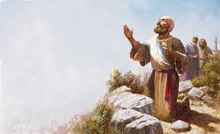
Christian Responses
Responses Christians give to the problem of evil and suffering:
God gave people free will and they choose to do right or wrong. Otherwise people would be like robots.
Evil and suffering encourages people to pray meaning they are in communication with God.
The Devil tempts people into evil like he did with Eve in the Garden of Eden.
People can not know God’s reasons for allowing evil. Which story does this relate to?
Christians should work hard for justice following the example of Jesus.
The Vale of Soul Making: without bad we can not have good and people doing good deeds becoming better people for example giving to charity, running charities etc.
Natural evil might have a more positive effect that humans are not aware of, for example forest fires making the way for new trees. Psalm 119
Stick in and read these solutions. Let’s see if we can figure out which ones are biblical, theoretical and practical solutions.

Slide 12
Solutions Christians give to the problem of evil and suffering:
God gave people free will and they choose to do right or wrong. Otherwise people would be like robots.
Evil and suffering encourages people to pray meaning they are in communication with God.
The Devil tempts people into evil like he did with Eve in the Garden of Eden.
People can not know God’s reasons for allowing evil. Which story does this relate to?
Christians should work hard for justice following the example of Jesus.
The Vale of Soul Making: without bad we can not have good and people doing good deeds becoming better people for example giving to charity, running charities etc.
Natural evil might have a more positive effect that humans are not aware of, for example forest fires making the way for new trees. Psalm 119
Solutions Christians give to the problem of evil and suffering:
God gave people free will and they choose to do right or wrong. Otherwise people would be like robots.
Evil and suffering encourages people to pray meaning they are in communication with God.
The Devil tempts people into evil like he did with Eve in the Garden of Eden.
People can not know God’s reasons for allowing evil. Which story does this relate to?
Christians should work hard for justice following the example of Jesus.
The Vale of Soul Making: without bad we can not have good and people doing good deeds becoming better people for example giving to charity, running charities etc.
Natural evil might have a more positive effect that humans are not aware of, for example forest fires making the way for new trees. Psalm 119
Solutions Christians give to the problem of evil and suffering:
God gave people free will and they choose to do right or wrong. Otherwise people would be like robots.
Evil and suffering encourages people to pray meaning they are in communication with God.
The Devil tempts people into evil like he did with Eve in the Garden of Eden.
People can not know God’s reasons for allowing evil. Which story does this relate to?
Christians should work hard for justice following the example of Jesus.
The Vale of Soul Making: without bad we can not have good and people doing good deeds becoming better people for example giving to charity, running charities etc.
Natural evil might have a more positive effect that humans are not aware of, for example forest fires making the way for new trees. Psalm 119
Solutions Christians give to the problem of evil and suffering:
God gave people free will and they choose to do right or wrong. Otherwise people would be like robots.
Evil and suffering encourages people to pray meaning they are in communication with God.
The Devil tempts people into evil like he did with Eve in the Garden of Eden.
People can not know God’s reasons for allowing evil. Which story does this relate to?
Christians should work hard for justice following the example of Jesus.
The Vale of Soul Making: without bad we can not have good and people doing good deeds becoming better people for example giving to charity, running charities etc.
Natural evil might have a more positive effect that humans are not aware of, for example forest fires making the way for new trees. Psalm 119

