Slide 1
Lesson 1: Animal and Plant Cells
LO: To be able to identify the key organelles in an animal and plant cell, and explain their function.
CO: To be able to differentiate between animal and plant cells based on their organelles.
Starter:
What is the link between these different words?
Cell Organelle Organ Tissue System
Notes:
Animal and Plant cell worksheet

Slide 2
Today we are looking at these!
Tissues are a group of cells working together
Organs are a group of different tissues working to fulfil a function.
Organ systems are multiple organs working together.
An organism is a living being!

Slide 3
On your tables on the blank paper provided
Draw a diagram of an animal and plant cell.
Label any key parts; can you explain what they do?
Do this independently – you are in competition with other members of your table to see who can draw the best!
YOU HAVE 4 MINUTES
Notes:
Encourage students to draw on the board their answers.
Opportunity for differentiation – students can identify the organelles, before more able students explain their functions.
Students can draw a second diagram during this time.

Slide 4
Animal and plant cell
Task- complete animal and plant cell worksheet. You should have covered some of the work previously in year 9.
I’m going to give you 6 minutes.
Extension:
Which structures are found in plant cells that are not found in animal cells?

Slide 5
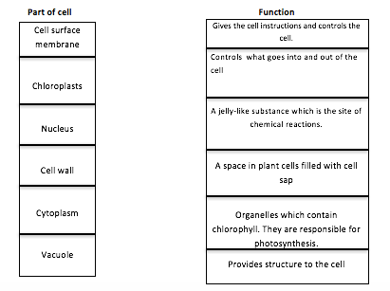

Slide 6
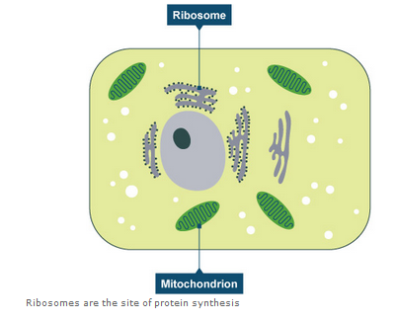
Ribosomes and Mitochondria
Two new organelles!
Ribosomes:
Ribosomes are found in cells and they are responsible for making proteins
Mitochondria is where respiration takes place and it gives the cell energy.

Slide 7
Do you think this is a plant or animal cell? Why?

Slide 8
Do you think this is a plant or animal cell? Why?

Slide 9
Do you think this is a plant or animal cell? Why?

Slide 10
AFL POINT
LO: To be able to identify the key organelles in an animal and plant cell, and explain their function.
CO: To be able to differentiate between animal and plant cells based on their organelles.
After today’s lesson, I feel confident that I can…
My understanding would be improved if I…
I can improve my understanding at home by…

