Slide 1
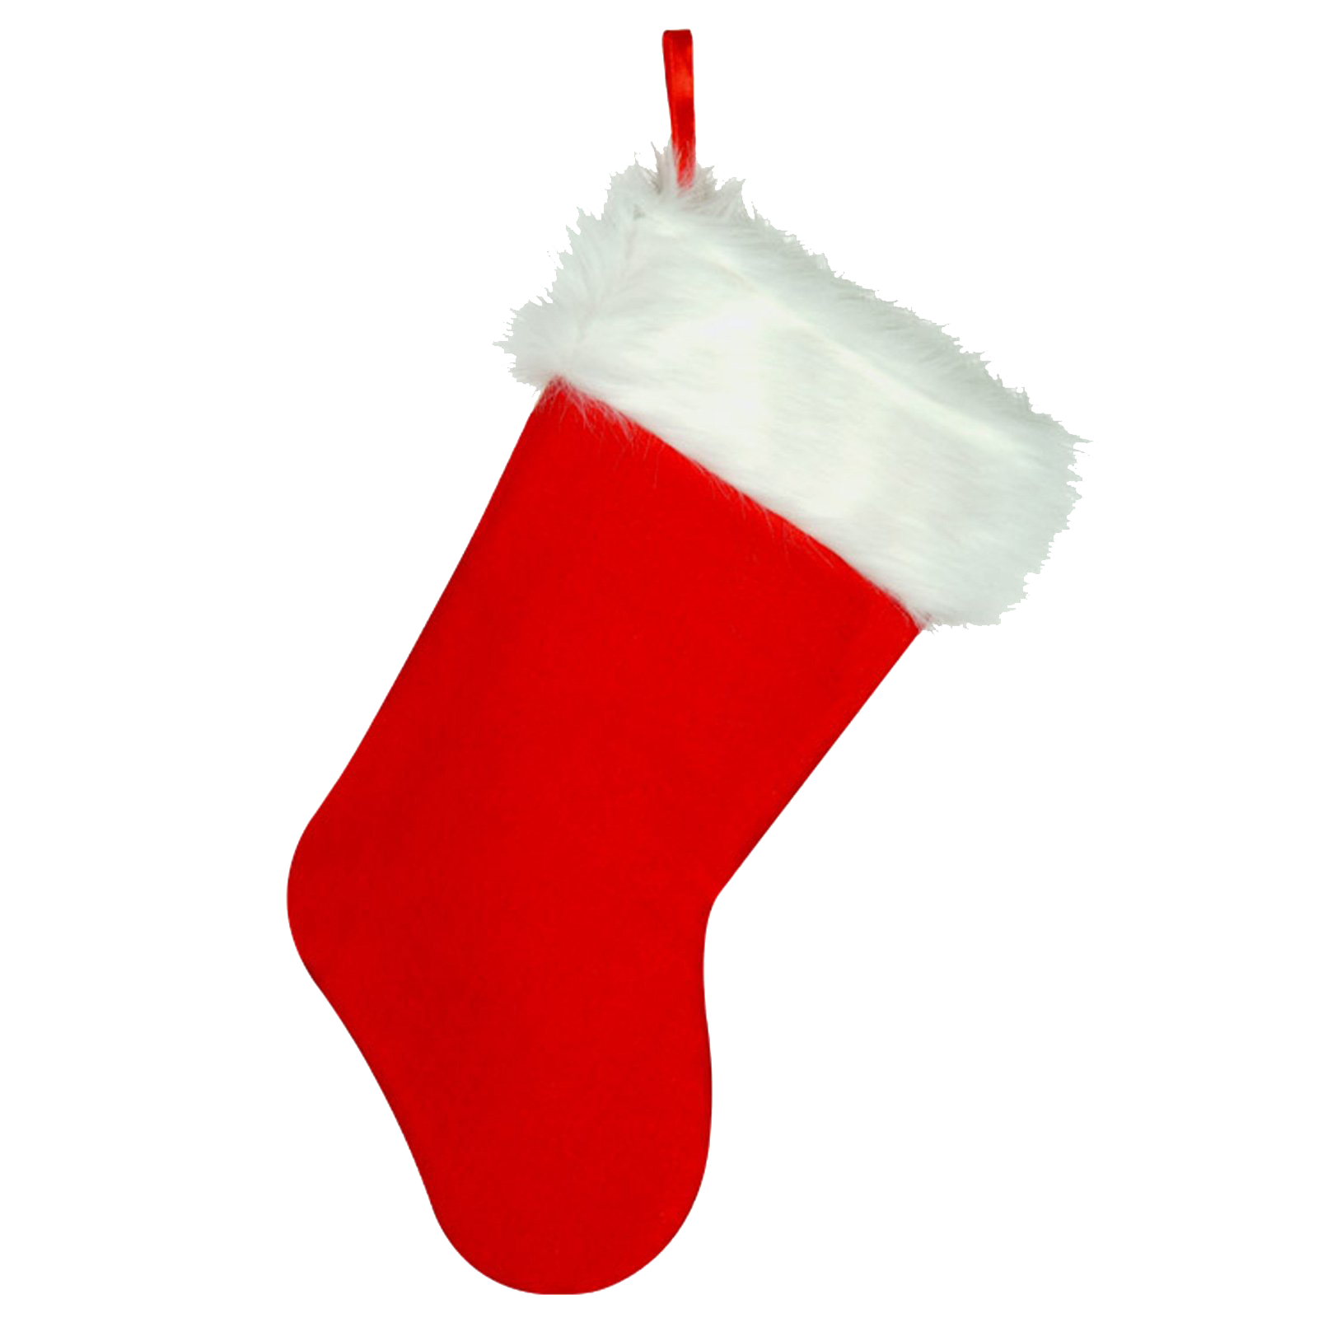
Word sort
Help Santa sort the presents for each child into alphabetical order
Alex
banana
ball
boat
bat
Barbie
Lee
Hot wheels
hedgehog
Hatchimals
Hexbug gecko
Eddie
pyjamas
PlayStation
penguin
Play-doh
painting set
Emily
dress
doll
dinosaur
Disney princess
dartboard
This Photo by Unknown Author is licensed under CC BY-NC

