Slide 1
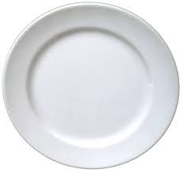
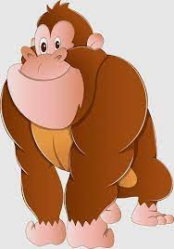
Name:________________ Date:___________________
Phonics
1.
7.
Chn to write the words in the boxes next to the picture.
2.
8.
3.
9.
4.
10.
5.
11.
6.
12.

