Slide 1

How can studying English and a variety of texts help me in a future career?
Year 7 English Careers

Slide 2
Why do you think we study English at school?
Discuss with your partner and note down on your sheet
Be prepared to share your ideas

Slide 3
Why Learning English at School is Important
- Builds strong communication skills
- Improves reading, writing, and speaking
- Helps with exams and further education
- Opens doors to many career paths
- Develops critical thinking and creativity

Slide 4

Why Study English?
Why is it important that we can communicate effectively?
Develop essential skills: English isn't just about reading books. It's about learning to think critically, analyse information, and communicate effectively. These are transferable skills valuable in almost any career.
Explore human experience: Studying literature allows you to understand different cultures, historical periods, and human motivations.
Master communication: You'll learn to write clearly, persuasively, and concisely—a skill that is always in demand.
Become a lifelong learner: The field is constantly evolving, encouraging a curiosity that extends beyond the classroom.

Slide 5
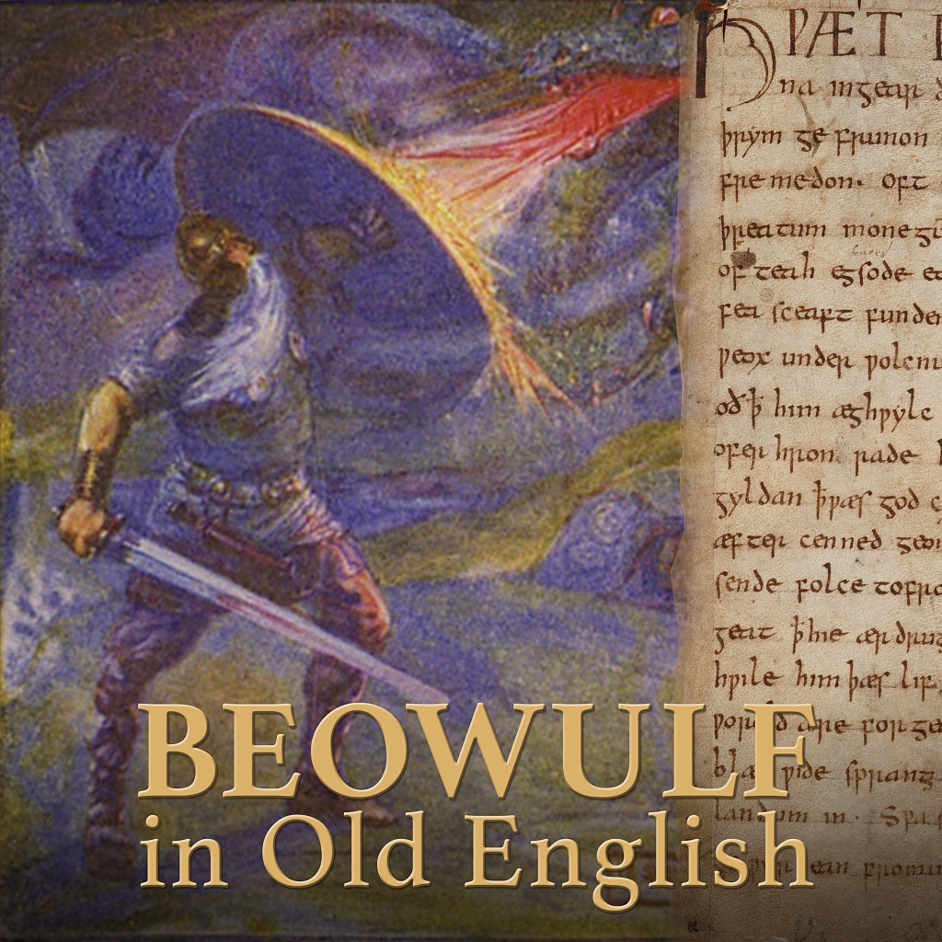
Careers in English, from Chaucer to the Digital Age

Slide 6
What careers do you think you could go into with English? Which English skills can you use in these careers?
Discuss with your partner and note down on your sheet
Be prepared to share your ideas

Slide 7
Guess the career…

Slide 8
This industry is perfect for those who love books. Roles include editor, proofreader, literary agent, and marketing manager for a publishing house.

Slide 9
Publishing

Slide 10
A solid foundation in English is crucial for a career in journalism. You could be a reporter, columnist, or editor for a newspaper, magazine, or online publication.

Slide 11
Journalism

Slide 12
Companies need people who can craft compelling messages. Roles like copywriter, content creator, and public relations specialist are a great fit.

Slide 13
Marketing

Slide 14

Core English Careers
Are there any careers on here that we haven’t come across before?
If so, which ones? Let’s discuss as a class!
Teaching/Education: From primary school to university, an English degree is a direct path to teaching literature, grammar, and writing.
Publishing: This industry is perfect for those who love books. Roles include editor, proofreader, literary agent, and marketing manager for a publishing house.
Journalism: A solid foundation in English is crucial for a career in journalism. You could be a reporter, columnist, or editor for a newspaper, magazine, or online publication.
Marketing & Communications: Companies need people who can craft compelling messages. Roles like copywriter, content creator, and public relations specialist are a great fit.

Slide 15
So, why do you think we studied Old English and Middle English?
Discuss with your partner and note down on your sheet
Be prepared to share your ideas

Slide 16
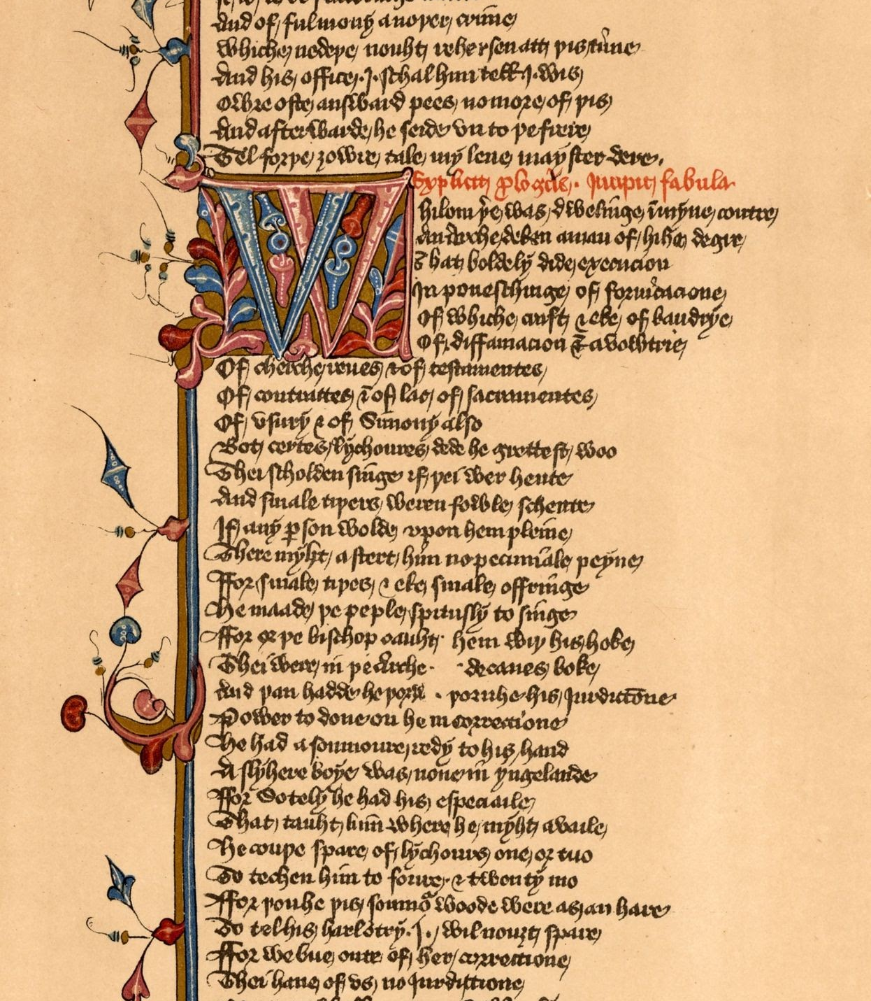
The Value of Studying Early & Middle English
A Window into Language Evolution: Studying texts like Beowulf and The Canterbury Tales provides a deep understanding of how the English language has changed over centuries. It's like being a language detective!
Analytical Mastery: Deciphering complex, archaic texts hones your close reading and analytical skills to an expert level.
Historical & Cultural Context: These texts aren't just stories; they're historical documents that reveal the values, beliefs, and social structures of their time.

Slide 17
Guess the career…

Slide 18
A love for this period can lead to a career as a ………………… specializing in medieval literature, history, or linguistics.

Slide 19
University Professor or Researcher

Slide 20
Special collections libraries and archives often need experts who can catalog, preserve, and interpret rare and historical documents.

Slide 21
Archivist / Librarian

Slide 22
You could work in a place of history, helping to design exhibits and write educational materials about medieval artifacts and history.

Slide 23
Museum Curator

Slide 24
This specialised role involves translating or transcribing old manuscripts for modern readers.

Slide 25
Translator / Editor of Historical Texts

Slide 26

Niche Careers with an Early & Middle English Specialism
How well did you do?
How many of these jobs had you heard of before today?
Do any of these jobs interest you? If so, why / why not?
Discuss with your partners and then be ready to feedback to the class
Academic Research: A love for this period can lead to a career as a university professor or researcher, specializing in medieval literature, history, or linguistics.
Archivist/Librarian: Special collections libraries and archives often need experts who can catalog, preserve, and interpret rare and historical documents.
Museum Curator: You could work in a museum, helping to design exhibits and write educational materials about medieval artifacts and history.
Translator/Editor of Historical Texts: This specialised role involves translating or transcribing old manuscripts for modern readers.

Slide 27

Why does English and Studying Romeo & Juliet Matter?
Exploring Language, Literature, and Careers in Theatre

Slide 28
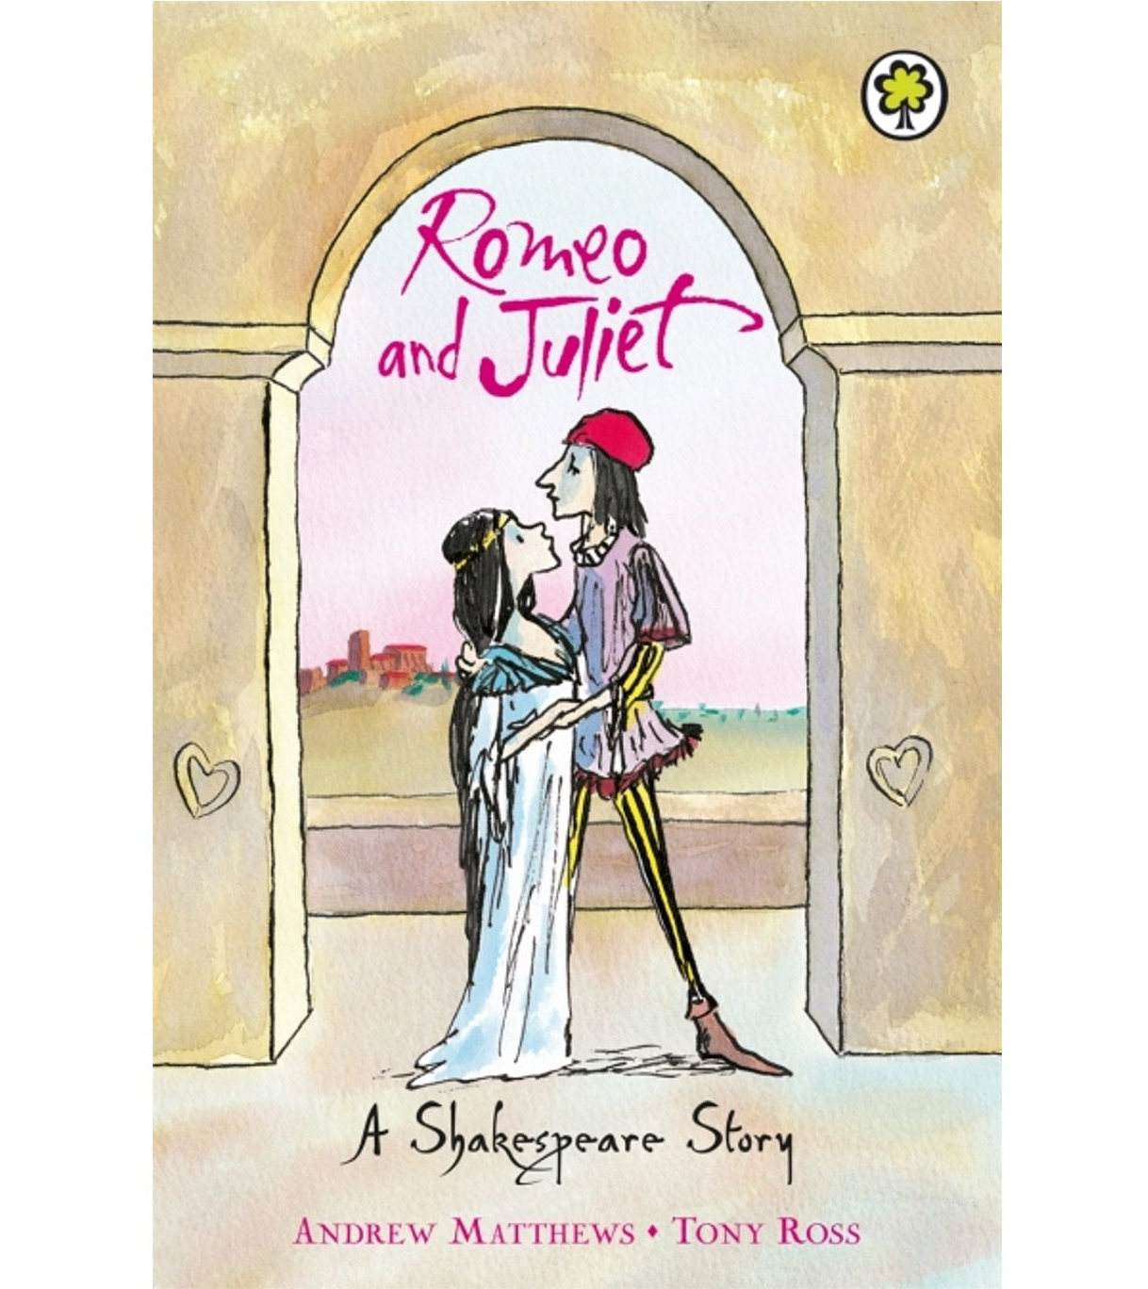
Why Study Romeo & Juliet?
- One of Shakespeare’s most famous plays
- Explores themes like love, conflict, and family
- Teaches us about human emotions and choices
- Helps us understand history and culture
- Encourages empathy and deeper thinking

Slide 29

How English and Shakespeare Connect to Theatre Careers
- Actors bring Shakespeare’s words to life
- Directors shape performances and themes
- Playwrights and writers are inspired by classics
- Stage designers create sets and costumes
- Theatre critics use strong English skills to review shows
Studying plays builds teamwork and presentation skills
Understanding Shakespeare gives an edge in arts and culture
- Strong English = confidence in any career path

Slide 30

How might an English qualification help you in the following career industries?
Complete the grid on your sheet
Law
Technological World
Corporate communications
Game Designer

Slide 31
Beyond the Obvious: Unexpected English Careers
Law: The legal profession is all about interpretation and argumentation. An English degree is great preparation for law school, as it trains you to read dense texts and construct persuasive arguments.
Technological world: UX (User Experience) Writer: In the tech world, this role involves writing the text you see on apps and websites, like buttons and menu options, to make them easy to use.
Corporate Communications: Large companies need writers for internal newsletters, press releases, and speeches for executives.
Game Designer/Narrative Designer: If you love storytelling, you can create the plots and characters for video games

Slide 32

Career Action Plan
Gain Experience: Volunteer for the school newspaper, start a blog, or get an internship with a local publisher or marketing company.
Network: Talk to professionals in fields you're interested in. Ask them about their career paths and for advice.
Build a Portfolio: Create a collection of your best writing samples, whether they're academic essays, creative pieces, or blog posts.
Leverage your Skills: In interviews, don't just talk about the books you read. Emphasize your analytical skills, communication abilities, and capacity for critical thinking.

Slide 33

Which of the careers that you’ve learnt about, might you be interested in?
Explain why on your sheet and how you might work towards that in the near future and long-term goals

Slide 34
What did you like about this session? What new things did you learn about?

