Slide 1
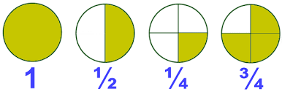
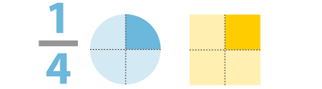
Fractions
What is a fraction
Identifying simple fractions
Finding equivalent fractions
Simplifying fractions

