Slide 1


GCSE Drama
Component 2 Booklet
Name:
Candidate Number:
Performance 1 Character: Group type: Pages: | Performance 2 Character: Group type: Pages:

Slide 2
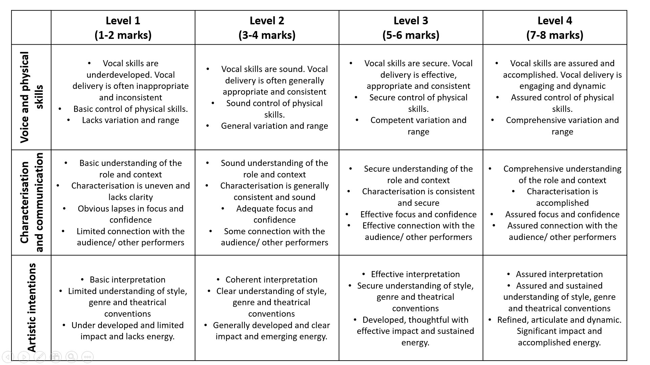
COMPONENT 2 ASSESSMENT CRITERIA

Slide 3
Timings:
Monologue: 2-3 Minutes
Duologue: 3-5 Minutes
Group Piece: 10-15 mins
Note: YOU MUST NOT BE UNDER THE MINIMUM – if you are under minimum time there is a penalty and you cannot access the top band!
If you go over the maximum time anything beyond that point will not be marked.
The Marking:
Performers get marked on:
Vocal and Physical Skills: /8
Characterisation and Communication: /8
Artistic intention and style/genre/theatrical conventions: /8
Frequently Asked Questions:
Do we get marked individually? – Yes! You will get a separate mark /24 for each monologue
What happens if I say my line wrong? – The examiner will not be checking the script line for line. What they are looking for is your performance ability. If you mess up – just keep going. You will not be allowed to start again in the exam.
Can I get full marks? – Yes! It is possible to get full marks on this exam – it is however is hard to get full marks. You should all be aiming for a 6 or above on each category.
How much is it worth? – This component is worth 20% of your overall grade. 10% each performance
Who marks it? – The exam board mark your performances. Miss Haynes will video your work and send it in. She can give you a rough idea of what you may receive however this is not confirmed. You will find out the grade on Results Day in August
Do props and costume impact the grade? – Technically no, however, you are marked on your characterisation and how well you communicate the character to the audience, costume/lighting/sound/props/set will help you.

Slide 4
UNDERSTANDING THE PLAY
Who wrote the play?
Where was it first performed?
Where is the play set?
What is the genre of your play?
Play:
What is the style of your play?
When was it written?
When was it set?
What is your play about?
____________________________________________________________________________________________________________________________________________________________________________________________________________________________________________________
What were the playwrights intention?
____________________________________________________________________________________________________________________________________________________________________________________________________________________________________________________

Slide 5
CONTEXT: What was going on in the world at the time of your play?
Historically
Socially
Politically

Slide 6
Mood board of your play
A mood board is a visual tool that helps you communicate your design concepts and ideas.

Slide 7
Playwright profile
Here you should gather information about the playwright.

Slide 8
Performance 1 Exploration
Character:
What does your character want to achieve in this scene?
What has happened before this scene?
________________________________________________________________________________________________________________________________________________________________________________________________________________________
_________________________________________________________________________________________________________________________________________________________________________________________________________________________________
What happens in this scene?
___________________________________________________________________________________________________________________________________________________________________________________________________________________________________________________________________________________________________________________________________________________________________________________________________________________________________________
What happens after this scene?
_____________________________________________________________________________________________________________________________________________________________________________________________________________________________________________________________________________________________

Slide 9
Performance 1: Performance skills
Will they change?
Any words you will emphasise? How will you use pace?
What is your tone?
How will you use your voice to communicate your intention?
How will you use VOCAL SKILLS in this scene?
_____________________________________________________________________________________________________________________________________________________________________________________________________________________________________________________________________________________________________________________________________________________________________________________________________________________
How will you use PHYSICAL SKILLS in this scene?
_____________________________________________________________________________________________________________________________________________________________________________________________________________________________________________________________________________________________________________________________________________________________________________________________________________________
How will you use STAGE SPACE in this scene?
_____________________________________________________________________________________________________________________________________________________________________________________________________________________________________________________________________________________________________________________________________________________________________________________________________________________
Will they change?
How will you use your stance? Gait?
What particular facial expressions? How will you use pace?
How will you use eye contact? How will you use your physicality to communicate your intention?
When and how will you change level?
Proxemics?
Where will you stand?
How will you use stage space to meet your intentions?

Slide 10
Performance 1: Hot-seating
Name: Age: Occupation:
If you could have a super power, what would it be? ____________________________________________________________________________________________________________________________________
You get three wishes: What do you wish for?
____________________________________________________________________________________________________________________________________________________________________________________
What is the nicest thing that someone has done for you?
____________________________________________________________________________________________________________
What three words would you use to describe yourself?
__________________________________________________________________________________________
What is your dream job? And why?
___________________________________________________________________________________________________________________________________________________________
What is one of your strengths?
______________________________________________________________________________________________________________________________________________________
Where do you see yourself in ten years’ time?
______________________________________________________________________________________________________________________________________________________
What is your biggest fear?
______________________________________________________________________________________________________________________________________________________________________________________________________

Slide 11
Performance 1: Notes
________________________________________________________________________________________________________________________________________________________________________________________________________________________________________________________________________________________________________________________________________________________________________________________________________________________________________________________________________________________________________________________________________________________________________________________________________________________________________________________________________________________________________________________________________________________________________________________________________________________________________________________________________________________________________________________________________________________________________________________________________________________________________________________________________________________________________________________________________________________________________________________________________________________________________________________________________________________________________________________________________________________________________________________________________________________________________________________________________________________________________________________________________________________________________________________________________________________________________________________________________________________________________________________________________________________________________________________________

Slide 12
Performance 1 Exploration
Character:
What does your character want to achieve in this scene?
What has happened before this scene?
______________________________________________________________________________________________________________________________________________________________________________________________________________________________________________________________________________________
_________________________________________________________________________________________________________________________________________________________________________________________________________________________________
What happens in this scene?
___________________________________________________________________________________________________________________________________________________________________________________________________________________________________________________________________________________________________________________________________________________________________________________________________________________________________________
What happens after this scene?
_____________________________________________________________________________________________________________________________________________________________________________________________________________________________________________________________________________________________

Slide 13
Performance 2 Exploration
Character:
What does your character want to achieve in this scene?
What has happened before this scene?
______________________________________________________________________________________________________________________________________________________________________________________________________________________________________________________________________________________
_________________________________________________________________________________________________________________________________________________________________________________________________________________________________
What happens in this scene?
___________________________________________________________________________________________________________________________________________________________________________________________________________________________________________________________________________________________________________________________________________________________________________________________________________________________________________
What happens after this scene?
_____________________________________________________________________________________________________________________________________________________________________________________________________________________________________________________________________________________________

Slide 14
Performance 2: Performance skills
Will they change?
Any words you will emphasise? How will you use pace?
What is your tone?
How will you use your voice to communicate your intention?
How will you use VOCAL SKILLS in this scene?
_____________________________________________________________________________________________________________________________________________________________________________________________________________________________________________________________________________________________________________________________________________________________________________________________________________________
How will you use PHYSICAL SKILLS in this scene?
_______________________________________________________________________________________________________________________________________________________________________________________________________________________________________________________________________________________________________________________________________________________________________________________________________________
How will you use STAGE SPACE in this scene?
_____________________________________________________________________________________________________________________________________________________________________________________________________________________________________________________________________________________________________________________________________________________________________________________________________________________
Will they change?
How will you use your stance? Gait?
What particular facial expressions? How will you use pace?
How will you use eye contact? How will you use your physicality to communicate your intention?
When and how will you change level?
Proxemics?
Where will you stand?
How will you use stage space to meet your intentions?

Slide 15
Performance 2: Hot-seating
Name: Age: Occupation:
If you could have a super power, what would it be? ____________________________________________________________________________________________________________________________________
You get three wishes: What do you wish for?
____________________________________________________________________________________________________________________________________________________________________________________
What is the nicest thing that someone has done for you?
____________________________________________________________________________________________________________
What three words would you use to describe yourself?
__________________________________________________________________________________________
What is your dream job? And why?
___________________________________________________________________________________________________________________________________________________________
What is one of your strengths?
______________________________________________________________________________________________________________________________________________________
Where do you see yourself in ten years’ time?
______________________________________________________________________________________________________________________________________________________
What is your biggest fear?
______________________________________________________________________________________________________________________________________________________________________________________________________

Slide 16
Performance 2: Notes
________________________________________________________________________________________________________________________________________________________________________________________________________________________________________________________________________________________________________________________________________________________________________________________________________________________________________________________________________________________________________________________________________________________________________________________________________________________________________________________________________________________________________________________________________________________________________________________________________________________________________________________________________________________________________________________________________________________________________________________________________________________________________________________________________________________________________________________________________________________________________________________________________________________________________________________________________________________________________________________________________________________________________________________________________________________________________________________________________________________________________________________________________________________________________________________________________________________________________________________________________________________________________________________________________________________________________________________________

Slide 17
Written Intentions
Prior to your Component 2 exam, you have to send the examiner a short bit of writing explaining your intentions for your performance. This paragraph is 200 Words and should answer 4 questions. You will not receive a mark for these 4 questions BUT you will receive a mark based on how well you met the intentions.
Question | How to answer it | How many sentences? | Sentence Starters
1: What role are you playing? | What part you played in the | 1 Sentence | In the performance I played the role of… In the play… by …
2: What is happening to your character in the extract? | What is happening in the extract. This should be short and concise. | 1 Sentence | In this extract…..
3: What are your character’s objectives/motivations/feelings? | Explain what you are trying to show from the extract Objective - Overall, in this extract, what is the character trying to achieve? Motivation - what is driving the character? Feelings - How does the character feel? | 2-3 Sentences | In this extract my character’s objective is…. By the end of this extract I wanted to show… In this extract my character is feeling….. because/as….
4: How are you interpreting this character in the performance (vocal, physical, communication of intent)? | Explain specifically how you plan to use vocal skills, physical skills and stage space to communicate your intentions to the audience. Aim to describe at least 1 of each (use the keywords in your booklet). | 5 -7 Sentences | One way I will communicate this is through the use of… I will make this clear to the audience by… One way I will show this is by…

Slide 18
Examples of written intentions
1. In my monologue I will be performing as Verity Taylor in Find Me. In the play, Verity has an undiagnosed mental disability, she can be over excitable and uncontrollable. Find Me is about Verity growing up and how her behaviour affects those around her. This extract takes place roughly half way through the play, when Verity is about eleven years old. The monologue is about Verity’s new love for swimming, something her mother stated earlier that ‘She’s got so good at’. My objective is to show the extreme excitement she is feeling but also contrast this with a sense of self-doubt and confusion displaying the difficulties she faces in processing her feelings. To show her excitement I will speak with a high pitched, childlike voice and at times I will talk quite fast. Using movement I will use wide gestures with my feet stood apart as if she is presenting to the audience. I will also lean towards the audience to help engage them in to the piece. In contrast to this I will stop, look towards the ground, move and then continue – this will show that she has a fresh thought in her head that she can run with. I will vary between using direct address and self-address showing that she thinks out loud and there is little difference to her between talking to herself and talking to others.
2. In my monologue I will be performing as Jean Taylor, Verity’s mother. This monologue occurs after she has received a visit from social services who have told her that she ‘can’t find a residential place for Verity’. We see in the monologue that Jean has no idea how she is going to cope with the family’s situation and how she has little hope for the future. I want the audience to connect with Jean and understand her situation. I additionally want to show that Jean is voicing her feelings for the first time. To show this, I will use a conversational yet bitter tone as if she is talking to herself and reflecting on her difficult situation. I will also raise my voice in volume when Jean feels more angry at her situation such as during the line ‘Your own child that you love’. Using physical movement as I walk around I will hold on to the chairs due to shock and sit down when speaking due to how exhausted Jean feels from having to deal with Verity. I will use pause when she has realisations of how she truly feels for example during the line ‘I don’t even know if I do love her’.
Use this space to plan your own intentions:
__________________________________________________________________________________________________________________________________________________________________________________________________________________________________________________________________________________________________________________________________________________________________________________________________________________________________________________________________________________________________________________________________________________________________________________________________________________

Slide 19
Mock Performance 1
Feedback notes:
__________________________________________________________________________________________________________________________________________________________________________________________________________________________________________________________________________________________________________________________________________________________________________________________________________________________________________________________________________________________________________________________________________________

Slide 20
Mock Performance 2
Feedback notes:
__________________________________________________________________________________________________________________________________________________________________________________________________________________________________________________________________________________________________________________________________________________________________________________________________________________________________________________________________________________________________________________________________________________

