Slide 1
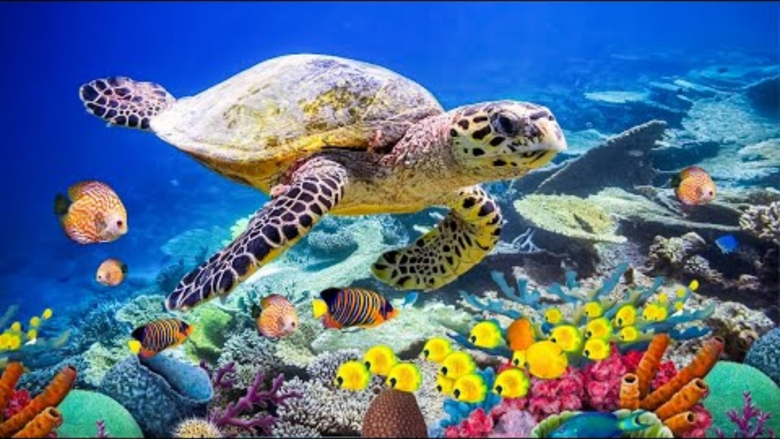
Friday Worship Song

Slide 2
Friday Worship
Welcome to our

Slide 3
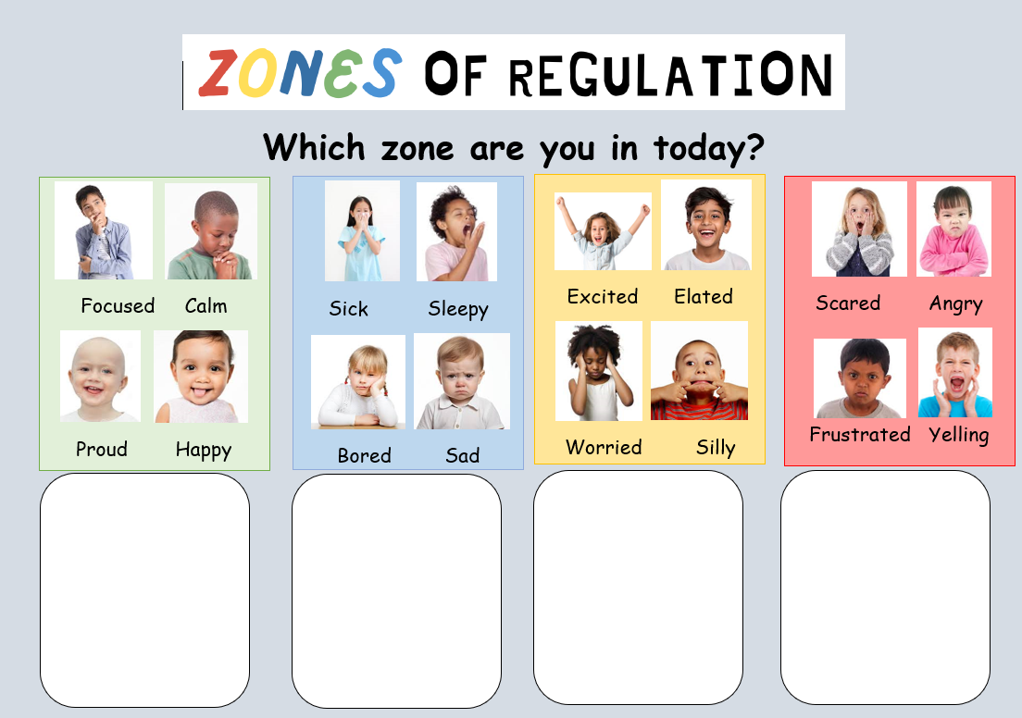
Zones of Regulation
Who can name the four zones?

Slide 4


Slide 5
What can you do when you are in these zones?
Yellow Zone
Blue Zone
Red Zone
Go for a run
Do mindfulness
Play with friends.
Colouring
Go on a trampoline
Have a rest
Take a drink or eat a snack.
Have a brain break.
Write down your feelings.
Ask for a hug
Slow breathing
Go to a safe place
Distract yourself with something you like.
Play with sensory toys.
Go to a different room.
Have some time to yourself.

Slide 6

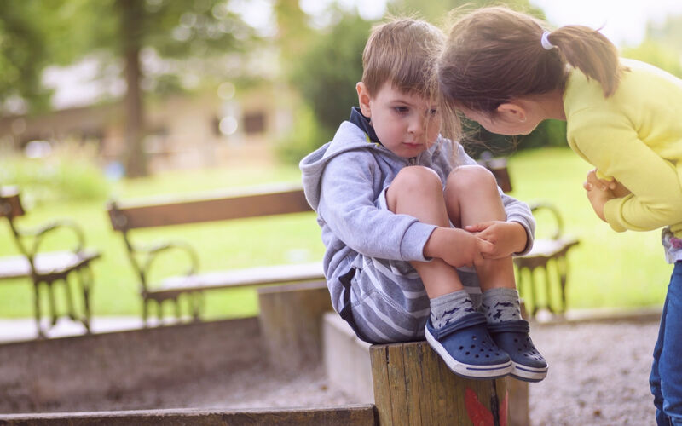
What could you do if you see something in these zones?

Slide 7

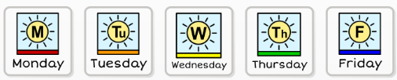

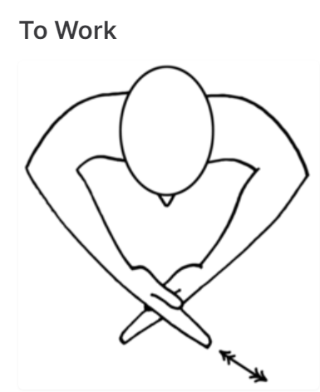
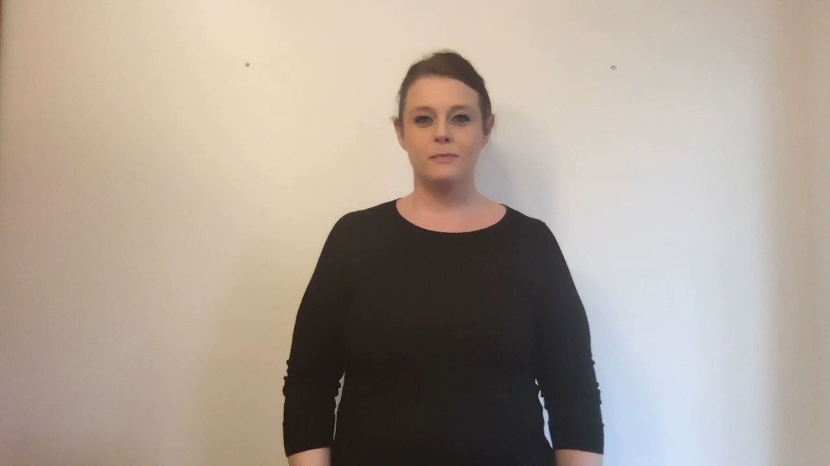
Watch here
Makaton Sign of the Week.

Slide 8




Rewards
Names and Class
Name and Class
Name and Class
Name and Class

Slide 9


Rewards
Name and Class
Name and Class

Slide 10
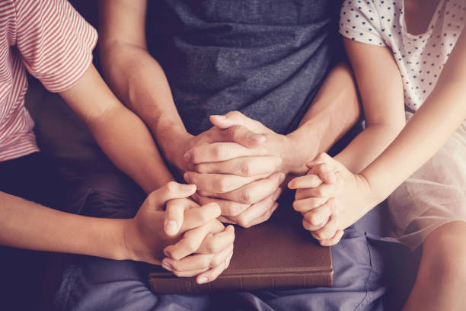

Our School Prayer

Slide 11
Our Father in Heaven,
We praise you for making the world.
We praise you for taking care of us and our school.
We are sorry for the times we fall out and hurt each other.
Help us to re-make friendships that have fallen apart.
Father, we thank you for our teachers and the opportunity to learn.
Help us with the challenges and changes we face.
Please help us to do our best and be thankful each day.
Lord in your mercy,
Hear our prayer.
Amen.

