Slide 1
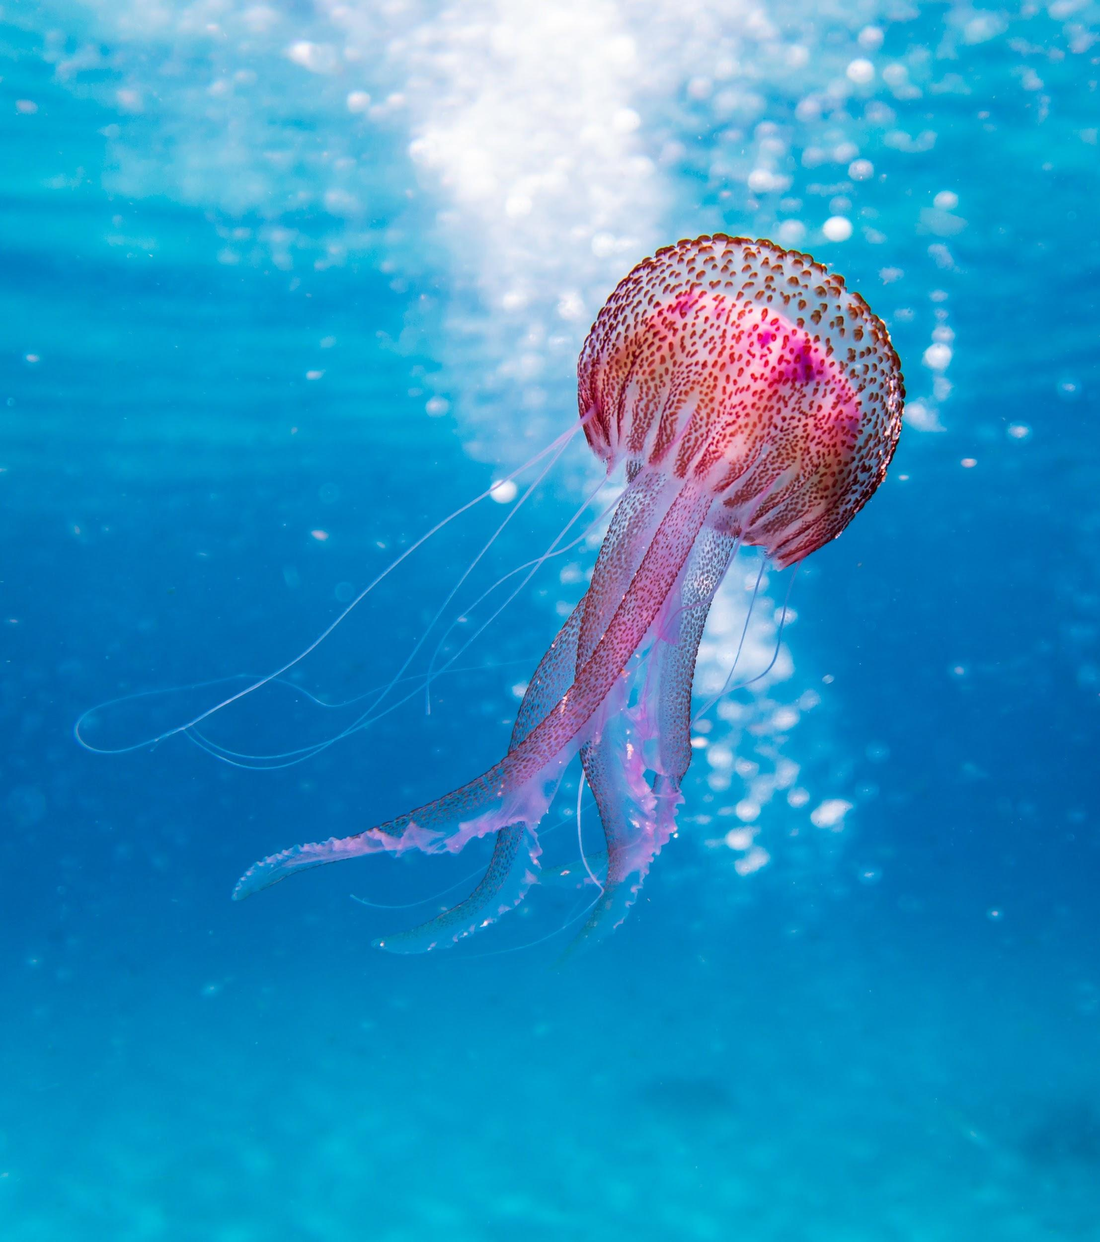
CB1 Paper 1
Biology

Slide 2
LO: To secure knowledge on using microscopes and magnification.

Slide 3
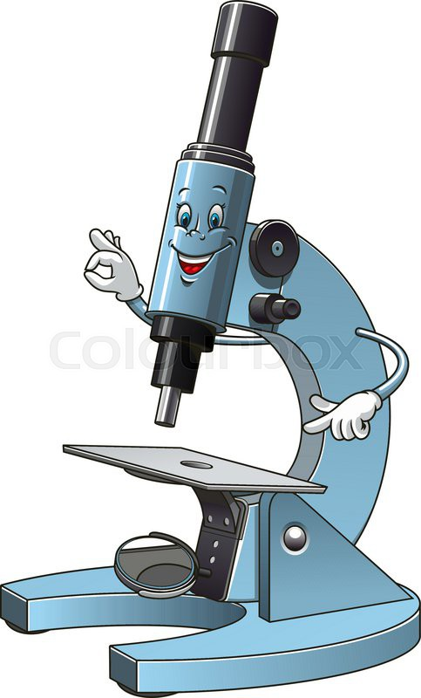
Hooke’s microscope
Hooke’s microscope had a magnification of x 30 this means it made things 30 times larger than it was.
To work out the magnification you multiply the two lens together…….. Eg the objective lens and the eyepiece lens.
Eyepiece lens is 5
The objective lens is 10
What is the magnification?

Slide 4
Detail
The detail that is from a microscope depends on its resolution.

Slide 5
Electron microscope
Was invented in the 1930s
Instead of light electrons pass through the specimen
Allow cells to be seen in great detail.
Magnifies up to x2 000 000

Slide 6
SI Units
Milli = 1000
Micro = 1000 000
Nano = 1000 000 000
Pico = 1 000 000 000 000
Example: How many micrometers are in 10 millimeters?
Working out - 10 x 1000 = 10,000 micrometers
Notes:
divide/multiply by 1000 each time
So 1 millimeter is equal to 1000 micrometers?

Slide 7
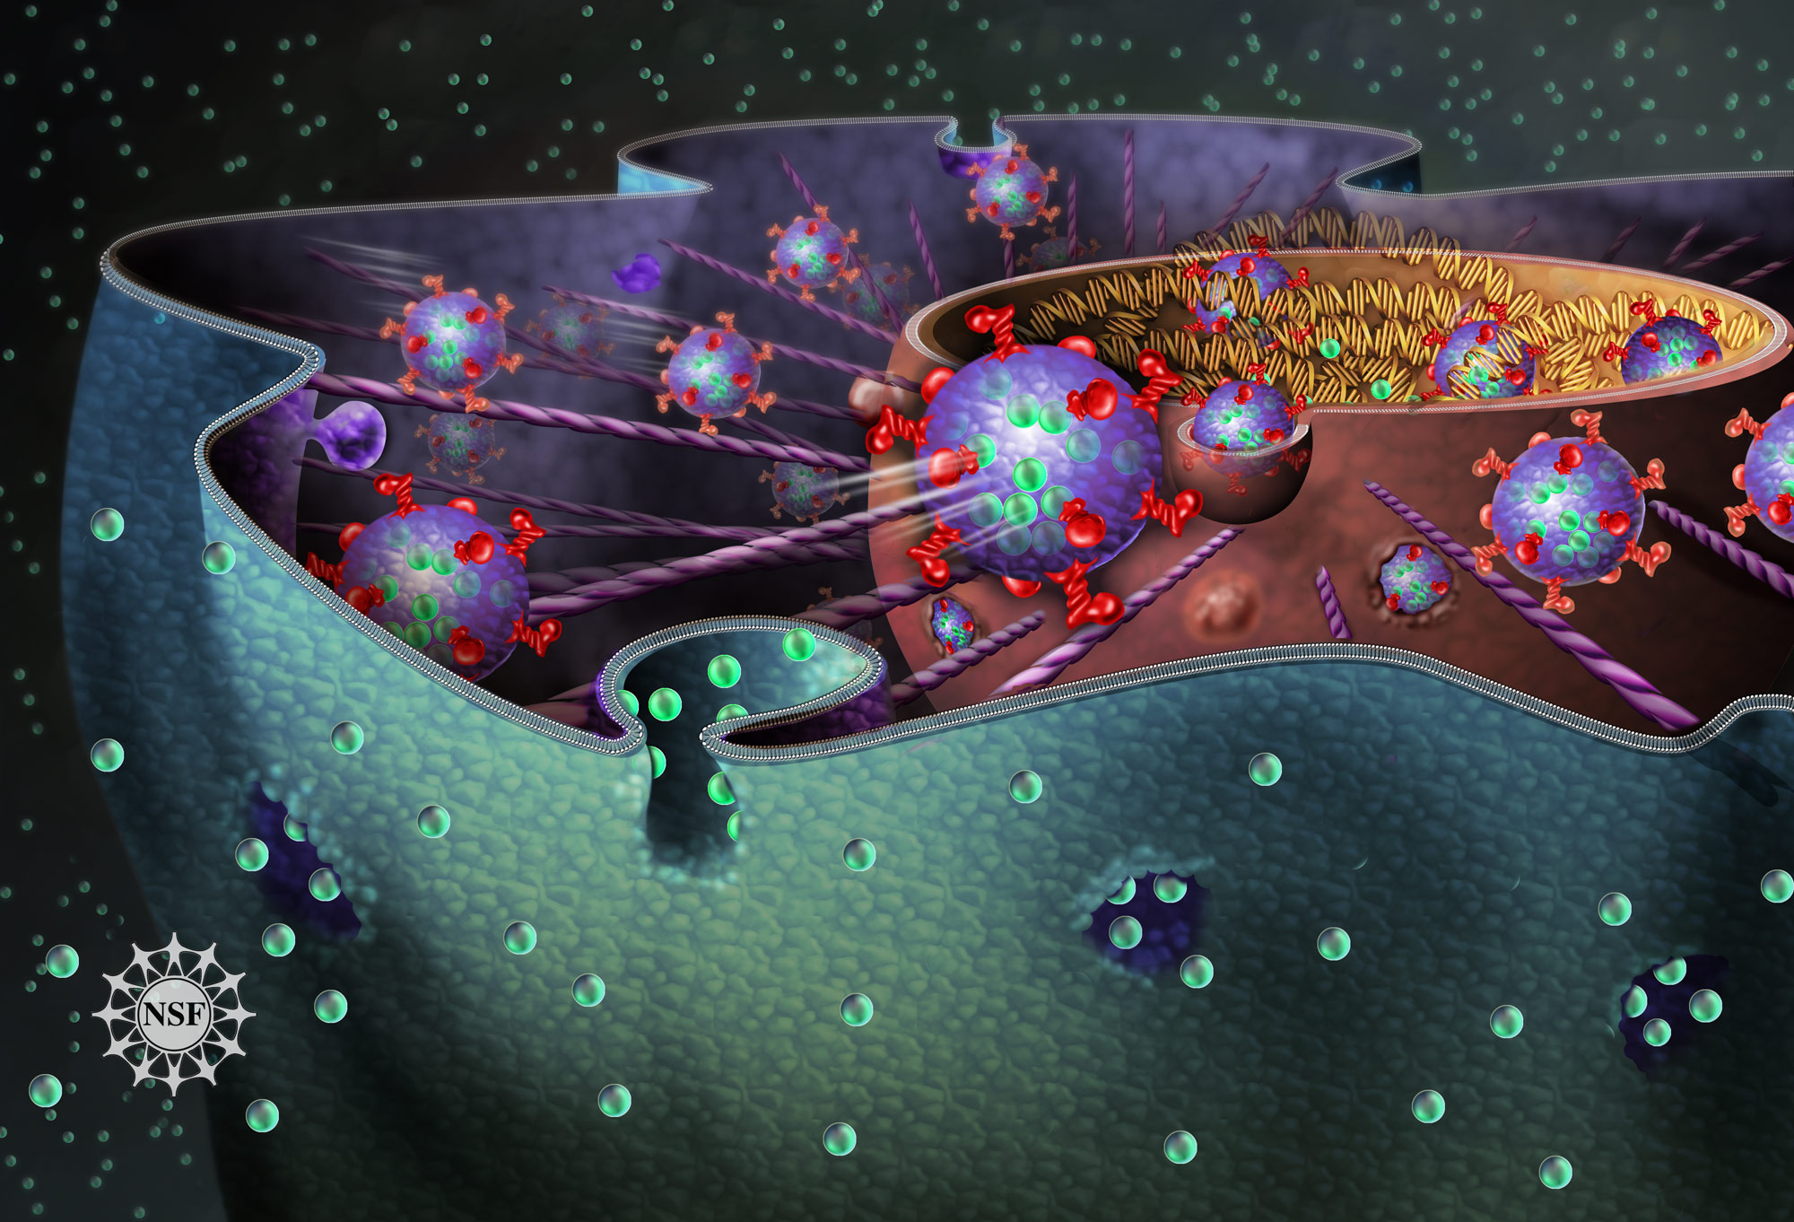
CB1 Plant and Animal Cells

Slide 8
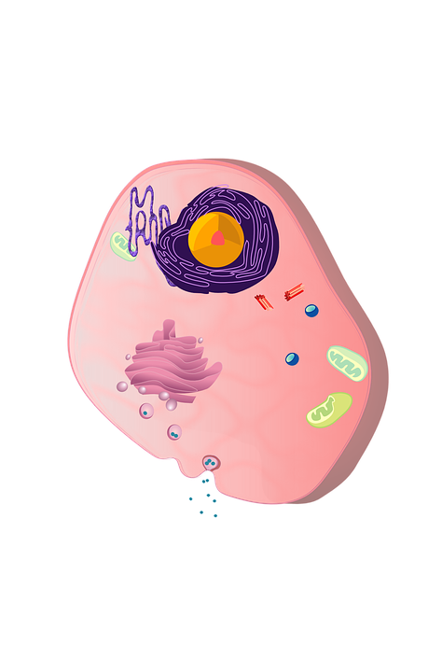
Eukaryotic cell
Has a nucleus.
This is the control centre of the cell
Contains DNA
Usually 1 per cell
Easiest to see under a microscope

Slide 9
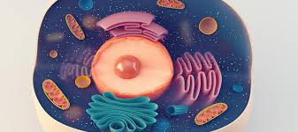
Cytoplasm
Watery jelly
Where the cells activities occur
Removes waste
Other subcellular organelles are in it
Contains ribosomes (makes new proteins for a cell.)

Slide 10
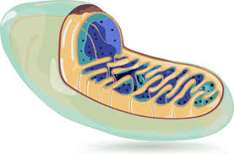
Mitochondria
Mitochondrion is a jelly bean shaped structures
It is where aerobic respiration occurs
They are very difficult to see under a light microscope

Slide 11
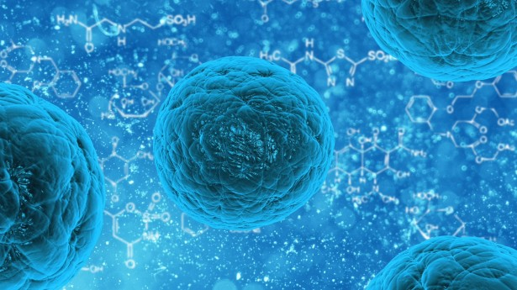
Cell membrane
Is a very thing sac
It controls what enters and what leaves
It separates one cell from another.

Slide 12
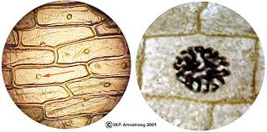
Field of view
This is the circular area you see when
You look through the microscope.
If this field of view is 36 nanometer (nm)
Then you would divide by how many cells are in there to get the size of each cell.
Eg 36/ 2 = 18 nm each cell is 18 nm

Slide 13
Electron micrographs
These allow more detail to be seen compared to a light microscope.
Scale bars are used on a microscope to estimate sizes.
If the scale bar is 10 nm in length and 3 could fit across the cell then you 10 x 3 and this will give you the length of the cell = 3.3 nm

Slide 14


Slide 15
ACTIVITY. PAGE 4-5
COMPLETE PROGRESS QUESTIONS
Exam style question
Describe the function of chloroplasts in a leaf palisade cell.

Slide 16
Title; Specialised cells
LO - To familiarise with exam questions and enhance understandings of specialised cells.

Slide 17
Self assess exam style question answer
The chloroplasts contain chlorophyll, which traps energy transferred from the sun.
The energy is used for photosynthesis.

Slide 18
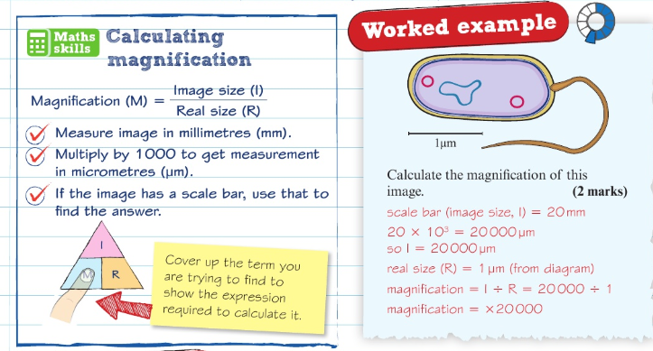

Slide 19
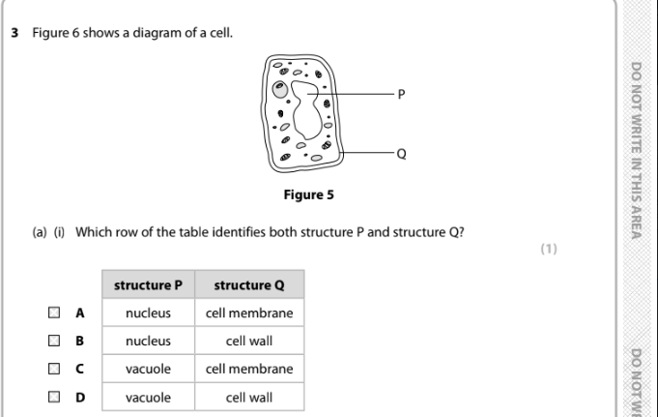


Slide 20

Self Assess

Slide 21

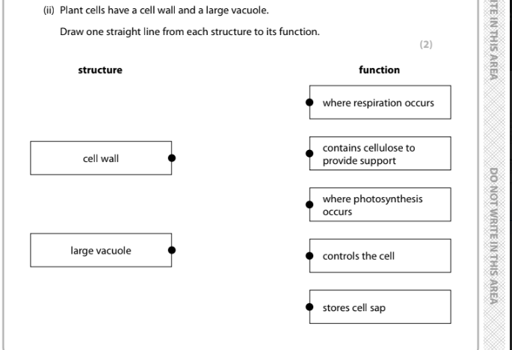

Slide 22
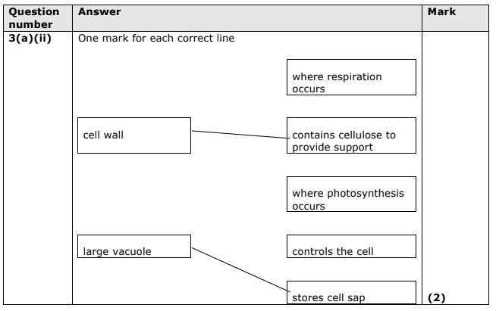

Slide 23
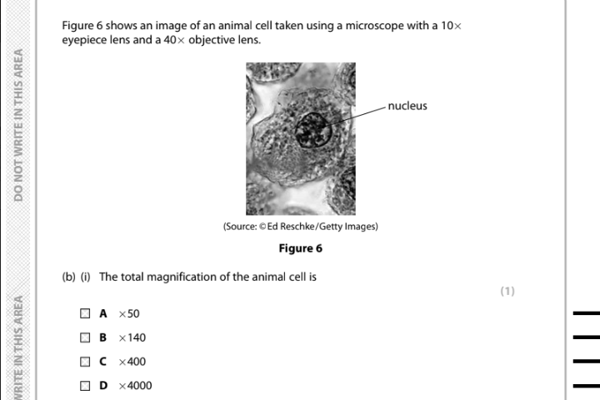

Slide 24
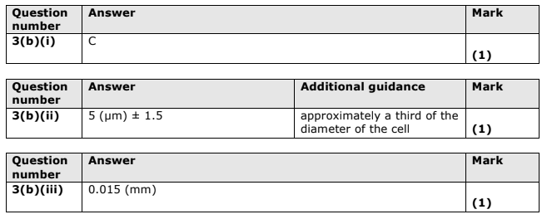

Slide 25
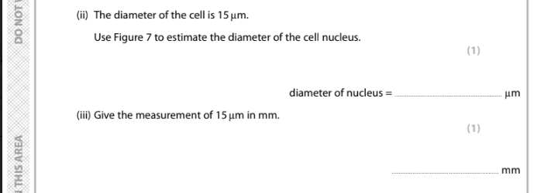

Slide 27
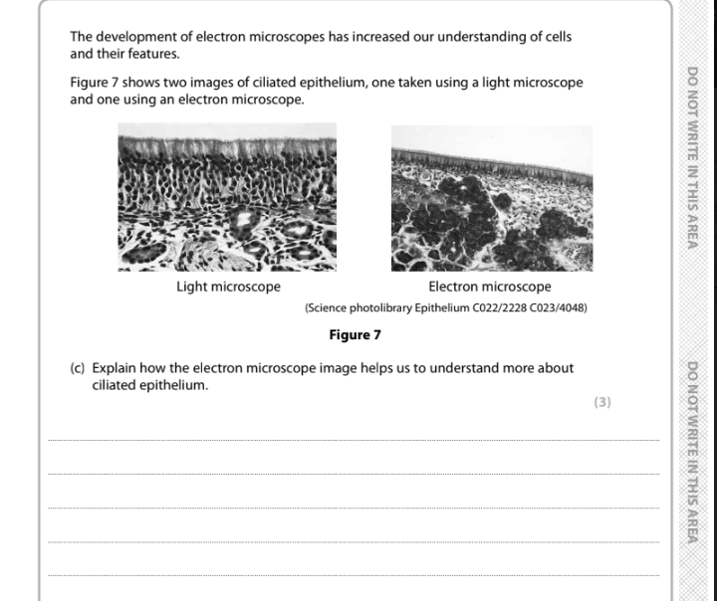
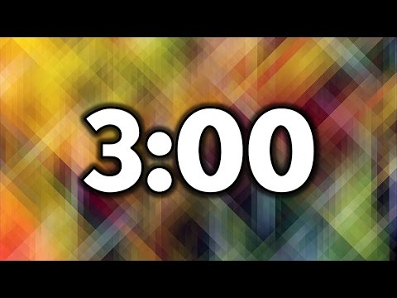

Slide 28
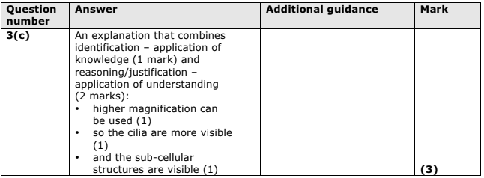

Slide 29
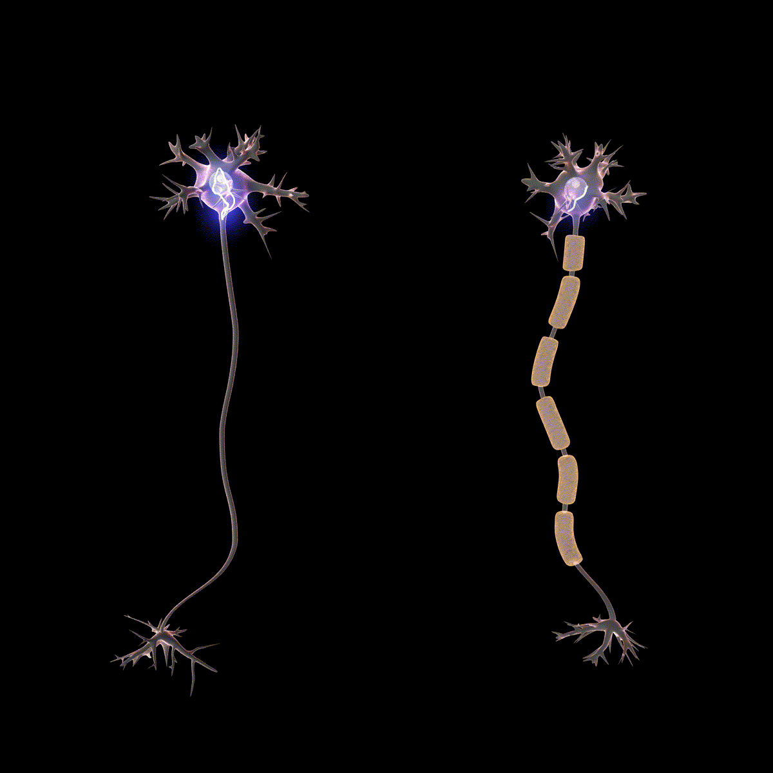
Specialised cells
CB1c

Slide 30
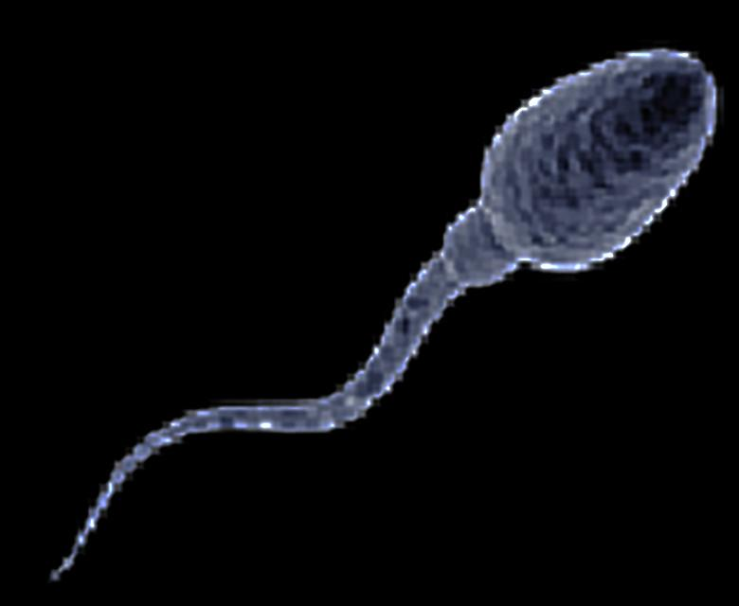
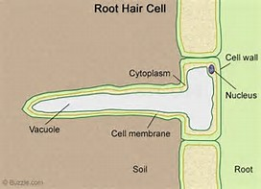
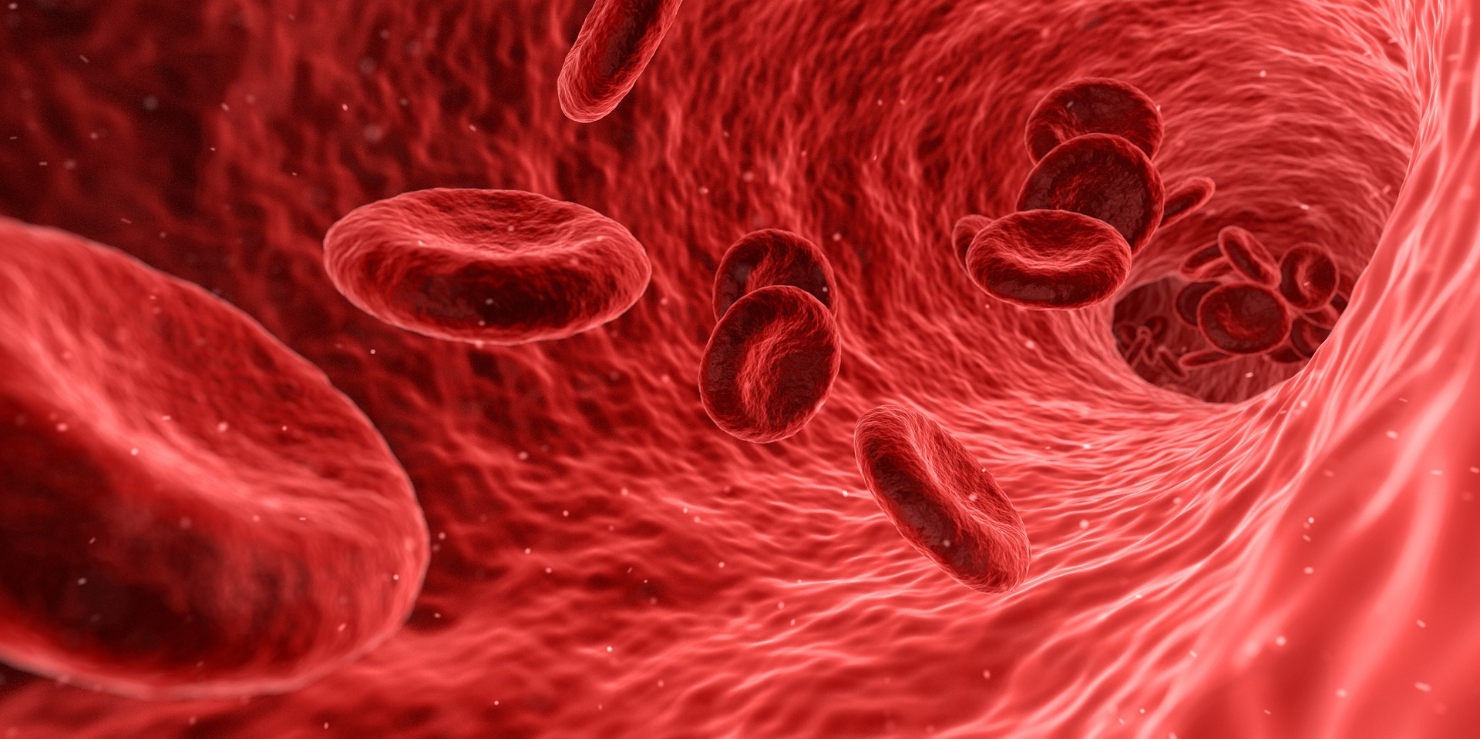
A Specialised cell
They have a specific job.
They are adapted to their functions.
How are these adapted?

Slide 31
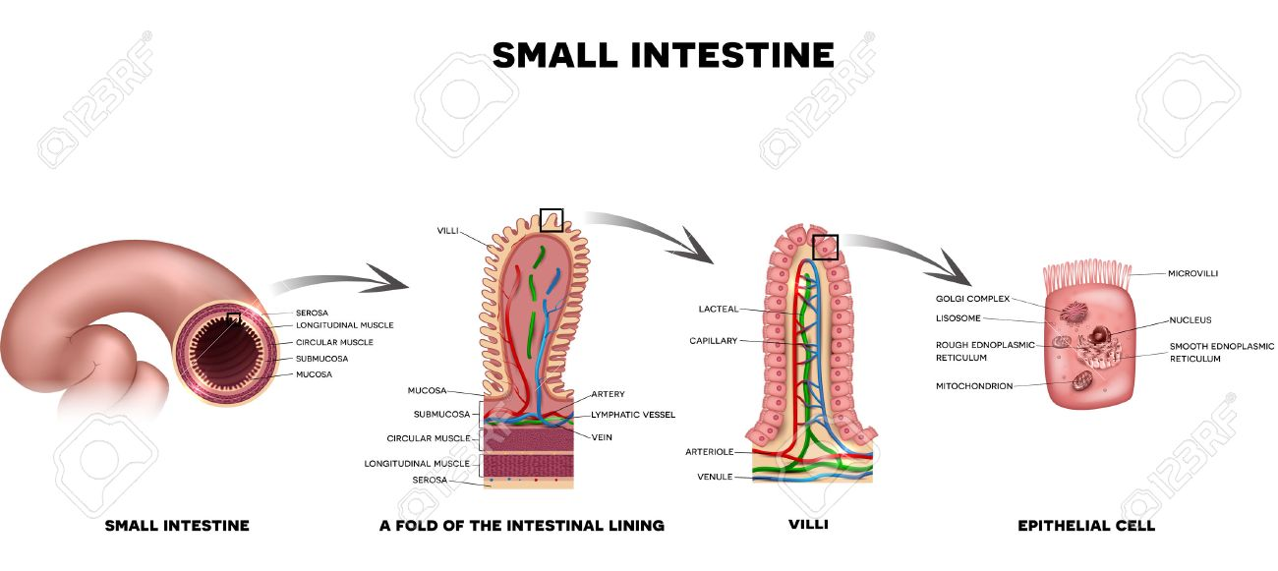
Specific cells for digestion

Slide 32
Specific cells in the small intestine
They have adapted by having membranes with tiny folds called microvilli.
The adaptations increase the surface area of the cell.
The larger the area for molecules to be absorbed the quicker it happens the more effective it is.

Slide 33
Specialised cells for reproduction.
During sexual reproduction two specialised cells (gametes) fuse together to create an embryo.
Human gametes are sperm cells and egg cells.
Inside the nuclei of most cells in the human body there are 23 pairs (46)of chromosomes. This means they are diploid (di meaning two)
In the gametes there is only one copy of each (23) they are haploid. This is because these gametes will fuse together with another gamete (sperm or egg) and then create a embryo with 23 from each gamete.

Slide 34
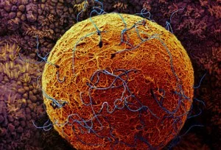
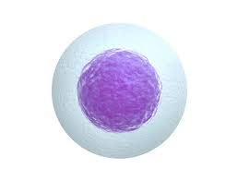
Egg cell
Haploid nucleus
Jelly coat protects egg.
Hardens so only one sperm can enter
Cell membrane fuses with sperm cell membrane. It becomes hard to stop other sperm entering
Cytoplasm is packed with nutrients to supply the egg cell with energy for growth and embryo development

Slide 35
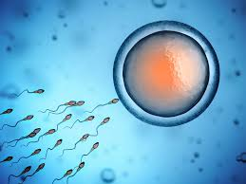
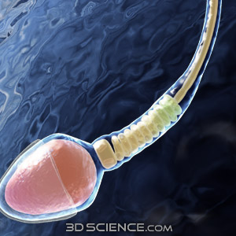
Sperm cell
Tail allows it to swim
The tip of the head has a small acrosome. It contains enzymes to break down the jelly coat of the egg. Allowing the sperm to burrow inside
Large number of mitochondria, in a spiral, to release lots of energy.
Streamline head
Cell surface membrane
Nucleus

Slide 36
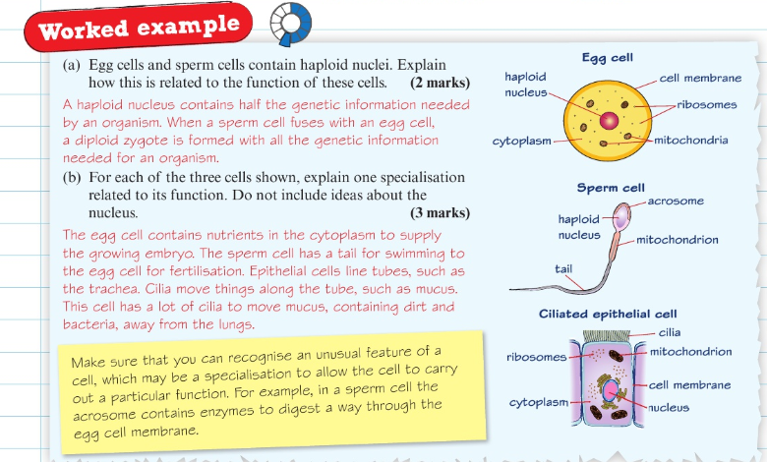

Slide 38
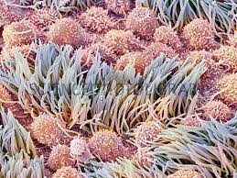
Oviduct
This is where fertilisation occurs.
Cells (cilia) transport the egg cells along.
Cilia are short sperm tail like that wave
From side to side sweeping substances
Epithelial cells - cells that line structures
Ciliated epithelial cells - when they have cilia

Slide 39
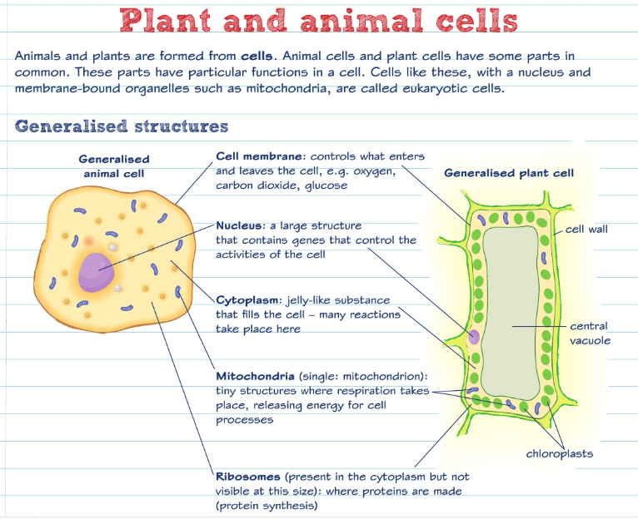

Slide 40
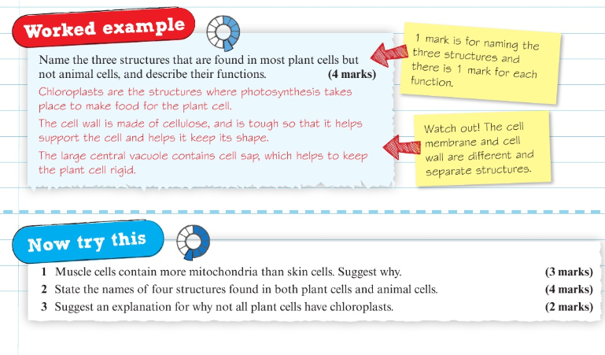

Slide 41
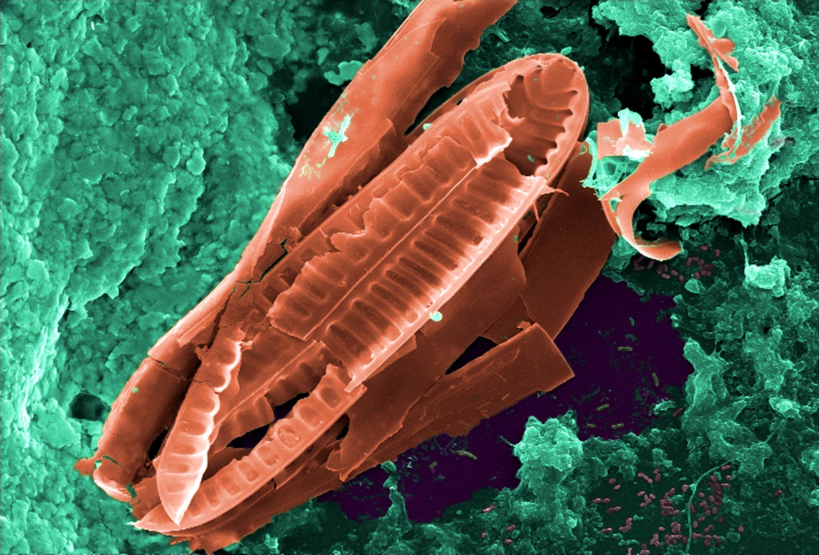
Inside Bacteria

Slide 42
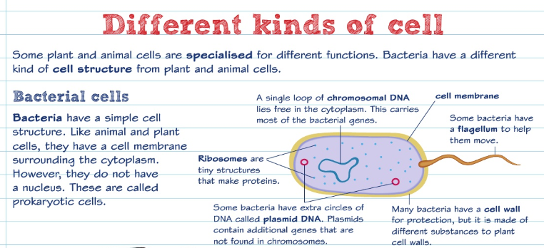

Slide 43
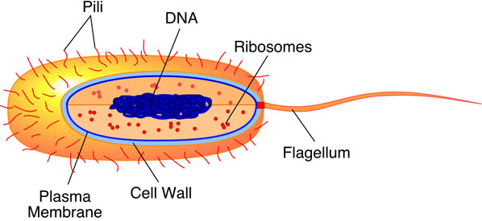
Bacteria
They are very small and very difficult to see. Staining is used to help see them.
The flagellum of a bacteria spins around like a propeller allowing the bacterium to move.

Slide 44
Bacteria are prokaryotic
Prokaryotic means that their cells do not have a nucleus or chromosomes.
Instead the cytoplasm contains one large loop of chromosomal DNA - this controls the cells activity.
There are smaller loops of DNA called plasmids.
They do not have chloroplasts or mitochondria.

Slide 45
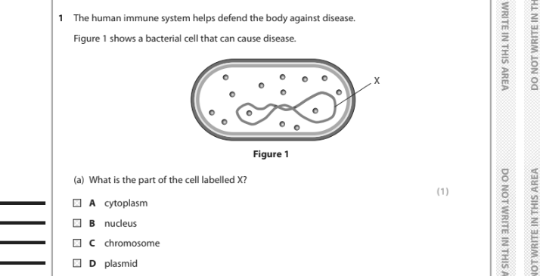

Slide 46
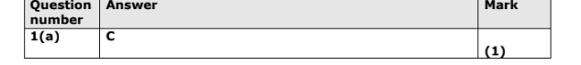

Slide 47
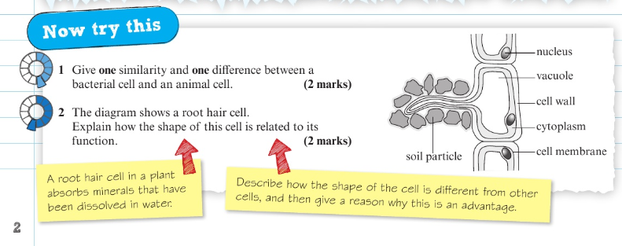
Exam style question

Slide 48
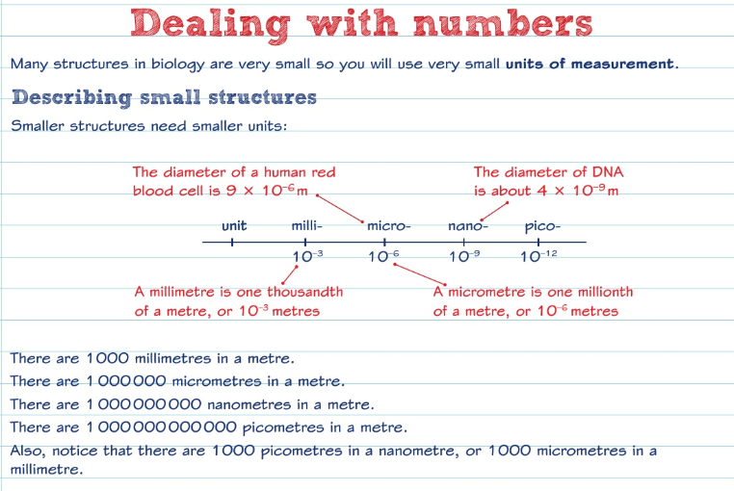

Slide 49
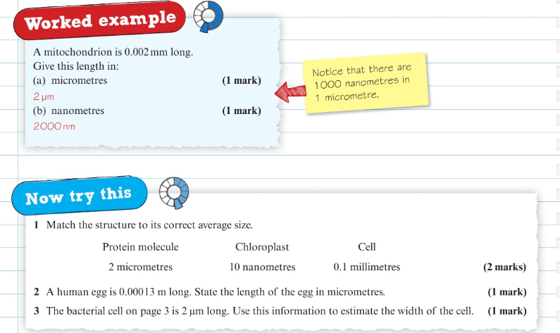

Slide 50
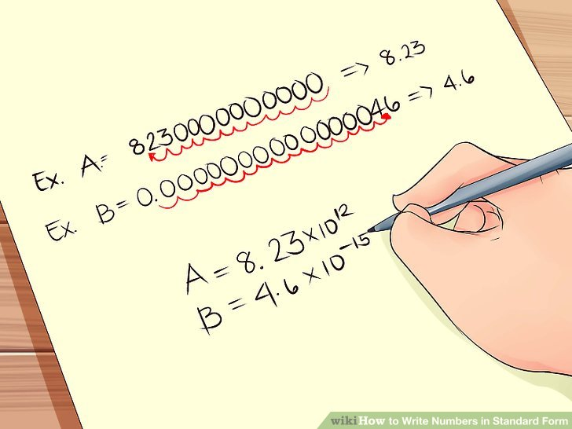
Standard form.

Slide 51
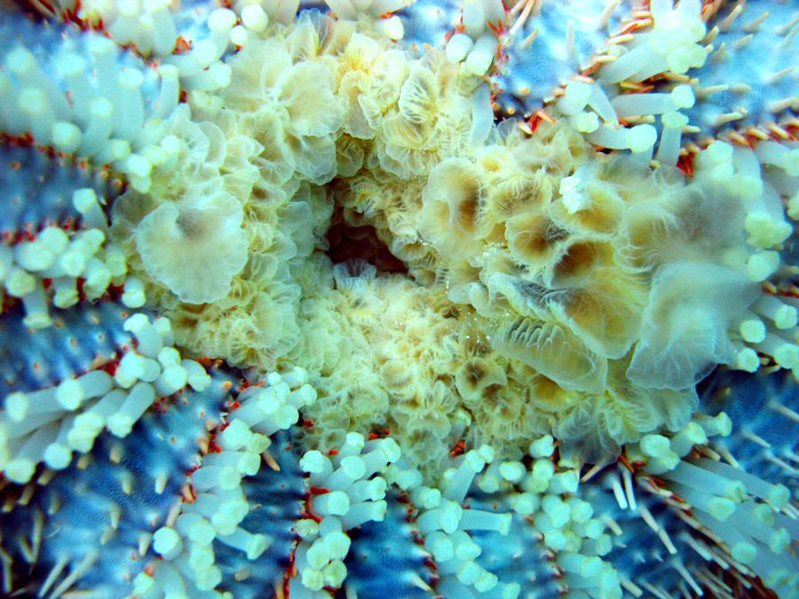
Enzymes and nutrition

Slide 52
Enzymes?
Enzymes are biological catalysts.
There are optimum temperatures and pH values at which their activity is greatest. Enzymes are proteins
They are denatured above about 45ºC.

Slide 53
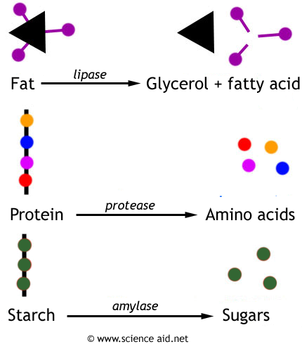
The main groups of digestive enzymes
Lipase enzymes digest fat substrates.
Protease enzymes digest protein substrates.
Amylase enzymes digest carbohydrate substrates.

Slide 54
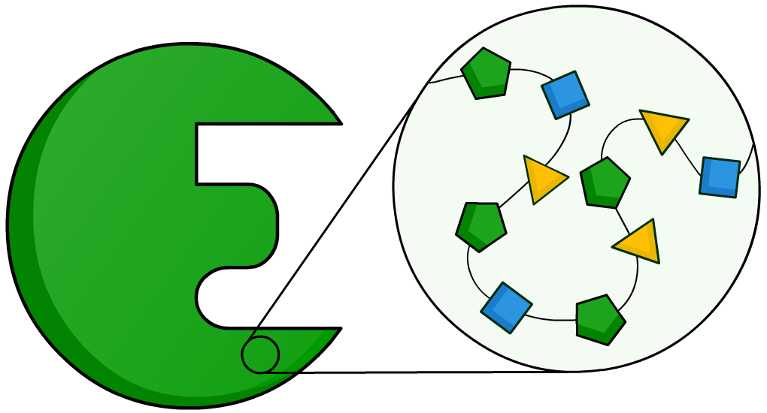
What are enzymes made of?
Enzymes are protein molecules, and so are made up of amino acids. Most enzymes contain between 100 and 1,000 amino acids.
These amino acids are joined together in a long chain, which is folded to produce a unique 3D structure.

Slide 55




What happens at the active site?
In the same way that a key fits into a lock, so a substrate is thought to fit into an enzyme’s active site. The enzyme is the lock, and the reactant is the key.
+
↔
↔
+
enzyme
enzyme
+
+
products
substrate

Slide 56
The action of bile
It’s produced by the liver and is stored in the gall bladder
It’s alkaline to neutralise acidic chyme coming from stomach.
It emulsifies fats to break them into smaller droplets which increases the surface area for lipase enzymes to work.

Slide 57
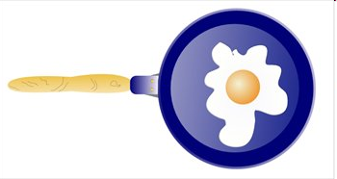
Catalysts
A catalyst is a substance that speeds up the rate of a chemical reaction but is not itself changed by the reaction.

Slide 58
Enzymes act as biological catalysts
They occur inside cells or are secreted by the cells.
Increasing the rate of reaction
Catalase

Slide 59
Enzymes are proteins
Proteins are long molecules that are folded into a specific shape.
catalase
amylase
pepsin
trypsin

Slide 60
The part of an enzyme where the reaction occurs is known as the active site
Active site:
Enzyme

Slide 61
The molecule the enzyme acts on is known as the substrate molecule
Substrate molecules
Active site:
The site on the enzyme where the reaction occurs
Enzyme

Slide 62
The molecule the enzyme produces is known as the product molecule
Product molecules
Active site:
The site on the enzyme where the reaction occurs
Enzyme

Slide 63
Each enzyme is specific to one substrate molecule or type of molecule
The lock and key hypothesis states that the active site specifically matches the shape of the substrate molecule
active site

Slide 64
The rate of an enzyme controlled reaction is
affected by temperature
At low temperatures enzyme controlled reactions go slowly because the molecules have low kinetic energy.

Slide 65
When temperature increases the reaction also increases as the molecules have more kinetic energy
But this only occurs up to the optimum temperature (usually about 40ºC)
The temperature at which the rate of reaction is
fastest is known as the optimum temperature

Slide 66
After the optimum temperature the heat causes the enzyme to denature
The enzyme changes shape and the active site no longer matches the shape of the substrate molecule

Slide 67
Rates of enzyme reactions can be measured by recording the time for a substrate to disappear or a product appears

Slide 68
Rate of reaction of an enzyme reaction changes at different temperatures
Optimum temperature
Molecules gain kinetic energy
Enzyme
is denaturing
Rate
Of
Reaction
0 10 20 30 40 50 60 70
Temperature/ºC

Slide 69
The activity and shape of enzymes is also
affected by pH
Enzymes prefer to work at an optimum pH. Outside of its pH range the enzyme is denatured.
Optimum pH
pepsin
amylase
Rate
Of
Reaction
1 2 3 4 5 6 7 8 9 10 11 12
pH

Slide 70
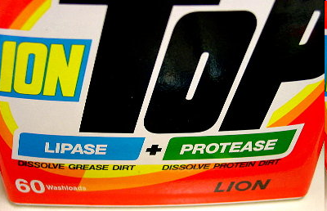
Enzymes are used in biological washing powders
Proteases break down the coloured, insoluble proteins that cause stains to smaller, colourless soluble polypeptides.
Can wash at lower temperatures

Slide 71
Different enzymes
Amylase - in saliva/ small intestine breaks down starch to sugars
Catalase most cells & liver cells breaking down hydrogen peroxide to o2
and h2o
Starch Plant starch to glucose
DNA Nucleus Synthesis of DNA from monomers
polymerase

Slide 72

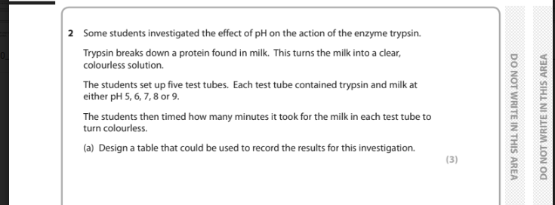

Slide 73
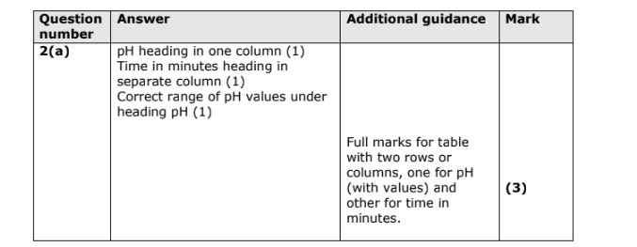

Slide 74
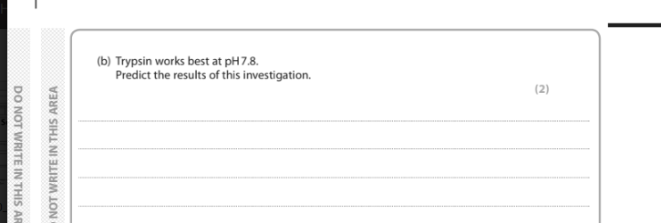

Slide 75


Slide 76
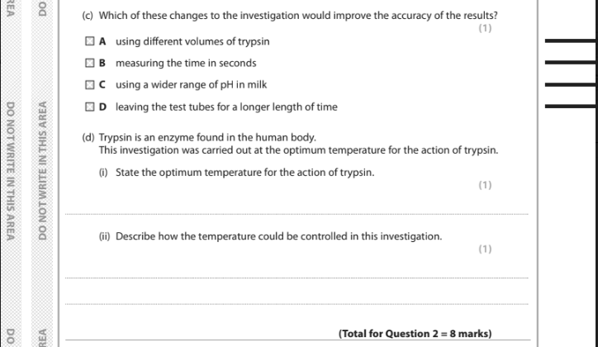

Slide 77
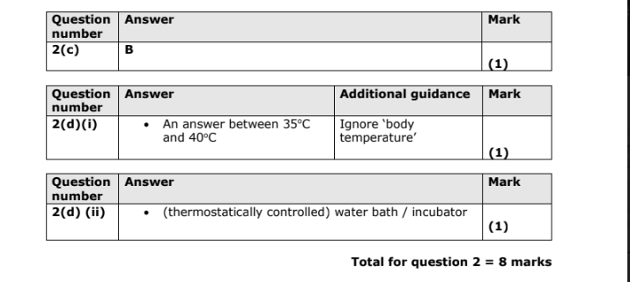

Slide 78

Core Practical - Using microscopes CB1b
Onion cell investigation

Slide 79


Slide 80

Activity
Draw and label your cell,
label its parts.

Slide 81


Complete this table

Slide 82


Slide 83

Core Practical pH and enzymes
CB1g

Slide 84


Slide 85


Slide 86

Transporting substances

Slide 87
Diffusion
Bacteria that live on your body cause odour.
This creates a smell and by diffusion reaches our noses.
Smell spreads by diffusion
Gas and liquid particles constantly move past one another this causes overall movement of particles
They move from a high concentration to a low concentration

Slide 88
Concentration gradient
The differences in the two concentrations form what is called a concentration gradient
The bigger the difference between them the steeper the gradient and the quicker diffusion occurs.

Slide 89
Osmosis
A membrane that allows particles through it is called a partially permeable membrane (semi-permeable membrane)
Cell membranes are partially permeable as they allow soluble molecules inside.
More water molecules move to the side where there are less.
The movement of a solvent (liquid such as water) is called osmosis.
It will stop when there is the same concentration of solute on both sides of the membrane.

Slide 90



Slide 91
Active transport
A cell may need to transport molecules against a concentration gradient.
This happens when the molecules are too big to diffuse through the membrane.
This is carried out by transport proteins
The transport proteins capture a certain molecule and transport them across the cell membrane.
It’s an active process so it requires energy
Osmosis and diffusion are passive processes so do not need energy.

Slide 92


Slide 93

Core Practical Osmosis
CB1h

Slide 94


Slide 95


