Slide 1

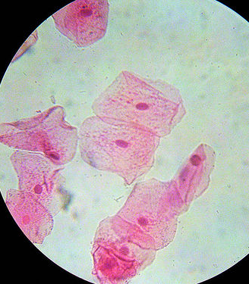

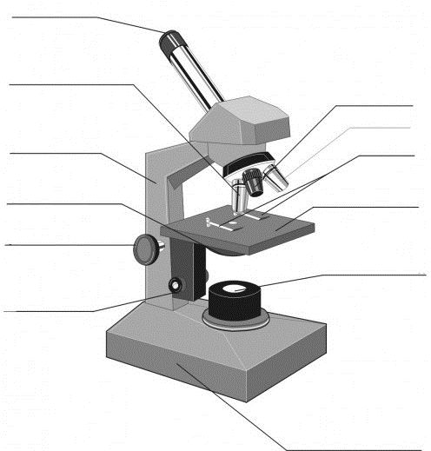
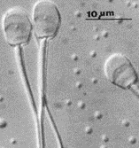


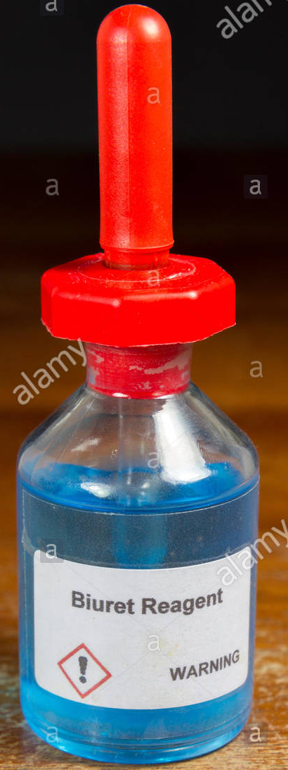

GCSE Biology Required Practicals Y10 December | Produce a scientific drawing of a cell from this x400 micrograph. | Describe a method used to find the sucrose concentration of a carrot. | List the reagents used to test for: Protein: Sugar: Starch: Fat:
Label the microscope: | Calculate the magnification: | Sketch the graph you would expect to plot once you had your results. | Explain the results of this Benedict’s test.
Describe how you would prepare a wet mount of onion tissue to view under a light microscope. | Define osmosis: | Explain why you would see both positive and negative results. | How would you test an unknown sample for the presence of different carbohydrates?
List three factors that make a good scientific drawing. | How might osmosis be useful when finding the sucrose concentration of a potato? | Calculate the percentage change for a potato chip with starting mass 1.26g and final mass 1.07g. | Describe the test for protein:
A B C D

Slide 2
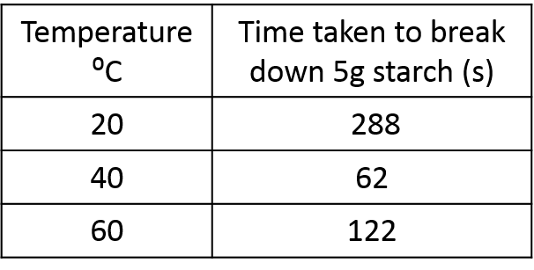
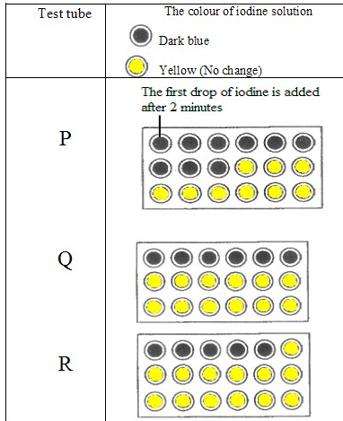
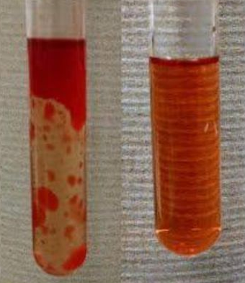

GCSE Biology Required Practicals Y10 December | In an investigation into the effect of temperature on lipase, which variables should you control? | Calculate the rate of reaction for: 40⁰C 60⁰C | Suggest a method that the student used to obtain these results.
Explain these results of a test for fat: | A student obtained the following results and concluded that amylase has an optimum temperature of 40ºC. | A student obtained the following results in a test for amylase activity. | What product is formed from the breakdown of starch? How might you test for this in the lab?
What is an enzyme? | Sketch a graph of these results. | How long did it take for the starch to be completely broken down in: Test tube P: Test tube Q: Test tube R: | The student controlled their experiment by adding 10cm³ starch solution to each test tube. What other variables should have been controlled? Calculate the rate of reaction in Tube P.
Which enzyme breaks down the following: Starch Protein Fat | Evaluate the student’s conclusion. | Each test tube contained different concentrations of amylase. Suggest and explain which test tube contained the highest concentration of amylase. | Describe and explain two ways that the student could improve their investigation.

