Slide 1
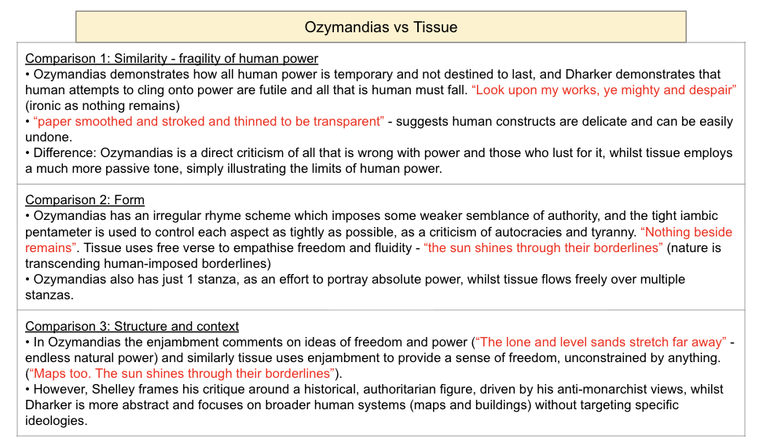
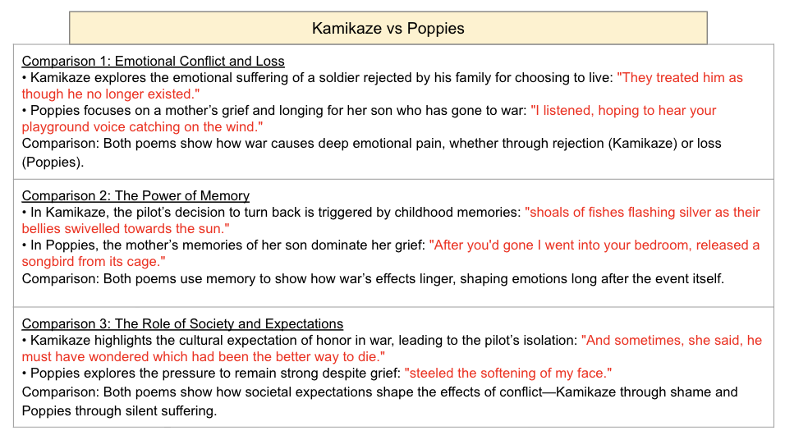
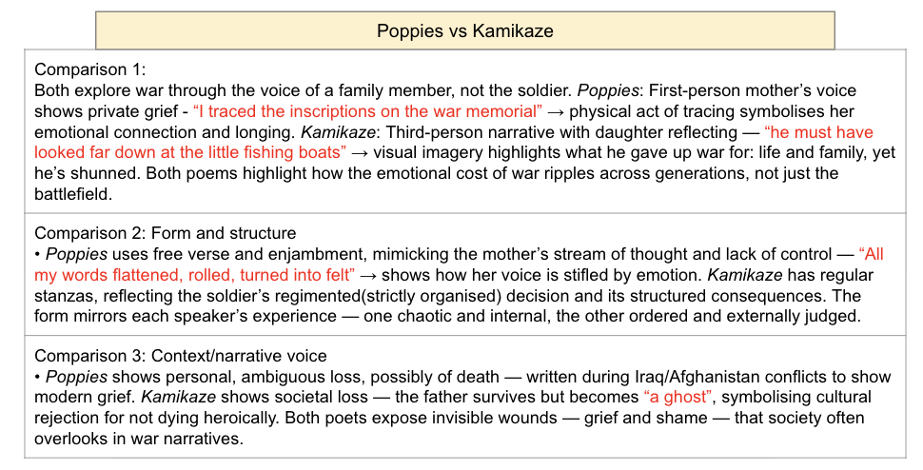
All 15 poems from ‘Power and Conflict’
Quotes included for each paragraph

Slide 2
All power and conflict poem comparisons
• Grade 9 analysis
• Ready-made essay plans
• Quotes for each paragraph
• 3 comparisons for each poem
All you need to do is memorise these flashcards

Slide 3
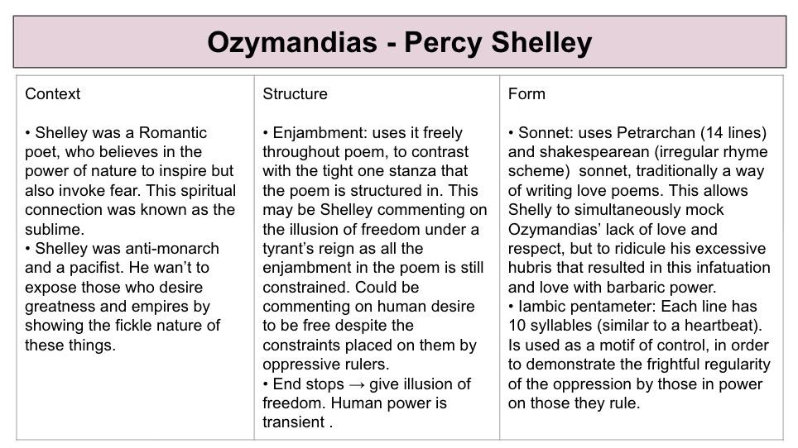
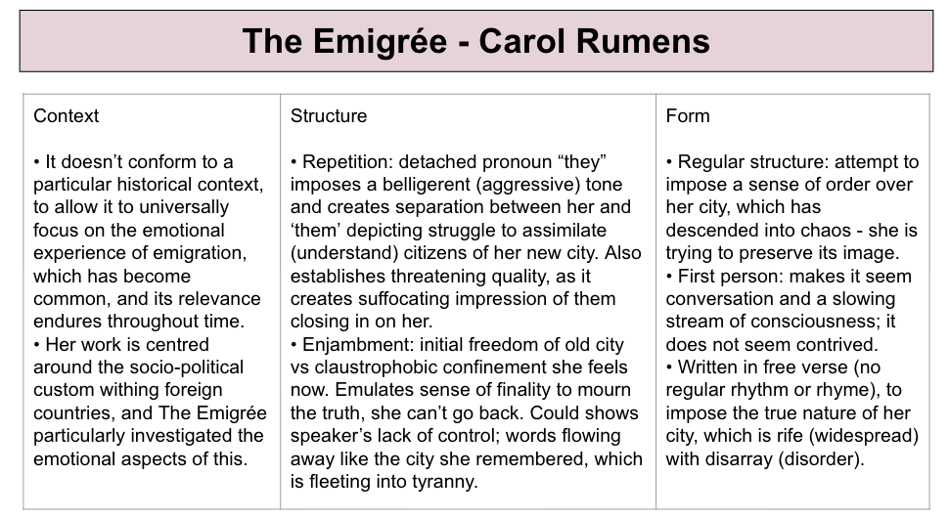
Grade 9 - extra things to remember for each poem!!!
Context, structure and form

