Slide 1
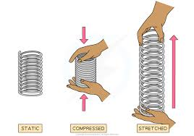
Elastic potential energy equations
By the end of the lesson you will be able to:
LO1 – Recall the elastic potential energy equations
LO2 – Apply the elastic potential energy equation to an exam questions
LO3 – rearrange the elastic potential energy equation
DO IT NOW!
Q1. What is the equation that links velocity, V, mass, m, and kinetic energy, E_{k}? | Q2. What is the equation that links height, h, gravitational filed strength, g, mass, m and gravitation potential energy, E_{p}?
Q3. A 4kg ball is at the top of a 2m slope. How much gpe does it have (g=9.8N/kg) | Q4. A 350g tennis ball is hit at 30m/s. How much kinetic energy does it have?
Keywords
Elastic potential energy
Spring constant
Limit of proportionality
Gravitational potential energy
Gravitaional field strength

Slide 2
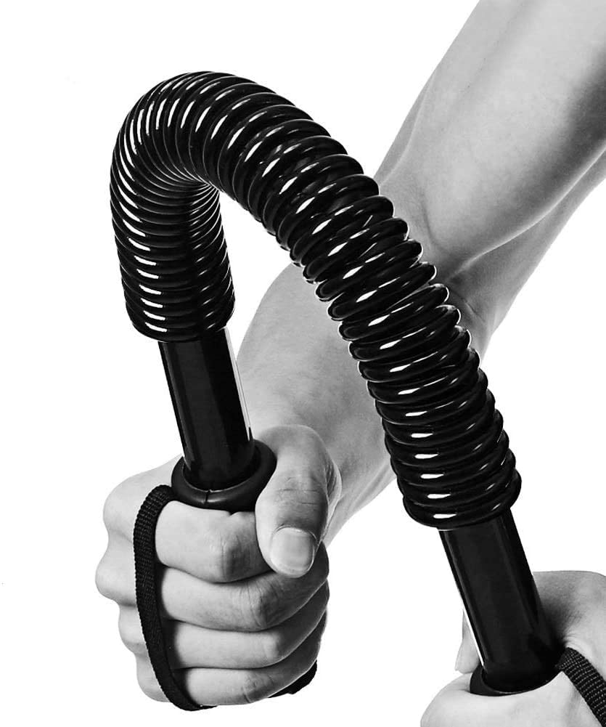
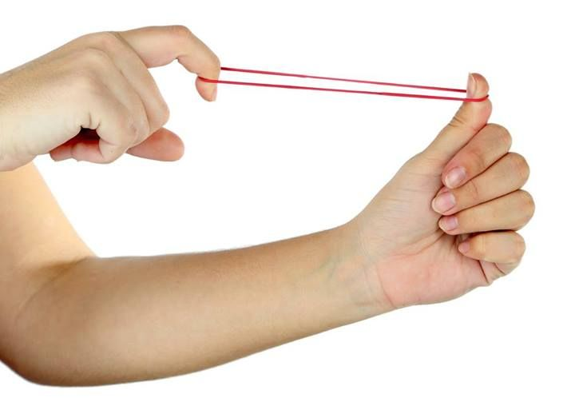

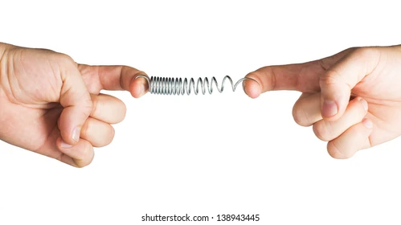
I do - Elastic potential energy
When we stretch a spring or an elastic band we do work and we store energy in it. This energy is called elastic potential energy.
What two factors will affect how much energy can be stored in it?
The stiffness of the spring. We call this the spring constant, k
The amount the spring/elastic is stretched. We call this the extension, e

Slide 3
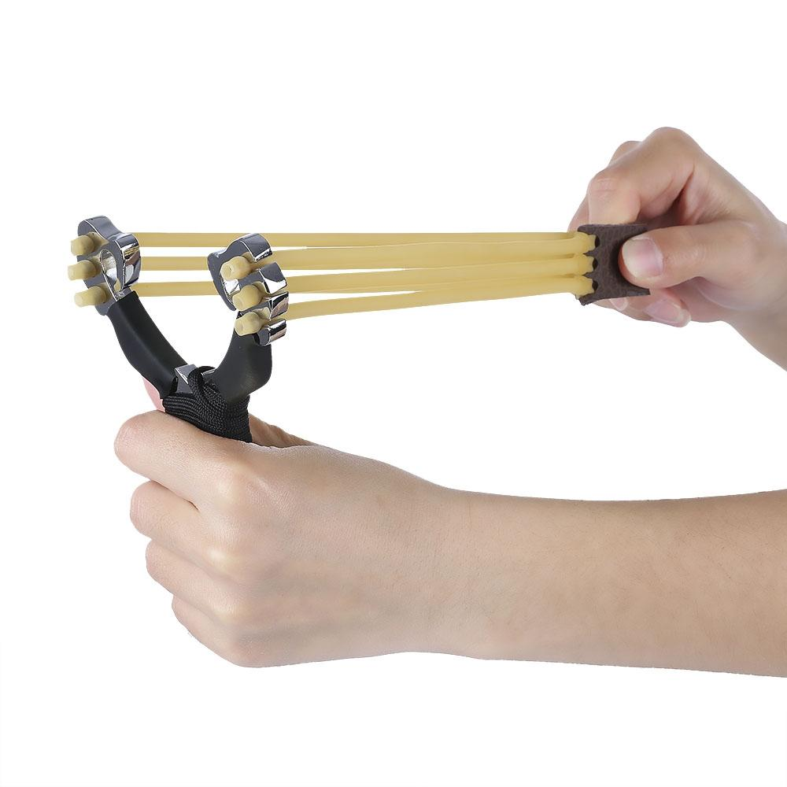
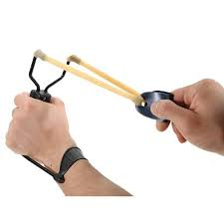
I do - Elastic potential energy
Why will the catapault on the right fire its missiles much faster than the one on the left (the elastic in each is the same and so is the extension)?
What is the downside?
The three elastic bands means that the spring constant, k, will be three times as big so three times more elastic potential energy will be stored in it.
Because the spring constant is three times bigger, it will need three times as much work to stretch it the same amount.

Slide 4
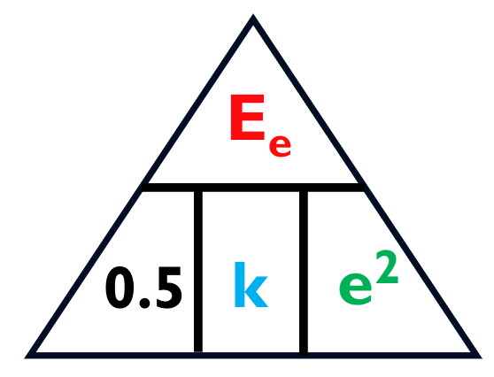
Calculating elastic potential energy
Elastic Potential = 0.5. x Spring x Extension²
Constant
(Joules, J)
(Newtons per metre, N/m)
(Meters, m)
E_{e} = 0.5 x k x e²
Notes:
There is space around the symbol equation and triangle for you to label/get the students to copy on their sheet
Colour coded to scaffold/make it easier

Slide 5
I do
Spring with a spring constant of 65 N/m, is extended 0.350m. What is its elastic potential energy?
E_{e} = 0.5 x k x e²
E_{e} = 0.5 x 65 x 0.350²
What is the subject for the equation?
Add in your numbers from the question in to the equation
Put your numbers into a calculator
Remember to add your units
E_{e} = 3.98
E_{e} = 3.98J

Slide 6
We do
A spring has a spring constant of 200N/m and is stretched by 0.1 m. Calculate the elastic potential energy stored in the spring.
What is the subject for the equation?
Add in your numbers from the question in to the equation
Put your numbers into a calculator
Remember to add your units

Slide 7
We do
Spring with a spring constant of 45 N/m, is extended 45cm. What is its elastic potential energy? (Look at units)
What is the subject for the equation?
Add in your numbers from the question in to the equation
Put your numbers into a calculator
Remember to add your units

Slide 8
I do
Spring is extended 0.6m with an elastic potential of 80 J. What is its spring constant?
K = E_{e}
0.5 x e²
What is the subject for the equation?
Add in your numbers from the question in to the equation
Put your numbers into a calculator
Remember to add your units
2. K = 80
0.5x0.6²
3. K = 57.6
4. K = 57.6 N/m

Slide 9
You do
What is the subject for the equation?
Add in your numbers from the question in to the equation
Put your numbers into a calculator
Remember to add your units
A bungee cord has a spring constant of 22N/m and is stretched 4m. What energy is stored in it?​
A spring with spring constant 8N/m is stretched 14cm. What energy is stored in it?​
2J of energy is stored in a spring stretched 20cm. What is its spring constant?​
When an elastic band is stretched 6cm, it stores 22J of elastic potential energy in it. What is its spring constant?​
If a bungee rope has a spring constant of 26N/m and is stretched from 40m to 48m, what energy is stored in it?​
By how much will a spring stretch if it has a spring constant of 6N/m and has 40J of energy stored in it?​

Slide 10
You do
What is the subject for the equation?
Add in your numbers from the question in to the equation
Put your numbers into a calculator
Remember to add your units
A bungee cord has a spring constant of 22N/m and is stretched 4m. What energy is storedin it?​
E_{e} = ½ ke² = ½ x 22 x 4² = ½ x 22 x 16 = 176J​
A spring with spring constant 8N/m is stretched 14cm. What energy is stored in it?​
E_{e} = ½ ke² = ½ x 8 x 0.14² = ½ x 8 x 0.0196 = 0.0784J​
2J of energy is stored in a spring stretched 20cm. What is its spring constant?​
E_{e} = ½ ke²; 2 = ½ x k x 0.2² = ½ x k x 0.04 = 0.02k ; k = 2/0.02 = 100N/m​
When an elastic band is stretched 6cm, it stores 22J of elastic potential energy in it. Whatis its spring constant?​
E_{e} = ½ ke²; 22 = ½ x k x 0.06² = ½ x k x 0.0036 = 0.0018k ; k = 22/0.0018 =12,000N/m​
If a bungee rope has a spring constant of 26N/m and is stretched from 40m to 48m, whatenergy is stored in it?​
E_{e} = ½ ke²; E_{e} = ½ x 26 x 8² = ½ x 26 x 64 = 832J​
By how much will a spring stretch if it has a spring constant of 6N/m and has 40J of energystored in it?​
E_{e} = ½ ke²; 40 = ½ x 6 x e² = 3e² ; e² = 40/3 = 13.3; e = 3.65m

