Slide 1
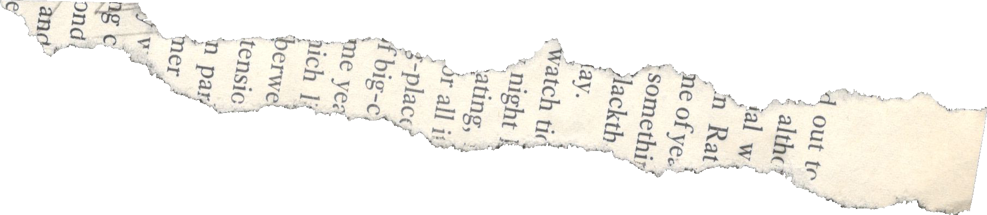

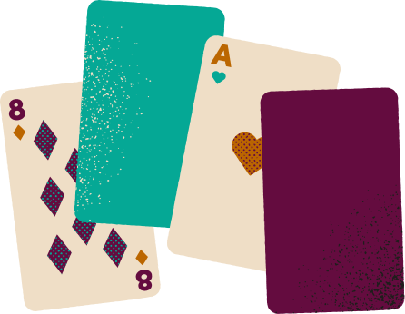

Hitler’s Foreign Policy:
Higher or Lower?

Slide 2
Instructions
Students can do this in teams or as individuals.
Students are presented with a historical event. For the first event, the students guess the year.
Subsequently, students decide if the next event is before or after that one chronologically.

Slide 3






Higher or Lower?
Remilitarisation of Rhineland
Add a little bit of body text
Add a little bit of body text
Add a little bit of body text
1936
1933
1938
1935
Add a little bit of body text
Add a little bit of body text
Add a little bit of body text
Add a little bit of body text
1939
1935
1934
1939

Slide 4
Higher or Lower?
Remilitarisation of Rhineland
Add a little bit of body text
Add a little bit of body text
Add a little bit of body text
1936
1933
1938
1935
Add a little bit of body text
Add a little bit of body text
Add a little bit of body text
Add a little bit of body text
1939
1935
1934
1939

Slide 5
Higher or Lower?
Remilitarisation of Rhineland
Germany begins to rearm
Add a little bit of body text
Add a little bit of body text
1936
1933
1938
1935
Add a little bit of body text
Add a little bit of body text
Add a little bit of body text
Add a little bit of body text
1939
1935
1934
1939

Slide 6
Higher or Lower?
Remilitarisation of Rhineland
Germany begins to rearm
Add a little bit of body text
Add a little bit of body text
1936
1933
1938
1935
Add a little bit of body text
Add a little bit of body text
Add a little bit of body text
Add a little bit of body text
1939
1935
1934
1939

Slide 7
Higher or Lower?
Remilitarisation of Rhineland
Germany begins to rearm
Munich Conference
Add a little bit of body text
1936
1933
1938
1935
Add a little bit of body text
Add a little bit of body text
Add a little bit of body text
Add a little bit of body text
1939
1935
1934
1939

Slide 8
Higher or Lower?
Remilitarisation of Rhineland
Germany begins to rearm
Munich Conference
Add a little bit of body text
1936
1933
1938
1935
Add a little bit of body text
Add a little bit of body text
Add a little bit of body text
Add a little bit of body text
1939
1935
1934
1939

Slide 9
Higher or Lower?
Remilitarisation of Rhineland
Germany begins to rearm
Munich Conference
Conscription introduced
1936
1933
1938
1935
Add a little bit of body text
Add a little bit of body text
Add a little bit of body text
Add a little bit of body text
1939
1935
1934
1939

Slide 10
Higher or Lower?
Remilitarisation of Rhineland
Germany begins to rearm
Munich Conference
Conscription introduced
1936
1933
1938
1935
Add a little bit of body text
Add a little bit of body text
Add a little bit of body text
Add a little bit of body text
1939
1935
1934
1939

Slide 11
Higher or Lower?
Remilitarisation of Rhineland
Germany begins to rearm
Munich Conference
Conscription introduced
1936
1933
1938
1935
Czechoslovakia invaded
Add a little bit of body text
Add a little bit of body text
Add a little bit of body text
1939
1935
1934
1939

Slide 12
Higher or Lower?
Remilitarisation of Rhineland
Germany begins to rearm
Munich Conference
Conscription introduced
1936
1933
1938
1935
Czechoslovakia invaded
Add a little bit of body text
Add a little bit of body text
Add a little bit of body text
1939
1935
1934
1939

Slide 13
Higher or Lower?
Remilitarisation of Rhineland
Germany begins to rearm
Munich Conference
Conscription introduced
1936
1933
1938
1935
Czechoslovakia invaded
Anschluss
Add a little bit of body text
Add a little bit of body text
1939
1938
1934
1939

Slide 14
Higher or Lower?
Remilitarisation of Rhineland
Germany begins to rearm
Munich Conference
Conscription introduced
1936
1933
1938
1935
Czechoslovakia invaded
Anschluss
Add a little bit of body text
Add a little bit of body text
1939
1938
1934
1939

Slide 15
Higher or Lower?
Remilitarisation of Rhineland
Germany begins to rearm
Munich Conference
Conscription introduced
1936
1933
1938
1935
Czechoslovakia invaded
Anschluss
Saar returned
Add a little bit of body text
1939
1938
1935
1939

Slide 16
Higher or Lower?
Remilitarisation of Rhineland
Germany begins to rearm
Munich Conference
Conscription introduced
1936
1933
1938
1935
Czechoslovakia invaded
Anschluss
Saar returned
Add a little bit of body text
1939
1938
1935
1939

Slide 17
Higher or Lower?
Remilitarisation of Rhineland
Germany begins to rearm
Munich Conference
Conscription introduced
1936
1933
1938
1935
Czechoslovakia invaded
Anschluss
Saar returned
Invasion of Poland
1939
1938
1935
1939

Slide 18
Higher or Lower?
Remilitarisation of Rhineland
Germany begins to rearm
Munich Conference
Conscription introduced
1936
1933
1938
1935
Czechoslovakia invaded
Anschluss
Saar returned
Invasion of Poland
1939
1938
1935
1939

