Slide 1
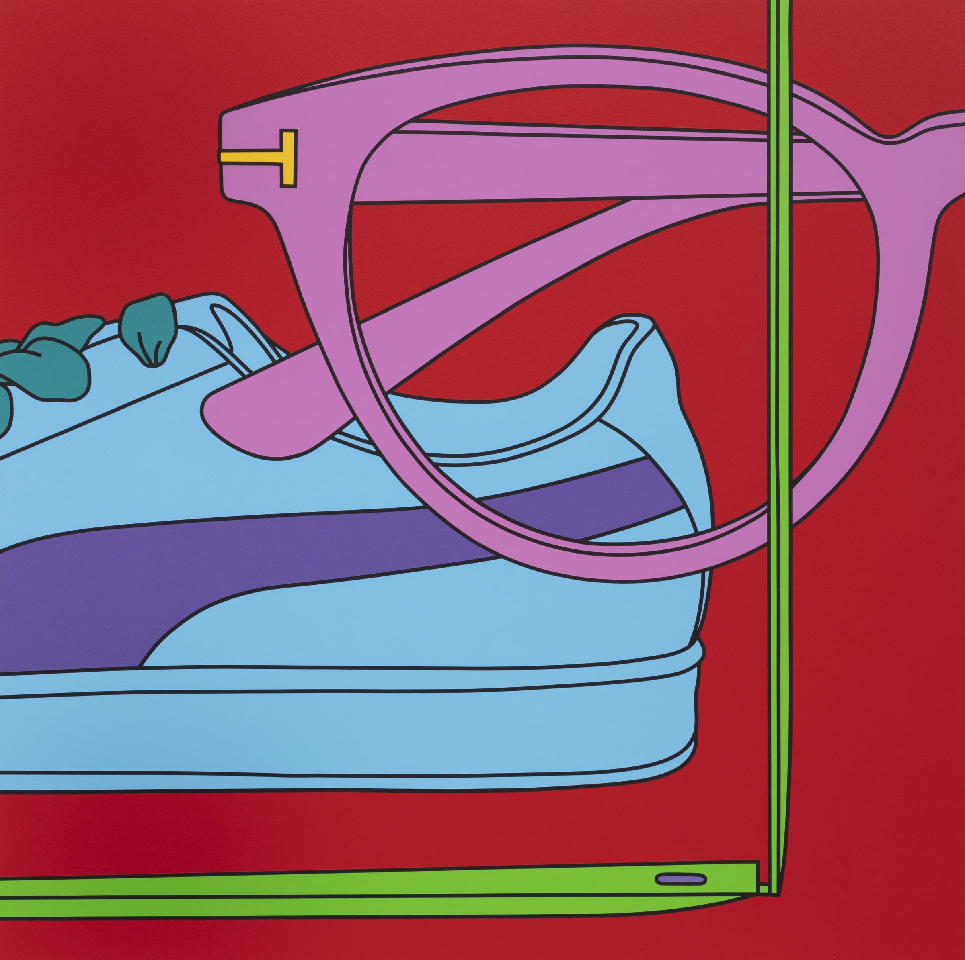
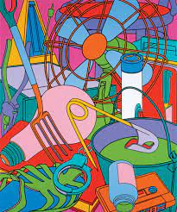
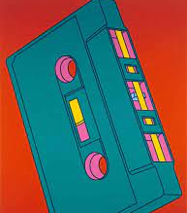
Artist: Michael Craig Martin

Slide 2
Michael Craig-Martin is an Irish artist, born in Dublin in 1941. A prominent figure of British conceptual art, Craig-Martin explores the relationship between the form and purpose of the objects he depicts.
His sculptures and installations focus on ordinary, mass produced functional objects, and he is best known for his vibrant paintings and sculptures of everyday objects in bright candy colours. His most recent paintings have incorporated subjects that reflect contemporary life – credit cards, mobile phones, takeaway coffee cups, designer trainers, sunglasses and even references to the covid pandemic. Within the compositions Craig Martin explores spatial relationships by juxtaposing and layering the colour and objects together. The objects are often placed next to one another, or a number of objects are layered one on top of the other, creating a confusion of scale, as all the objects are treated as having equal dimensions
He has developed a unique style of drawing from life, using a mechanical line, without sense of the artist’s own hand. He applies electrical tape to create the shape of the object and then infills the shape with colour. This enables him to create a precise and accurate representation of the object, which is a true reflection of the objects form and shape.
Craig-Martin taught at Goldsmiths College School of Art, London, from 1974 to 1988 and from 1994 to 2000. During this time he became a powerful influence on a generation of his students who would become known as the Young British Artists, including Gary Hume, Sarah Lucas, and Damien Hirst, among others.

Slide 3

Key words/art terms:
Minimalism
Conceptual
Proportion
Juxtaposition
Sculpture
Composition
Research and write out a definition for each of the key words relating to the artists work.

Slide 4
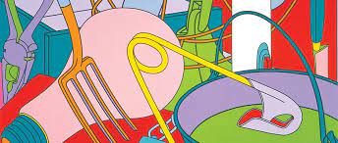
Image analysis
Composition
How has the image been organised?
What can you see in the foreground/Background and Middle ground?
Colour, shape, texture
What is the colour scheme?
What shapes, textures,
marks can you see?
Mood
What emotion or feeling does it evoke?
How does it make you feel? Why?

Slide 5
Re read the artist information and answer the following questions, using your own words and the key words to help you:
Where is the artist from, and what is his work about?
What does it mean to be a conceptual artist?
How could you describe his use of composition and what are his intentions with how he sets up his
images?
4. In your own words analyse a piece of his work using the key words to help you?

