Slide 1
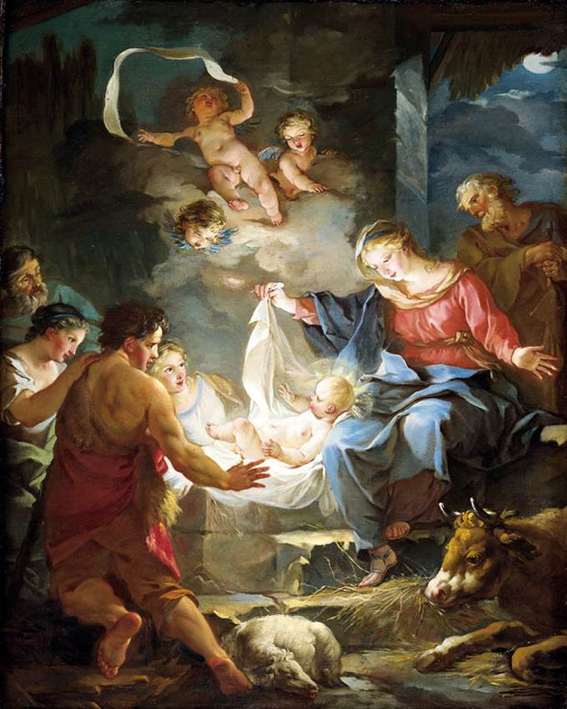

Year 7 – Galilee to Jerusalem
What is the Incarnation?
What does the word Incarnation mean?
What does the Bible say about the incarnation?
What is the Incarnation?

