Slide 1
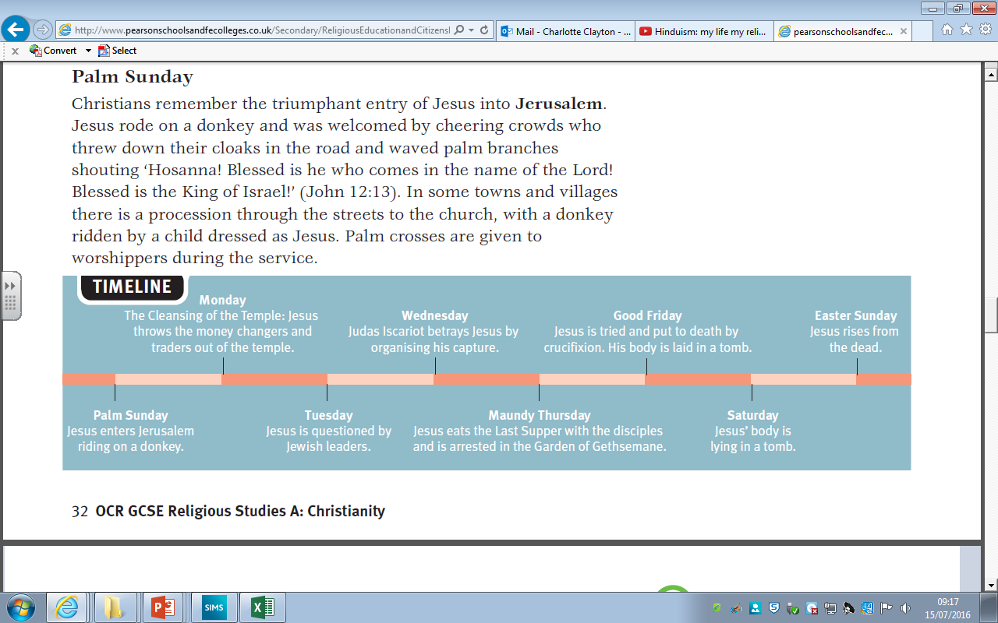
Classwork 27/02/2024 Christian Beliefs – Last Days of Jesus’ life
Step 1: Write today’s date and title
Step 2: Stick in your timeline sheet
Step 3: There are 8 significant moments at the end of Jesus’ life.
Each of these moments are remembered by Christians today in different ways.
When referring to the last few days of Jesus’ life Christians use the phrase ‘The Passion’.
Which day do you think is the most important and why? Be prepared to share your answer.

Slide 3

The BIG Idea
Classwork 27/02/2024 Christian Beliefs – Last Days of Jesus’ life
We are Learning to...
Understand how and why Christians remember the last days of Jesus’ life
In today’s lesson...
You will be able to describe how Jesus’ death and resurrection supports the Old Testament.
You will be able to explain reasons why Christians remember the last moments of Jesus’ life and provide examples of how they do this.
…
You will be able to evaluate the importance of remembering Jesus to the lives of Christians today.

Slide 4
So what happened on these days and who was involved?
We are going to watch a series of videos that explain each day.
As we watch each video we will be adding notes to our Easter calendars.
Palm Sunday - https://www.youtube.com/watch?v=z-39h0xYqdE
Maundy Thursday - https://www.youtube.com/watch?v=HL1KWNdNTsQ
Good Friday - https://www.youtube.com/watch?v=h3PBJwA3HHE
Easter Sunday - https://www.youtube.com/watch?v=HL8R158Ujp4

Slide 5
Independent Tasks
Which day do you think is the most important and why do you think this?
During Holy Week how did Jesus prove he was the Son of God?
Outline three events that happened during Holy Week (3 marks)
Explain two reasons Holy Week is important (4 marks)
3) Why do you think Jesus washed his disciples feet?

