Slide 1
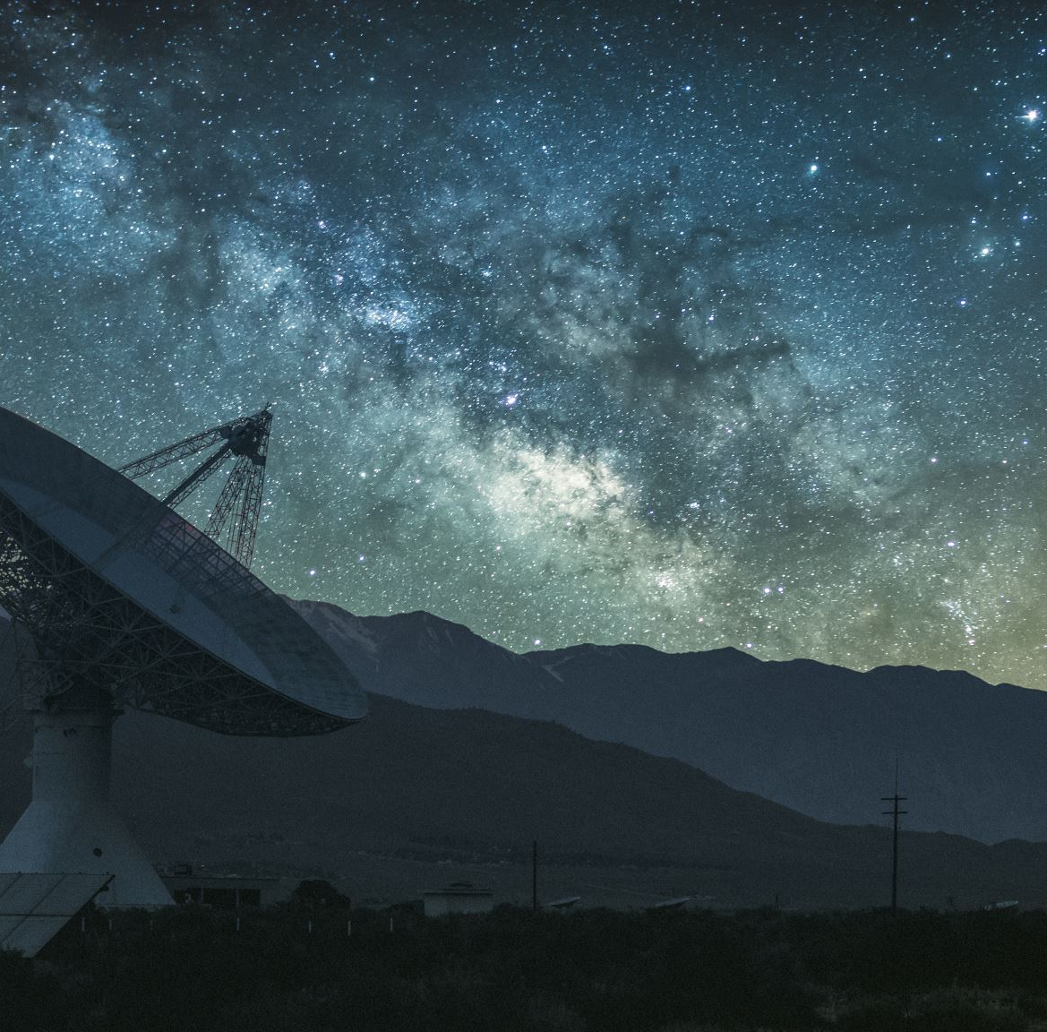
Create your own Alien Adventure

