Slide 1

Autism in girls – ASD and its behaviour patterns in females.
-What is Autism or Autism spectrum Disorder (ASD)?
The presentation of ASD different in females, why is this?
Main/Common behaviours and actions seen and portrayed in Females with autism
How as an educator can I help students with ASD?
How can I as an educator help Female students with ASD and allow for equal support needs and opportunities compared to students with normal support needs.
How can I help students struggling with ASD?
By E.G 21/9/24

Slide 2
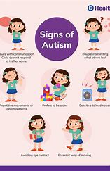
What is Autism or Autism Spectrum Disorder (ASD)?
Autism is a spectrum condition and developmental disorder it is characterized by
- difficulties in forming and maintain social relationships. - Impairment of the ability to communicate verbally and non-verbally
- Repetitive behaviour patterns and restricted interests and activities
It is a disability that is lifelong that has no treatment and no cure.

Slide 3
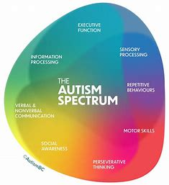
Sensory Processing
Repetitive behaviours
Motor Skills
Preservative thinking
Social Awareness
Verbal & Nonverbal communication
Information processing
Executive function

Slide 4
The presentation of ASD is different in females, why is this?
When Autism was first identified – the people it was found in were all male. This led to a long period of time were it was mutually agreed by psychologists and psychiatrists that Autism was only a disorder found in males.
Only in the past few decades has it been found and accredited that all people of all genders can have autism.
One of the main reasons why it is harder to diagnose and identify females with autism was because the diagnostic criteria was created for males as they due to the history and prominence in studies represent a large part of the diagnostic criteria.
This means that autistic females often slip through the cracks of the SEND and Mental Health system.

Slide 5
Main/common behaviours and actions seen and portrayed in females with Autism.
On top of displaying the "typical" and common behaviours found in people with Autism ( difficulties in forming relationships and contributing to social relationships, and also repetitive behaviour patterns.)
Autism characteristics in women and girls often differ from ones found in people of different genders
A quote from The national Autistic Society
Autistic characteristics in women and girls may differ from those of other autistic people. They might seem to have fewer social difficulties than autistic men and boys, but this could be because they are more likely to 'mask' their autistic traits (though the stress of doing so can result in anxiety and overwhelm). At school, autistic girls may be more likely to be part of a friendship group and this could be a reason that teachers don't notice their differences. They may also be missed if their academic achievement masks difficulties they are facing in other areas.
Masking is extremely common in females with autism – they often do this to "survive" often by copying peers and trying to fit in with society. This often means that Females with autism appear to function well in society.

Slide 6
How as an educator can I help students with ASD?
ASD is a developmental spectrum disorder that causes systematic struggles with behaviour, communication and preservative thinking.
This often means that school is a very overwhelming and harsh environment for Autistic people of all genders. Problems in information processing, communication with peers and teachers and staff.
As an educator always prioritise wellbeing with autistic students due to anxiety, overwhelm and sensory overload.
Speaking softly, kindly and with no forced contact like eye contact and touch initiated if the student doesn't want to – this is very common with ASD.

Slide 7
How can I as an educator help Female students with ASD and allow for equal support needs and opportunities compared to students with normal support needs
Autism means that students are different then neurotypical students; this means that their treatment and behaviour will be different and your behaviour to these students should be different to.
Never demand or request eye contact as this is a difficult thing to do for a lot of autistic people; just because an autistic student isn't looking at you doesn't mean that they are not listening.
A busy, loud classroom and corridor is a really hard environment it can lead to sensory overload, meltdowns and shut down behaviours – this is not the same as resisting instruction it is a product of the disability.

Slide 8
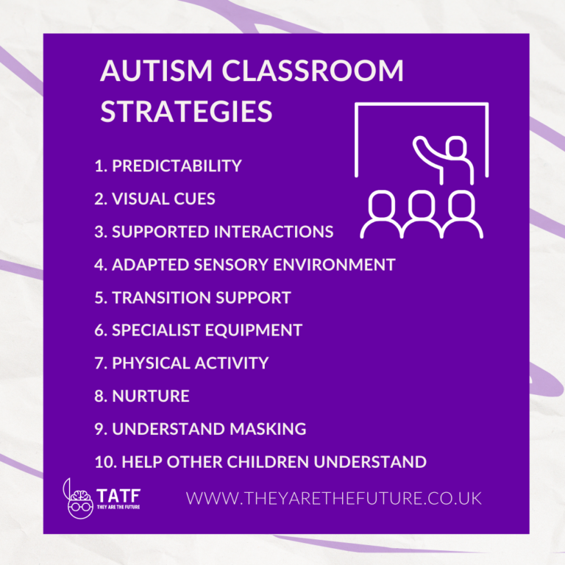
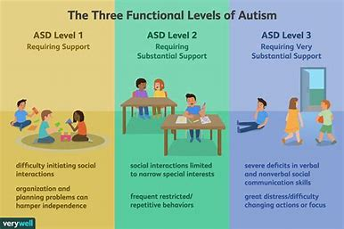

Slide 9
How can I help students struggling with ASD?
Have a designated plan in place that has been formed with input from the student themself and SEND department.
Allow the student to be aware of the classroom structure and familiar with all teachers and staff.
Ensure that if needed the student can sit next to someone in the class that they are comfortable or friends with.
Let the students be near an exit to the classroom if they need to leave if they become distressed, overwhelmed and can utilise a pass.
Create passes with students and the SEND department and their guardians for permission to exit a upsetting or overwhelming environment discreetly no questions asked, allowing them to go to a safe room or environment.
Don't demand eye contact or hard assignments such as speaking infront of the class
Allow for room in homework or assignments due dates
Assign a buddy or friend for the student and follow bully protocols if there are bad situations with other pupils.

Slide 10
Additional resources
Autism - NHS (www.nhs.uk)
Autistic women and girls (autism.org.uk)
What is autism
It's not just boys who are autistic | Women | The Guardian
Supporting autistic students | Ambitious about Autism

