Slide 1


Where our food comes from...
Grown, Reared & Caught
Our Learning Journey
Learning Objectives
To be able to define what grown, caught and reared means and give examples
To be able to discuss the differences between free range and intensive farming methods
To be able identify foods that are grown, reared or caught from around the world and consider the factors that mean they grow there.
How food grows
Grown | To concentrate and go 'all out'
Caught | When something naturally gets bigger
Intensive | To go somewhere without restriction
Reared | To get hold of
Free Range | To bring up and care for

Slide 2
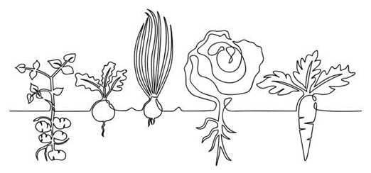
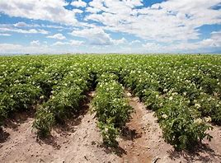
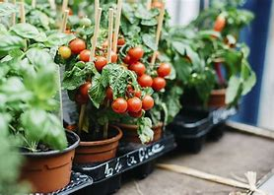
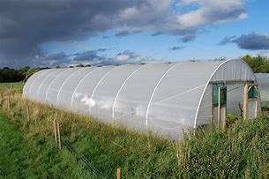
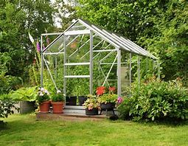
Growing Food…
In order to grow food needs:
Light
Food (soil)
Water
This is called photosynthesis.
We can grow food…
Outside in fields
Outside in containers
In polytunnels
In greenhouses
https://www.youtube.com/watch?v=lYBuY-DnCJc&list=PLbPWPsvL8htk0B5pGQJx5_s-6IUNjoa0E&index=4
https://www.youtube.com/watch?v=lYBuY-DnCJc&list=PLbPWPsvL8htk0B5pGQJx5_s-6IUNjoa0E&index=4
https://www.youtube.com/watch?v=PGoPGAR5OMw

Slide 3
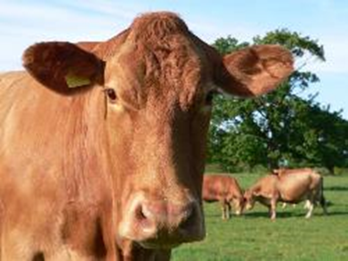
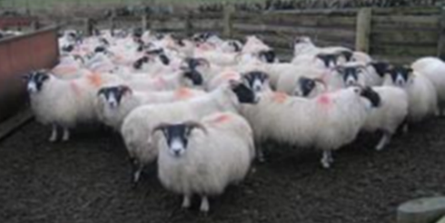
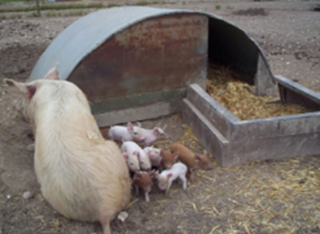
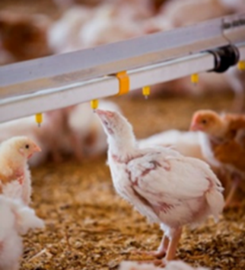
Rearing Food...
Animals aren’t grown in the same way as plants however they are looked after until they ready to be slaughtered and consumed.
A range of animals are reared for food
Animals are slaughtered and butchered into different cuts of meat or processed into different foods.
They can be farmed in either free range or intensive ways
Chicken meat production. BBC Countryfile - YouTube
Burly beef - YouTube

Slide 4
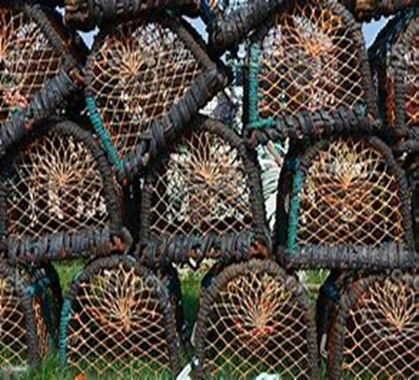
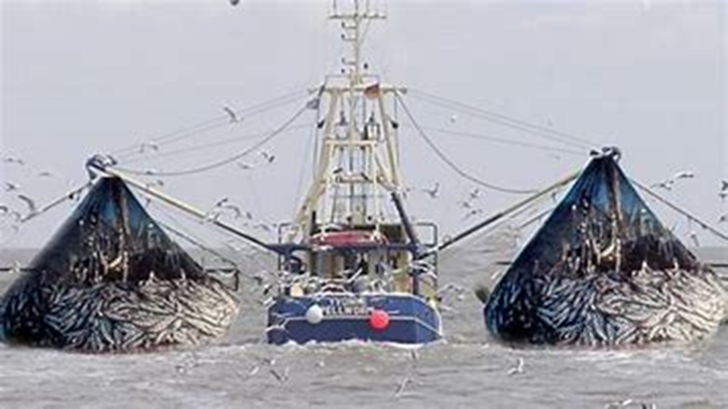
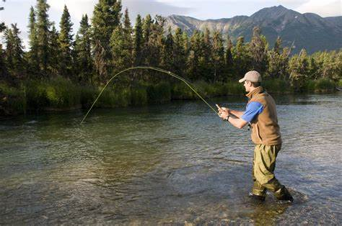
Catching Food...
Most of the fish we eat, we have to catch
Larger fishing boats called trawlers catch large amounts of fish by dredging the sea
Lobsters and crabs are caught in pots on the seabed
Some fish are farmed in tanks or enclosures in rivers, lochs or seas – intensive farming
https://www.youtube.com/watch?v=1cVwkbHBOR4
Slippery salmon – YouTub
Finding Nemo - Keep swimming – YouTube
e

Slide 5
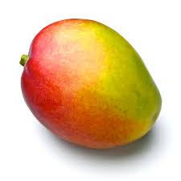
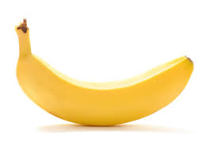
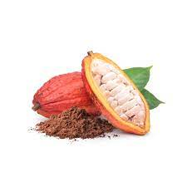
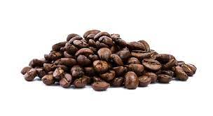
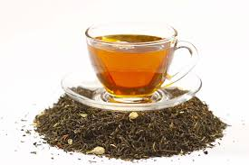
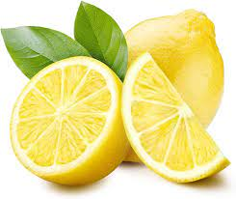
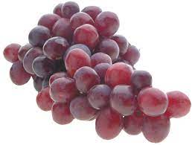
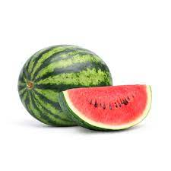
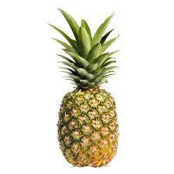
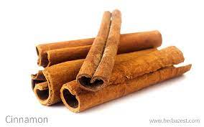
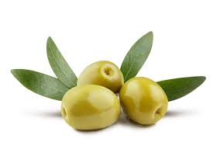
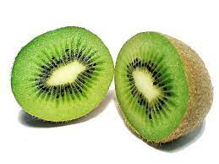

Where our food comes from...
Food from around the World
Our Learning Journey
Learning Objectives
To be able to identify a range of foods grown outside of the UK
To be able to locate a wide range of locations on a world map
To be able to discuss some of the factors that influence whether a food grows in a particular country
How food grows

Slide 6
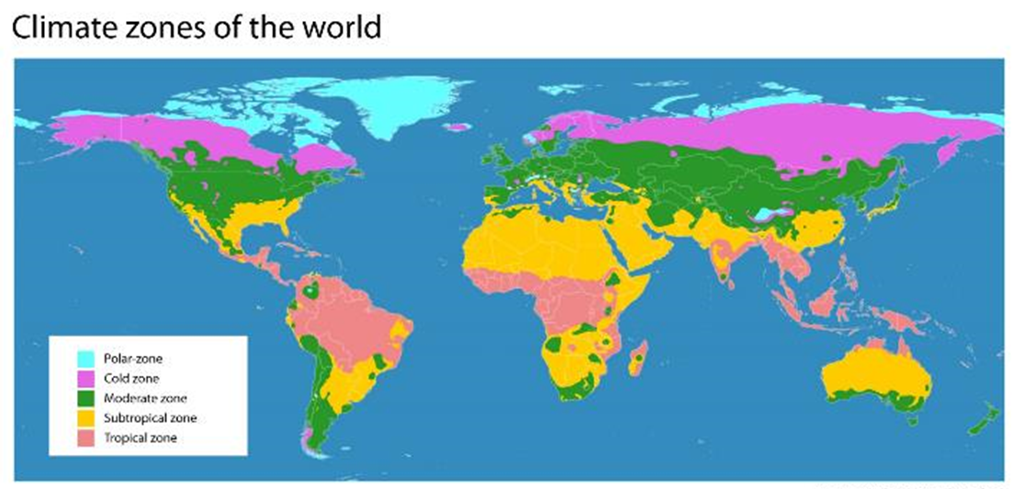
Prickly Pineapples: from farm to fork (youtube.com)
Does your class know what cacao is? (youtube.com)

Slide 7
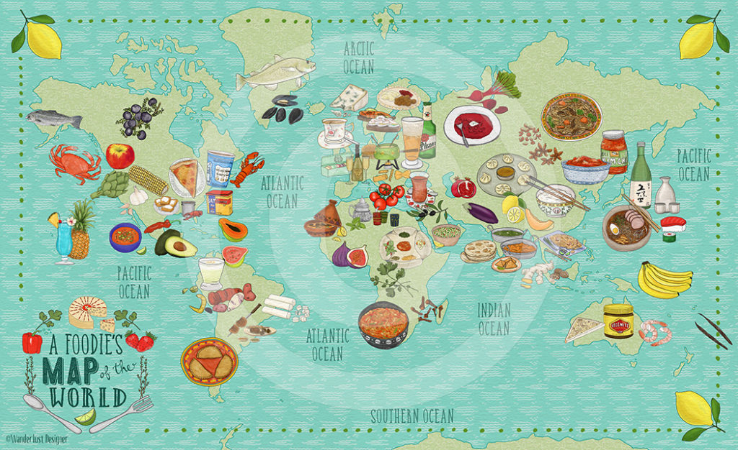

Let's explore more...
To do...
Using your world map & the internet, locate and plot...
6 fruits that grow around the world
6 vegetables/crops grow around the world
6 foods that are reared or caught grow around the world
Challenge task...
What is it about these locations that mean some foods grow and some foods don’t?
Many types of food from plant sources are grown all over the world.
These include:
cereal crops;
fruits;
vegetables;
nuts;
herbs and spices.
Many foods are imported from other
countries into the UK, giving access to
ingredients that would not normally
grow.
This means we can have almost any
food, at any time of the year.

Slide 8
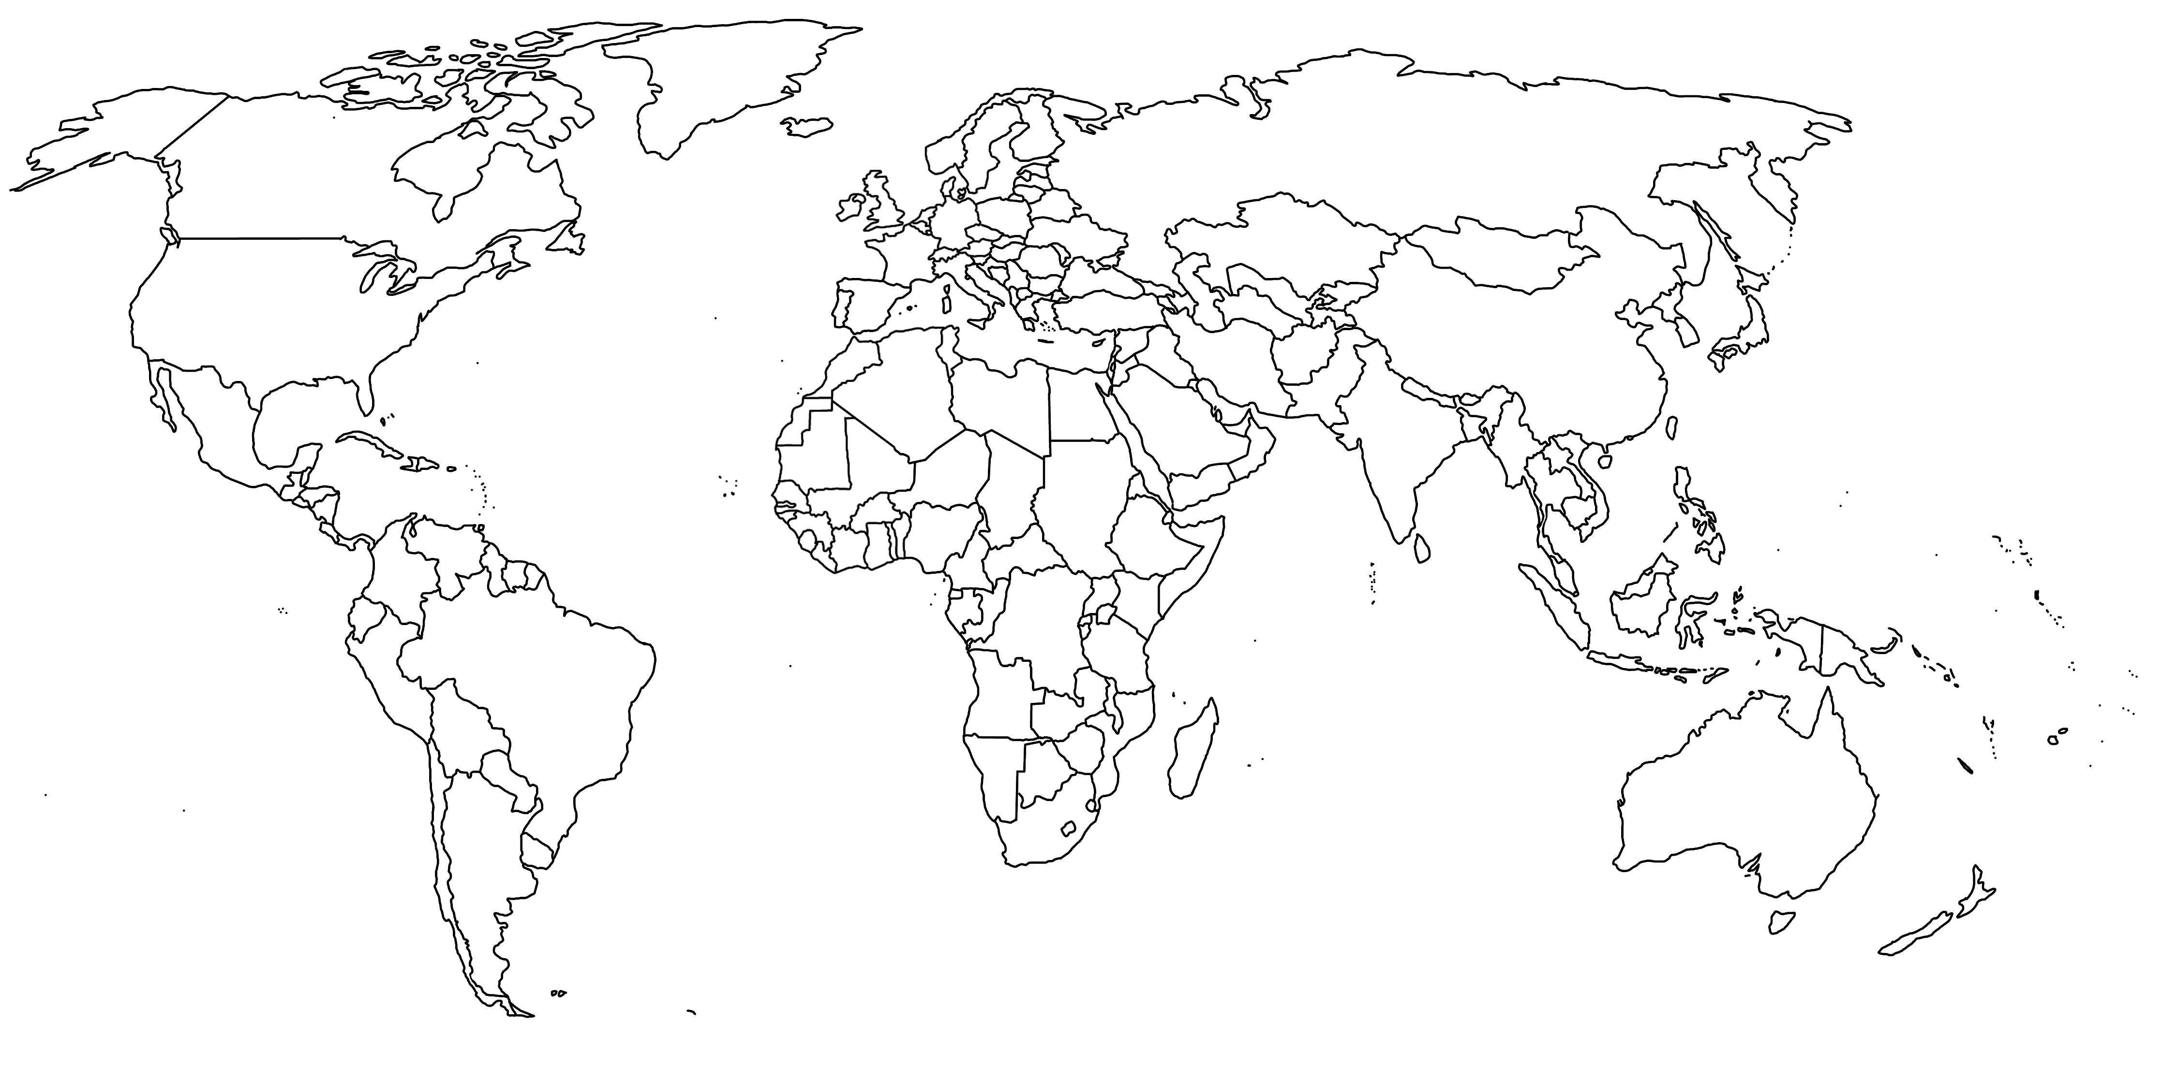
Plenary...
Global food supply
Generally speaking:
Countries in Asia grow more , rice and sugar than other parts of the world
South American countries grow more oil crops
North American countries produce the most grain. This is used for making animal feed and for brewing.
European countries grow the most barley. They are also the second biggest producers of some types of meat (eg pig meat), milk and fish.

Slide 9

Where our food comes from...
British Food
Our Learning Journey
Learning Objectives
To be able to name a range of iconic British foods
To be able to discuss factors that influence what foods grow well in the UK
To be able to distinguish why foods are produced in particular regions of the UK
British Cuisine
Indian Cuisine
Chinese Cuisine
Kids Try British Food | Kids Try | HiHo Kids (youtube.com)

Slide 10
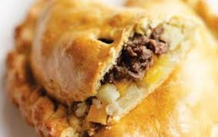
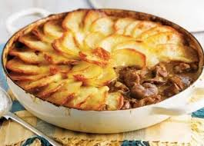
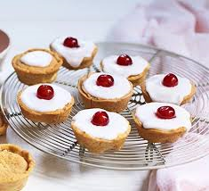
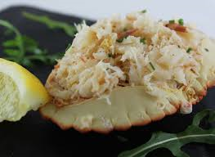
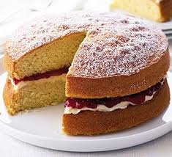
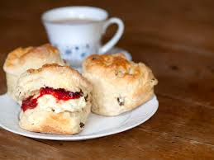
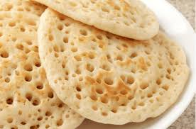
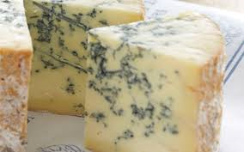
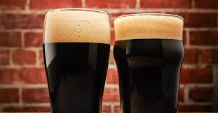
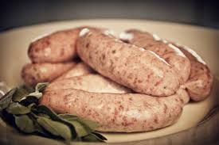
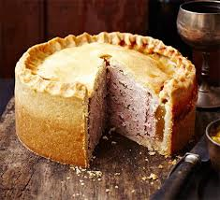
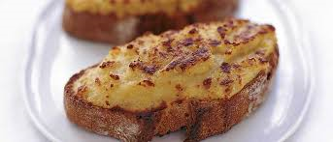
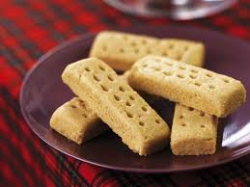
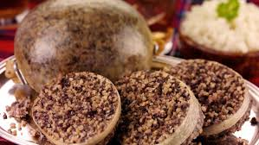
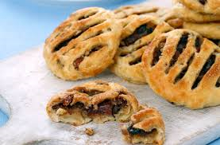
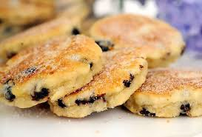
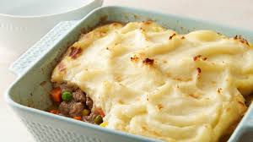
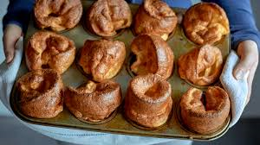
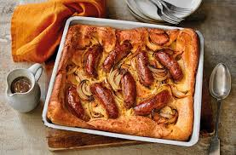
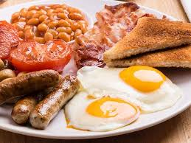
Cornish pasty | Lancashire Hot Pot | Bakewell tart | Cromer Crab | Victoria Sponge
Cream tea | Pikelet | Stilton Cheese | Guinness | Lincolnshire Sausage
Pork Pie | Rarebit | Shortbread | Haggis | Eccles Cake
Welsh cakes | Shepherds pie | Yorkshire pudding | Toad in the hole | English breakfast
Cornish pasty | Lancashire Hot Pot | Bakewell tart | Cromer Crab | Victoria Sponge
Cream tea | Pikelet | Stilton | Guinness | Sausages
Pork Pie | Rarebit | Shortbread | Haggis | Eccles Cake
Welsh cakes | Shepherds pie | Yorkshire pudding | Toad in the hole | English breakfast
Discussion: How many have you tried?

Slide 11
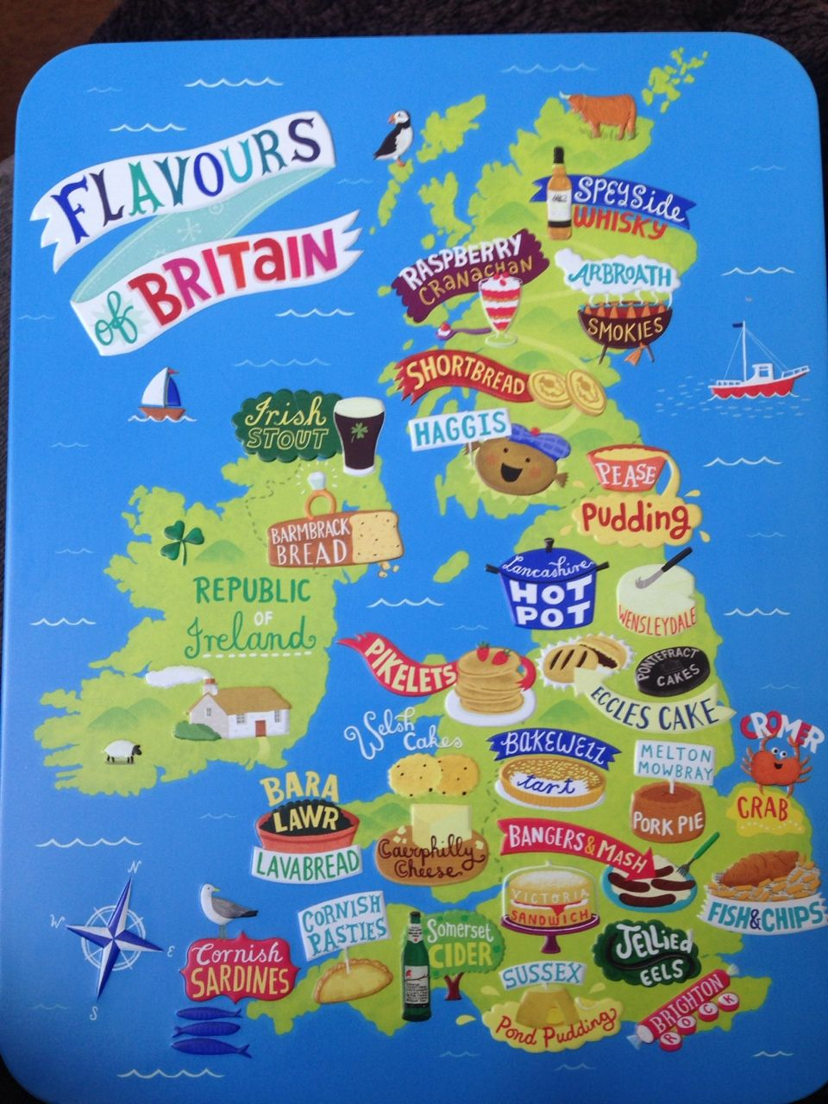
https://www.youtube.com/watch?v=fsEKMTZvHbY
https://www.youtube.com/watch?v=VijTieSlaE0
https://www.youtube.com/watch?v=tDSoqQuxLfs
British Cuisine
Influenced by..
our island location (we are surrounded by the sea)
Lots of land to grow food and rear livestock
Our climate
Our history
A trend in using British grown and seasonal foods
Traditional Ingredients
Wheat and potatoes
We mainly eat wheat in the form of bread
We eat less potatoes and more pasta nowadays
Why?
No preparation required to cook pasta
Quicker to cook
More interesting
We enjoy them more

Slide 12
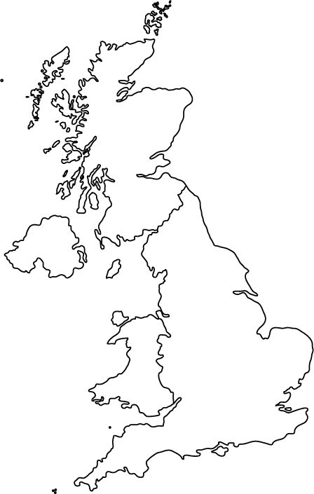
On your map of the UK...
Locate where the British foods listed below come from. Consider what it is about each location that might make it a good producer. Identify 4 other foods that grow well in the UK and plot them on your map
Cornish pasty​ | Lancashire Hot Pot ​ | Bakewell tart ​ | Cromer Crab​
Lincolnshire Sausage | Yorkshire Pudding | Stilton Cheese​ | Guinness​
Pork Pie​ | Rarebit​ | Shortbread​ | Eccles Cakes

Slide 13
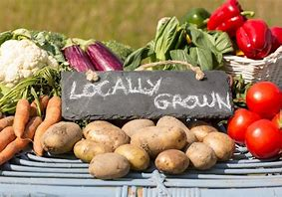
Seasonal Food in the UK
Fruit and vegetables naturally grow in cycles, and ripen during a certain season each year.
When they are in season they are harvested
They are only available at certain times of the year
Advantages
More likely to be local or grown in the UK
The food miles are lower
They support local farms
They are nutritionally better
They are fresher
They are plentiful – makes them cheaper
Disadvantages
Can become repetitive when served too often
Can go off quickly
Can be wasted

Slide 14



Easting a balanced diet with local, seasonal foods - YouTube
Complete this table…
For each of the months outlined, identify a range of foods that are in season.
Make sure that the foods you select are in season in the UK

Slide 15

Check your learning...
Using your knowledge of seasonal local foods...
Remove a coloured brick from the Jenga tower.
For each colour, name a different seasonal food
Orange = fruit
Blue = vegetable
Yellow = Meat/fish
If you get it correct, you keep the brick.
If you get it wrong, you stack the brick on the top.
The winner is the person with the most bricks.

Slide 16

Plenary Task
Thinking about today’s lesson write down…
5… food that are grown in the UK
4… seasons
3… Advantages of seasonal food
2… keywords from today's lesson
1… definition of seasonal food

Slide 17
Where Our Food Comes from...
Indian Cuisine
Our Learning Journey
Learning Objectives
To be able to identify flavours typical to Indian cuisine
To explain the differences in eating habits in India and the factors that influence these
To be able to compare and contrast British and Indian food & culture
British Cuisine
Indian Cuisine
Chinese Cuisine
Kids Try Food from India | Kids Try | HiHo Kids - YouTube

Slide 18

Common Indian Flavours…. Which do you recognise?
How curry from India conquered Britain | Edible Histories Episode 6 | BBC Ideas (youtube.com)

Slide 19

In the North….
Foods From Other Cultures – Indian Food
Factors affecting eating habits…
In the South….
Common flavours…

Slide 20
Food is cooked in a clay oven called a tandoor. | Wheat is the staple food.
Dishes are drier (less sauce). | Dishes are often scooped up using a bread such as a Naan or Chapati.

Slide 21
People are mostly Vegetarian. | People are often poor and/or live in poverty.
The main religion is Hindu. | Spices are used to add colour and flavours.

Slide 22
Rice is the staple food. | Less dry (more liquid) curries are eaten.
Wetter climate. | Drier climate.

Slide 23
Wider variety of vegetables. | The stove top is regularly used for cooking.
Fresh herbs and spices are used over dry. | Dry herbs and spices are used over fresh.

Slide 24







Slide 25



More than half the people of India are Vegetarians: some for religious reasons, but many because they cannot afford to buy meat or fish.
Poorer people live on a diet of cereals, lentils and vegetables, and a main meal may only consist of rice, dhal (lentils and beans) and spices used to add colour and flavour.
In India, Pakistan and Bangladesh the chief religions which affect food customs are Hinduism and Islam. About 80 per cent of Indians are Hindus.
Strict Hindus are vegetarians who believe that it is wrong to kill animals so they do not eat meat, fish or eggs. Other Hindus do not eat beef since the cow is sacred to them, but they do eat lamb, poultry, fish and sometimes pork. Milk and milk products are used.
Muslims may not eat pork or drink alcohol. Animals are specially slaughtered and sold as halal meat from special butchers.

Slide 26



India has a population of nearly 1 billion (the UK has approx. 66 million) and is an agricultural country with nearly 70 per cent of the people working on the land.
Important crops include wheat, rice and maize, as well as lentils, spices such as the very expensive saffron and varieties of tea like Assam.
Cooking in Different Areas
Northern India
In northern India and Pakistan, food is often cooked in a clay oven called a Tandoor, which is charcoal fired. Meat, usually lamb, goat or chicken, is marinated in yoghurt and spices to make it tender, then cooked quickly in the oven. The tandoor is used to cook a bread called a Naan.
In the north of India where wheat is the staple food, dishes are drier and may be scooped up using Chapatti's: round, flat breads made from wheat.
Gordon Ramsay Cooks Street Food In India | Gordon's Great Escape – YouTube (stop at 6:50 to avoid the swearword!)

Slide 27

Cooking in Different Areas
Southern India
Rice is the staple food in Southern India. More liquid curries are served in this area.
The heavy rains help to produce a great variety of vegetables including aubergines, okra and different sorts of pepper. Here many people are Vegetarian.
Most Indian food is cooked on top of the stove and an oven is rarely used. Indian cooks make up their own special blends of spices and don’t use ready made curry powder.
Cooking is done using ghee or vegetable oil. Ghee is made by heating butter, then leaving to set. This is a way of preserving butter since ghee will not go rancid .
How Does Rice Grow? | Maddie Moate (youtube.com)

Slide 28


Compare and Contrast
To notice things that are the same or different...
 | Indian Cuisine | British Cuisine
Similarities
Differences
Words to help...
like, similar to, also, unlike, similarly, in the same way, likewise, again, compared to, in contrast, in like manner, contrasted with, on the contrary, however, although, yet, even though, still, but, nevertheless, conversely, at the same time, regardless, despite, while, on the one hand

Slide 29
Plenary Task
Thinking about today’s lesson write down…
5… typical Indian Ingredients
4… factors that influence food choice in India
3… typically British foods
2… Indian dishes/meals
1… cuisine you'd like to learn about

Slide 30

Naan Bread
Learning Objectives
To be able to combine ingredients to make a bread dough
To be able to demonstrate kneading
To be able to dry fry a dough
1. Sieve the flour, sugar, salt and baking powder into a bowl.
2. In a jug, mix together the milk and oil.
3. Make a well in the centre of the flour mixture and pour in the liquid mixture. Slowly mix together the dough by working from the centre and incorporating the flour from the edges of the 'well', to make a smooth, soft dough.
4. Knead well for 8-10 minutes, adding a little flour if the dough is too sticky. Divide into 4 and make each into a tear drop/naan bread shape.
5. On a medium high heat, warm a dry frying pan (no oil).
6. Carefully fry each side of one of the naan breads until lightly golden and set. Repeat until all naans are cooked.
Ingredients
250g plain flour
2 x 5ml spoon sugar
½ tsp. salt
½ tsp. baking powder
110-130ml milk
2 x 15ml spoon vegetable oil

Slide 31

Tidying away…
Food away. Rubbish in the bin. Sweep floor.
All equipment for washing by the sink.
Antibac the worktop and wipe down with the dish cloth.
Warm soapy water in the washing up bowl
Wash glass first and then everything else.
Dry and put back on the trolley
Empty washing bowl. Remove any food from the plug
Dry with the tea towel and put bottles back in the bowl
Put cloths in the laundry

Slide 32

Food From Other Cultures - Indian Cuisine
Indian Culture
Indian Ingredients
All about India...
India the country
Indian Food

Slide 33
Where our food comes from...
Food Poverty
Our Learning Journey
Learning Objectives
To be able to explain what food poverty is
To be able to recall some of the factors that impact food poverty
To be able to relate some of these factors to the country of India
British Cuisine
Indian Cuisine
Chinese Cuisine
Quick fire 5...
State two ingredients commonly used in Indian cuisine
What is the main religion of people living in India?
Give one factor which affects what food can grow in the UK.
Name one food that is reared to be eaten
Give one difference between Indian and British cuisine.
https://www.youtube.com/watch?v=zOyI6N4Teq0

Slide 34

Food Poverty
Food poverty is defined as 'the inability to acquire or consume an adequate or sufficient quantity of food in socially acceptable ways, or the uncertainty that one will be able to do so'.

Slide 35

How do each of these factors affect food supply?... annotate your mind map to show your ideas.
Challenge task...
How do each of these factors affect food in India specifically?
Pests and disease
Climate
Technology
Factors that affect food supply
Water
Money
Conflict

Slide 36
Global warming is increasing temperatures by around 0.2°C every 10 years.
Rainfall is increasing in some places, but decreasing in others.
Higher temperatures and unreliable rainfall make farming difficult
Have increased crop yields.
Farmers in wealthier countries can afford pesticides, whereas most farmers in poorer countries cannot afford them.
Improvements in technology have increased the amount of food available.
Technology can overcome temperature, water and nutrient deficiencies in the form of greenhouses, irrigation and fertilisers.
Pests and disease
Climate
Technology
Systems provide water for countries with unreliable or low rainfall.
Irrigation can double crop but it is expensive to put these systems in place.
Water can be taken either from underground or directly from rivers. Both have environmental consequences.
Factors that affect food supply
When people have less money, they cannot afford food and they
become unable to work. Families in developing countries spend much of their income on food.
Water
Money
Conflict
War forces farmers to flee their land or to fight in conflict.
Food can be used as a weapon, with enemies cutting off food supplies in order to gain ground.
Crops can also be destroyed during fighting.
Food shortages have caused riots and conflict, eg the Darfur region has faced conflict for many years because of disagreements over land and rights.

Slide 37
Why Mum & Dad are trying to help end hunger in the UK 🍽 (youtube.com)
Does food poverty exist in the UK?
https://www.youtube.com/watch?v=taiI6Wda79k

Slide 38


Slide 39




Explore...
https://www.bigissue.com/
https://fareshare.org.uk/what-we-do/hunger-food-waste/
https://www.trusselltrust.org/
https://www.ladbaby.com
/
Do some independent enquiry into food poverty in the UK.
Be prepared to share what you find out...
These examples shown are a good place to start...

Slide 40


Where our food comes from...
Chinese Cuisine
Our Learning Journey
Learning Objectives
To be able to recognise ingredients common to Chinese cuisine
To be able to summarise how food is celebrated in the Chinese culture
To be able to review and select relevant information to produce research
British Cuisine
Indian Cuisine
Chinese Cuisine
Chinese Food | American Kids Try Food from Around the World - Ep 6 | Kids Try | Cut (youtube.com)

Slide 41






All about China...
WAGOLL
China is a country in East Asia
Population exceeding 1.4 billion
China spans 5 time zones
Borders 14 countries

Slide 42

Research Skills
Produce an A4 one sided page of research into Chinese food and the Chinese culture.
Your research should cover the following points:
What foods grow well in China
What foods/ingredients/meals are typical in China
What traditions and customs are connected to food
What is Chinese new year and why is it important
If you are stuck...
www.bbcgoodfood.com/recipes/collection/chinese-recipes
www.lonelyplanet.com/articles/what-to-eat-and-drink-in-china
www.tastingtable.com/1121996/regional-chinese-food-explained/
Supermarket websites, you tube videos, restaurant menus and recipe books are all excellent places to get research.

Slide 43
Plenary Task
Thinking about today’s lesson write down…
5… typical Chinese meals
4… spices/herbs/flavours commonly used
3… Chinese meals that you’d like to make
2… Facts that surprised you
1… thing you did well today
How Does Rice Grow? | Maddie Moate (youtube.com)

Slide 44

Today we are learning about....
Food from around the world – Independent Research
Learning Objectives
To be able to recognise foods from different international cuisines
To be able to summarise how food is celebrated, used, grown and shared within a particular cuisine
To be able to review and select relevant information
Our Learning Journey
How food is grown
How food is caught and reared
Seasonal & local food
Do it now task…
On your whiteboard, mind map all the different cultures/countries/
cuisines you can think of. Highlight 3 that you are most interested in.
Food waste
Food from around the world
Independent research

Slide 45
Research Skills
Research the cuisine of your choice.
Your research could cover the following points:
How food is used in your chosen culture
A wide range of example foods, meals and ingredients typically eaten
Food provenance and seasonality of ingredients produced in your chosen country
Traditions and customs connected to food
Select one recipe that you will make to show this cuisine
If you are stuck...
www.bbcgoodfood.com
www.lonelyplanet.com
www.tastingtable.com
Supermarket websites, you tube videos, restaurant menus and recipe books are all excellent places to get research.

Slide 46












Mexican families prefer to cook and eat together all taking a role in preparing food to eat.
Mexican food personality – Mexican food is flavor, color, shape and occasion all in one dish at a time. I would mention the pozole, for example.
Foods that grown in Mexico:
Chilies
Tomatoes
Avocados
Corn
Chia
Agave
Cacoa
Vanilla
Squash
Sweet potato
Mexican cuisine involves exotic flavors: some of the most popular Mexican food will involve all kinds of ingredients and all kinds of flavors. Combination of chilies and chocolate, or, fruits and meat, or even including insects in a main meal. Mexican food is interesting to say the least. One of the most exotic dishes is a simple “quesadilla de huitlacoche”, for example. The “Huitlacoche” is the fungi that lives in the corn. Or, of course, all kinds of insects in tacos or in salsas like: chapulines, Jumiles, chicatanas, and more

