Slide 1
Lesson 12 – narrative paired work

Slide 2
Do now: complete each key quotation
Which character do these quotes belong to?
1. (stage direction) “Creates at once an __________ of massiveness, solidity and _______________”
2. “It’s better to ask for the ________ than to _______ it”
3. “Public men, Mr Birling, have _____________ as well as ____________”
4. “It’s my ______ to ask _________”
Word Bank:
Take
Privileges
Impression
Duty
Earth
Questions
Purposefulness
Responsibilities

Slide 3
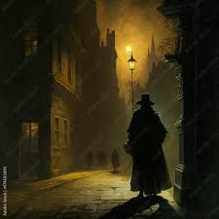
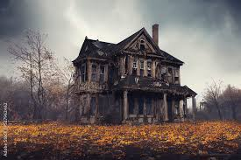
Show, don’t tell
Telling:
The old house was creepy.
Showing:
A cold draft whispered through the cracks of the old house, carrying with it the faint, unsettling creak of floorboards settling under unseen footsteps.
Telling:
The man in the trench coat was suspicious.
Showing:
The man in the trench coat lingered at the corner, glancing over his shoulder every few seconds, his eyes darting like a startled bird’s.

Slide 4
Telling → showing
Telling:
Detective Monroe was anxious about the case.
The basement was very creepy.
The detective was determined to solve the mystery.
There was a sense of urgency in the air.
Copy down the subheading and upgrade these four sentences in your books, ensuring to add detail that helps the reader to paint an image in their mind.

Slide 5
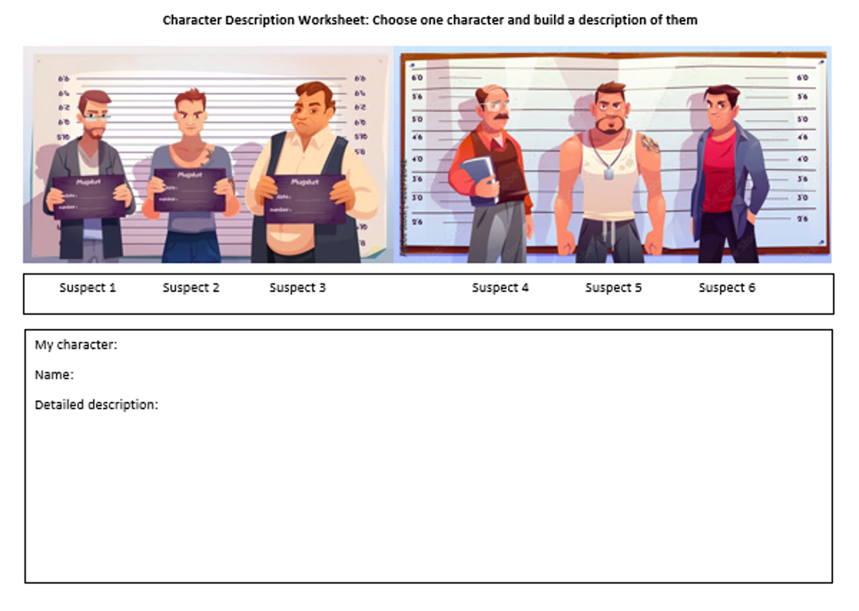
Character description task
Success Criteria:
Varied use of ambitious vocabulary
Sensory details
Range of sentence types
Show, don’t tell
Correct SPaG

Slide 6
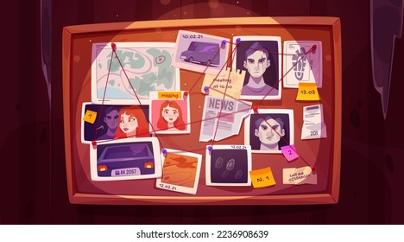
Task: create a plan for a short mystery story using the image
Rules:
- It must include a detective/inspector that solves the case
- It has to link to the image and characters
- Your narrative has to have a clear start/end and plot

Slide 7

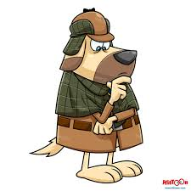

Plenary: Character guess who
With a partner, read your character description and have them guess which suspect you’ve described. Your partner can either try to guess immediately or ask up to five questions.

