Slide 1
Paper 1
Case Study Booklet

Slide 2
The Challenge of Natural Hazards
  HIC Earthquake – Kaikoura, New Zealand
  LIC Earthquake – Nepal
  Tropical Storm – Hurricane Katrina
  UK Extreme Weather Event – Beast from the East
The Living World
  Small scale Ecosystem (example) – Epping Forest
  Tropical Rainforest – Amazon Rainforest
  Hot Desert – Sahara Desert
  Desertification – Sahel, edge of the Sahara Desert
Physical Landscapes
Coasts
  Section of coastline in the UK (example) – Holderness
  Coastal Management – Holderness
Rivers
River from source to mouth (example) – River Tees
Flood management – Boscastle

Slide 3
The challenge of Natural Hazards

Slide 4
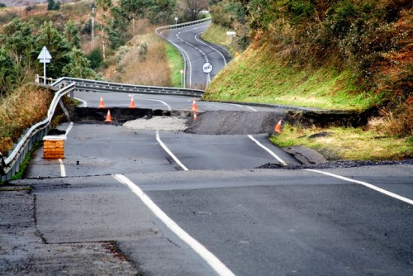
Kaikoura Earthquake (HIC)
Primary effects
2 died, over 50 People injured
over 190km or road & 200km or rail line were destroyed
20,000 buildings damaged or destroyed
60 people needed emergency housing
total cost of damage was $5.8 billion
communication, water, sewerage and power supplied cut off
Secondary effects
The earthquake triggered up to 100,000 landslides, which blocked major road and rail routes
A major landslide blocked the Clarence river leading to the flooding and evacuation of 10 farms
The earthquake triggered a tsunami of 5m, leaving debris up to250km inland
Causes:
November 14, 2016, an earthquake measuring 7.8 magnitude on the Richter scale struck the north eastern Kaikōura region on the South Island of New Zealand.
The earthquakes were caused by one plate moving on top of the other at an ‘oblique-reverse’ fault, after a sudden release in pressure from the Pacific and Australian plates moving towards one another.
Management/Responses
Immediate Responses​
Tsunami warning issued quickly – residents in coastal areas moved to higher ground​
Emergency shelters – used by hundreds​
200 of Kaikoura’s most vulnerable people were evacuated by helicopter within 24 hours​
Temporary water supplies, power restored quickly​
Long Term Responses​
$5.3million of funding from Kaikoura District Council to rebuilt town’s water systems and harbour ​
Most road and rail routes repaired in 2 years​
Kaikoura Mayoral Earthquake Relief Fund for residents who couldn’t afford basic supplies – donations for this from around the world.​
By March 2017 – a permanent earthquake resistant water main installed – will move with future earthquakes so it won’t break

Slide 5
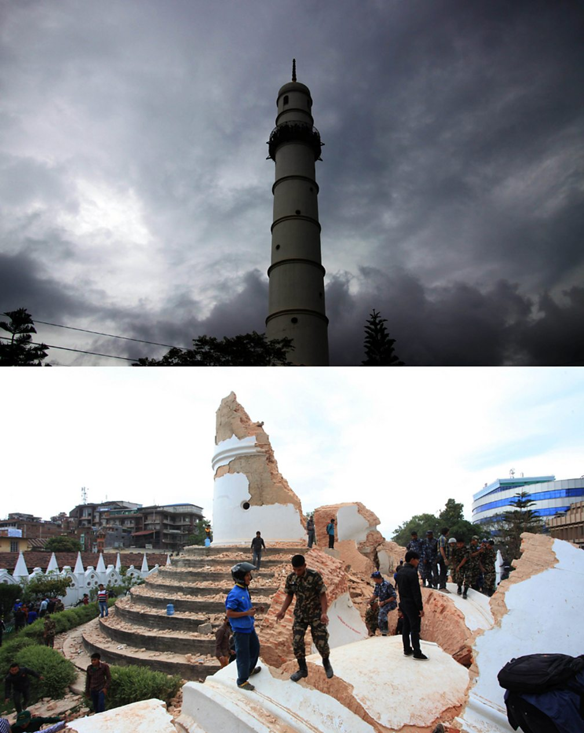
Nepal Earthquake (LIC)
Primary effects
Nine thousand people died, and 20,000 people were injured – over 8 million people were affected.
Three million people were made homeless.
1.4 million people needed support with access to water, food and shelter in the days and weeks after the earthquake
Seven thousand schools were destroyed.
Hospitals were overwhelmed.
50% of shops were destroyed, affecting supplies of food and people’s livelihoods.
The cost of the earthquake was estimated to be US$5 billion.
Secondary effects
Avalanches and landslides were triggered by the quake, blocking rocks and hampering the relief effort.
At least nineteen people lost their lives on Mount Everest due to avalanches.
Two hundred fifty people were missing in the Langtang region due to an avalanche.
The Kali Gandaki River was blocked by a landslide leading many people to be evacuated due to the increased risk of flooding.
Causes:
On 25 April 2015 a 7.8 earthquake struck Nepal in Asia. The earthquake occurred on a convergent collision plate boundary between the Indian and Eurasian plates. The focus was only eight kilometres deep and the epicentre was just 60 kilometres north-west from the capital Kathmandu.
Management/Responses
Immediate Responses​
India and China provided over $1 billion of international aid.
Aid workers from charities such as the Red Cross came to help.
Temporary housing was provided, including a ‘Tent city’ in Kathmandu.
Search and rescue teams, and water and medical support arrived quickly from China, the UK and India.
Field hospitals were set up to take pressure off hospitals.
Long Term Responses​
A $3 million grant was provided by The Asian Development Bank (ADB)
Many countries donated aid. £73 million was donated by the UK (£23 million by the government and £50 million by the public).
Landslides were cleared, and roads were repaired.
Lakes that formed behind rivers damned by landslides were drained to avoid flooding.
Stricter building codes were introduced.
Thousands of homeless people were rehoused, and damaged homes were repaired.
Over 7000 schools were rebuilt.

Slide 6
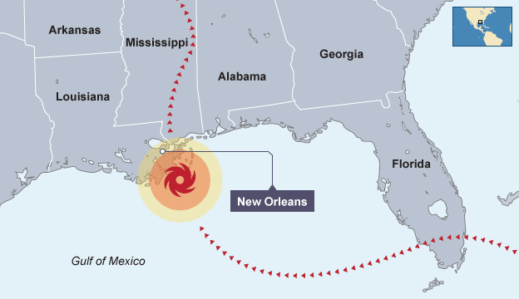
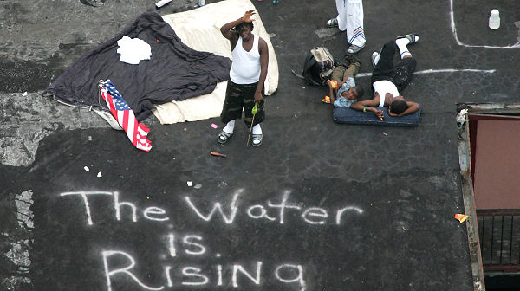
Hurricane Katrina
Social effects
More than 1800 people were killed
1 million people were made homeless
3 million people were left without electricity​
On of the main routes out of New Orleans was closed because parts of the I-10 bridge collapsed
Economic Effects
30 offshore oil platforms sunk or went missing (This increased the price of fuel)
Shops were looted by residents after the hurricane
$300 billion worth of damage
230,000 jobs were lost
Environmental Effects
6m high sea surge broke the levee's protecting the city
80% of the city of New Orleans was flooded, and the floodwaters remained for weeks.
Causes:
Hurricane Katrina was an extremely destructive and deadly Category 5 hurricane. It made landfall on 25th August 2005 in Florida and Louisiana, particularly the city of New Orleans and surrounding areas,
The city of New Orleans was one of the worst affected areas. This is because it lies below sea level and is protected by levees. The levees protect the city from the Mississippi River and Lake Ponchartrain. However, these were unable to cope with the storm surge, and water flooded the city.
Management/Responses
Immediate Responses​
The coastguard, police, fire service and army rescued over 50 000 people​
The Superdome stadium was set up as a centre for people who could not escape the storm. Although there was a shortage of food, and the conditions were unhygienic.
70-80% of New Orleans residents were evacuated before the hurricane reached land.​
Charities collected donations and provided aid, including millions of hot meals.​
Long Term Responses​
Repaired and improved flood defences for New Orleans costing 14.5 billion dollars were completed in 2013
The US government provided over 16 billion dollars for the rebuilding of homes, and provided funds to repair other essential infrastructure
The US Army recommended that buildings are rebuild on stilts or not rebuilt at all in very low-lying areas

Slide 7
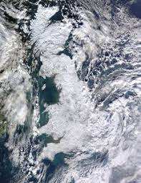
Beast from the East
Primary effects
A man died in London after being pulled from a frozen lake, whilst there were 3 other reported deaths
Up to 50cm (19 inches) of snow in parts of Dartmoor, Exmoor and uplands parts of south-east Wales accompanied by gales or - severe gales (60-70mph) in exposed areas. Snow drifts were as high as 7m in places
Rural areas experienced temperature lows of -12°C
Many coastlines were also issued with flood warnings
Secondary effects
British Airways cancelled hundreds of short-haul flights from Heathrow
Hospitals cancelled all outpatient appointments while Harrogate hospital asked staff who can walk to work to go in to cover shifts
Thousands of schools were closed
Hundreds of people were trapped in their vehicles for hours
The weather cost the UK millions. The AA estimated that there were 8,260 collisions on Britain’s roads from the snow chaos in just three days, with the insurance cost above £10m.
Some supermarkets saw a rush of customers. There were reports of shelves being stripped of bread, milk and soup.
There were worries the UK could run out of Gas
Causes:
The Beast from the East (25 February) was caused by a change to the northern polar jet stream, which twisted its direction unexpectedly, drawing in cold air to the UK from the east. This met moisture from the Atlantic causing SNOW.
Management/Responses
The Army were called in to help people when Storm Emma hit
Councils had to send out gritters and snow ploughs to clear the roads
The Met Office issued "red Warnings" for several areas, - Public Health England (PHE) urged people to plan ahead to ensure they have enough food and medicine.
Rail passengers were warned to avoid travelling to or from Scotland on Thursday while in Kent 50 stations closed.
Army and Royal Air Force personnel were called in to ferry health workers through blocked

Slide 8
The living World

Slide 9
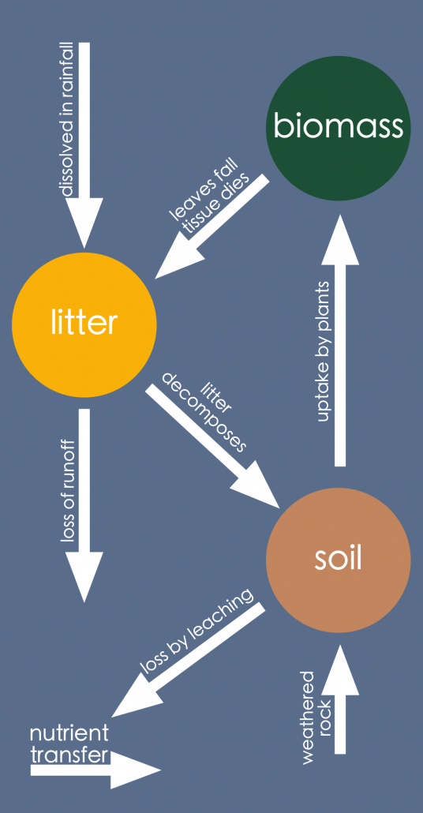
Epping Forest – Small scale Ecosystem
Location & Background:
Epping forest is an ancient, deciduous woodland to the northeast of London. The forest is approximately 19 kilometres long from north to south but no more than 4 kilometres from east to west at its widest point.
The forest has been used for hunting and timber resources. Recreation is the leading role of the forest now.
The forest is designated as a Site of Special Scientific Interest (SSSI), meaning it is a protected environment.
Examples of species in Epping Forest
Epping Forest has a complex food web composed of thousands of species. The forest has:
a wide variety of native tree species that include beech, elm, oak and ash;
a shrub layer consisting of hazel and holly, along with grasses, brambles, fern, bracken and flowering plants;
177 species of lichen and moss
many primary consumers, including insects and small mammals, and deer, along with 38 species of birds
secondary consumers such as owls, adders and foxes;
700 species of fungi, important decomposers, which are common due to a large amount of deadwood;
over 100 lakes and ponds provide essential habitats for numerous fauna species (animals) and flora (plants).
Sustainable Management of Epping Forest
Recreation is controlled within the forest, including having designated car parking areas, a visitor centre and leaflets on how to use the forest to protect the environment. Paths for walking and riding are open to public use. There are currently 13 Keepers employed to protect the forest environment.
Vegetation is cut back to protect the native deer population from road traffic accidents.
Cattle have been reintroduced in some areas as grazing supports the growth of some flora.

Slide 10
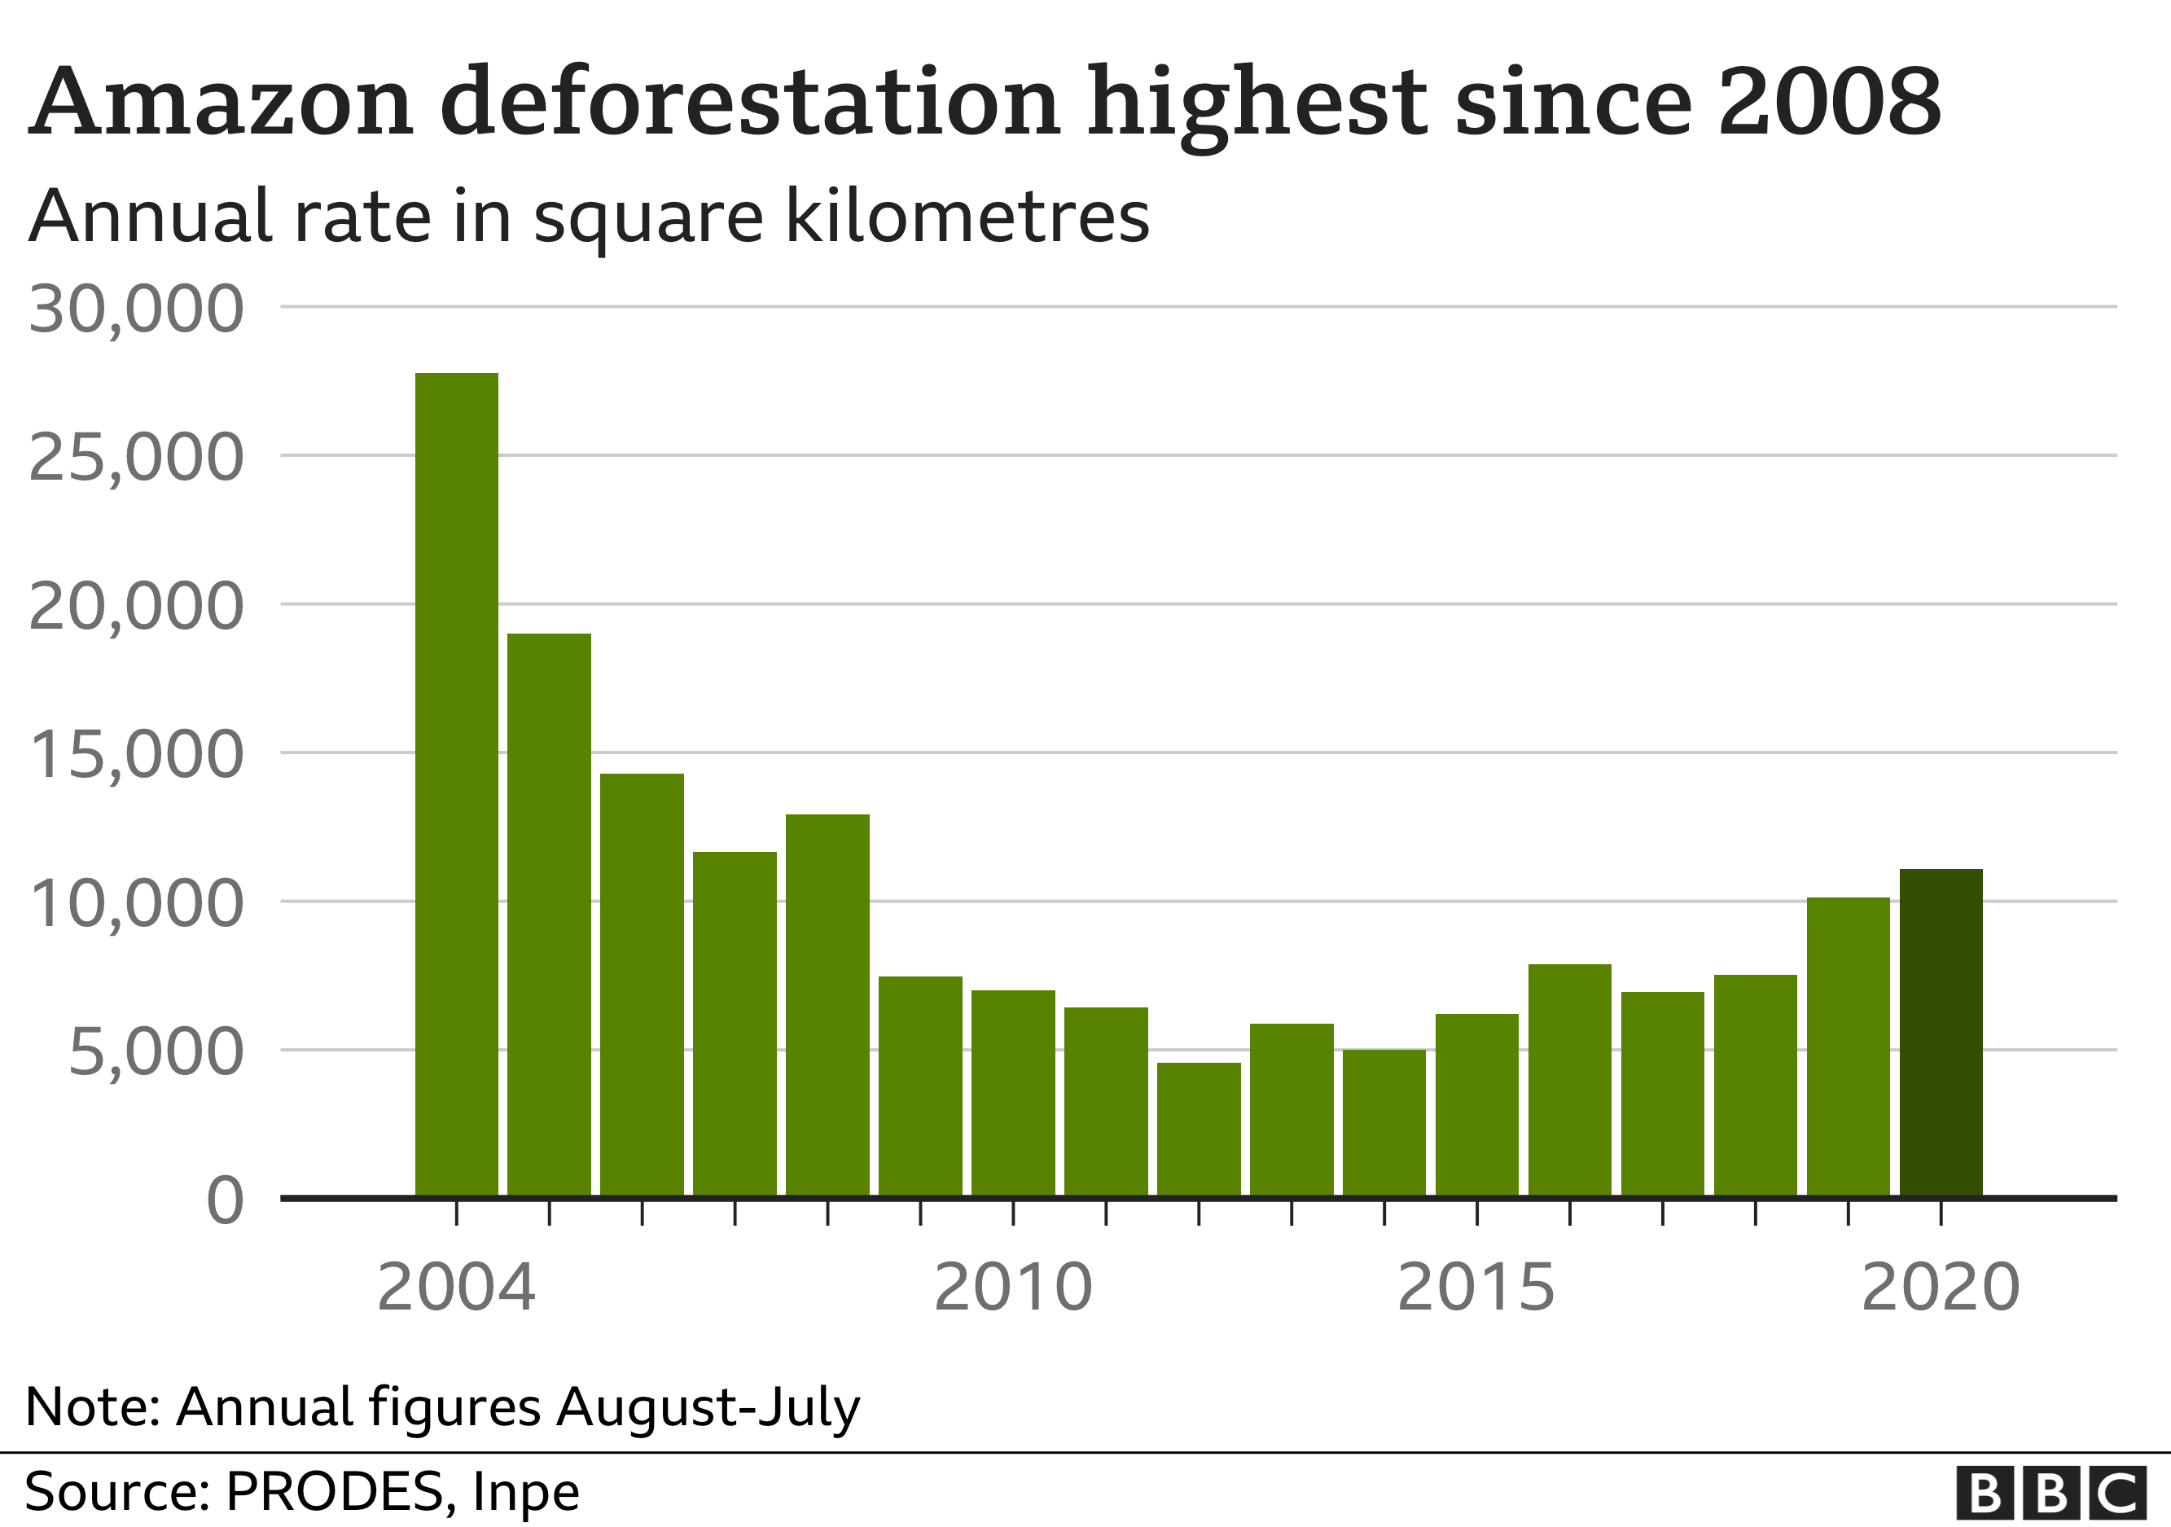
The Amazon Rainforest
Facts:
It is home to 1000 species of bird and 60,000 species of plant
10 million species of insects live in the Amazon
It is home to 20 million people, who use the wood, cut down trees for farms and for cattle.
It covers 2.1 million square miles of land
The Amazon is home to almost 20% of species on Earth
Location
The Amazon is the largest tropical rainforest on Earth. It sits within the Amazon River basin, covers some 40% of the South American continent and includes parts of eight South American countries: Brazil, Bolivia, Peru, Ecuador, Colombia, Venezuela, Guyana, and Suriname.
Causes of Deforestation
Subsistence and commercial farming – subsistence farming is where poor farmers occupy plots of the forest to grow food to feed themselves and their families. They clear forest and then burn it, hence the name slash and burn. They grow crops until the soil is exhausted and then move on.
Logging – This involves cutting down trees for sale as timber or pulp. The timber is used to build homes, furniture, etc. Loggers are interested in all types of wood and therefore cut all of the trees down, thus clearing the forest (clear-cutting).
Road building – trees are also clear for roads. Roads are an essential way for the Brazilian government to allow development of the Amazon rainforest. he Trans Amazonian Highway has already opened up large parts of the forest.
Mineral extraction – forests are also cleared to make way for huge mines. The Brazilian part of the Amazon has mines that extract iron, manganese, nickel, tin, bauxite, beryllium, copper, lead, tungsten, zinc and gold! The Carajas mine extracts 190 million tonnes or iron ore a year.
Energy Generation – Use of Hydro Electric Power. There are 150 new dams planned for the Amazon alone. The dams create electricity as water is passed through huge pipes within them, where it turns a turbine which helps to generate the electricity. The power in the Amazon is often used for mining. The huge Belo Monte dam started operating in April 2016 and will generate over 11,000 Mw of power.
Settlement & population growth – populations are growing within the Amazon forest and along with them settlements. Many people are migrating to the forest looking for work associated with the natural wealth of this environment. Settlements like Parauapebas, an iron ore mining town, have grown rapidly.
Impacts of deforestation
• Climate Change - Burning the forest releases greenhouse gasses like CO2 as trees are a carbon store. This contributes to the warming of our planet via climate change and global warming. In addition, the loss of trees prevents CO2 being absorbed, making the problem worse. The Amazon also helps to drive the global atmospheric system. There is a lot of rainfall there and changes to the Amazon could disrupt the global system.
• Economic development – Brazil has used the forests as a way to develop their country. The forest has many natural riches that can be exploited. In addition, Brazil has huge foreign debt and lots of poor people to feed, so they want to develop the forest. May Brazilians see deforestation as a way to help develop their country and improve people’s standard of living.
• Soil erosion - the soils of the Amazon forest are not fertile and are quickly exhausted once the forest is cleared. The farmers now artificially fertilise the soil when in the past the nutrient cycle would have done this naturally. In addition, the lack of forest cover means that soils are exposed to the rainfall. This washes huge amounts of soil into rivers in the process of soil erosion.

Slide 11
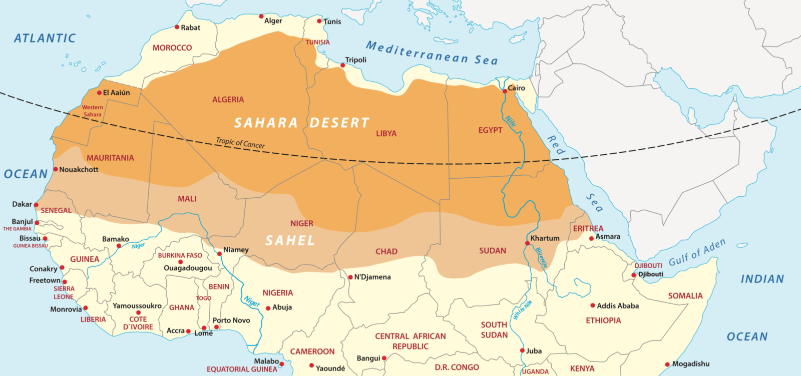
The Sahara Desert
Location
The Sahara desert is the largest hot desert on Earth. It stretches across many countries in north Africa including Egypt, Tunisia, Algeria and Morocco covering an area almost the size of the United States of America.
Opportunities for development
Mineral resources - Morocco is the world’s largest exporter of phosphate used in cleaning products, batteries and fertilisers. There are also major iron ore deposits in Algeria. 60% of Algeria’s income comes from the oil and gas industry.
Solar Energy - Morocco is currently building one of the world’s biggest solar power plants in a project largely funded by the European Union. An example is the huge 160-megawatt Noor plant.
Tourism - Tourism in the Sahara remains on a small scale, with much occurring in cities on the edge of the Sahara. Locations within Tunisia and Algeria also prove popular with Star Wars fans wanting to visit desert locations featured in a number of films.
Farming - Commercial farming is limited to areas where there is enough irrigation water. The Aswan Dam provides Egyptians with a year-round water supply through extensive irrigation.
Challenges to development
1. Water - The Sahara has very low levels of rainfall. Due to the development that is happening in the Sahara there is a growing demand for water for works, irrigation and industry. This is very difficult to provide due to the hot, dry climate. Boreholes (a form of water well) are used to extract water from the underground aquifers. These have taken hundreds of thousands of years to fill so extracting water from them is not sustainable.
2. Inaccessibility - The Sahara covers a vast area. Often, air has to be used to transport people and materials which is very expensive. Expensive pipelines have to be built to transport oil, gas and electricity from remote areas. It is hard to provide services in remote regions therefore there is often a lack of medical care.
3. Temperature - High temperatures in the Sahara present a threat to human life. With daily temperatures often higher than 40°C exposure to this kind of heat leads to death or illness. In addition to this healthcare may be a long distance away. The hot season is too warm for tourists so tourism is seasonal.

Slide 12
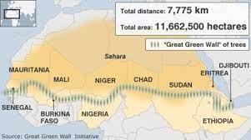
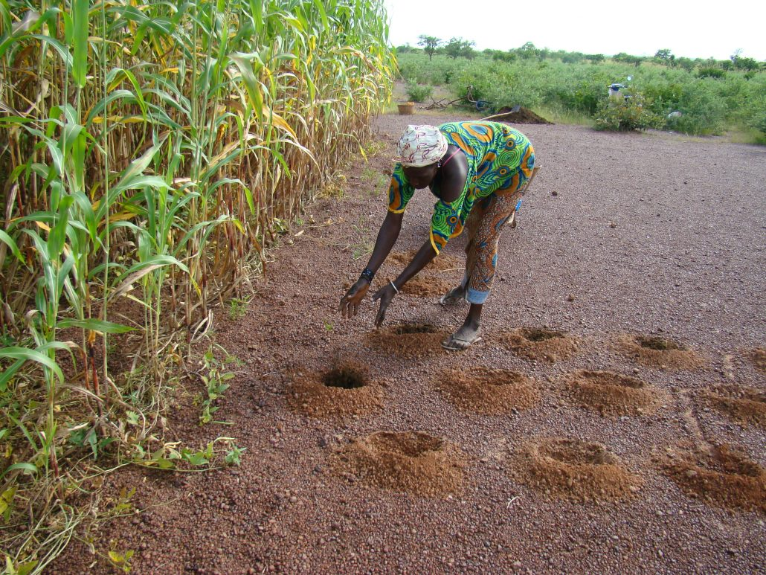
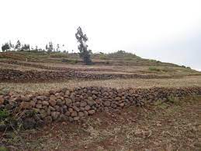
Desertification – Sahel
Strategies to reduce desertification
The Great Green wall is a planned project to plant trees across Africa along the southern edge of the Sahara Desert to prevent the desert spreading south. A trees canopy gives shade meaning more water goes to soil to be absorbed It has been developed by the African Union to reduce the negative effects of desertification and land degradation on people, the environment and the economies of the countries affected.
Stone lines (bunds) - stones lines are laid across the contours of the land and slow down run off water and allow it time to infiltrate the ground and rich sediments to be trapped in the field. This results in less erosion and more water for the crops.
Soil Management - Allowing land to rest between growing crops and grazing allows it nutrients to recover which means it can be used again in the future. Changing the crops (crop rotation) means the same nutrients are not removed from the soil. Local people can produce their own compost and add it to the soil to replace nutrients.
Water management - Crops can be grown that don’t need very much water (e.g. olives and millet). This helps reduce water use. Drip irrigation schemes can be set up which means little erosion happens compared to adding a large amount of water in one go. Planting pits or zai involves digging a hollow in the soil and planting crops in them. They collect rainfall and runoff in the depression which means there is a regular supply of water to the plant.
Desertification is the degrading of land so that it becomes more desert like ​eg. drier ​ and less productive.. 1/3 of the world’s land surface is at risk of desertification – especially if they’re on the margin of deserts ​.
Physical causes of Desertification
Rainfall is expected to reduce in areas that are already dry . Less rain means less water is available for plant growth – so the plant dies ​ Plants roots can no longer hold the soil together and less plants causes bare ground​
Temperatures are expected to increase​. Higher temperatures evaporates more water making soils drier and it can kill plants​
Human causes of Desertification
Removal of fuel wood​ - many people in arid areas rely on wood for cooking, the removal of trees, leaves soil bare ​
Overgrazing ​ - too many cattle or sheep eat the plants faster than they can grow​
Over cultivation ​- if crops are planted in the same area continually uses all the nutrients get used up, so plants can no longer be grown ​
Population growth​ - this puts pressure on the land leading to more deforestation, more overgrazing and more over-cultivation

Slide 13
Physical Landscapes in the uk

Slide 14
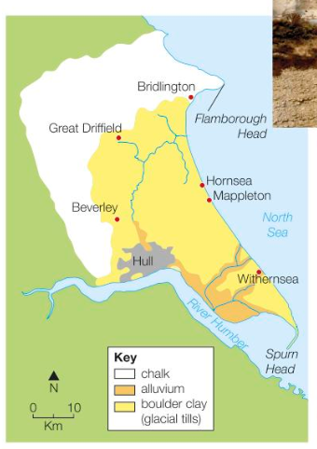
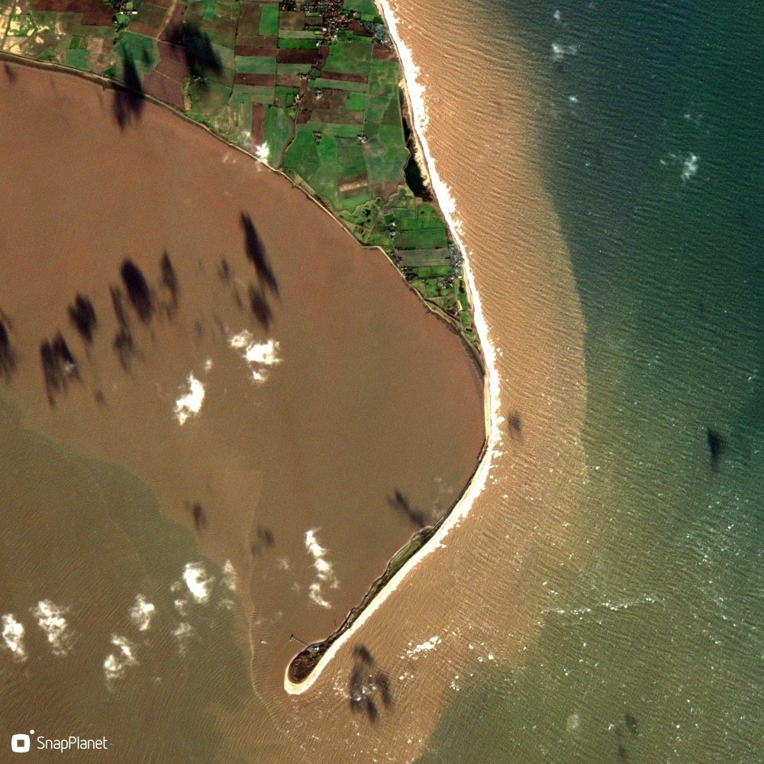
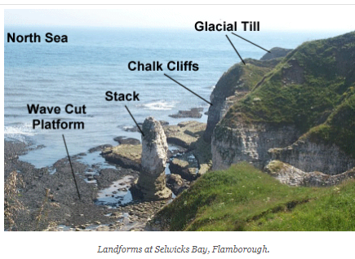
Holderness Coast - Landforms
Spurn Point – Spit
The area known as Spurn forms the southern end of the Holderness coast and includes the unique feature of Spurn Point, a sand and shingle spit 5.5km long, reaching across the mouth of the Humber. The spit forms a sweeping curve which continues the line of the coast. The sand which forms the spit has been transported along the Holderness Coast by longshore drift.
Background
The Holderness Coastline is in the North of England and runs between the Humber Estuary in the south and a headland at Flamborough head.
Flamborough
Flamborough is the headland that forms the most northerly point of the Holderness Coast. The sea attacks the coast around the headland in two ways. Waves beat against the vertical cliffs and, at the high water line, weak points in the chalk are worn away into caves. At places on the cliffs where the chalk juts out, these caves are worn away into rock arches. If the top of an arch collapses, the result is a pillar of chalk cut off from the rest of the headland – this is called a stack. Flamborough Head has many caves and arches, as well as a few stacks. The process of erosion that has created them can take hundreds of years to do its work.

Slide 15
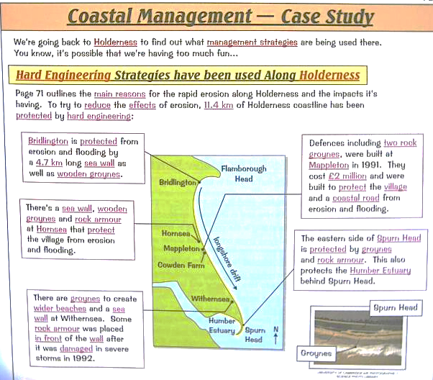
Holderness Coast - Management
Background
It is one of the fastest eroding coastlines in Europe as a result of it’s geology. 7 and 10m of coastline can disappear per winter.
Underlying the Holderness Coast is bedrock made up of Cretaceous Chalk. However, in most places, this is covered by glacial till deposited over 18,000 years ago. It is this soft boulder clay that is being rapidly eroded.
There are two main reasons why this area of coast is eroding so rapidly. The first is the result of the strong prevailing winds creating longshore drift that moves material south along the coastline. The second is that the cliffs are made of soft boulder clay which erodes rapidly when saturated.
Hornsea
There is up to 3m of erosion per year. The management protects tourist features such as arcades and hotels and creates a sandy beach. Wooden Groynes repaired and built at a cost of £5.2m.
Groynes prevent material reaching popular seaside towns to the South. Tourism leads to congestion in the summer, negatively impacting on locals. Sea Wall - The wall is an unattractive feature
Mappleton
Massive rock groynes at a cost of £2 million - stops the flow of sand down the coast. There is less sand available for the rest of the coastline meaning more erosion. This has been effective at Mappleton. But the areas to the south of Mappleton have experienced increased erosion
Withnersea - Rip-rap stops erosion by dissipating the waves energy. Very effective at Withnersea and has led to an increase in tourism due to a larger beach.
Spurn point - various groynes and gabions to stop the sand moving down the coastline - slows down longshore drift. Spurn point is growing slowly and the groynes are helping to trap more sand and reduce the impacts of longshore drift.

Slide 16
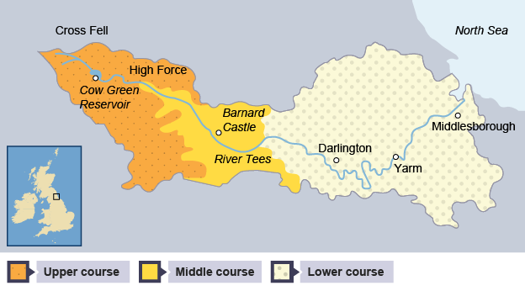
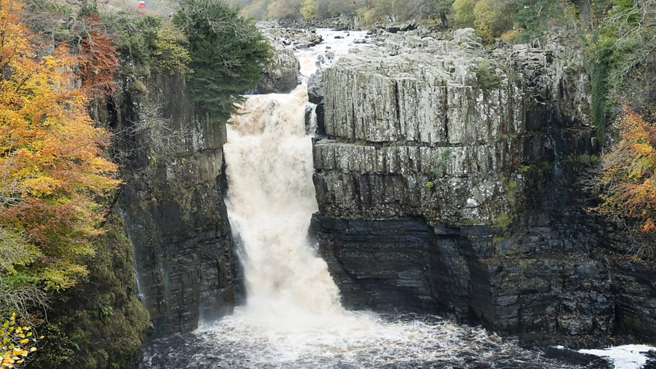
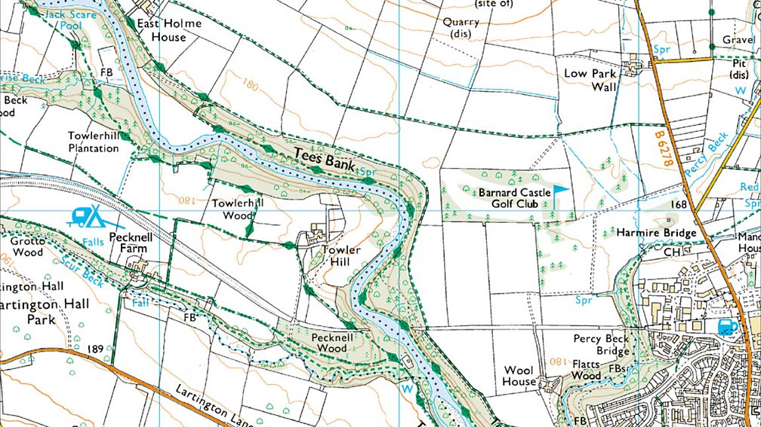
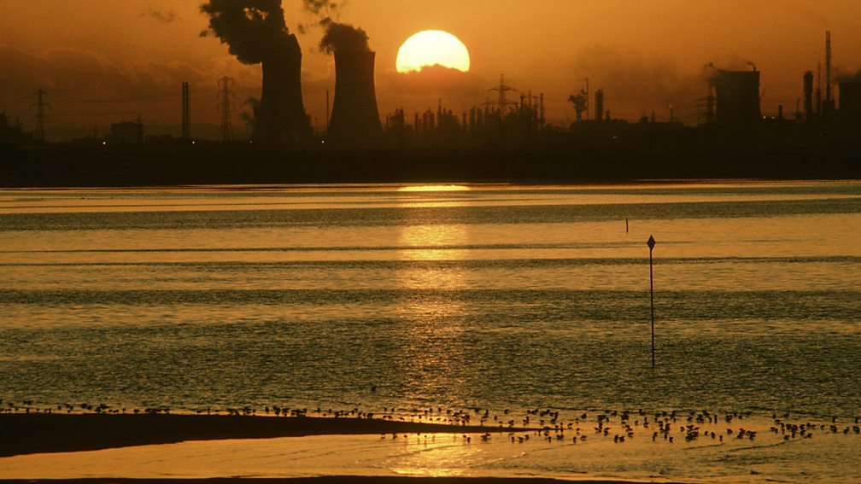
River Tees – Source to Mouth
The River Tees is located in the north of England. The source of the River Tees is located in the Pennines and it flows east to its mouth where the river joins the North Sea.
Upper Course
In its upper course, the River Tees flows over hard, impermeable rocks. Vertical erosion has formed classic V-shaped valleys. The image below shows interlocking spurs close to Cauldron Snout.
The UK’s largest waterfall, High Force, is located in the upper course of the River Tees. An area of hard rock, called Whin Sill (or Whinstone), is located above a layer of soft rocks (sandstone and shale) and together they create the waterfall.
Middle Course
As the River Tees reaches its middle course lateral erosion overtakes vertical erosion and is evidenced by winding meanders. Meanders in the lower course are much larger such as at Barnard Castle. Oxbow lakes have formed in some areas. Evidence of past flooding can be seen in the natural levees that have formed.
Lower Course
Near Yarm, the meanders in the lower course are much larger, and oxbow lakes have formed. In this area there are also levees which have formed when the river has flooded.
The River Tees has a very large estuary with mudflats and sandbanks which supports wildlife in the area. Sites such as Seal Sands are protected areas.

Slide 17
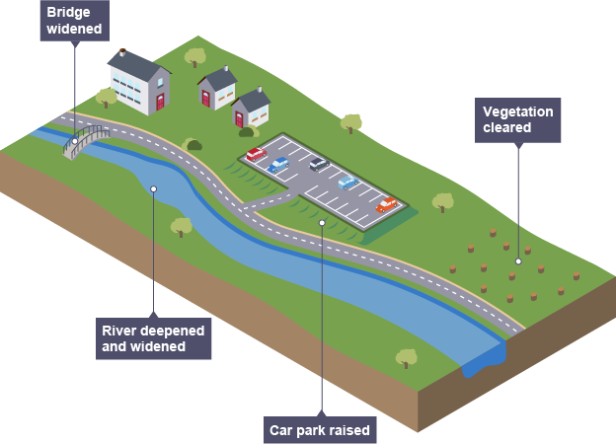
Boscastle – Flood Management
WHAT ARE THE SOCIAL, ECONOMIC AND ENVIRONMENTAL ISSUES?
Social issues:
The rebuilding projects and construction of flood defences took several years which meant the lives of local people were disrupted for sometime. The risk of flooding has been reduced making Boscastle safer. The defences would not protect against a flood the same size as the one in 2004. The new bridge is not popular with local people as it is out of character compared to the rest of the building.
Economic issues:
The risk of flooding has been reduced. Therefore, there is less risk of damage to property and businesses. The flood-defence scheme cost over £4 million. However, the scheme could have been significantly better, though some options were too expensive.
Environmental issues:
Biodiversity has improved as have the river habitats. Vegetation in the area is now managed
Background
In August 2004, the village of Boscastle saw a month's worth of rain fall in two hours (60mm). The drainage basin of Boscastle is steep and impermeable rock. Boscastle is also located on a confluence of three rivers (Valency, Jordan and Paradise. These factors led to a flash flood which caused over one thousand homes, cars and businesses to be swept away and damaged. About two billion litres of water then rushed down the valley straight into Boscastle within a short space of time causing the rivers to overflow. Additionally, the deluge of water coincided with a high tide.
The flood defence scheme
To prevent this type of flood happening again, the environmental agency invested £10 million into several flood defences, such as:
Widening and deepening the river channel - this allowed the river to carry more water.
Removing low bridges and replacing them with wider bridges - this meant large amounts of water could flow freely underneath the bridge and the bridge wouldn't act like a dam (in the 2004 flood, vegetation and debris became blocked, creating the effect of a dam).
Raising the car park and using a permeable surface - this allowed cars to be much higher and so they were less likely to be swept away.
Tree management - dead trees were removed to prevent them being swept away, causing blockages under bridges. Land owners were encouraged to maintain vegetation and plant new trees..

