Slide 1

The BIG Idea
Classwork Tuesday, 27 February 2024 Christian Beliefs - The Trinity
We are Learning to...
Understand what the ‘trinity’ is and why it is an important belief of Christianity.
In today’s lesson...
You will be able to understand the three parts of the Trinity.
You will be able to explain the different roles of each part of the Trinity.
You will be able to understand where the beliefs about God can be found.

Slide 2
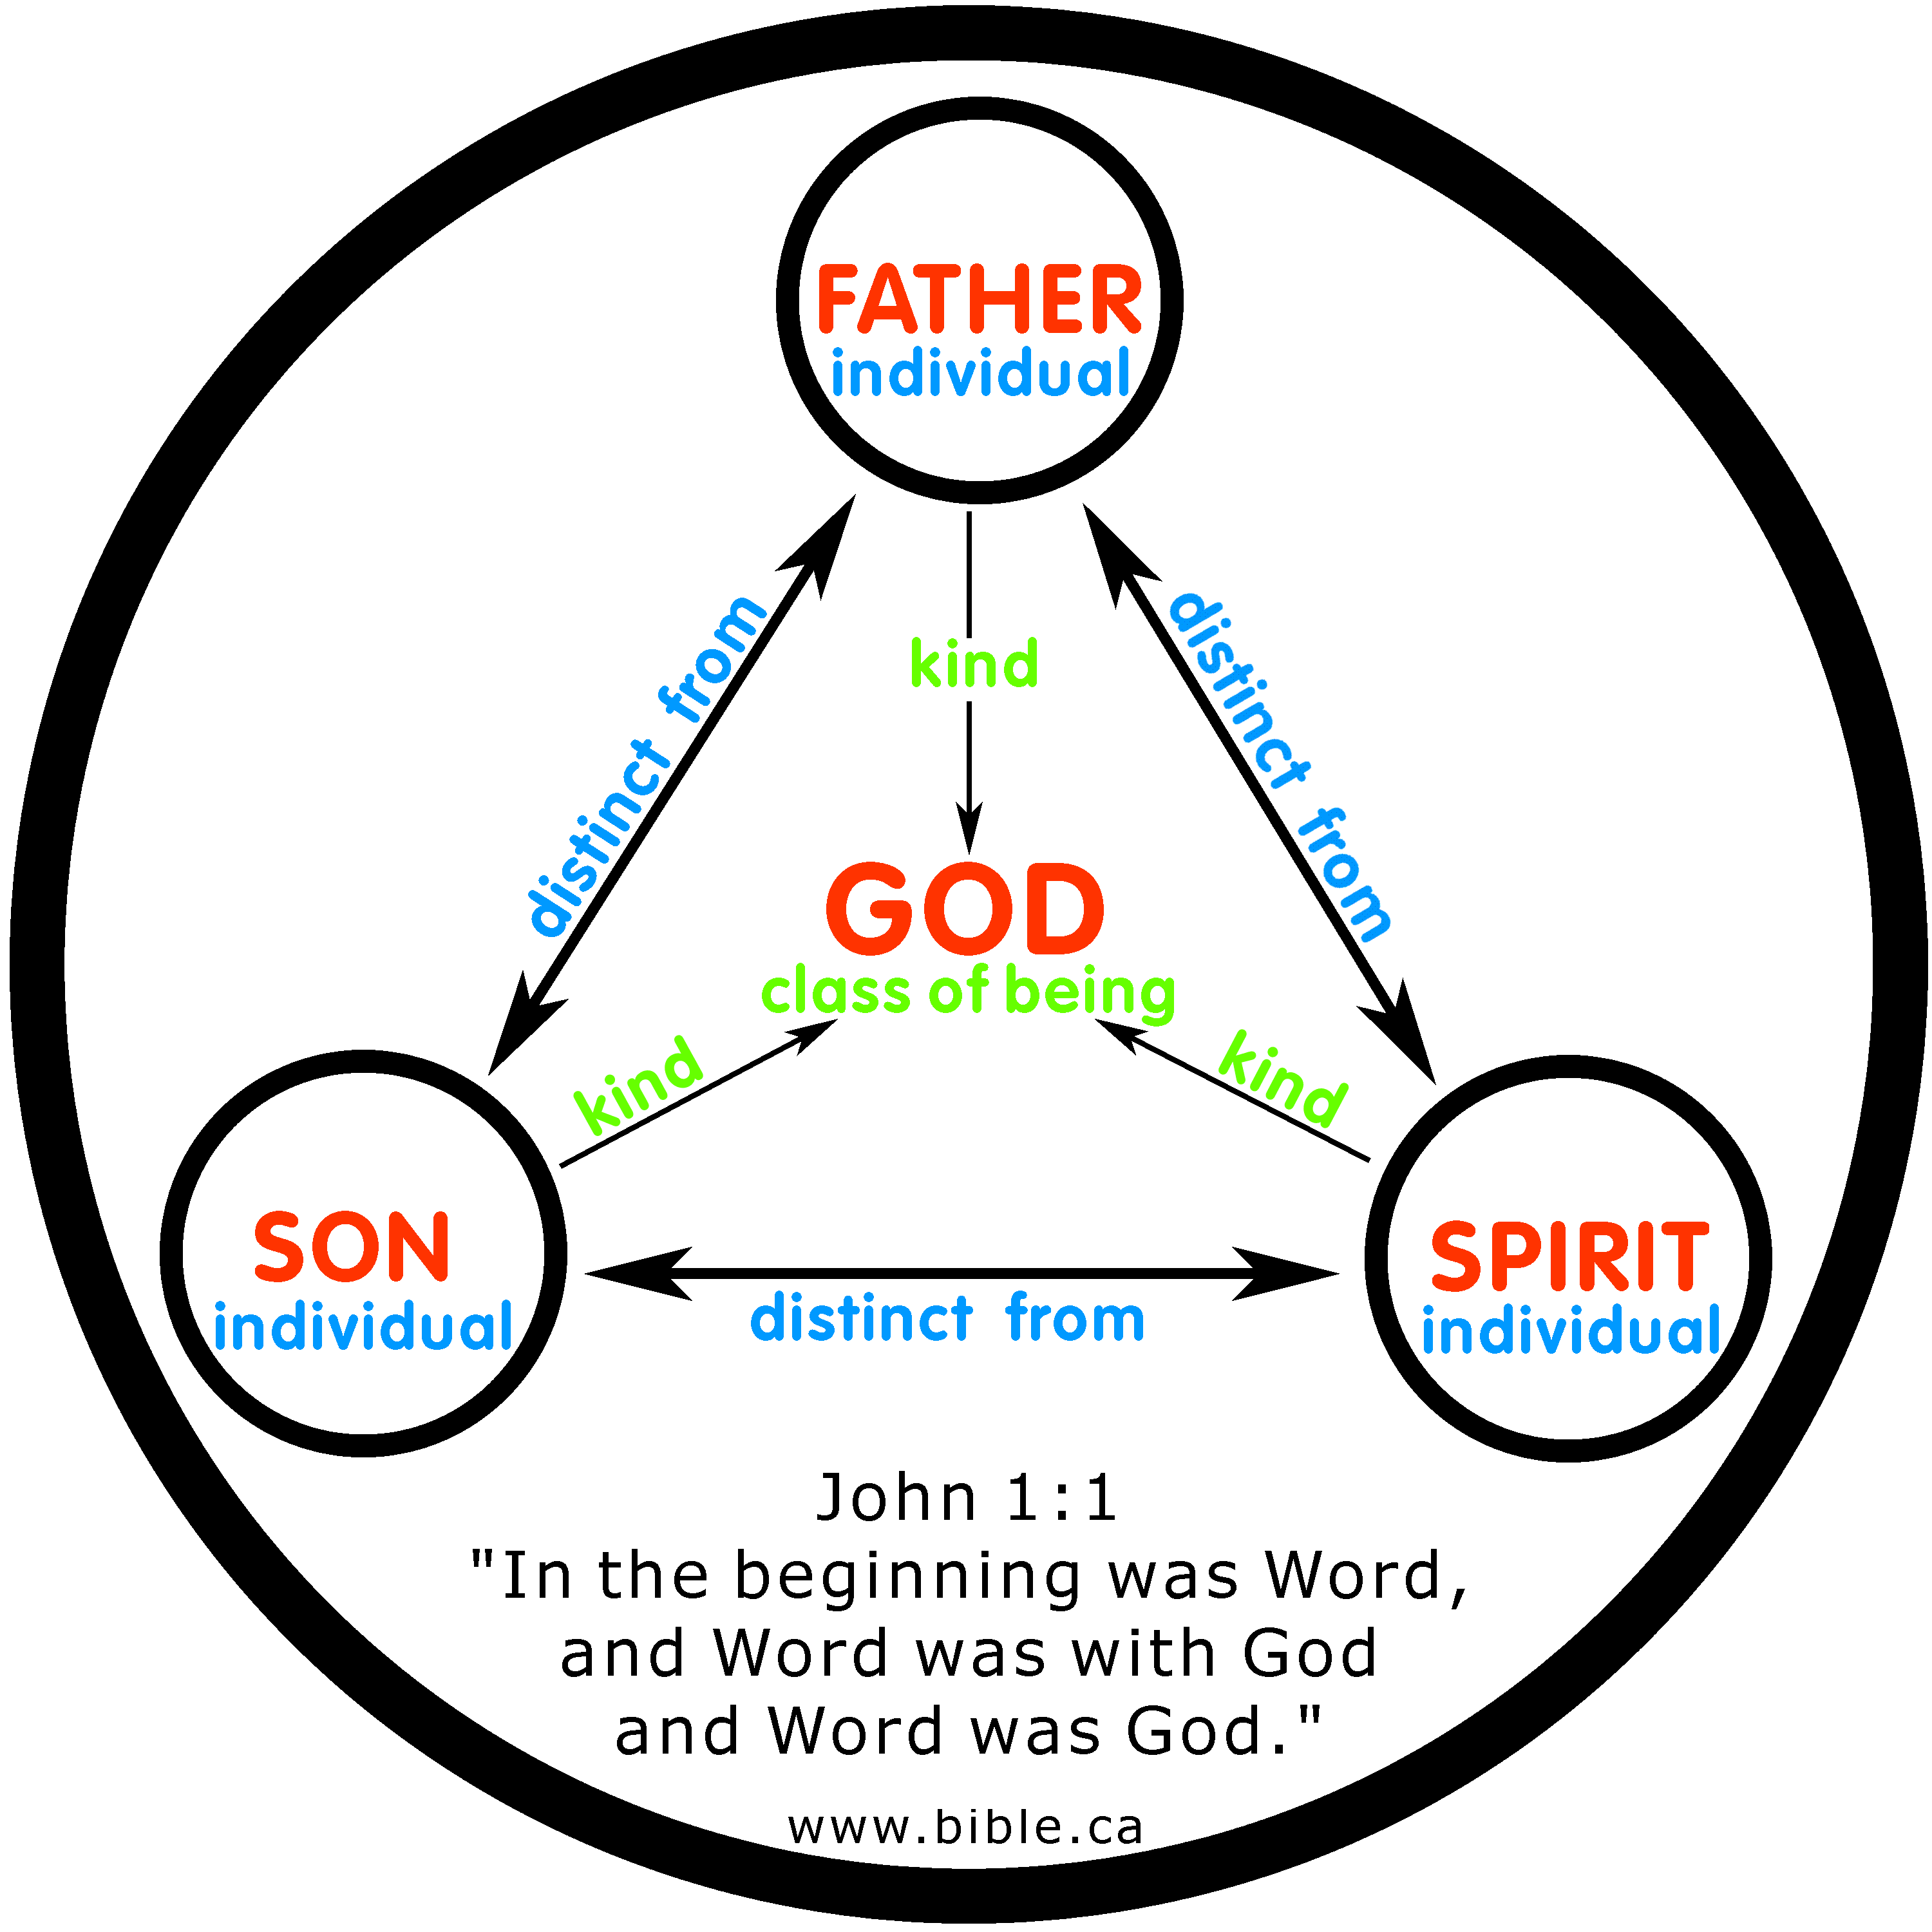
The Oneness of God
Believing in one God is called monotheism, and believing in the oneness of God is the basis of Christianity:
The teachings in the Bible in both the Old and New testaments show clearly that there is only one God.
The belief in the oneness of God is the first of the 10 commandments, which all Christians accept as God’s rules about belief and behaviour.
When asked what was the greatest commandment, Jesus replied. The most important one is this, ‘Hear O Israel, the Lord our God, the Lord is one’. (Mark 12.29)
The oneness of God is the teaching of the Church as seen in the Creeds, the decisions of the Church Councils and the writings of the Church leaders.
Christians believe that the oneness of God is shown in the universe that God created. They believe that the fact it is a universe working to one set of laws means it was created by one God.

Slide 3
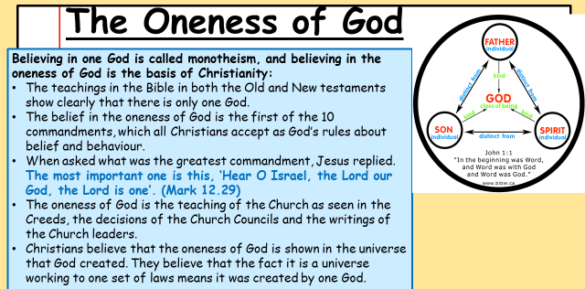
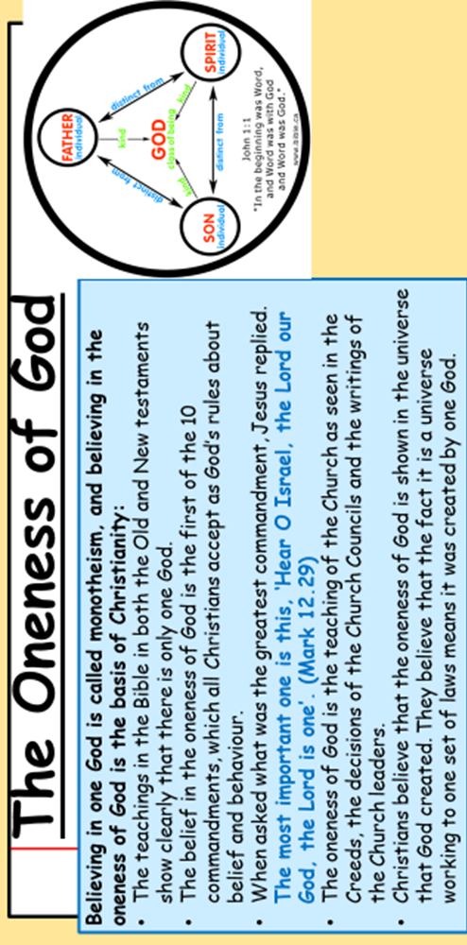

Slide 4
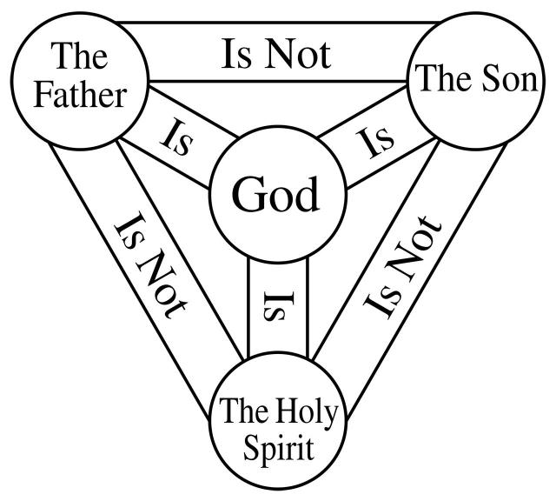
The Nature of the Trinity
The belief that there is only one God, but he exists in three persons.
Although each of the persons are different, they are all fully God, they all show the oneness of God.
God the Father – Creator of the universe and is the almighty (omnipotent, he has all the power)
God the Son – Jesus Christ who is ‘Lord’ and the son of the Father
God the Holy Spirit – Comes from the Father and the Son. Christians believe the Holy Spirit is the giver of life, meaning he is spiritually active in the world. He helps people to know God and worship him, and he equips and empowers believers.

Slide 5
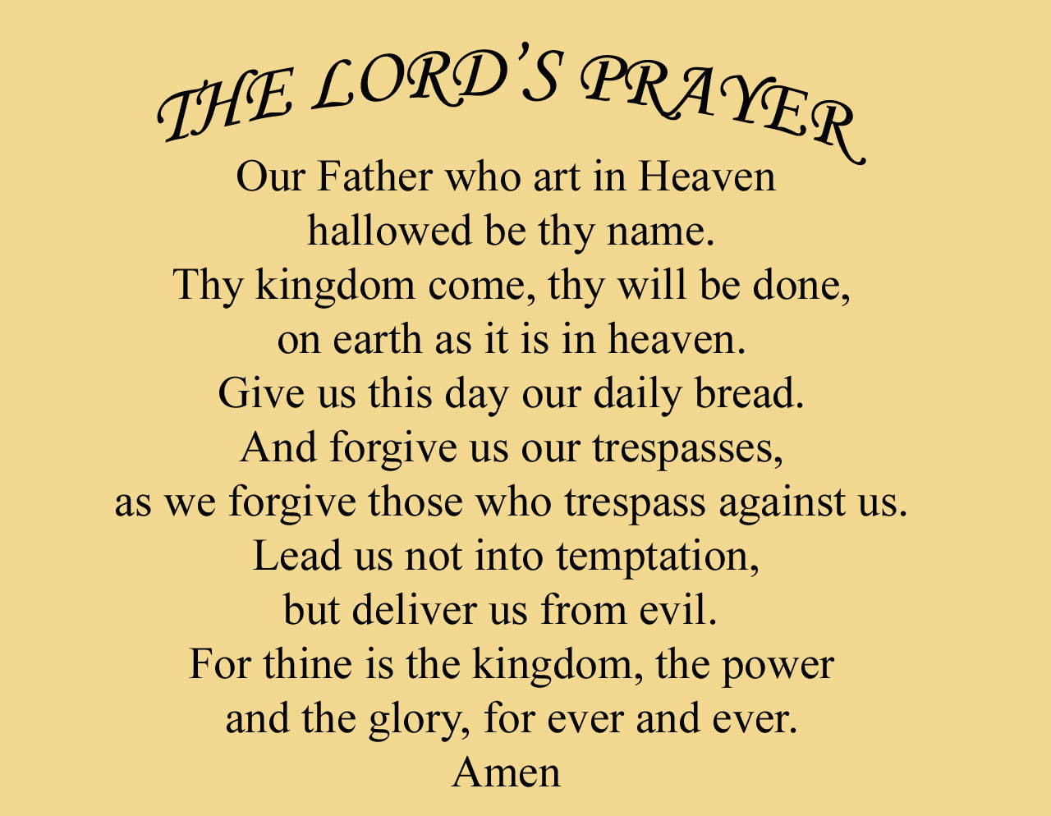

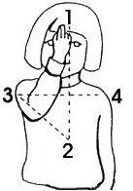



How do Christians show they believe in the Trinity?
Christians show belief in the trinity by…

Slide 6
Independent Tasks
Using the information on the board.
Explain in your own words what the role of The Father is.
Explain what the role of the Holy Spirit is.
Explain what the role of the Son is.
Further task: Why might some people not like the concept of the Trinity?
This person of God helps Christians to understand the presence of God in the world. Christians believe that the Holy Spirit is the means by which God communicates with humans, revealing God’s presence in the world. Christians believe that through the presence of the Holy Spirit in their lives, they can strengthen and empower Christians today.
This person of God helps Christians to understand the power and creativity of God and his care for the world and it’s people. It also shows that God creates human life like a father does. God is not a creator that leaves his creations to get on with their own things, he has a relationship of love and care with his creation. In the Lord’s prayer, Christians learn that God will provide food and protect them from evil. Christians would turn to God as they would a human father when they are in need.
This person of God helps Christians to understand the love of God. In his life and his teachings, Jesus showed God’s love by healing people and feeding people. In his death he showed how much God loves the world.

Slide 7

Reflection
Then Jesus came from Galilee to the Jordan to be baptised by John. But John tried to deter him, saying, ‘I need to be baptised by you, and do you come to me?’ Jesus replied, ‘Let it be for now; it is proper for us to do this to fulfil all righteousness.’ Then John consented. As soon as Jesus was baptised, he went up out of the water. At that moment heaven was opened, and he saw the spirit of God descending like a dove and alighting on him. And a voice from heaven said. ‘This is my son, whom I love; with him I am well pleased.’ (Matthew 3.14)
What does this biblical story tell us about the Trinity?
Why is baptism so important in this story?
Why is this story so important to Christians?
Who is Matthew?

