Slide 1

Scientific Enquiry

Slide 2
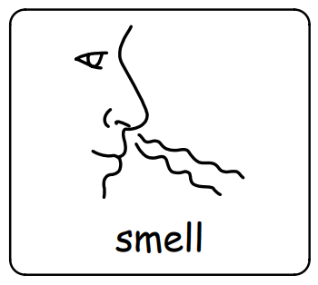
WALT: perform a simple test
Let’s investigate the question…
Is our sense of smell better when we can’t see?

Slide 3

What do you think?
Think – pair – share your ideas (predictions)
Is our sense of smell better when we can’t see?

Slide 4
First, we will smell three different foods and say what we think they are. We will write down our ideas.
Then we will put on a blindfold and smell the foods again and say what we think they are.

Slide 5
Finally, we will talk about what we have found out.
How would we answer the question now?

