Slide 1
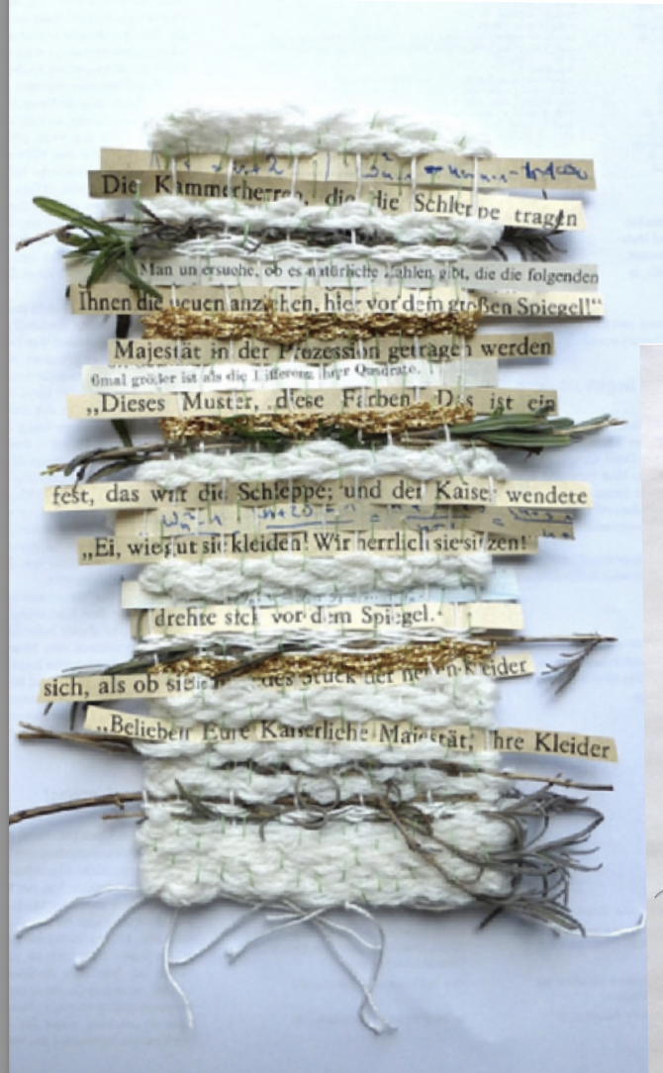
Artist: Ines Seidel
PREVIEW
PREVIEW
Name of artwork: ‘woven story’ from ‘Transfiguration’ exhibition
Date of artwork: 2014
Image source:
https://ines-seidel.de/en/tag/ausstellung/page/2/

Slide 2
PREVIEW
Artist: Josh Blackwell
PREVIEW
PREVIEW
Name of artwork: Neveruses (Misused)
Date of artwork: 2014
Image source:
https://dailyartfair.com/artist/josh-blackwell

Slide 3
Artist: Nicoletta Daríta de La Brown
PREVIEW
PREVIEW
Name of artwork: From a series called “El Barrio Bodega”,
Date of artwork: 2013
PREVIEW
Image source:
https://www.thejealouscurator.com/blog/2016/12/13/nicoletta-darita-de-la-brown/

Slide 4
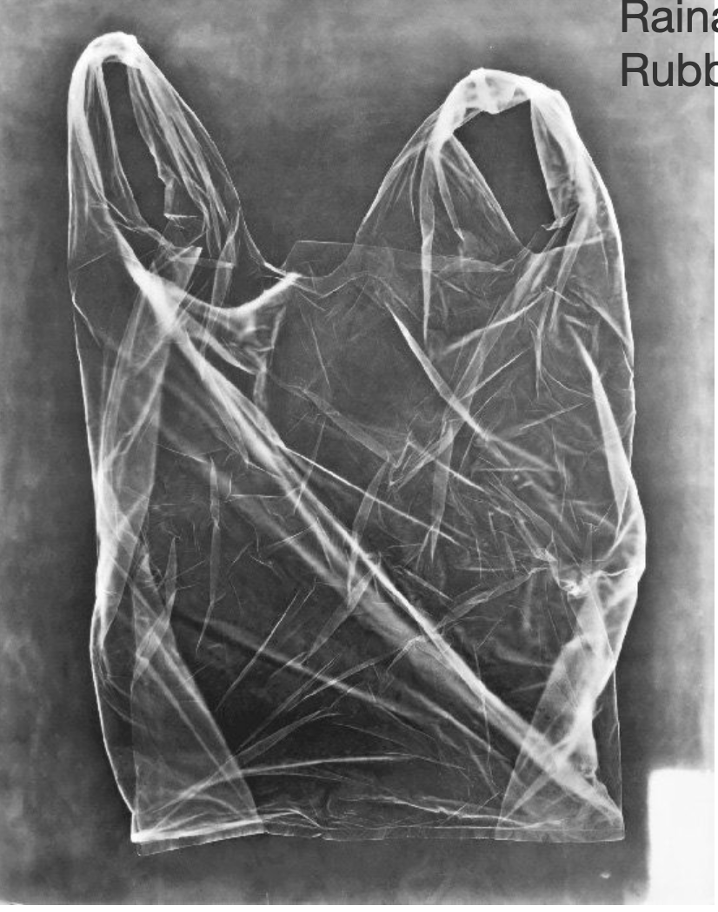
Artist: Raina Vlaskovska
PREVIEW
PREVIEW
PREVIEW
Name of artwork: ‘Photograms’
Date of artwork: 2014
Image source:
https://www.lensculture.com/projects/17247-photograms

Slide 5
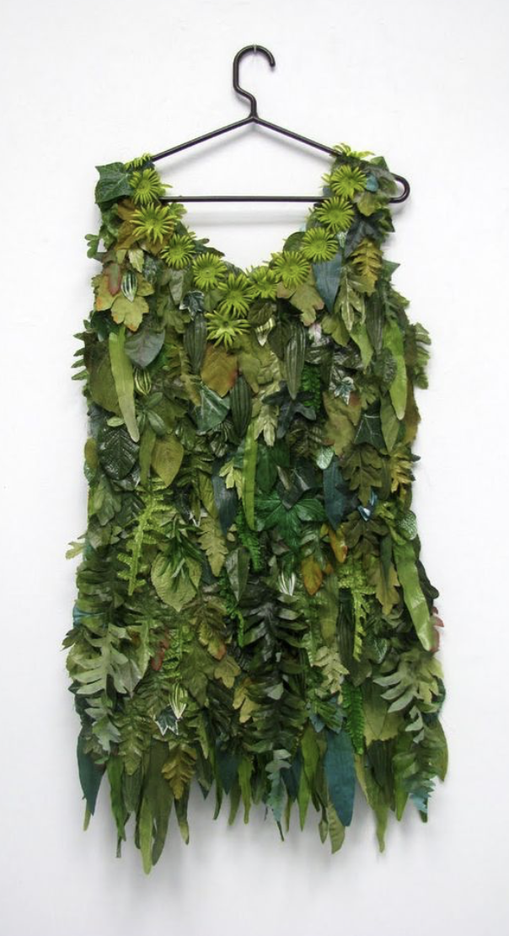
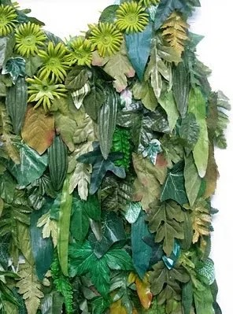
Artist: Susan Lenz
PREVIEW
PREVIEW
PREVIEW
Name of artwork: ‘leaf dress’
Date of artwork: 2010
Image source:
https://i0.wp.com/agoodgoodbye.com/wp-content/uploads/2013/01/leaf-dress.jpg?ssl=1

Slide 6
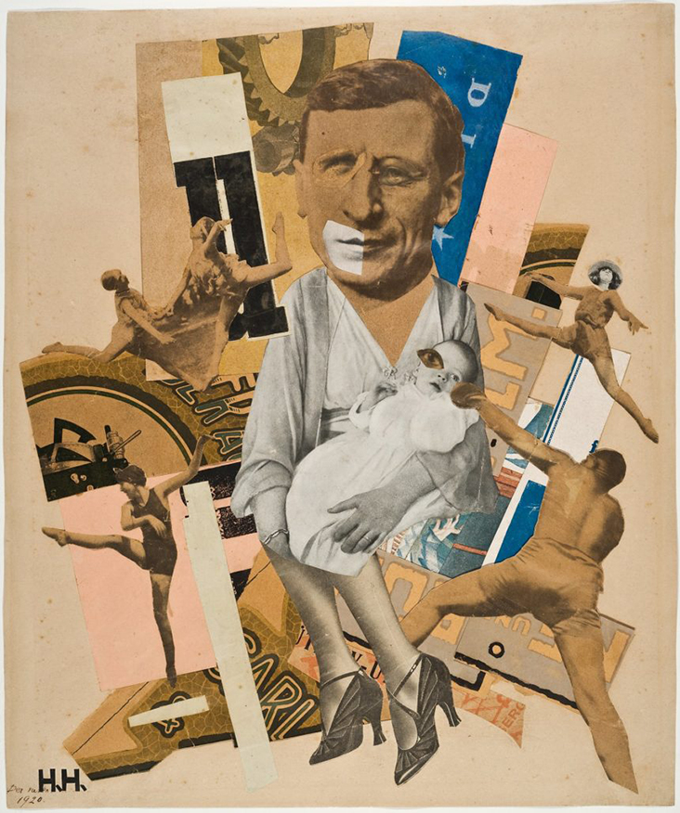
Artist: Hannah Hoch
PREVIEW
PREVIEW
PREVIEW
Name of artwork: ‘The Father’
Date of artwork: 1920
Image source:
https://blog.fabrics-store.com/2024/02/13/hannah-hoch-rebel-with-a-cause/

Slide 7
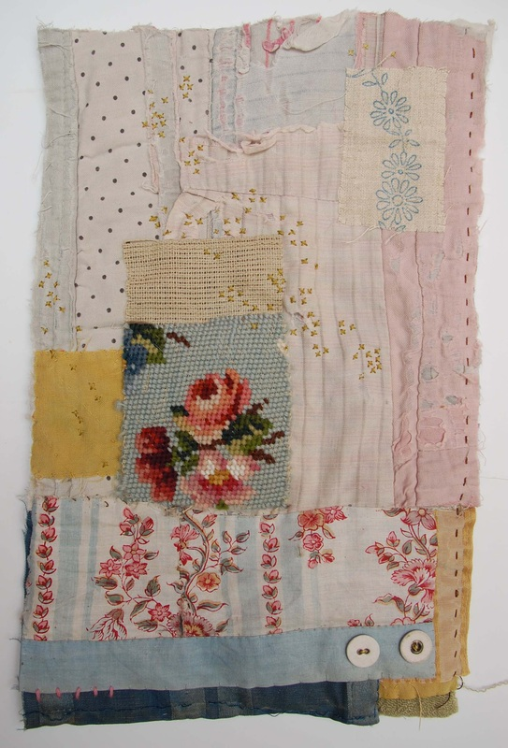
PREVIEW
Artist: Mandy Pattullo
PREVIEW
PREVIEW
PREVIEW
Name of artwork: Untitled
Date of artwork: 2016
Image source:
https://www.mandypattullo.co.uk/gallery.html

Slide 8
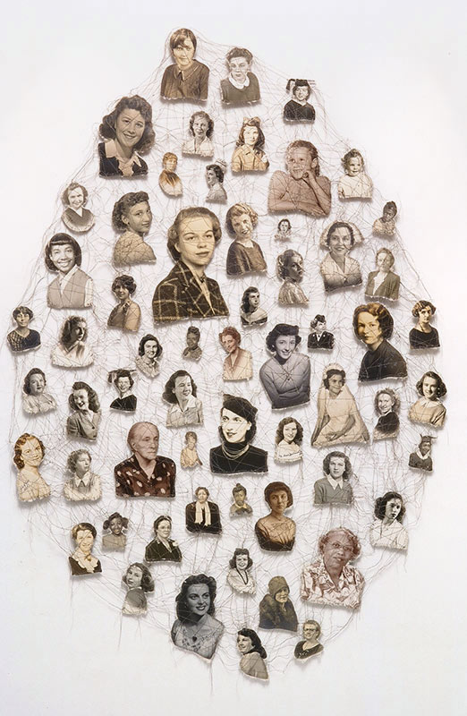
PREVIEW
Artist: Lisa Kokin
PREVIEW
PREVIEW
Name of artwork: Forget-Me-Not
Date of artwork: 2000
Image source:
https://lisakokin.com/sewn-found-photos01#!prettyPhoto[folio]/1/

Slide 9
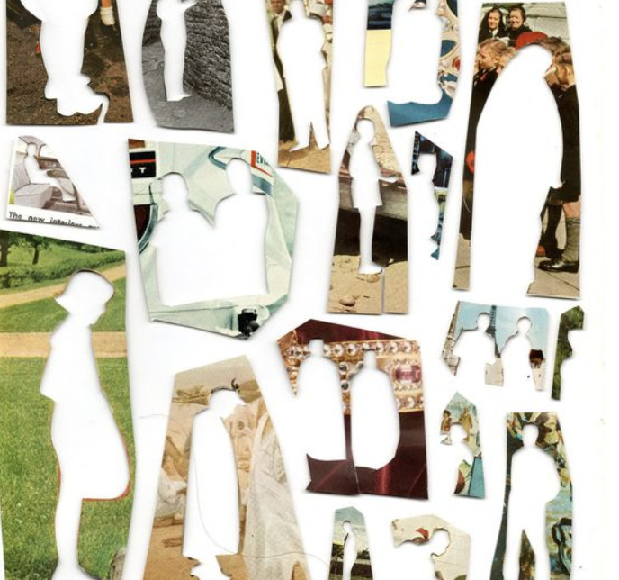
PREVIEW
Artist: Ben Giles
PREVIEW
PREVIEW
Name of artwork: I am
Date of artwork: 2012
Image source:
https://www.flickr.com/photos/ben_giles/7043191533/

Slide 10
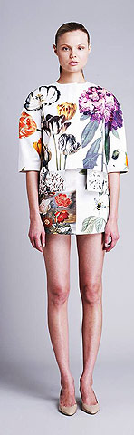
PREVIEW
Artist: Stella McCartney
PREVIEW
PREVIEW
Name of artwork: I am
Date of artwork: 2011
Image source:
https://rihannastyle.wordpress.com/2010/10/06/rihanna-stella-mccartney-resort-2011/

Slide 11
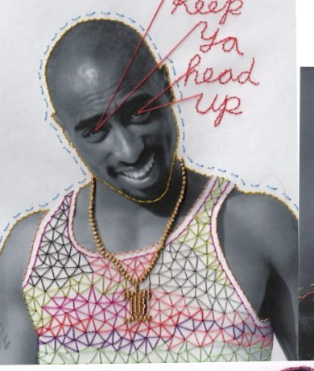
Artist: Mana Morimoto
PREVIEW
PREVIEW
PREVIEW
Name of artwork: Keep Ya Head UpDate of artwork: 2013
Image source:
https://www.ignant.com/2013/11/21/embroidery-by-mana-morimoto/

Slide 12
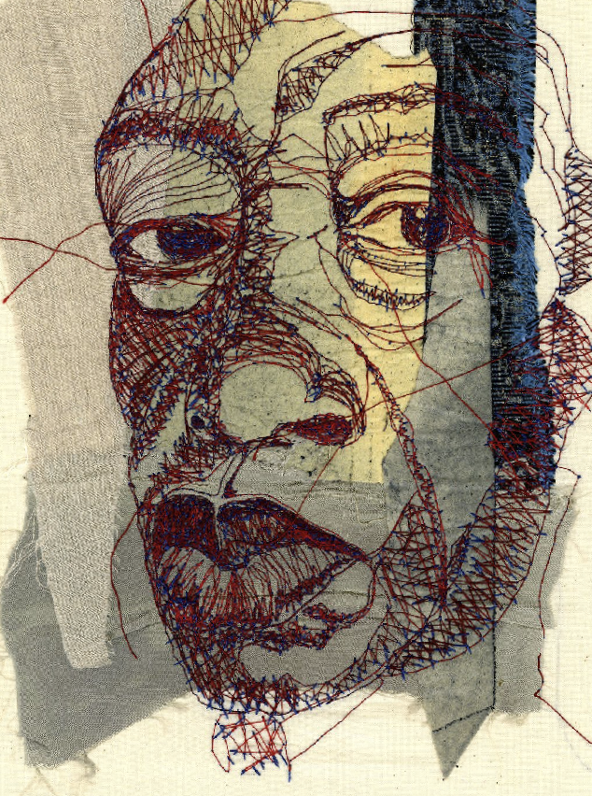
PREVIEW
Artist: Shirley Nette Williams
PREVIEW
PREVIEW
Name of artwork: Untitled
Date of artwork: 2017
Image source:
https://nz.pinterest.com/pin/243827767313075893/

Slide 13
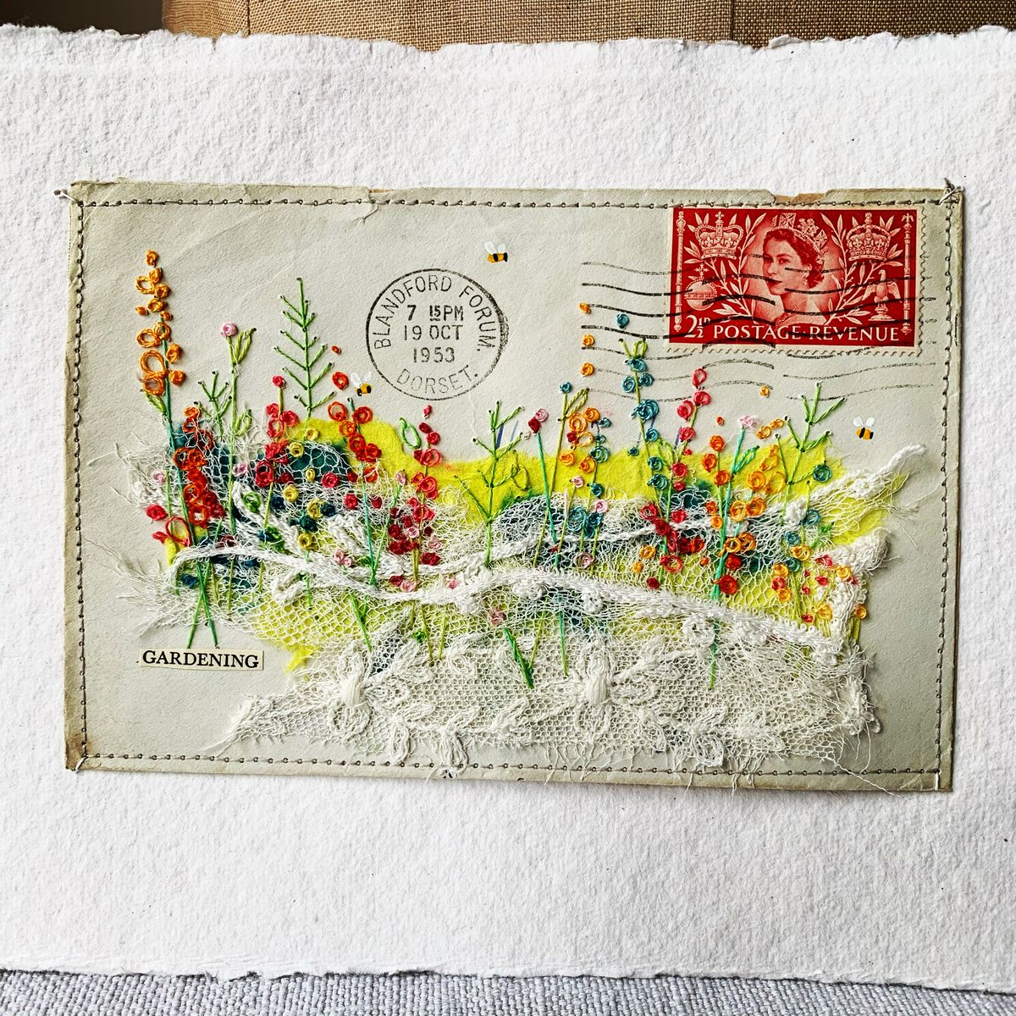
PREVIEW
Artist: Hens Teeth Art
viv_sliwka
PREVIEW
PREVIEW
Name of artwork: Untitled
Date of artwork: N.D.
Image source:
https://uk.pinterest.com/pin/72409506496652028/

