Slide 1

The BIG Idea
Classwork 27/02/2024
Christian Beliefs - Salvation and Atonement
We are Learning to...
Investigate how is Jesus’ death connected to Salvation and Atonement.
In today’s lesson...
You will be able to describe information about Jesus’ death.
You will be able to explain Christian teachings about Atonement and Salvation.
You will be able to evaluate your learning through identifying the importance of Salvation and Atonement for Christians today.

Slide 2
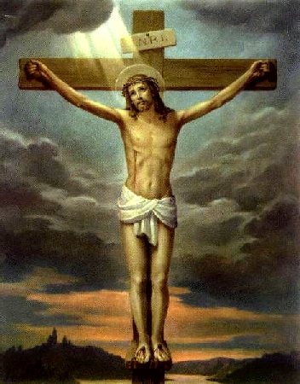
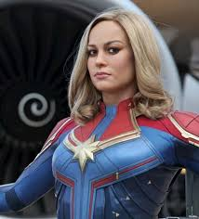

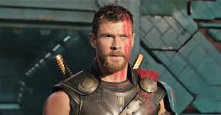
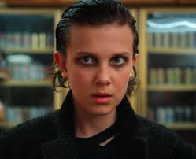
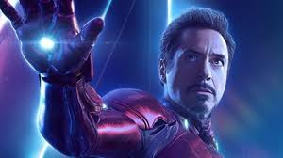

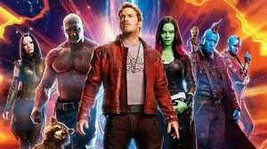
Jesus
What are the similarities and differences between Jesus and the following?

Slide 3
Independent Tasks
Iterative questions;
What are the two parts of the Bible called?
Which person of the Trinity is the giver of life?
Name a Christian source of wisdom and authority other than the Bible
In the story of creation where did God place man?
What is Jesus in human form known as?
What is the last week of Jesus’ life known as?
Name three events during the last week of Jesus’ life
Further Task:
What does the Nicene Creed teach Christians?
Why is the incarnation important?
Why is Good Friday an important day?
Possible SOWA
“Repent, then, and turn to God, so that your sins may be wiped out, that times of refreshing may come from the Lord”

Slide 4
Iterative questions;
What are the two parts of the Bible called? Old Testament and New Testament
Which person of the Trinity is the giver of life? The Holy Spirit
Name a Christian source of wisdom and authority other than the Bible Nicene Creed, Priest, The Pope, Apostles Creed
In the story of creation where did God place man? Garden of Eden
What is Jesus in human form known as? Incarnation
What is the last week of Jesus’ life known as? Holy Week/The Passion
Name three events during the last week of Jesus’ life Jesus‘ washed the Disciples feet Jesus had the Last Supper Jesus predicted he would die/be betrayed Jesus was put on trial Jesus died Jesus resurrected

Slide 5
Iterative questions;
What are the two parts of the Bible called?
Which person of the Trinity is the giver of life?
Name a Christian source of wisdom and authority other than the Bible
In the story of creation where did God place man?
What is Jesus in human form known as?
What is the last week of Jesus’ life known as?
Name three events during the last week of Jesus’ life
Iterative questions;
What are the two parts of the Bible called?
Which person of the Trinity is the giver of life?
Name a Christian source of wisdom and authority other than the Bible
In the story of creation where did God place man?
What is Jesus in human form known as?
What is the last week of Jesus’ life known as?
Name three events during the last week of Jesus’ life
Iterative questions;
What are the two parts of the Bible called?
Which person of the Trinity is the giver of life?
Name a Christian source of wisdom and authority other than the Bible
In the story of creation where did God place man?
What is Jesus in human form known as?
What is the last week of Jesus’ life known as?
Name three events during the last week of Jesus’ life
Iterative questions;
What are the two parts of the Bible called?
Which person of the Trinity is the giver of life?
Name a Christian source of wisdom and authority other than the Bible
In the story of creation where did God place man?
What is Jesus in human form known as?
What is the last week of Jesus’ life known as?
Name three events during the last week of Jesus’ life
Iterative questions;
What are the two parts of the Bible called?
Which person of the Trinity is the giver of life?
Name a Christian source of wisdom and authority other than the Bible
In the story of creation where did God place man?
What is Jesus in human form known as?
What is the last week of Jesus’ life known as?
Name three events during the last week of Jesus’ life
Iterative questions;
What are the two parts of the Bible called?
Which person of the Trinity is the giver of life?
Name a Christian source of wisdom and authority other than the Bible
In the story of creation where did God place man?
What is Jesus in human form known as?
What is the last week of Jesus’ life known as?
Name three events during the last week of Jesus’ life

Slide 6
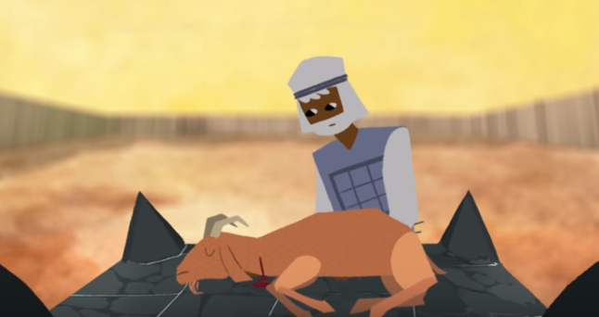
Atonement and Salvation
Salvation is the act of delivering (or keeping away) from evil or saving from sin. Sin is an act that is against God’s will and therefore morally wrong.
The ideas of salvation and atonement are very closely linked in Christianity. Atonement is the idea of the relationship between humans and God being healed, with God and humanity becoming united. Christians believe that Jesus’ death and therefore his salvation allowed humans to begin the process of atonement.
Definitions:
Salvation: Being delivered (keeping away) from the results of sin.
Atonement: The teaching about God’s reconciliation (forgiveness) of humans, gained by the suffering and death of Jesus.

Slide 7
Atonement and Salvation
To deeper our understanding we are going to watch an animation that helps explain what salvation and atonement is.
As we watch the video we will be answering a series of questions below:
Stick these in and be having a read of them, to help you know what to listen out for.
https://www.youtube.com/watch?v=G_OlRWGLdnw

Slide 8
What do the animals symbolise?
What does atonement mean in the Bible?
What does blood represent?
What is purification?
What did Isaiah say about the sacrifices the Israelites were making?
What did Isaiah say the King would do?
What does the Bible say Jesus’ death is?
Why was Jesus’ sacrifice the perfect sacrifice?
What do the animals symbolise?
What does atonement mean in the Bible?
What does blood represent?
What is purification?
What did Isaiah say about the sacrifices the Israelites were making?
What did Isaiah say the King would do?
What does the Bible say Jesus’ death is?
Why was Jesus’ sacrifice the perfect sacrifice?
What do the animals symbolise?
What does atonement mean in the Bible?
What does blood represent?
What is purification?
What did Isaiah say about the sacrifices the Israelites were making?
What did Isaiah say the King would do?
What does the Bible say Jesus’ death is?
Why was Jesus’ sacrifice the perfect sacrifice?
What do the animals symbolise?
What does atonement mean in the Bible?
What does blood represent?
What is purification?
What did Isaiah say about the sacrifices the Israelites were making?
What did Isaiah say the King would do?
What does the Bible say Jesus’ death is?
Why was Jesus’ sacrifice the perfect sacrifice?
What do the animals symbolise?
What does atonement mean in the Bible?
What does blood represent?
What is purification?
What did Isaiah say about the sacrifices the Israelites were making?
What did Isaiah say the King would do?
What does the Bible say Jesus’ death is?
Why was Jesus’ sacrifice the perfect sacrifice?
What do the animals symbolise?
What does atonement mean in the Bible?
What does blood represent?
What is purification?
What did Isaiah say about the sacrifices the Israelites were making?
What did Isaiah say the King would do?
What does the Bible say Jesus’ death is?
Why was Jesus’ sacrifice the perfect sacrifice?

Slide 9
What do the animals symbolise? God’s justice and his grace
What does atonement mean in the Bible? To cover over someone’s death
What does blood represent? Life
What is purification? Cleaning away the evil that has vandalised the world
What did Isaiah say about the sacrifices the Israelites were making? They had become meaningless, they were still allowing evil
What did Isaiah say the King would do? Suffer and die, his life would be offered as a sacrifice
What does the Bible say Jesus’ death is? An atoning sacrifice for us
Why was Jesus’ sacrifice the perfect sacrifice? He was able to defeat death, meaning people could join him

Slide 10
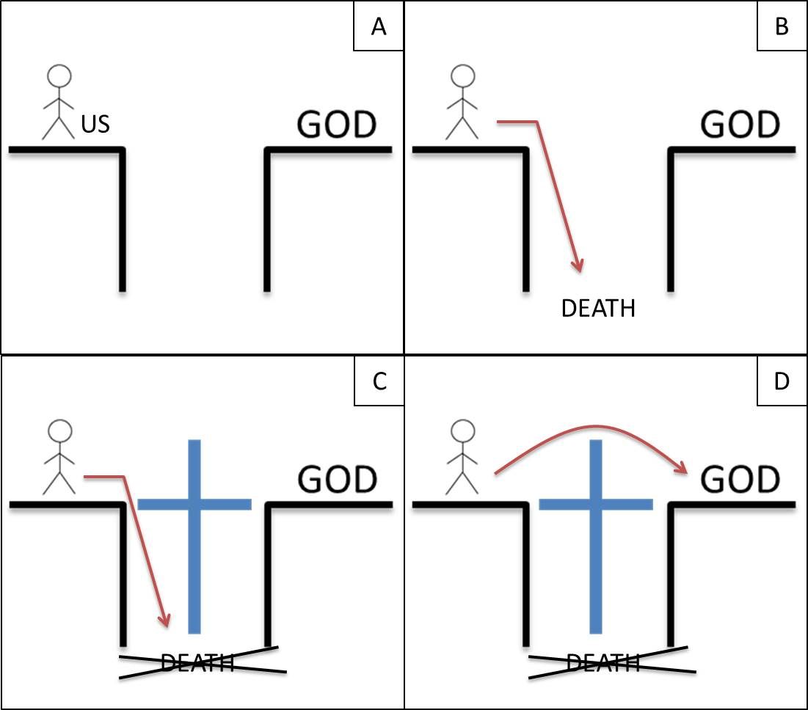
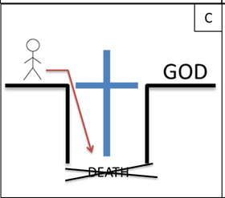
Give students the copy on slide 12.
They need to stick it in their books and annotate them as you do so on the board.
Slide 11 shows you a completed annotation to help you.

