Slide 1
GCSE OCR 9-1 Business revision
Paper 1 | Paper 2
Unit 1 - Business Activity ✅ | Unit 4 - Operations ✅
Unit 2 - Marketing ✅ | Unit 5 - Finance
Unit 3 - People ✅ | Unit 6 - Influences on Business
 | Unit 7 - The interdependent nature of business

Slide 2

Unit 1 - Business Activity
Memory Recall
State three purposes of business enterprise.
What is the purpose of a business plan?
Name 4 types of business ownership and a feature of each.
Name two objectives an established business would have.
Identify 2 internal stakeholders and 4 external stakeholders.
What is the difference between organic growth and external growth.
Notes:
Answers:
Spotting an opportunity; developing an idea; satisfying customer needs.
Reduce the risk of failure
Sole trader - one owner, unlimited liability; Partnership - 2 to 20 partners, unlimited liability; Private Limited Company - Shareholders can restrict who can buy shares, limited liability; Public Limited Company - Company is listed on the stock market, limited liability.
Growth and Profit
Internal - owners & employees; External - customers, suppliers, government & local community
Organic growth is concerned with the growth of the business through internal methods e.g. by increasing sales and external growth is growth of a business by takeover or merger.

Slide 3
Exam practice
Unit 1 - Business activity; Topic - risks and rewards
Amelia Prendergast bought a small newsagent shop using her own savings and a loan from a bank. She had been fed up in her office work as an accounts clerk and wanted to run her own business. SHe really struggled having to get up at 5am. each day, sorting the papers in to “rounds” for the paper boys and girls to deliver and then working in the shop all day until she closed at 6pm. After three months, exhausted and stressed. Amelia put the shop up for sale. However, in the time that she ran the business, she had increased the number of customers and the revenue the shop earned. Amelia sold the business for more than she had paid for it.
Evaluate the risks and rewards to Amelia of being an entrepreneur.

Slide 4
Exam practice
Unit - Business activity; Topic - risks and rewards
Evaluate the risks and rewards to Amelia of being an entrepreneur.
How to structure your answer:
Start with a sentence to say that there are both risks and rewards to Amelia of being an entrepreneur.
Discuss the risks of being an entrepreneur using examples from the text.
Discuss the rewards of being an entrepreneur using examples from the text.
Explain whether you think the risks outweigh the rewards of vice versa.
When you discuss each risk and reward remember to use PEEAL - state your point, explain your point and then describe what it would lead to.
Notes:
Amelia hoped to make a profit and enjoyed being her own boss. She risked her own money and health in running the business. In the end, the business was unsuccessful - Amelia was exhausted and stressed and her relationships with friends and family suffered. She did make a profit from buying and selling the business and would have had enough to pay off her debts and add something to her savings. Maybe Amelia didn’t have enough determination to succeed to come up with solutions to the problems she faced. She should think about her own skills and qualities and will learn a lot and benefit from this experience. Financially, Amelia is better off as a result of buying and running the business in the short period. In view of this, she may feel it is worth doing, provided she can recover her health quickly.

Slide 5
I am going to evaluate the risks and rewards to Amelia of being an entrepreneur. Amelia hoped to make a profit and enjoyed being her own boss. She risked her own money and health in running the business. In the end, the business was unsuccessful - Amelia was exhausted and stressed and her relationships with friends and family suffered.
She did make a profit from buying and selling the business and would have had enough to pay off her debts and add something to her savings. Maybe Amelia didn’t have enough determination to succeed to come up with solutions to the problems she faced. She should think about her own skills and qualities and will learn a lot and benefit from this experience.
Financially, Amelia is better off as a result of buying and running the business in the short period. In view of this, she may feel it is worth doing, provided she can recover her health quickly.

Slide 6
Exam practice
Unit 2 - Marketing; Topic - Pricing strategies
Q1. Explain one pricing strategy that might be successful for a new pizza delivery business (3 marks)
Q2. Fender is a producer of expensive guitars used by stars such as Bruno Mars. Analyse two benefits to Fender of charging high prices for its musical instruments (6 marks)

Slide 7
Exam practice
Unit 2- Marketing; Topic - Product
Q1. Which one of the following is an innovation:
Designing the world’s first robotic strawberry-picker
Persuading Tesco to stock the UK’s first alcoholic ice cream.
Thinking up a new way to iron shirts
Writing a brilliant TV commercial.

Slide 8
Unit 3 - People
Memory Recall
What is the purpose of human resources in a business?
Name two organisational structures and a feature of each.
Name two ways of working.
What is the advantage of letter as a form of communication?
Identify 3 reasons why businesses recruit.
Free health insurance is an example of what kind of motivation method?
Give a type of training which is off-the-job.
What is a contract of employment?
Notes:
Answers:
Identifying and meeting human resource needs of a business.
Tall - may layers of staff from top to bottom. Flat - only a few layers, maybe as little as two or three.
Full-time working, working from home, self-employed, part-time working, working while mobile, flexible working.
It provides a record of the communication.
To start up a business, when a business grows, to replace employees who leave, to fill a skills gap.
Fringe-benefit - financial method.
Demonstrations, role play or simulation, team building activities, lectures.
A legal agreement between an employer and an employee.

Slide 9
Unit 4 - Operations
Memory Recall
What are the 3 production processes?
Give two benefits of providing quality goods and services.
Describe each method of selling.
What does the Consumer Rights Act of 2015 state?
List the main factors influencing the location of a business.
What is the role procurement & logistics?
Notes:
Answers:
Job, batch & flow
Waste is reduced & the business gains a good reputation
Face-to-face - involves direct contact between buyer and seller; telesales - sales completed over the telephone, e-commerce - the bringing together of buying and selling electronically.
Goods and services must be “of satisfactory quality, fit for purpose and as described”.
Costs, proximity to the market, proximity to labour, proximity to materials and government.
Procurement is the management of purchasing within a business; logistics is the process of organising the transport of goods from the seller to the buyer.

Slide 10
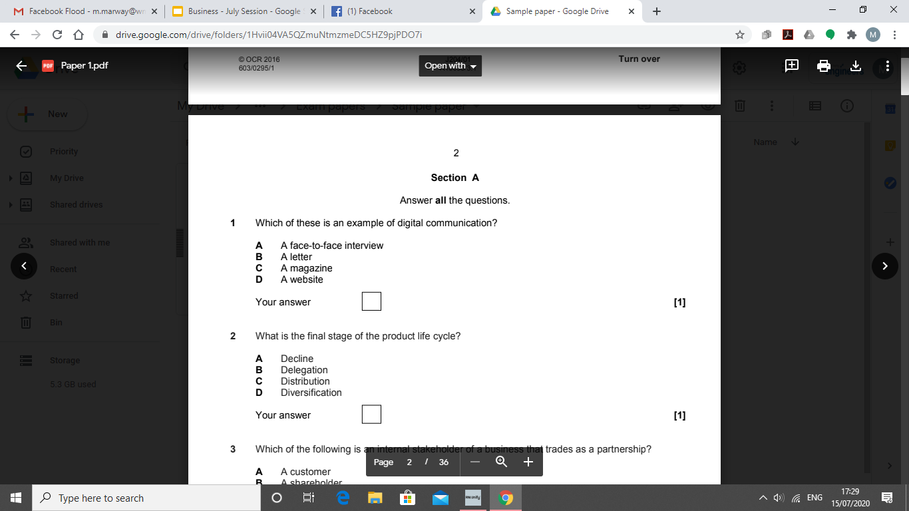
Multiple choice practice

Slide 12
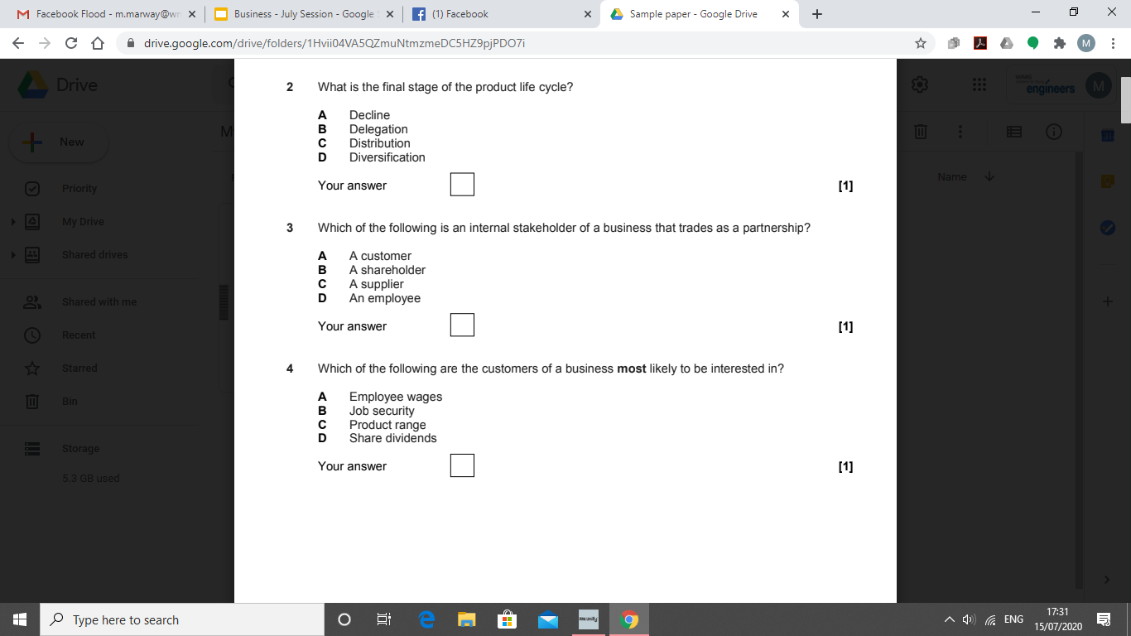

Slide 14
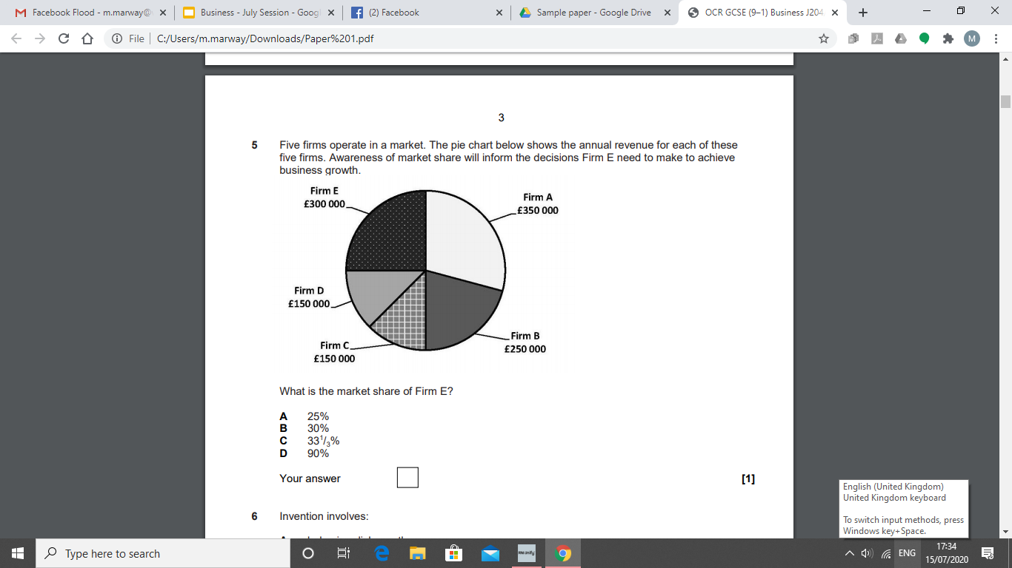

Slide 15
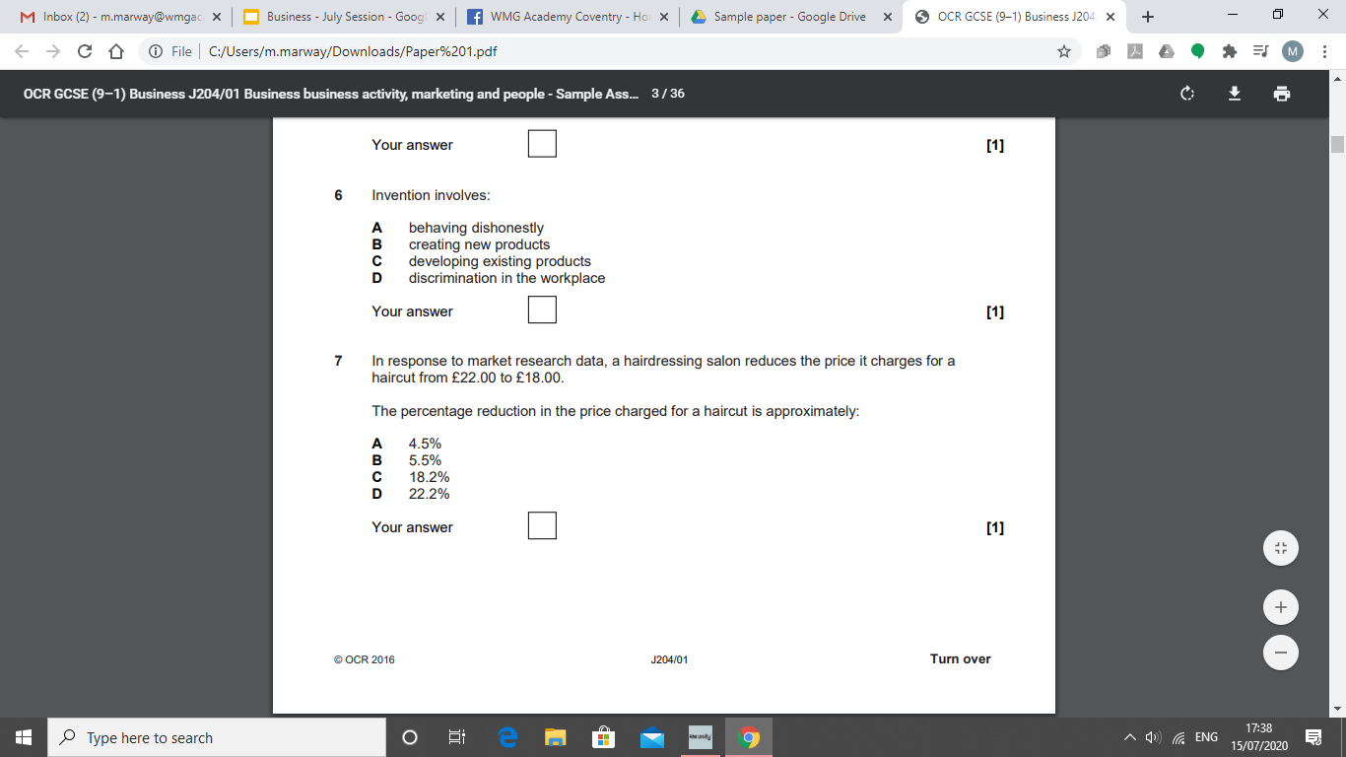

Slide 17
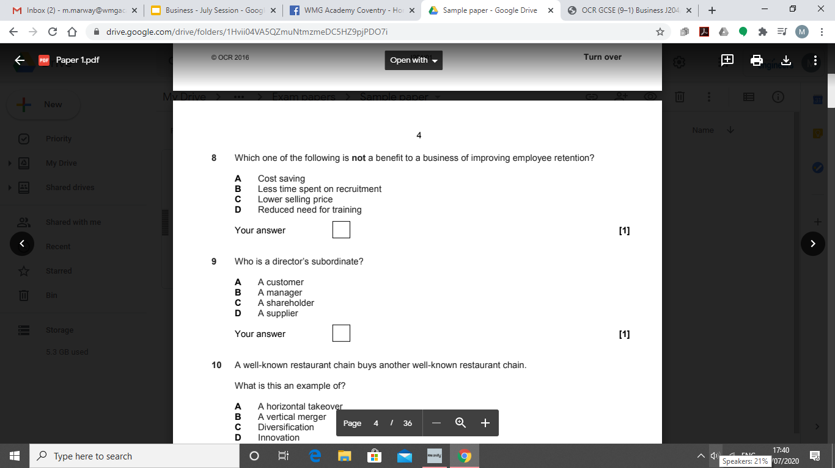

Slide 19
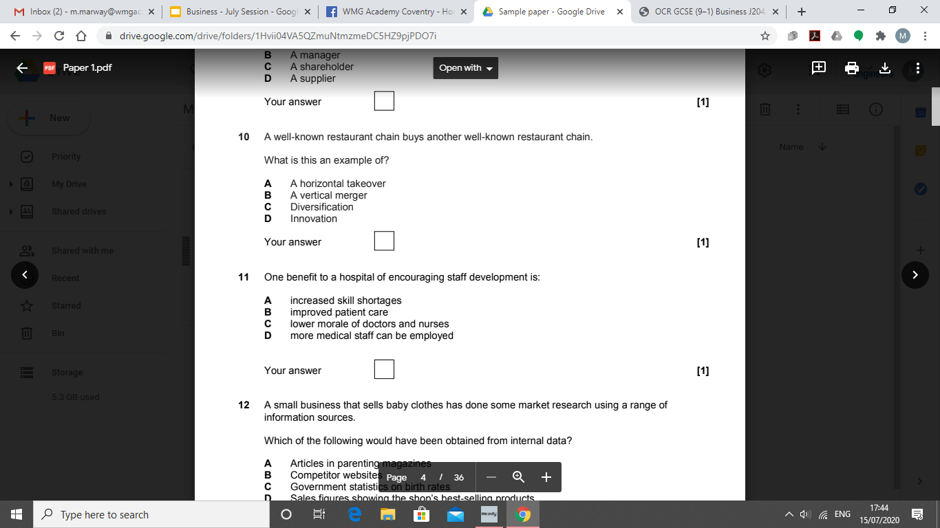

Slide 20
Check your answers

Slide 21
Multiple choice practice

