Slide 1

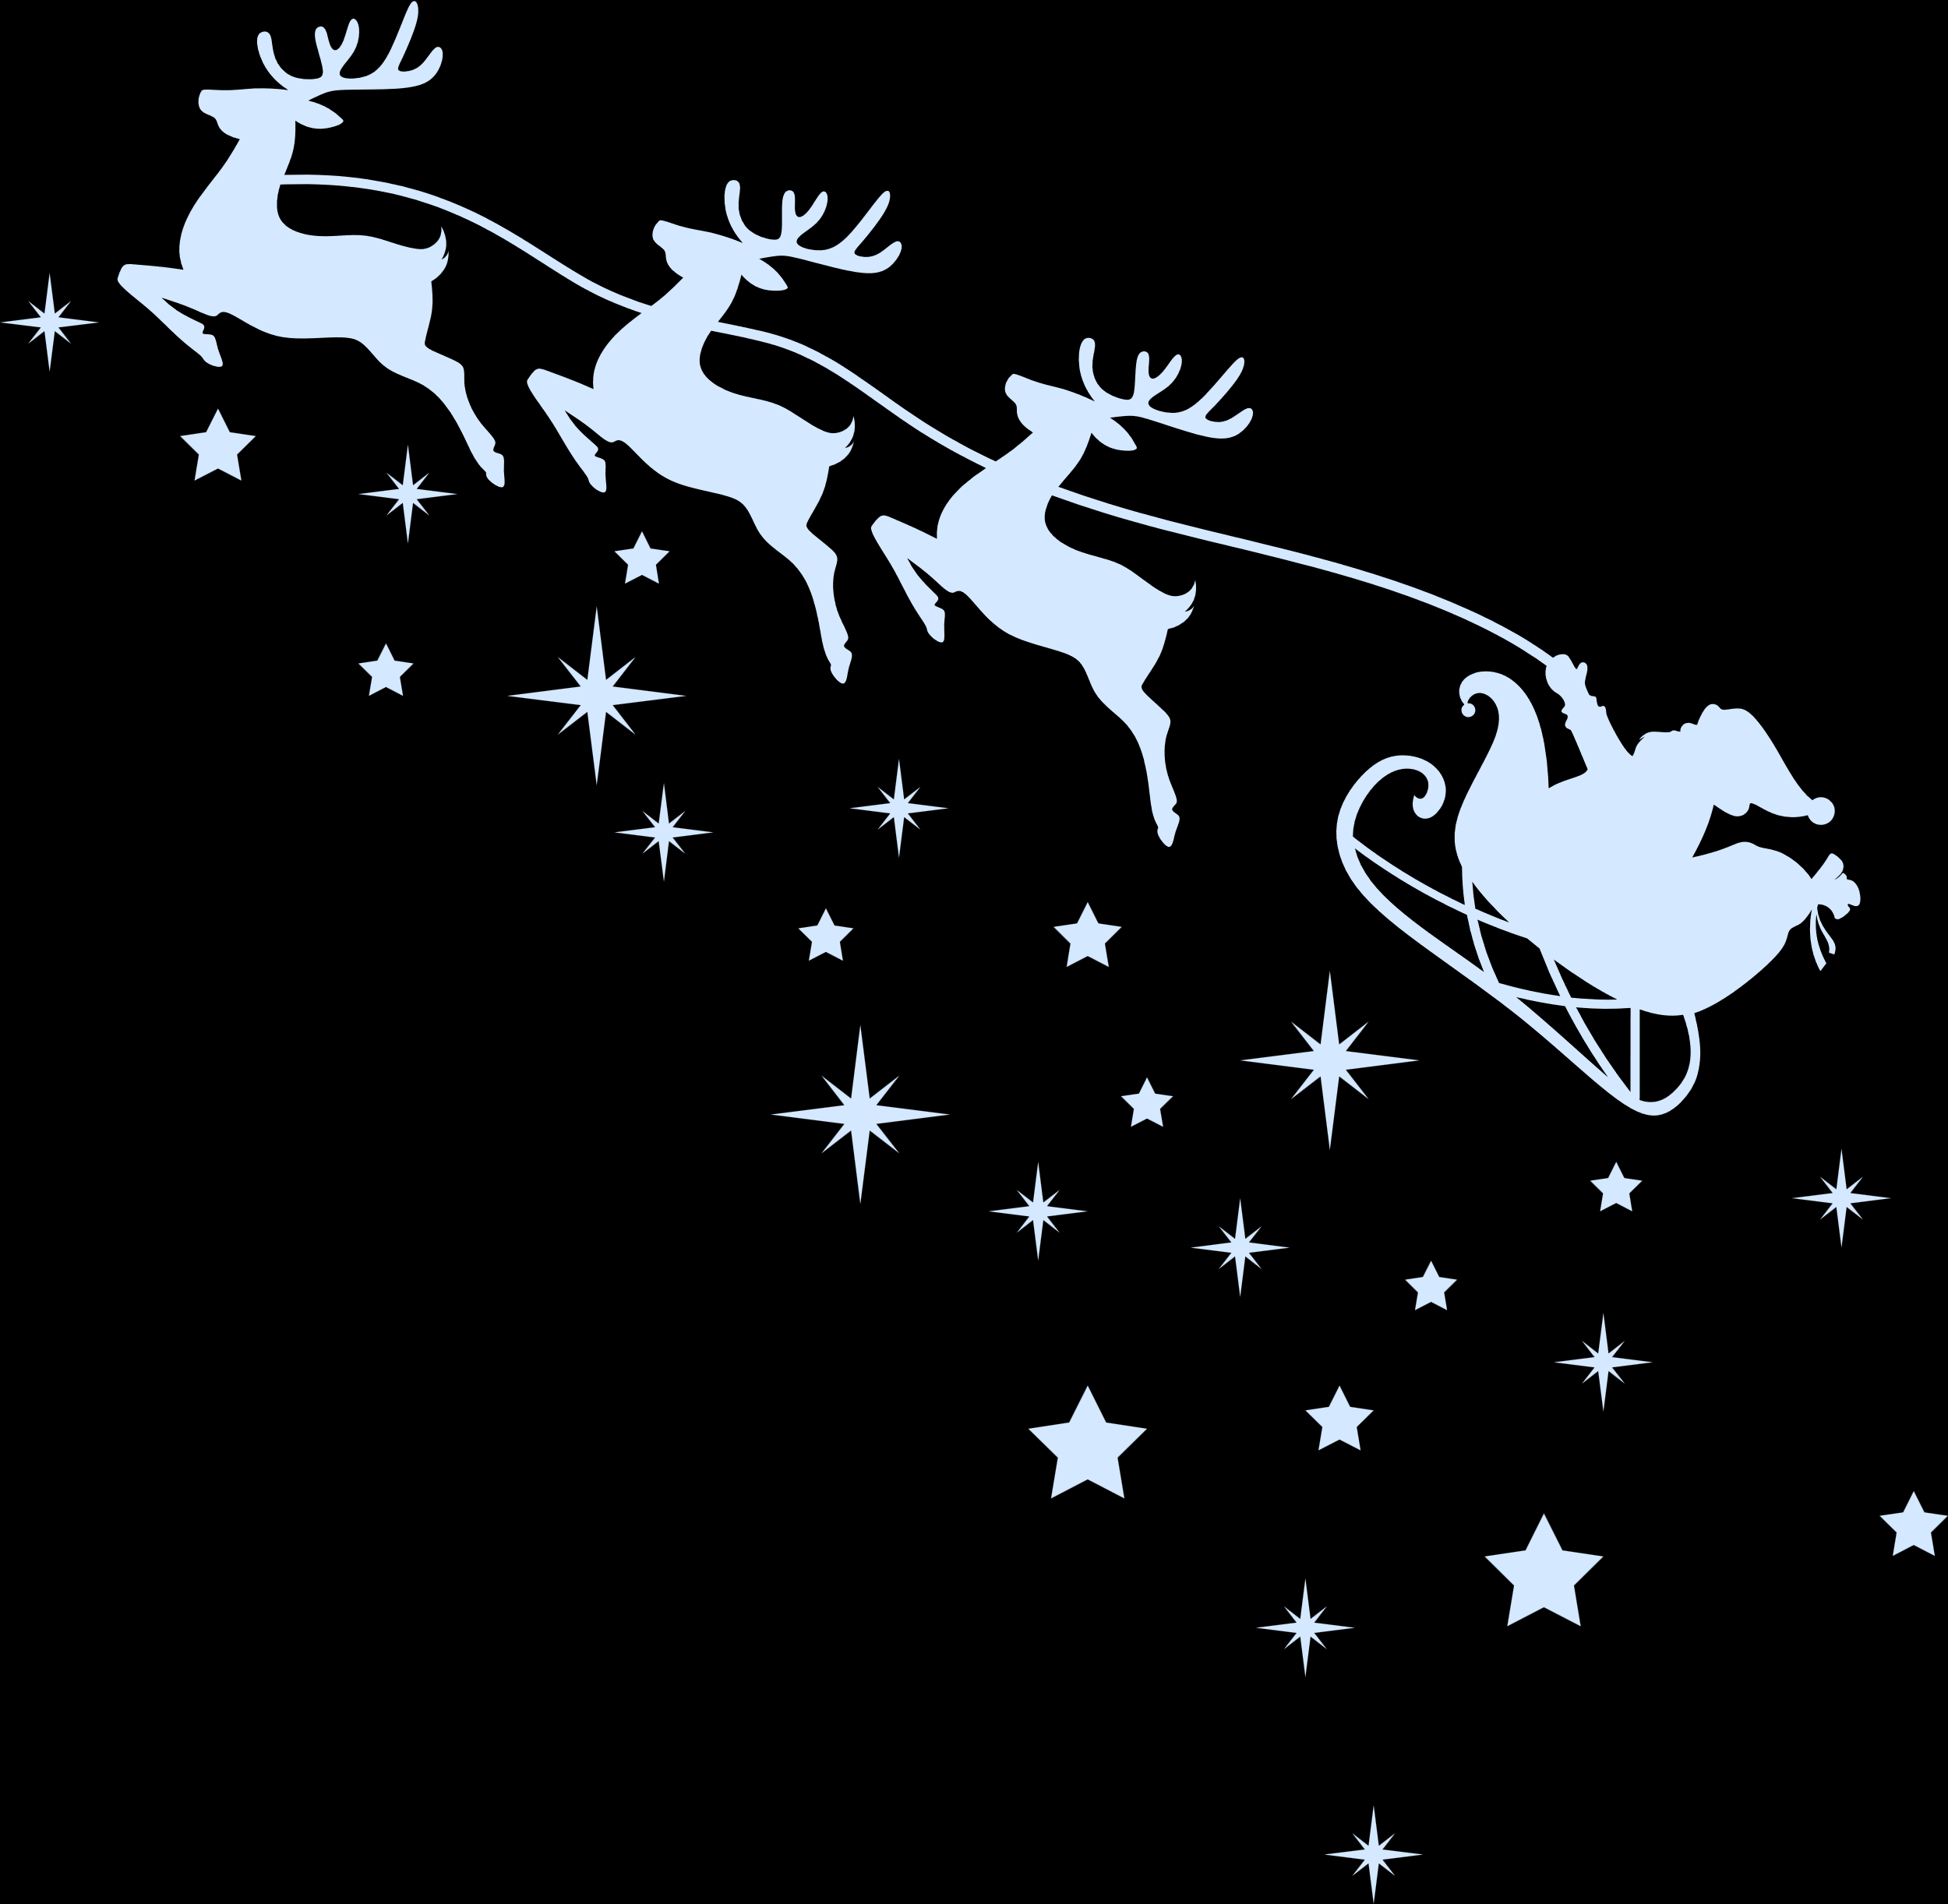


CHRISTMAS SONGS
Complete the line to ‘Rockin Around the Christmas Tree’
Later we’ll have some ...... and we’ll do some caroling
PUMPKIN PIE
APPLE PIE
MINCE PIE
CHOCOLATE PIE

