Slide 1
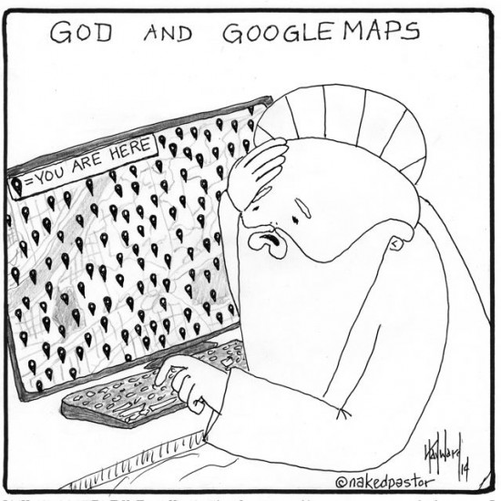
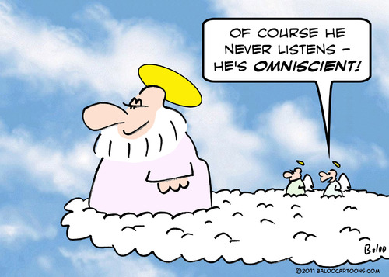
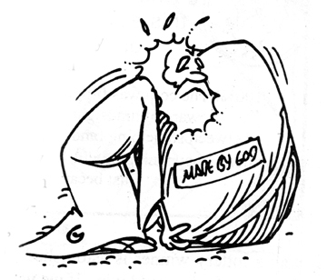

Classwork 27/02/2024 Christian Beliefs - Creation
Iterative thinking:
What are the key beliefs about God?
The key beliefs about the Christian God are…
Think back to the other week.
Write a response in your books.

Slide 2

The BIG Idea
Classwork 27/02/2024 Christian Beliefs - Creation
We are Learning to...
Consider the idea of creation and understand different interpretations of the Biblical account of creation.
In today’s lesson...
You will be able to understand where Christians get their belief of creation from.
You will be able to explain the difference between Genesis 1 and Genesis 2.
You will be able to explain what John 1 teaches Christians.

Slide 3
Match up the key terms and write them in your book
Creationism –
Conservation –
Environment –
Free will –
Stewardship –
looking after something so it can be passed on to the next generation
having the freedom to choose what to do
protecting something from being damaged or destroyed.
the surroundings which plants and animals live and on which they depend for life
Those who believe the world was created in a literal six days and who read Genesis as a scientific/historical account of the beginning of the world.

Slide 4
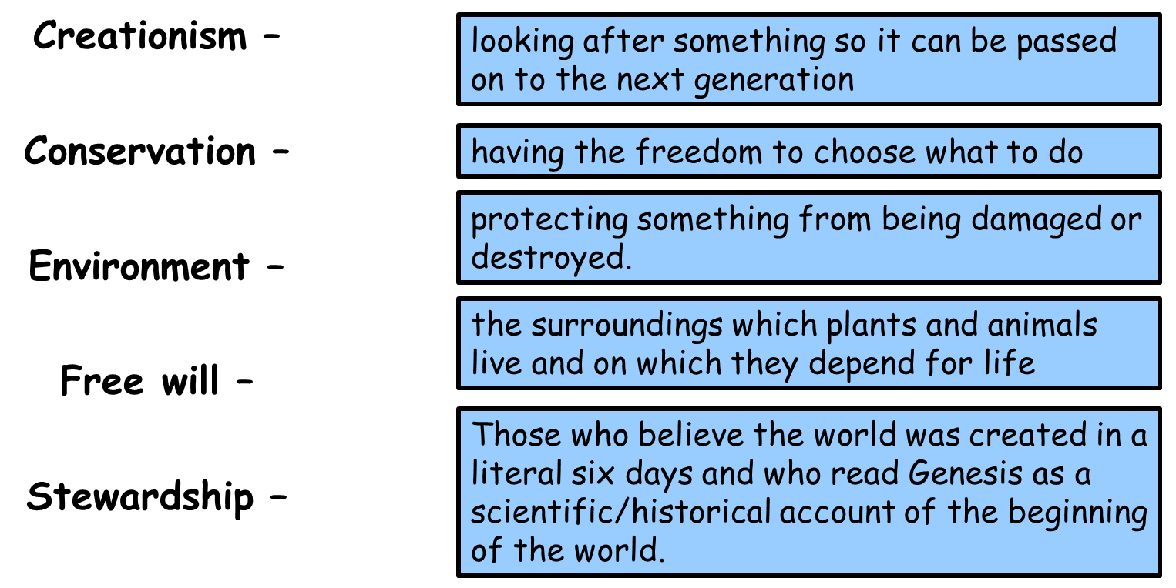

Slide 5
Match up the key terms and write them in your book
Creationism –
Conservation –
Environment –
Free will –
Stewardship –
looking after something so it can be passed on to the next generation
having the freedom to choose what to do
protecting something from being damaged or destroyed.
the surroundings which plants and animals live and on which they depend for life
Those who believe the world was created in a literal six days and who read Genesis as a scientific/historical account of the beginning of the world.

Slide 6
RE-cap
Think back to Year 8.
Who do Christians believe created the world?
Christians believe God created the world
Where do Christians find this belief?
Christians find this belief in the book of Genesis.
Today we are going to RE-cap the creation story for Christians.

Slide 7
Genesis 1
https://www.youtube.com/watch?v=yZ1Fd_SPC18
We are going to watch the creation story from the perspective of Genesis 1.
As we watch the video you need to answer the following questions in your books.
What did God create in the beginning?
Where was the Spirit of God?
What did God create on the first day?
What did God create on the second day?
What did God create on the third day?
On the fourth day, why did God create the sun, moon and stars?
On the fifth day what did God create?
On the sixth day what did God create?
Who’s image did God create humans in?
What did God say to Adam and Eve?
What did God think of his creation?
What did God make the seventh day?

Slide 8
What did God create in the beginning?
Where was the Spirit of God?
What did God create on the first day?
What did God create on the second day?
What did God create on the third day?
On the fourth day, why did God create the sun, moon and stars?
On the fifth day what did God create?
On the sixth day what did God create?
Who’s image did God create humans in?
What did God say to Adam and Eve?
What did God think of his creation?
What did God make the seventh day?
What did God create in the beginning?
Where was the Spirit of God?
What did God create on the first day?
What did God create on the second day?
What did God create on the third day?
On the fourth day, why did God create the sun, moon and stars?
On the fifth day what did God create?
On the sixth day what did God create?
Who’s image did God create humans in?
What did God say to Adam and Eve?
What did God think of his creation?
What did God make the seventh day?
What did God create in the beginning?
Where was the Spirit of God?
What did God create on the first day?
What did God create on the second day?
What did God create on the third day?
On the fourth day, why did God create the sun, moon and stars?
On the fifth day what did God create?
On the sixth day what did God create?
Who’s image did God create humans in?
What did God say to Adam and Eve?
What did God think of his creation?
What did God make the seventh day?
What did God create in the beginning?
Where was the Spirit of God?
What did God create on the first day?
What did God create on the second day?
What did God create on the third day?
On the fourth day, why did God create the sun, moon and stars?
On the fifth day what did God create?
On the sixth day what did God create?
Who’s image did God create humans in?
What did God say to Adam and Eve?
What did God think of his creation?
What did God make the seventh day?

Slide 9
What did God create in the beginning? The heavens and the Earth
Where was the Spirit of God? Hovering above the surface of the waters
What did God create on the first day? Day and night
What did God create on the second day? The sky
What did God create on the third day? The land and the seas, trees and plants with food on them
On the fourth day, why did God create the sun, moon and stars? To mark the seasons, days and years
On the fifth day what did God create? All the animals of the air and the sea
On the sixth day what did God create? All the animals of the land and Adam and Eve
Who’s image did God create humans in? His image
What did God say to Adam and Eve? Be fruitful and multiply
What did God think of his creation? That it was very good
What did God make the seventh day? Holy

Slide 10
Independent Tasks
Task 1:
Step 1: Stick in Genesis 2
Step 2: Read through Genesis 2
Step 3: Explain how Genesis 2 is different from Genesis 1.
Step 4: Which story is more believable, Genesis 1 or Genesis 2?
Task 2:
Outline three beliefs of the creation story (3 marks) One belief is… A second belief is… A third belief is…
Explain two things we can learn from the creation story in Genesis 1 (4 marks) One thing we learn is… This means that… A second thing we learn is… This means that…
Task 3:
(C) Explain two beliefs of humans from the book of Genesis (5 marks) One belief is… This means that… A second belief is… This can be seen in the Bible as it states that… This means that…
Task 4: Why might some Christians not believe the creation story in Genesis 1?

Slide 11

G4G and sharing
Those who did Task 1 are going to share their answers with the rest of the class.
As they share their answers we will be adding these answers to our books under the following subheading:
Differences between Genesis 1 and Genesis 2

Slide 12
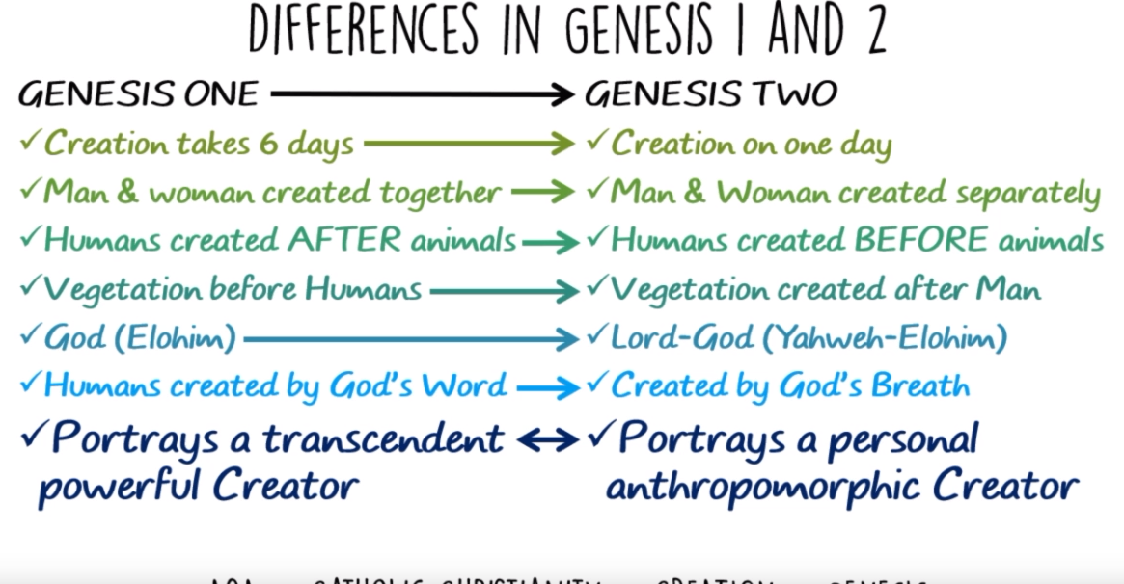

Slide 13

