Slide 1

Geography Case Studies
Key Details needed for each case study in Geography

Slide 2
Paper 1: Physical Geography
Hazards:
L’Aquila Earthquake, Italy (HIC)
Gorkha Earthquake, Nepal (LIC)
Typhoon Haiyan, Philippines (LIC)
Extreme weather in the UK
Flooding, Cumbria, UK (HIC)
Living with the Physical World:
River Severn, UK
Jubilee River, Flood Relief Channel, UK
Dorset Coast, Geology
Coastal Realignment, Medmerry, Uk
Epping Forest
Amazon Rainforest- deforestation
Alaska- Cold Environments

Slide 3
L’Aquila Earthquake, Italy (HIC)
Causes/key facts
Primary Effects
Secondary Effects
Immediate Responses
Long Term Responses
  6th April 2009
  6.3 Richter Scale
  Epicentre 7 KM Northwest of L’Aquila
  308 died
  1,500 injured
  67,500 homeless
  Happened at 3.32am so most people were asleep at home
  Aftershocks triggered landslides
  Numbers of students at University there decreased.
  Lack of housing-rent increased
  Hotels provided shelter for 10,000
  40,000 tents were given out.
  Red Cross raised £171,000
  Bills were suspended
  Residents did not have to pay taxes during 2010
  Students were given free university tutoring for 3 years.
  Took 15 years to rebuild everything.

Slide 4
Gorkha Earthquake, Nepal (LIC)
Causes/key facts
Primary Effects
Secondary Effects
Immediate Responses
Long Term Responses
  28th April 2015
  7.8 on the Richter scale.
  Epicentre was 80KM northwest of the capital Kathmandu
  8,632 dead (Official death toll)
  19,009 injured (Official)
  1 million homeless.
  26 hospitals and 50% of schools were destroyed.
  Triggered an avalanche on Mt Everest.
  Money from tourism (8.6% of GDP) has decreased.
  Rice seed that was stored in buildings was destroyed by rubble.
  Nepal requested international help- the UK raised $126 million.
  225,000 tents were put up by the Red Cross.
  Sherpas were used to hike relief supplies to remote areas
  23 areas in Nepal needed rebuilding.
  A recovery phase by the UN increased food production.
  Everest open in August 2015 for tourism.

Slide 5
Typhoon Haiyan, Philippines (LIC)
Causes/key facts
Primary Effects
Secondary Effects
Immediate Responses
Long Term Responses
  8th November 2013
  Category 5 Hurricane
  Wind speeds of up to 314kmp
  6,190 died
  4.1 million made homeless.
  1.1 million tonnes of crops destroyed.
  1.1 million houses destroyed.
  An oil tanker ran a ground causing 800,000 litres of oil to spill.
  Fishing had to stop due to contaminated water.
  Rice prices fell by 11.8%
  800,000 people evacuated.
  Emergency aid arrived 3 days later.
  Within two weeks over one million food packs and 250,000 litres of fresh water was delivered.
  'build back better’ was a scheme put in place.
  No build zone along the coast.
  New storm surge warning system.
  Mangroves replanted.

Slide 6
Extreme Weather in the UK
Storm Events
Flooding
Drought
Extreme cold
  Storm Jude- 2013- 160KMpH winds Killed 5 People
  Tornado- 2005 19 injuries £40 million damage in Birmingham
  Coastal- 1953- 300 people died in storm surge.
  Flash Flooding- 2004- Boscastle overwhelmed with 185mm rail fell in 5 hours.
  Slow- onset- 2014 Henley flooded.
  1975-1976 18 months with less than 0.2mm of rain per day.
  Droughts in 2003, 2006 and 2012.
  2003 caused 20,000 deaths across Europe.
  1946-1947
  1962-1963
  1978-1979
  2010-2011
  2014-2015 extremely cold winters.
  January 2014 17,000 trains were cancelled.

Slide 7
Flooding, Cumbria (2009)
Causes
Social Impacts
Economic Impacts
Environmental Impacts
Responses
  Atlantic Depression
  Heavy rainfall for a month before the flooding
  Already saturated soils couldn’t take anymore water.
  Very heavy Rainfall for two days before flood
  1,500 home affected.
  Policer Officer Bill Barker was killed.
  Rainwater contaminated with sewage brought health risks
  Many Businesses closed and did not reopen until long afterwards.
  Debris destroyed 6 important regional bridges.
  Cockermouth- £100m of damage.
  Water erosion triggered landslides.
  Loss of habitats along the river
  New fold defenses- £4.5million.
  Environmental Agency provided improved flood warnings and time to evacuate.
  Adverts in national newspapers to improve tourism.

Slide 8
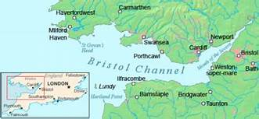
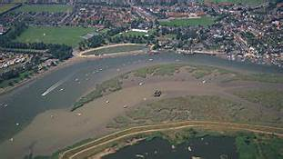
River Severn and its estuary
Characteristics
  It may have a high tidal range. The River Severn has a tidal range of 15m, which is highest in the world.
  It may be very wide. The Severn Estuary is 3.2 kilometers wide at the old Severn Bridge.
  It will have mudflats that are visible during low tides.
How is an estuary formed?
  A large river such as the Severn entered the sea at a narrow mouth.
  After the ice age, melting ice causes the sea level to rise- this caused the valley sides to flood.
  The original river is now on the estuary floor where it provides a deep channel for shipping.
How are estuary mudflats formed?
  MudflatsForm in sheltered areas where tidal water flows slowly. As River transports alluvium down to the sea and incoming tide transport sand and marine silt up the estuary.
  Where the waters meet, velocity is reduced, which causes deposition. This builds up layers of mud called mud flats. They will be covered at high tide but exposed at low tide.

Slide 9
Jubilee River Flood Relief Scheme
Background
Characteristics
Why was it required
Social issues
Economic Issues
Environmental Issues
  The Jubilee River is a relief channel for the River Thames in South East England.
  It runs through Berkshire and Buckinghamshire following roughly parallel to the River Thames.
  Once it has passed Eton, it re-joins the River Thames
  It was funded by the Environment Agency and cost £110 million
  It opened in 2002 and is 11.7 kilometres long and 15 metres wide.
  Designed to look like a natural River so it has meanders and nature reserves.
  Under normal conditions the level of the water in the River is low but when discharge is high the Jubilee River effectively diverts water from the River Thames preventing it from overflowing
  The area of the Thames flood plain is low lying and prone to flooding.
  It contains the royal settlement of Windsor which attracts many international visitors.
  It has Eton a prestigious public school.
  High value property.
  3000 properties were protected in affluent Eaton and Windsor, but this had a bad impact on settlements downstream to higher discharge.
  Paddle boaters are unable to sail their boats down River due to the wiers.
  The Jubilee River scheme is the most expensive flood relief scheme in the UK.
  Projected cost of 330 million.
  The Jubilee River was one of the flood relief channels planned for the lower course of the Thames
  Business insurance costs around 500 million in 2014 because of flooding
  In 2014 there was extensive flooding immediately downstream. The built environment suffered from flooded roads and buildings.
  The concrete wiers are rather ugly and ongoing repair work has made the matter worse
  There is also the problem of algae collecting behind the wiers, this disrupts the natural ecosystem

Slide 10
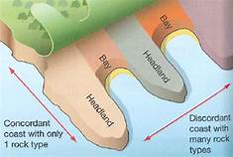
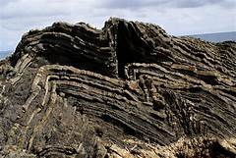
Dorset Coast Line- Geology
Concordant and Discordant Coastlines
Along the East Coast of the Isle of Purbeck the alternating layers of hard and soft rock run at right angles to the shore giving headland and Bay formation.this is a discordant coastline.
The southern coast is fairly smooth in shape weather rock is uniform this is typical of a concordant coastline with alternating layers of hard and soft rock running parallel to the coast. At Lulworth a Cove has formed where waves have broken through a weakness in the hard Portland limestone.
Rock angle of dip
Sedimentary rocks are formed on the seabed and are raised by mountain building processes which folded the rocks over millions of years .
In places along the Dorset coast and up folded area is called an antique line and can be seen in a headland.
this can be seen on the eastern edge of stair hole near Lulworth Cove

Slide 11
Coastal Realignment in Medmerry
Why was it needed?
What strategy was used?
Positive Effects
Negative Effects
  The environmental agency considered the area to be the most at risk of flooding due to climate change.
  A shingle ridge was the only protection from the sea and annual cost of upkeep was £200,000.
  If breached then 348 properties are water treatment plant and main road would be flooded causing £5million pounds of damage
  Building a new embankment up to two kilometres in land from shore using clay from within the area.
  Behind the embankment, a channel was built along its whole length to collect draining water.
  Rock Armour was then placed on the seaward edges of the embankment.
  A 110 metre breach was made in the shingle bank to allow the seed to flood the land to create a new intertidal area
  Social: It now has the best level of protection in the UK.
  provides a cycle route and footpath 10 kilometres of footpath and seven kilometres of new bike paths.
  Economic: tourism is a main contributor to the local economy and is expected to increase.
  Important area for fishing and salt marsh vegetation will be used for cattle farming
  Environmental: Measures to protect existing species such as water voles, crested newts and badgers have taken place.
  300 hectares of new habitats have been formed mud flats salt marshes and transitional grass's have attracted large number of ducks and lapwings
  Social: Some like residents feel that they shouldn't have given up the land so easily.
  some people feel that they shouldn't have spent so much money on a sparsely populated area.
  Economic: at £28 million pounds the scheme was very expensive
  Three farms growing oilseed rape and winter wheat had to be abandoned.
  Environmental:despite planning, habitats of existing species such as badgers would have been disturbed.

Slide 12
Epping Forest- food web
Characteristics
Large number of native trees including Oak, Elm, ash and Beech.
177 species of Moss and lichen grow here. There is a great diversity of producer species.
Many insect mammal and bird consumer species are supported.
Nine amphibian and reptile species and 38 bird species.
700 species of fungi, which are important decomposers.
Interdependent
The forests producers' consumers and decomposers are all interdependent
Most of the trees are deciduous, meaning that they lose their leaves in winter. This is an adaptation to the UK's seasonal climate.
Trees grow broad leaves in spring, this allows them to maximise photosynthesis in summer.
By mid autumn, the forest floor is covered with a thick layer of leaves this disappears by the processes of decomposers. Nutrients are then stored in the soil and taken up by trees.

Slide 13
Amazon Rainforest- Deforestation
Causes
Impacts
Management
  Logging- is the first step in the conversion of the forest. Selective logging (mahogany and Teak)
  Mineral Extraction- Mainly gold, in 1999 there were 10,000 hectares used for gold mining now there is 50,000.
  Energy- HEP (hydro-electric power) folding vast areas of the rainforest.
  Commercial Farming- Cattle ranching- causes 80% of destruction of TRF
  Commercial Farming- crops- Soybean has caused much of the forest clearance- this has doubled from 1990-2010
  Road Building- Trans- Amazonian Highway 4,000 KM long.
  Settlement and Population Growth- Worker need homes fir their families- knock on effect.
  Global Warming- The tree canopy absorbs CO2- this stops when the trees are felled, and more CO2 goes into the atmosphere. Fire used to clear the rainforest also adds CO2 to the atmosphere.
  Loss Of Biodiversity- 137 plant, animal and insect species is lost everyday due to forest clearance. 50,000 species per year.
  Soil Erosion and Fertility- as soon as part of the forest is removed the topi soil is removed by heavy rainfall and this is where the fertility is- this is very difficult to get back.
  River Pollution- mercury used to separate the gold from the ground causes fish to be poisoned, as well as people living in near by towns.
  Decline in Indigenous Tribes- There are now only 240 tribes left, compared to over 330 in 1900.
  Inter- government Agreements- International Tropical Timber Agreement (2006) restricts the trade in hardwood timber. CITES (convention on International Trade in Endangered Species) blocks illegal trade in endangered animals and plants.
  Debt Reduction by HIC’s- USA signed an agreement to convert Brazilian debt of £13.5 million into a fund to protect large areas of the TRF.
  Conservation- WWF/ World Land Trust promote conservation through education and provide training for conservation workers. Buy up threatened land and create nature reserves.
  Local areas can introduce selective logging ( Only taking trees when they are fully grown) Agroforestry (Combining crops and trees) Replanting (recreate forest cover almost like the original).

Slide 14
Alaska- Cold Environments
Opportunities
Challenges
Management
  Fishing- Commercial Fishing- 1 in 10 Alaskans are employed. 78,500 jobs and $6 billion to the state economy. Subsistence Fishing- Native Americans remain dependent on fish for food, oil and bones for clothing and tools.
  Mineral Extraction- 1/5 of the states mining wealth comes from gold (although silver, zinc and lead are very important too).
  Tourism- attracts 1-2 million tourists each year, making it one of Alaska biggest employers- although it is seasonal and poorly paid.
  Energy- More than 50 hydroelectric power (HEP) plants supply 1/5 of electricity. Geothermal energy is also being harnessed in the tectonically active areas.
  Short thermal growing season rules out crop production in some areas.
  The low population density means that most of Alaska lacks surfaced roads and transport is very difficult.
  Snow and ice make some roads and tracks unusable for months of the year.
  Permafrost (permanently frozen ground) underlies most of Alaska. The seasonal melting of the top layer means some roads cannot be used in summer.
  Migrant workers take most of the jobs created by the oil industry and they spend little locally and often only have short term contracts.
  In 1989, an oil tanker, Exxon Valdez ran a ground on the southern Alaskan coast 1.2 million barrels spilled. Around 5000 otters and many seals and Eagles were killed.
  Pipeline- Was raised off the ground on stilts and they're 11 metres deep to stop the impact of permafrost. the pipeline zigzags in some places. this means that it is flexible and can adjust to ground movement from earthquakes. rights are now built on gravel pads 12 metres deep to stop heat transfer from taking place.
  utilities such as water, sewage and gas cannot be buried underground, or they would freeze too. Instead, they are carried by utility corridors.
  Airport runways are painted whites to reflect the sunlight and stop them from warming up too much on sunny days.
  International Agreements- Arctic Council, which wants to deliver sustainable development.
  National Governments- Barack Obama banned oil exploration from taking place in the 12 million acres of national wildlife refuge.
  NGO’s (Non- governmental Organisations- Greenpeace has called for a ‘global sanctuary’ to be created in the Arctic

Slide 15
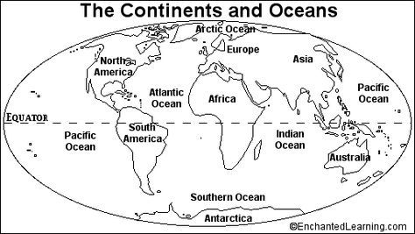
Case Study:
Location:
Key Facts:
Case Study:
Location:
Key Facts:
Case Study:
Location:
Key Facts:
Case Study:
Location:
Key Facts:
Case Study:
Location:
Key Facts:

Slide 16
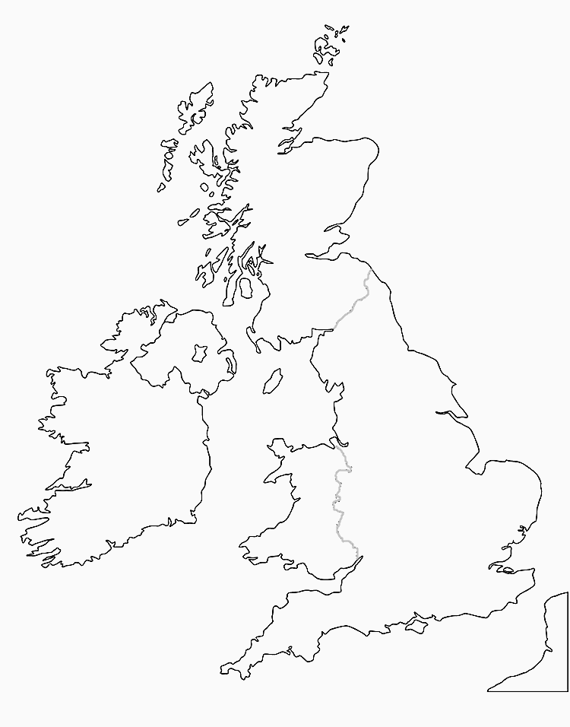
Case Study:
Location:
Key Facts:
Case Study:
Location:
Key Facts:
Case Study:
Location:
Key Facts:
Case Study:
Location:
Key Facts:
Case Study:
Location:
Key Facts:
Case Study:
Location:
Key Facts:

