Slide 1
Masterclass: Analysis.
Do now: What steps do you take when analysing a quotation?
Use the quotation below to write your steps of analysis.
“You’re just the kind of son-in-law I always wanted”

Slide 2
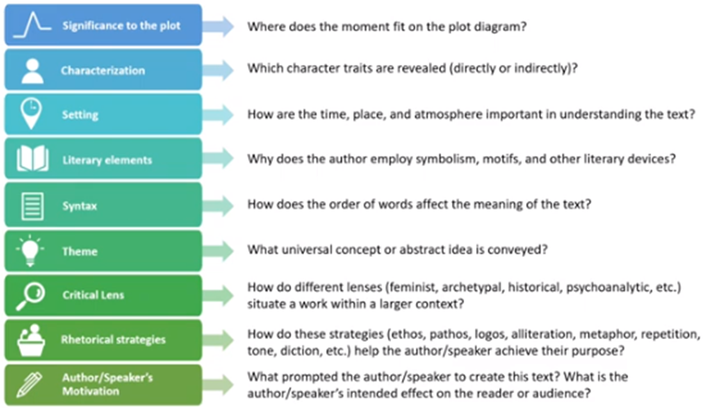
How to analyse a quotation:

Slide 3
MRS. BIRLING
Women of the town?
BIRLING
Yes, yes. But I see no point in mentioning the subject ....
Opening
Mr Birling probably understands exactly what Gerald means and due to the ellipsis, it could be inferred, that Mr B has visited once or twice himself.
The Palace bar is the symbol of the class reality and a symbol of the ‘fallen woman’.
Structural device of the writing to show that Mr Birling isn’t completely innocent here.
The repetition makes the things he is saying seem hurried - almost panicked.
Concept of gender inequality - could link into the feminist theory and the male gaze.

Slide 4
Fighting for survival:
As a theme within ‘An Inspector Calls’, the phrase survival of the fittest was coined in the 1800s used to describe the animal kingdom. However similar themes can be applied to the capitalist society of the 1900s.
Inspector:’all intertwined with our lives and what we think and say and do’ (Act 3)
Arthur: ‘a man has to make his own way’ (Act 2)

Slide 5
Class system.
Responsibility.
All other characters.
Arthur: ‘a man has to make his own way’ (Act 2)
The Inspector.
Arthur’s belief in the survival of the fittest is consistently seen with his promoting of the idea of looking out for yourself and ‘making his own way’, and his disregard for the community that he is always reminded of. He highlights the importance of making money through the auxiliary verb ‘has’ promotes his selfishness and domineering personality.

Slide 6
Social responsibility
Class
All other characters
Eric (to Birling): ‘It isn’t if you can’t go and work somewhere else’.
All other characters
Eric criticises his fathers treatment of Eva and this evidences his increasing desire to understand and acknowledge the impact which he, and his family have had on Eva’s life. This contrasts the opinion provided by his family earlier within the play as he understand the reality of society in comparison to his father, particularly as, at the start of the play, Arthur patronises him in regard to his own understanding and experiences. By using two negative verb phrases shows him challenging the right-wing perspective voices within the play.

Slide 7
Social responsibility
Class
All other characters
Inspector: ‘A chain of events’ (Act 1)
All other characters
Priestley explores the theme of time through his exploration of how the past impacts the present and continues to highlight the importance of this to the audience so that they reflect on the past and how the characters, similarly to 1920’s society, has changed throughout the text. The symbolism of chains also highlights how these events unity to create a bigger and more impactful final comment on the Birling’s actions. This also indicates the oppression forced upon Eva and how her class and gender have been used against her within the play.

Slide 8
Edna is a very minor character in the play with few lines, most of which include the words ‘Ma’am’ (p. 2) or ‘sir’ (p. 10) and illustrate her lowly status and her employers’ superiority. There is no conversation between Edna and the Birlings. Priestley has deliberately given Edna little dialogue and no character development for particular effects. He is making the point that she is one of the invisible ‘millions of Eva Smiths and John Smiths’ (p. 56). We do not know what Edna’s hopes and fears are. Nor, it is safe to say, would Mr and Mrs Birling. They are unlikely to feel any responsibility to her beyond paying her wages. Also note how Edna ushers Inspector Goole into the dining room (p. 10), a fitting action, since he is about to address the Birlings on their responsibility to women like her.
Edna is a direct representation of the working classes living under the Birling’s noses. She also seems to enter at key moments when the family are demonstrating these higher class views. “An Inspector has called” - Titular line.
Could link to the quotation when Mr Birling says about the wonderful meal they have had and Mrs Birling scolds him; showing no thought or thanks to the lower classes for what they provide and do for the family.
‘Giving us the port Edna?’ - Birling. Edna is the supplier for alcoholic motif - downfall of Eric

Slide 9
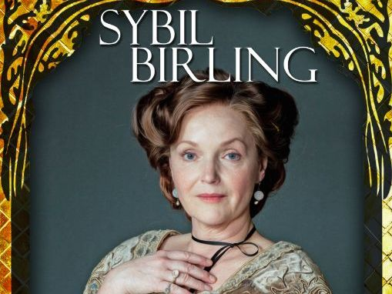
Key quotations:
“Unlike the other three, I did nothing I’m ashamed of”
“It wasn’t I who had her turned out of her employment – which probably began it all”
“I was the only one of you who didn’t give in to him”
Lack of sympathy and empathy.
Passes the blame.
Inconsiderate.
Prejudiced.
Mrs Birling

Slide 10
She doesn’t care to listen to others or their opinions as she deems them to be ‘beneath her’. She makes assumptions based on how someone looks and their class.
Assumptious.
Mrs Birling: (With dignity) We have done a great deal of useful work for deserving cases.
Prejudiced.
This highlights Mrs Birling’s prejudice against the lower classes as she deems them as needing to be ‘deserving’ of help.
The adjective ‘dignity’ shows that she is happy to do exactly the same time and time again. She is happy to play God with a girls life and she isn’t willing to see the consequences of her actions.
Discretion of the upper classes.

