Slide 1

Classwork 27/02/2024
Christian Beliefs – Problem of evil
Sentence starters you cold use:
Some Christians would agree with this…
This is a strong argument because…
To make this even stronger you could argue…
Despite the evidence given, some would argue against the statement because…
To back this point up you can use teachings from the Bible such as…
To make this a weak argument, you could argue that…
Further to this, you could argue that…
Overall, the strongest argument is…
Step 1: Complete your marking stamp in silence
Step 2: Check for any WAC errors and copy these out three times
Step 3: Write today’s date and title

Slide 2

The BIG Idea
Classwork 27/02/2024
Christian Beliefs – Problem of evil
We are Learning to...
What is meant by evil and what the problem of evil is.
In today’s lesson...
You will be able to recognise the differences between moral and natural evil
You will be able to explain the Christian and non religious responses to evil
You will be able to evaluate the problem of evil and human choice

Slide 3
What do we mean when we talk about evil?
Two minutes- talk to the person next to you and discuss, what do we mean by moral and natural evil?
Moral evil =
An evil as a result of human action (under human control)
Natural evil =
Any evil that is the result of the physical world (outside of human control)

Slide 4



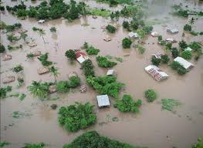
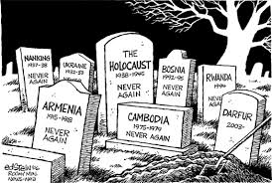

Slide 5
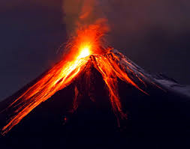
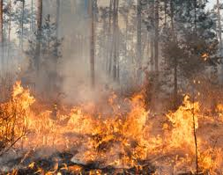




Slide 6
Moral Evil
What are these examples of moral evils?

Slide 7
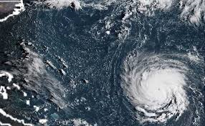
Natural evil
What are these examples of natural evils?

Slide 8
The Problem itself
The main question that gets asked is:
“If you have an omnipotent, omniscient and omnibenevolent God- then why is there evil in the world?”
Task 1: Copy down the main question people ask.
Task 2: Create a mind map or sub-heading that says Christian Responses.
Christians would argue that God and evil can both exist and there is a reason for evil existing. So what reasons might these be?

Slide 9
The Christian response
The main Christian responses to evil are (copy these in your books):
God has a plan for everyone. He sends us tests of faith but he has a positive ultimate plan for everyone.
In order to recognize good, we must have necessary evil in the world.
God created humans with free will
Evil is the absence of God and the absence of good- people choose to stray from God’s light
Follow the teachings of God or there will be consequences

Slide 10
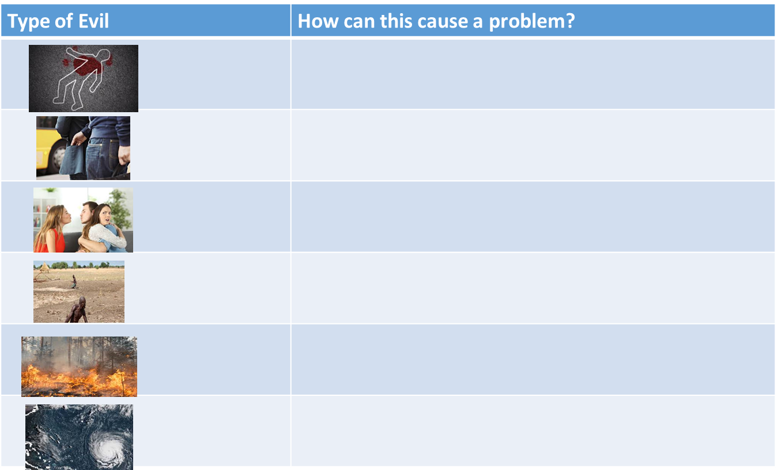
What problems can evil cause?
Stick the table in your book. How can these examples of evil cause problems?
You have 3 minutes to try this on your own then we will G4G each column.
- Leads to people losing their lives
- Death is a test of our faith, God will challenge us with hardships to see if we stay loyal to him.

Slide 11






What problems can evil cause? GFG your table
Type of Evil | How can this cause a problem?
 | Leads to people losing their lives Death is a test of our faith, God will challenge us with hardships to see if we stay loyal to him.
 | Can lead to people losing personal possessions and items that can be valuable God gave humans free will, we can choose to do bad actions if we want
 | Can lead to people being heartbroken and losing trust and faith in people We need bad in our lives to understand the good, once we experience some bad we will appreciate the good more when it happens.
 | Can lead to a loss of land or food, loss of livelihood or resources for homes We need bad in our lives to understand the good, once we experience some bad we will appreciate the good more when it happens.
 | Loss of trees which are needed for our environment, can lead to death We need bad in our lives to understand the good, once we experience some bad we will appreciate the good more when it happens.
 | Loss of homes, shops, jobs, lives If we don’t follow God’s teaching she will send us punishments to challenge us and punish us for not following his teachings.

Slide 12
The Christian response (examples)
GFG: What would be the religious and non religious response to these issues?
Type of Evil | Christian response | Non religious response
 | Death is a test of our faith, God will challenge us with hardships to see if we stay loyal to him. | How can you believe in a God who takes the lives of innocent people?
 | God gave humans free will, we can choose to do bad actions if we want | God has the power to stop people doing evil acts but chooses not to, that can’t be a God you would want to worship?
 | We need bad in our lives to understand the good, once we experience some bad we will appreciate the good more when it happens. | A loving God would not make people suffer and would want you to be happy all the time.
 | When people go off God’s plan he takes away the good in our life as a punishment – for example in the story of Noah’s Ark. | How can you believe in and worship a God that punishes people so much and allows so much evil to exist in the world?
 | We need bad in our lives to understand the good, once we experience some bad we will appreciate the good more when it happens. | Natural evil is truly unfair, people don’t deserve natural evils that destroy their homes and innocent animals as well.
 | If we don’t follow God’s teaching she will send us punishments to challenge us and punish us for not following his teachings. | Not everyone will go off God’s plan and not follow his teachings, why does he punish so many people and not just those who deserve it?

Slide 13
https://www.nayuki.io/res/full-screen-clock-javascript/full-screen-clock-24hr-with-seconds.html
Independent Tasks
Complete the following questions in your books:
1. What is worse moral or natural evil?
2. Why do you think people choose to do evil acts?
3. Can a natural evil ever be the result of human choices?
Further task:
Why do Christians have a problem with moral and natural evil?
Exam style questions:
B) Explain two Christian beliefs about evil and suffering
D) Write one paragraph for the following statement either for or against it:
“God is responsible for evil”

Slide 14
Purple Zone Questions
1. What is worse moral or natural evil?
2. Why do you think people choose to do evil acts?
3. Can a natural evil ever be the result of human choices?
Further task:
Why do Christians have a problem with moral and natural evil?
Purple Zone Questions
1. What is worse moral or natural evil?
2. Why do you think people choose to do evil acts?
3. Can a natural evil ever be the result of human choices?
Further task:
Why do Christians have a problem with moral and natural evil?
Purple Zone Questions
1. What is worse moral or natural evil?
2. Why do you think people choose to do evil acts?
3. Can a natural evil ever be the result of human choices?
Further task:
Why do Christians have a problem with moral and natural evil?
Purple Zone Questions
1. What is worse moral or natural evil?
2. Why do you think people choose to do evil acts?
3. Can a natural evil ever be the result of human choices?
Further task:
Why do Christians have a problem with moral and natural evil?
Purple Zone Questions
1. What is worse moral or natural evil?
2. Why do you think people choose to do evil acts?
3. Can a natural evil ever be the result of human choices?
Further task:
Why do Christians have a problem with moral and natural evil?
Purple Zone Questions
1. What is worse moral or natural evil?
2. Why do you think people choose to do evil acts?
3. Can a natural evil ever be the result of human choices?
Further task:
Why do Christians have a problem with moral and natural evil?

Slide 15

